Slide 1
EXPANDING BRACKETS (SINGLE)
CONTENTS

Slide 2
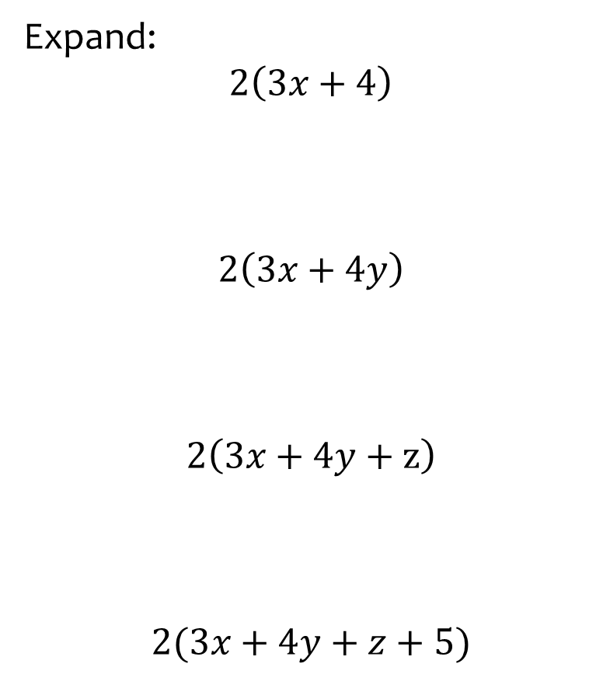


Worked example
Your turn
Expand:
$$2\left(3x+4\right)$$
$$2\left(3x+4y\right)$$
$$2\left(3x+4y+z\right)$$
$$2(3x+4y+z+5)$$
Expand:
$$5(4a+3b+2c+1)$$
$$20a+15b+10c+5$$

Slide 3
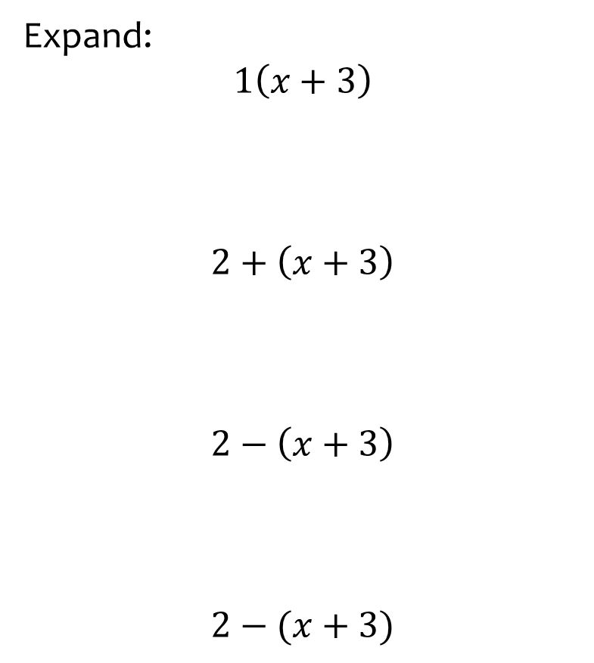


Worked example
Your turn
Expand:
$$1\left(x+3\right)$$
$$2+\left(x+3\right)$$
$$2−\left(x+3\right)$$
$$2−(x+3)$$
Expand:
$$3a+7−(a+2)$$
$$2a+5$$

Slide 4
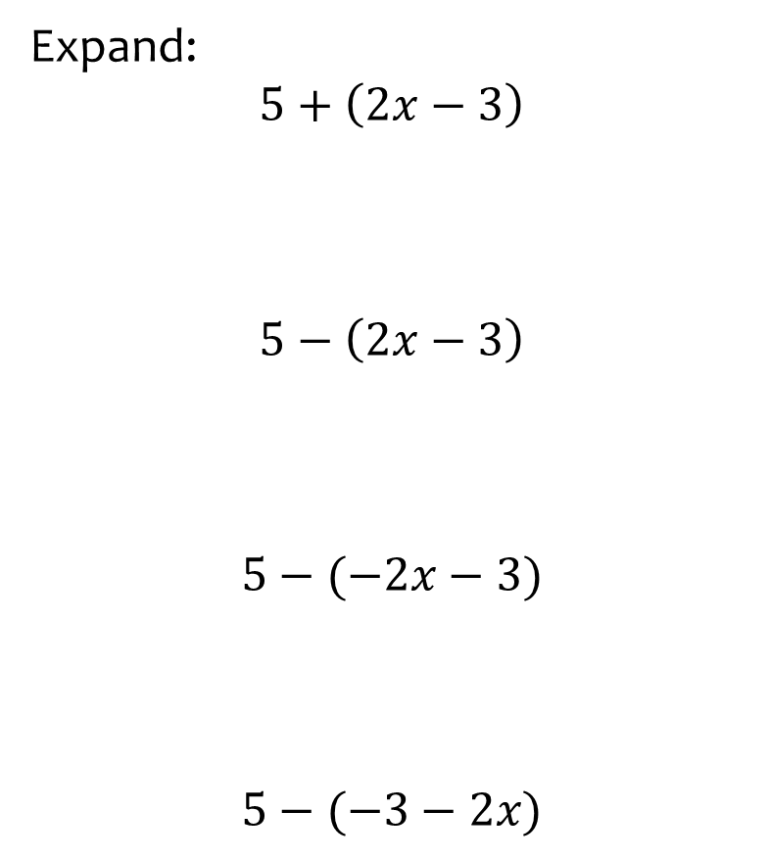
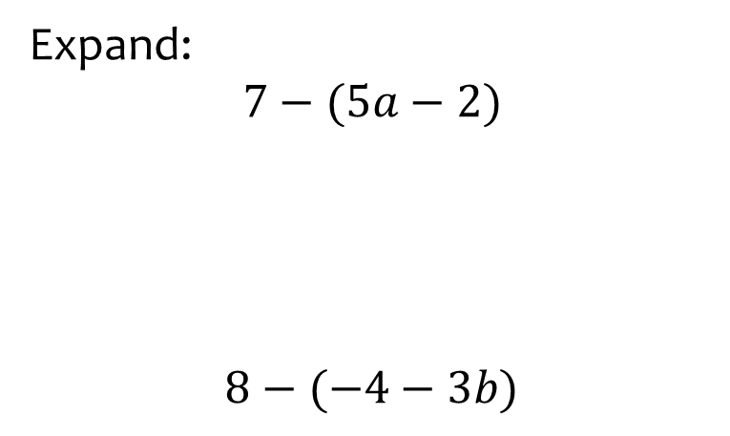


Worked example
Your turn
Expand:
$$5+\left(2x−3\right)$$
$$5−\left(2x−3\right)$$
$$5−(−2x−3)$$
$$5−(−3−2x)$$
Expand:
$$7−(5a−2)$$
$$8−(−4−3b)$$
$$9−5a$$
$$12+3b$$

Slide 5
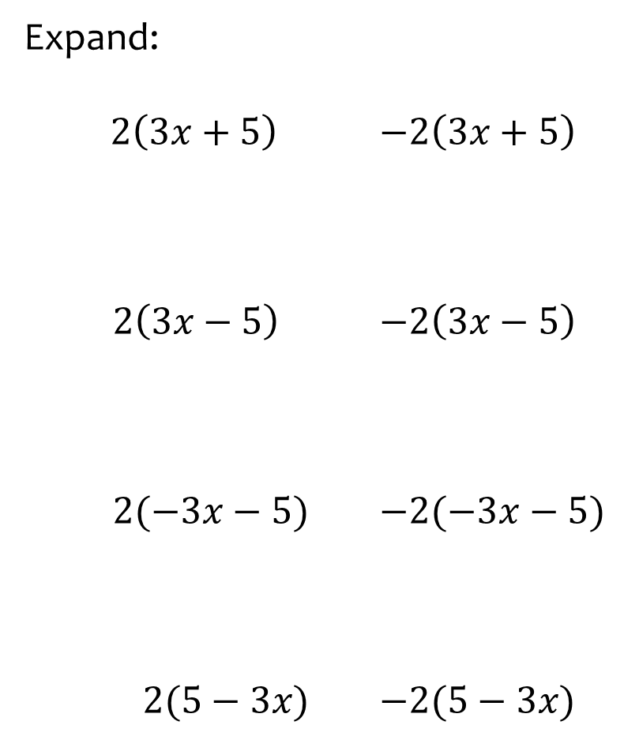
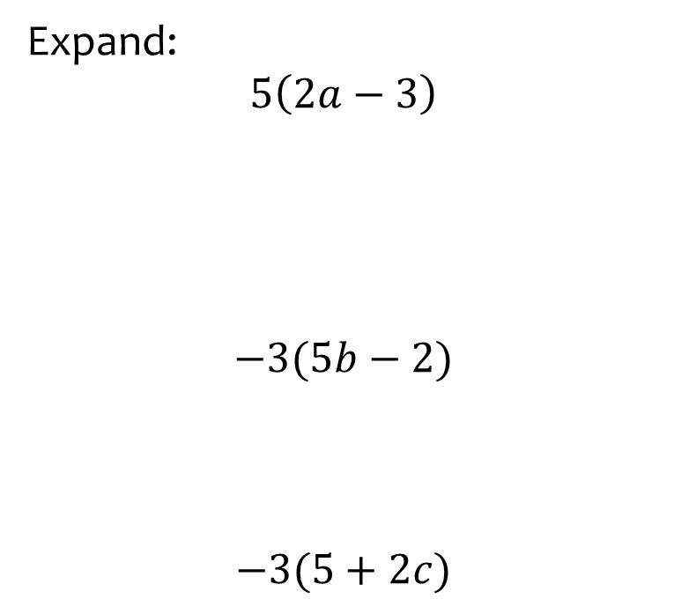



Worked example
Your turn
Expand:
$2\left(3x+5\right)$ $−2\left(3x+5\right)$
$2\left(3x−5\right)$ $−2\left(3x−5\right)$
$2(−3x−5)$ $−2(−3x−5)$
$2(5−3x)$ $−2(5−3x)$
Expand:
$$5\left(2a−3\right)$$
$$−3(5b−2)$$
$$−3(5+2c)$$
$$10a−15$$
$$−15b+6$$
$$−15−6c$$

Slide 6
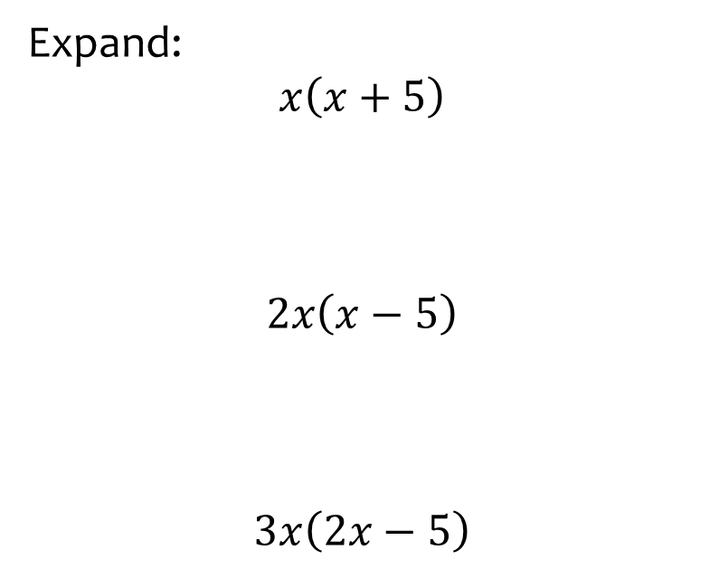


Worked example
Your turn
Expand:
$$x\left(x+5\right)$$
$$2x\left(x−5\right)$$
$$3x\left(2x−5\right)$$
Expand:
$$5a(3a−2)$$
$$15a^{2}−10a$$

Slide 7
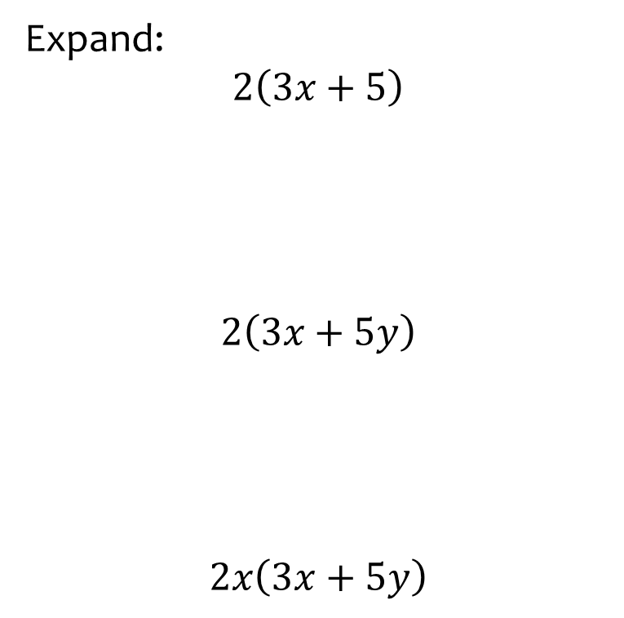
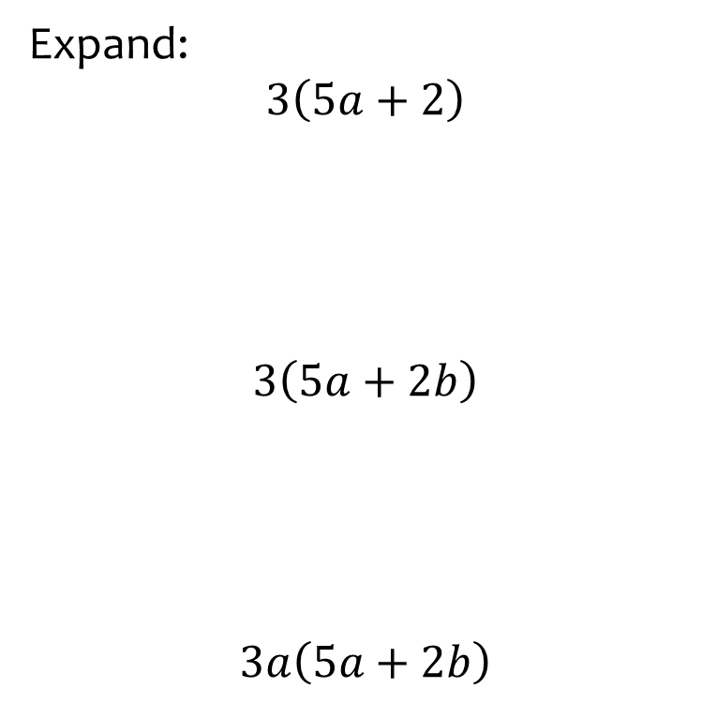



Worked example
Your turn
Expand:
$$2\left(3x+5\right)$$
$$2\left(3x+5y\right)$$
$$2x\left(3x+5y\right)$$
Expand:
$$3\left(5a+2\right)$$
$$3\left(5a+2b\right)$$
$$3a\left(5a+2b\right)$$
$$15a+6$$
$$15a+6b$$
$$15a^{2}+6ab$$

Slide 8
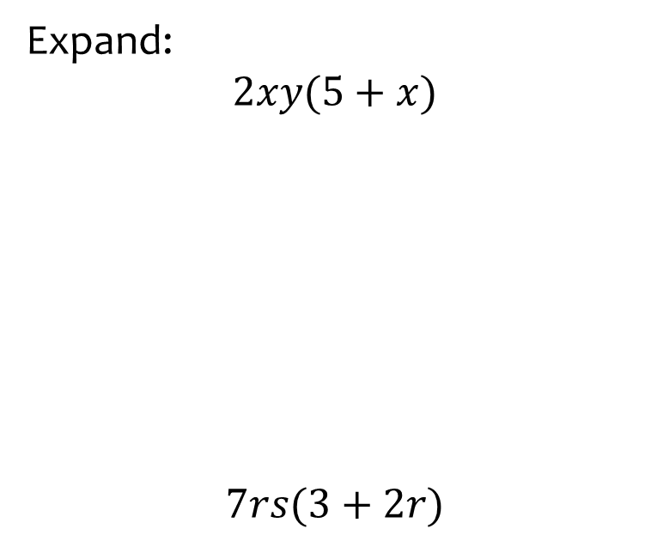


Worked example
Your turn
Expand:
$$2xy(5+x)$$
$$7rs(3+2r)$$
Expand:
$$3ab(2+5a)$$
$$6ab+15a^{2}b$$

Slide 9
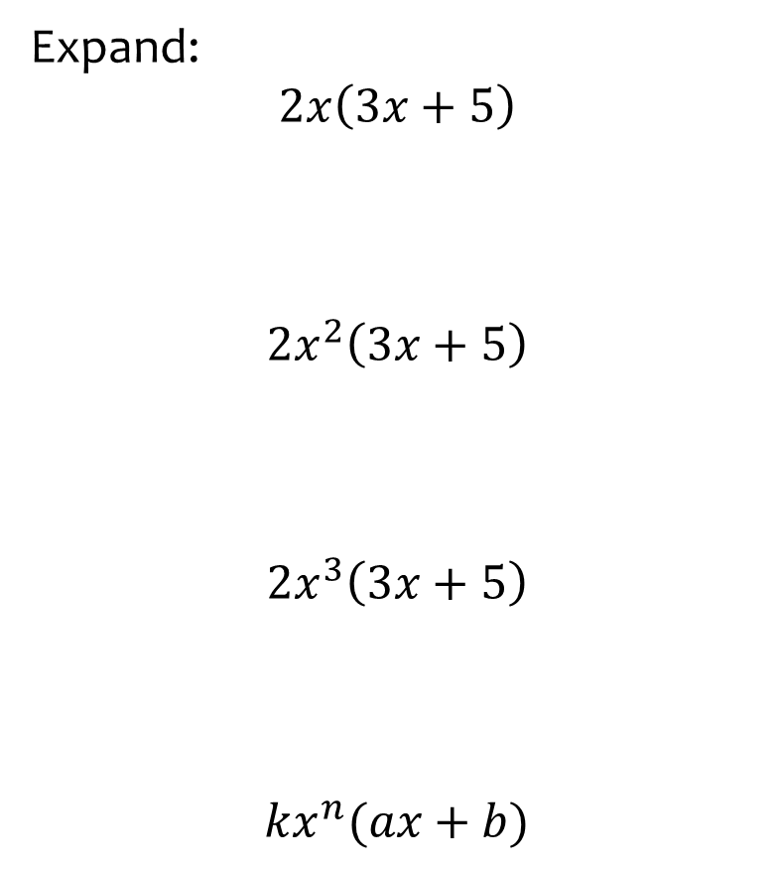


Worked example
Your turn
Expand:
$$2x\left(3x+5\right)$$
$$2x^{2}\left(3x+5\right)$$
$${2x}^{3}\left(3x+5\right)$$
$${kx}^{n}(ax+b)$$
Expand:
$$5a^{4}(3a−2)$$
$$15a^{5}−10a^{4}$$

Slide 10
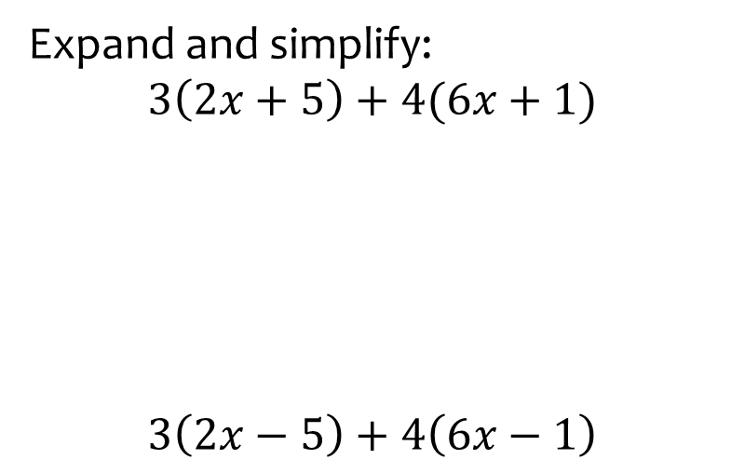
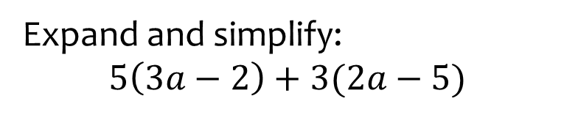

Worked example
Your turn
Expand and simplify:
$$3\left(2x+5\right)+4(6x+1)$$
$$3\left(2x−5\right)+4\left(6x−1\right)$$
Expand and simplify:
$$5\left(3a−2\right)+3(2a−5)$$
$$21a−25$$

Slide 11
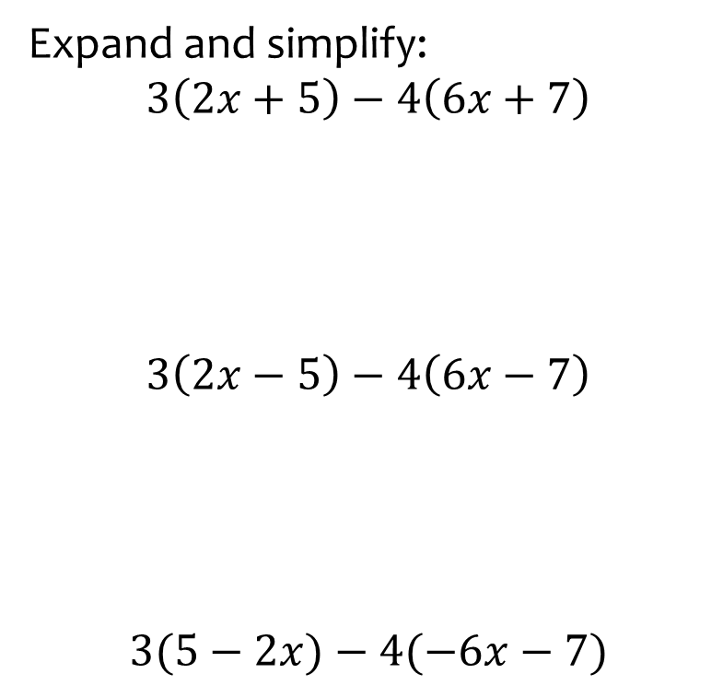
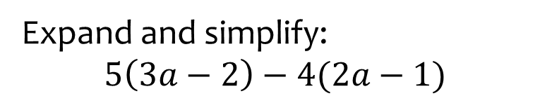

Worked example
Your turn
Expand and simplify:
$$3\left(2x+5\right)−4\left(6x+7\right)$$
$$3\left(2x−5\right)−4\left(6x−7\right)$$
$$3(5−2x)−4(−6x−7)$$
Expand and simplify:
$$5\left(3a−2\right)−4(2a−1)$$
$$7a−6$$

Slide 12
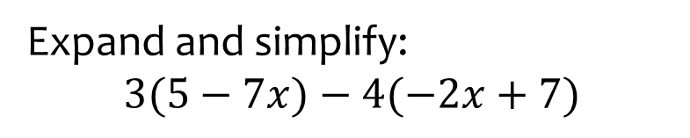
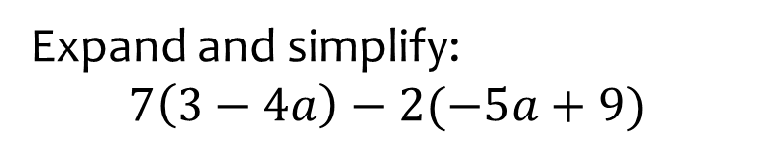

Worked example
Your turn
Expand and simplify:
$$3(5−7x)−4(−2x+7)$$
Expand and simplify:
$$7\left(3−4a\right)−2(−5a+9)$$
$$−18a+3$$

