Slide 1
EXPANDING BRACKETS (DOUBLE)
CONTENTS

Slide 2
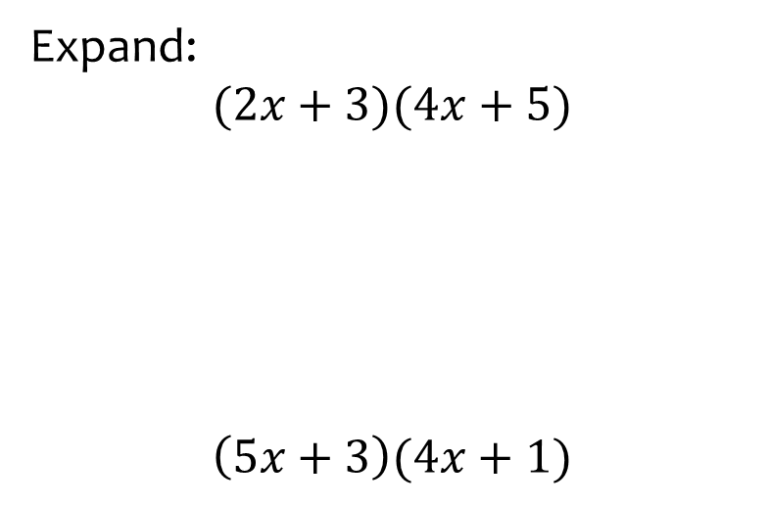


Worked example
Your turn
Expand:
$$(2x+3)(4x+5)$$
$$\left(5x+3\right)(4x+1)$$
Expand:
$$(3a+5)(2a+4)$$
$$6a^{2}+22a+20$$

Slide 3
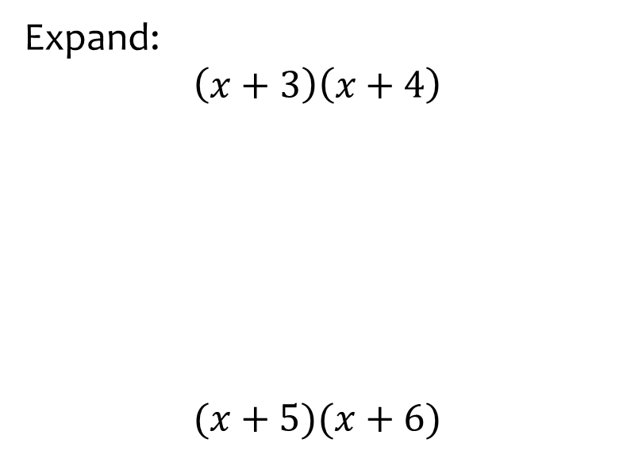


Worked example
Your turn
Expand:
$$\left(x+3\right)\left(x+4\right)$$
$$(x+5)(x+6)$$
Expand:
$$(x+2)(x+8)$$
$$x^{2}+10x+16$$

Slide 4
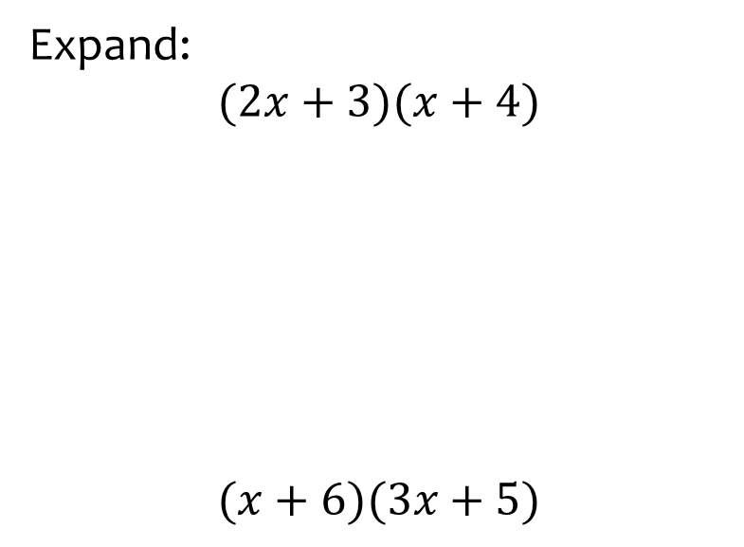


Worked example
Your turn
Expand:
$$(2x+3)(x+4)$$
$$(x+6)(3x+5)$$
Expand:
$$(5x+2)(x+8)$$
$$5x^{2}+42x+16$$

Slide 5
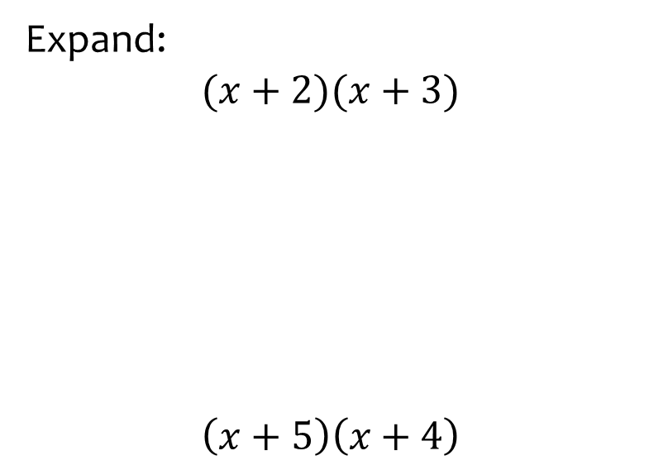


Worked example
Your turn
Expand:
$$(x+2)(x+3)$$
$$\left(x+5\right)\left(x+4\right)$$
Expand:
$$(x+7)(x+8)$$
$$x^{2}+15x+56$$

Slide 6
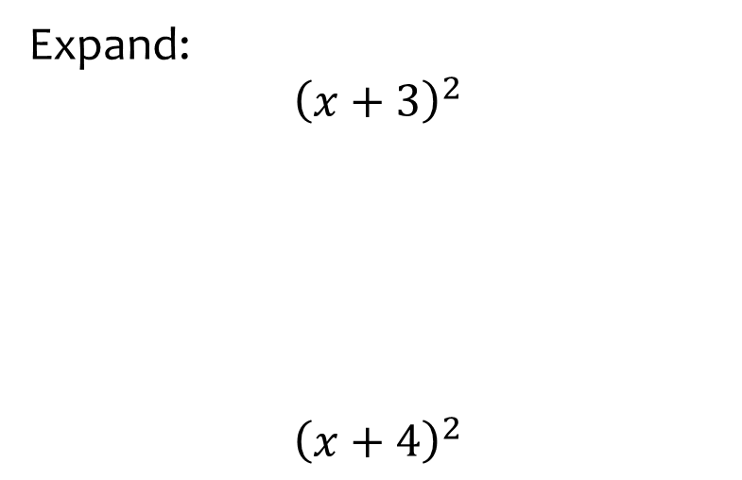
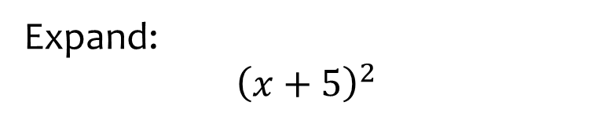

Worked example
Your turn
Expand:
$${\left(x+3\right)}^{2}$$
$${\left(x+4\right)}^{2}$$
Expand:
$${\left(x+5\right)}^{2}$$
$$x^{2}+10x+25$$

Slide 7
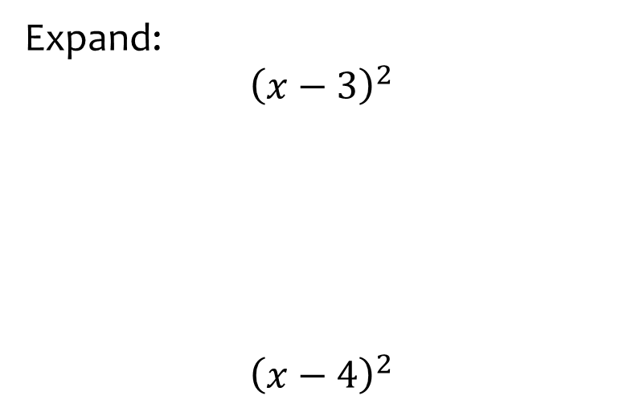
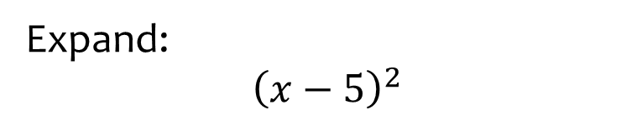

Worked example
Your turn
Expand:
$${\left(x−3\right)}^{2}$$
$${\left(x−4\right)}^{2}$$
Expand:
$${\left(x−5\right)}^{2}$$
$$x^{2}−10x+25$$

Slide 8
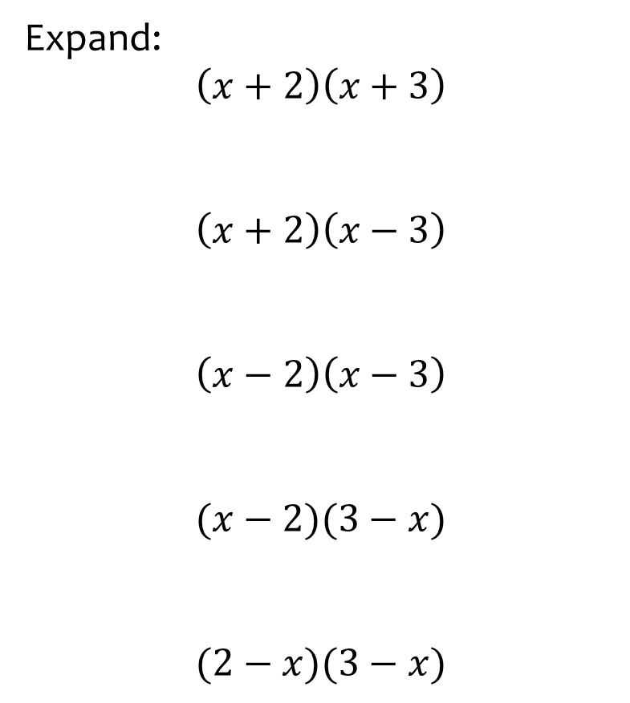
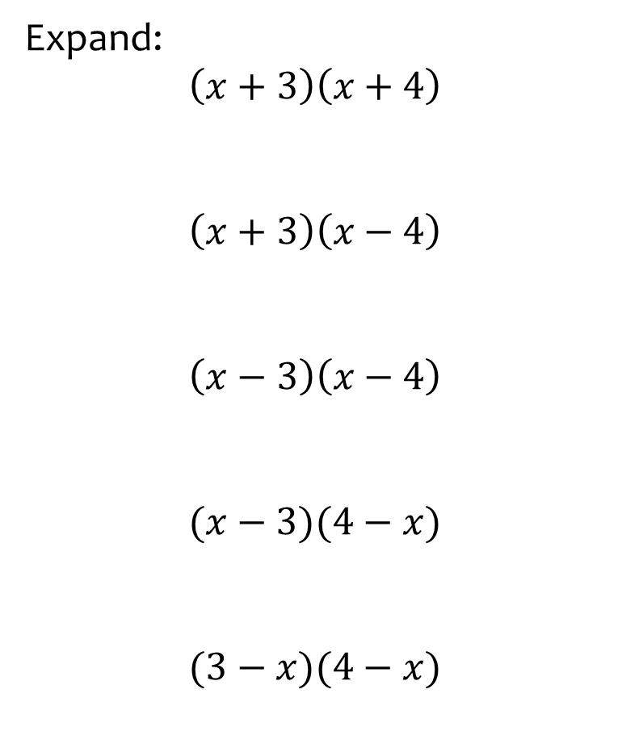





Worked example
Your turn
Expand:
$$\left(x+2\right)\left(x+3\right)$$
$$\left(x+2\right)\left(x−3\right)$$
$$\left(x−2\right)\left(x−3\right)$$
$$(x−2)(3−x)$$
$$(2−x)(3−x)$$
Expand:
$$\left(x+3\right)\left(x+4\right)$$
$$\left(x+3\right)\left(x−4\right)$$
$$\left(x−3\right)\left(x−4\right)$$
$$(x−3)(4−x)$$
$$(3−x)(4−x)$$
$$x^{2}+7x+12$$
$$x^{2}−x−12$$
$$x^{2}−7x+12$$
$$7x−12−x^{2}$$
$$x^{2}−7x+12$$

Slide 9
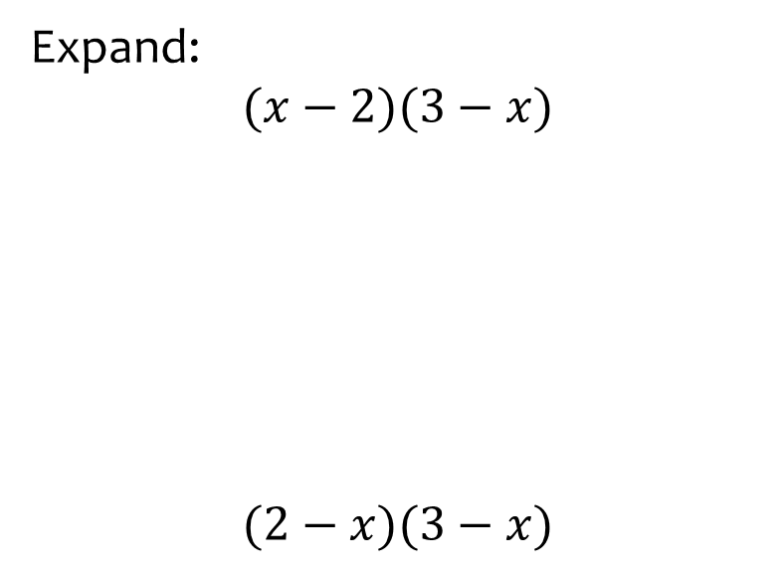
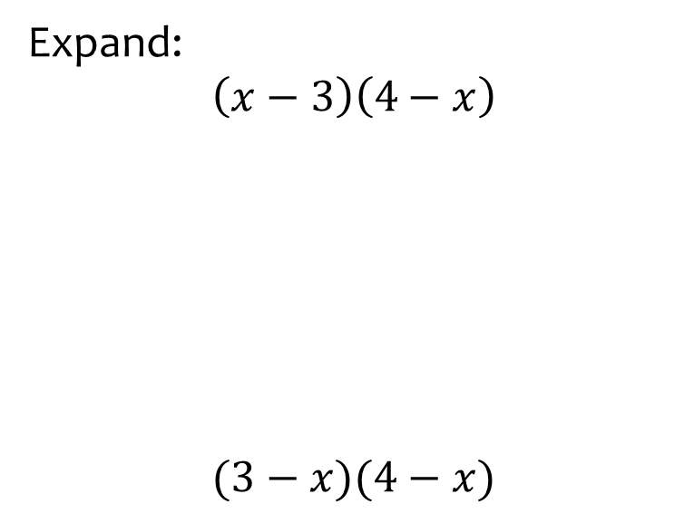


Worked example
Your turn
Expand:
$$(x−2)(3−x)$$
$$(2−x)(3−x)$$
Expand:
$$\left(x−3\right)\left(4−x\right)$$
$$(3−x)(4−x)$$
$$7x−12−x^{2}$$
$$x^{2}−7x+12$$

Slide 10
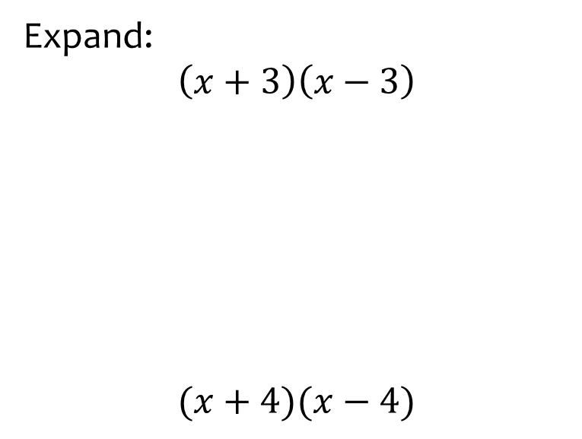


Worked example
Your turn
Expand:
$$\left(x+3\right)\left(x−3\right)$$
$$(x+4)(x−4)$$
Expand:
$$(x+5)(x−5)$$
$$x^{2}−25$$

Slide 11
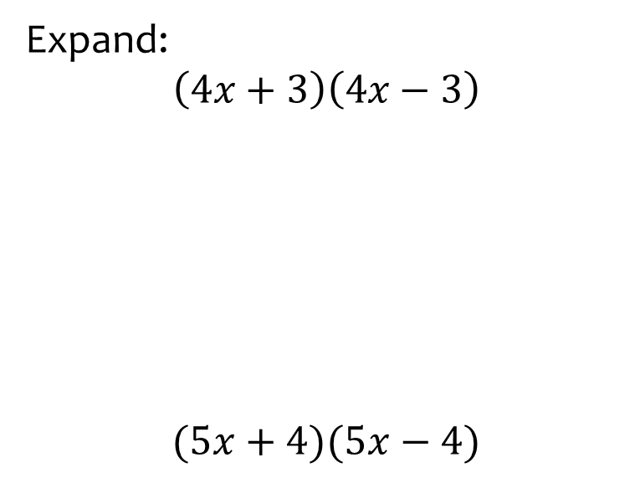


Worked example
Your turn
Expand:
$$\left(4x+3\right)\left(4x−3\right)$$
$$(5x+4)(5x−4)$$
Expand:
$$(3x+5)(3x−5)$$
$$9x^{2}−25$$

Slide 12
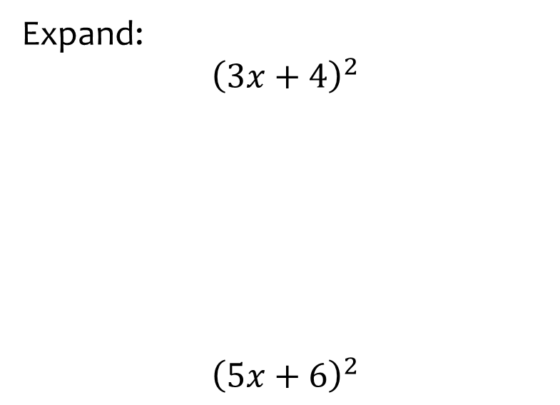
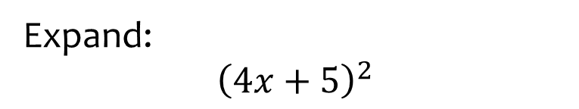

Worked example
Your turn
Expand:
$${\left(3x+4\right)}^{2}$$
$${\left(5x+6\right)}^{2}$$
Expand:
$${\left(4x+5\right)}^{2}$$
$$16x^{2}+40x+25$$

Slide 13
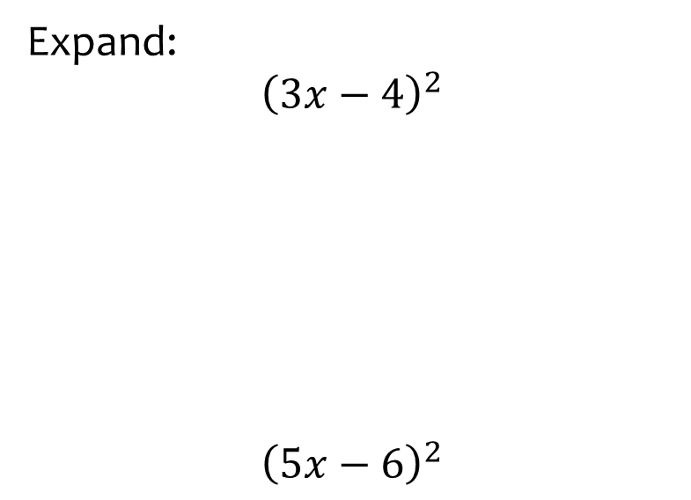
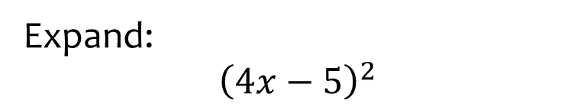

Worked example
Your turn
Expand:
$${\left(3x−4\right)}^{2}$$
$${\left(5x−6\right)}^{2}$$
Expand:
$${\left(4x−5\right)}^{2}$$
$$16x^{2}−40x+25$$

Slide 14
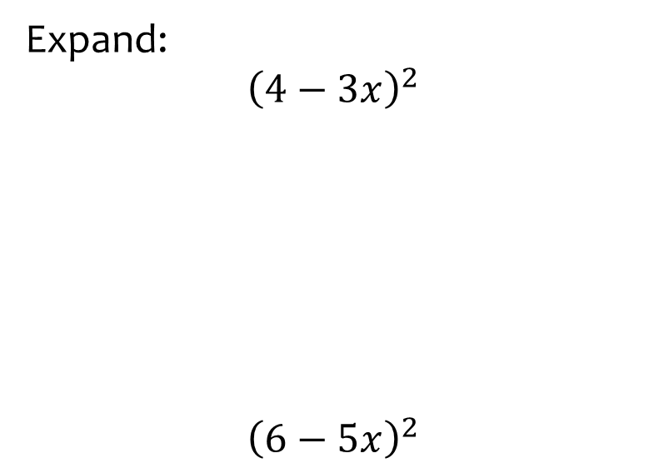

Worked example
Your turn
Expand:
$${\left(4−3x\right)}^{2}$$
$${\left(6−5x\right)}^{2}$$
Expand:
$${(5−4x)}^{2}$$
$$16x^{2}−40x+25$$

Slide 15
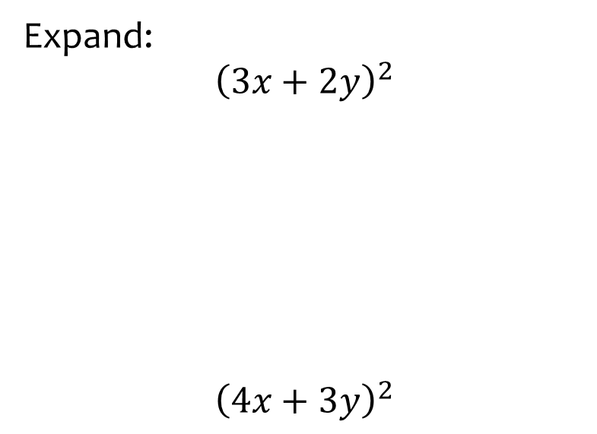


Worked example
Your turn
Expand:
$${\left(3x+2y\right)}^{2}$$
$${\left(4x+3y\right)}^{2}$$
Expand:
$${\left(5x+4y\right)}^{2}$$
$$25x^{2}+40xy+16y^{2}$$

Slide 16
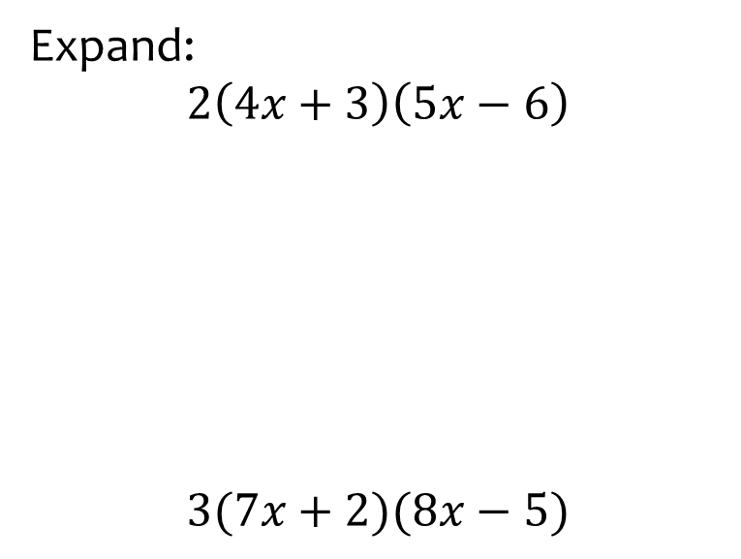


Worked example
Your turn
Expand:
$$2\left(4x+3\right)\left(5x−6\right)$$
$$3(7x+2)(8x−5)$$
Expand:
$$4(5x+6)(3x−2)$$
$$60x^{2}+32x−48$$

Slide 17
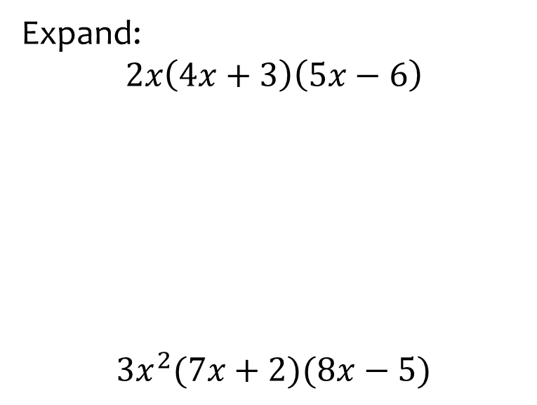


Worked example
Your turn
Expand:
$$2x\left(4x+3\right)\left(5x−6\right)$$
$$3x^{2}(7x+2)(8x−5)$$
Expand:
$$4x^{2}(5x+6)(3x−2)$$
$$60x^{4}+32x^{3}−48x^{2}$$

