Slide 1
COLLECTING LIKE TERMS
CONTENTS

Slide 2
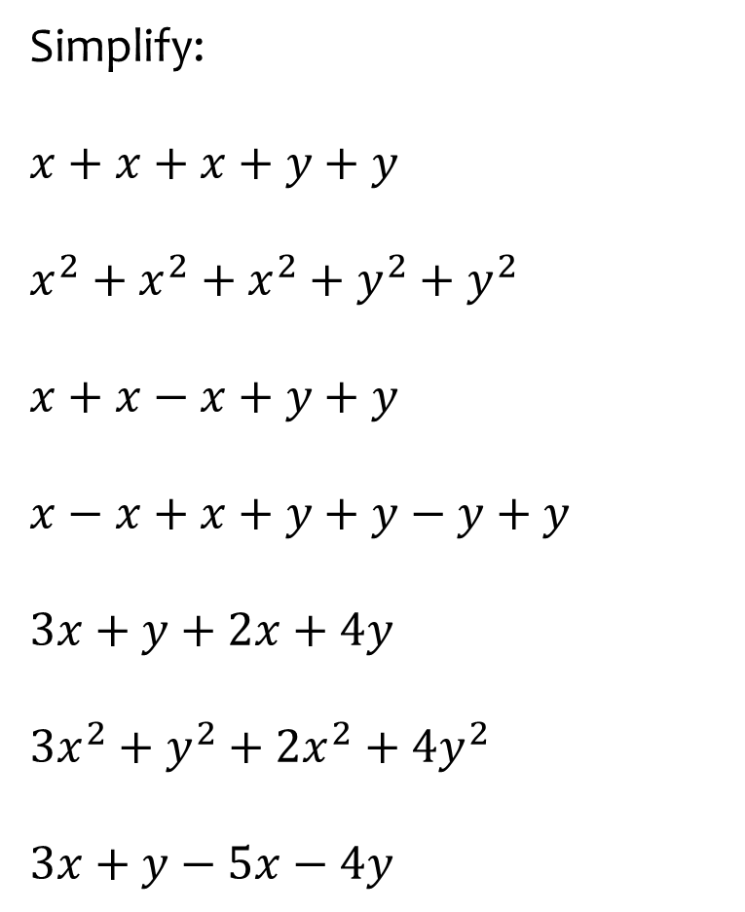
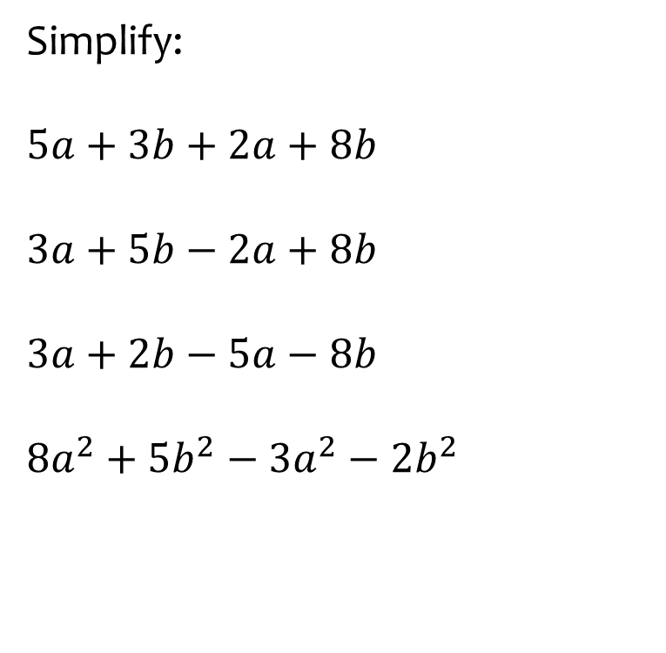
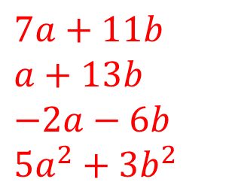
Worked example
Your turn
Simplify:
$$x+x+x+y+y$$
$$x^{2}+x^{2}+x^{2}+y^{2}+y^{2}$$
$$x+x−x+y+y$$
$$x−x+x+y+y−y+y$$
$$3x+y+2x+4y$$
$$3x^{2}+y^{2}+2x^{2}+4y^{2}$$
$$3x+y−5x−4y$$
Simplify:
$5a+3b+2a+8b$
$$3a+5b−2a+8b$$
$$3a+2b−5a−8b$$
$$8a^{2}+5b^{2}−{3a}^{2}−2b^{2}$$
$$7a+11b$$
$$a+13b$$
$$−2a−6b$$
$$5a^{2}+3b^{2}$$

Slide 3
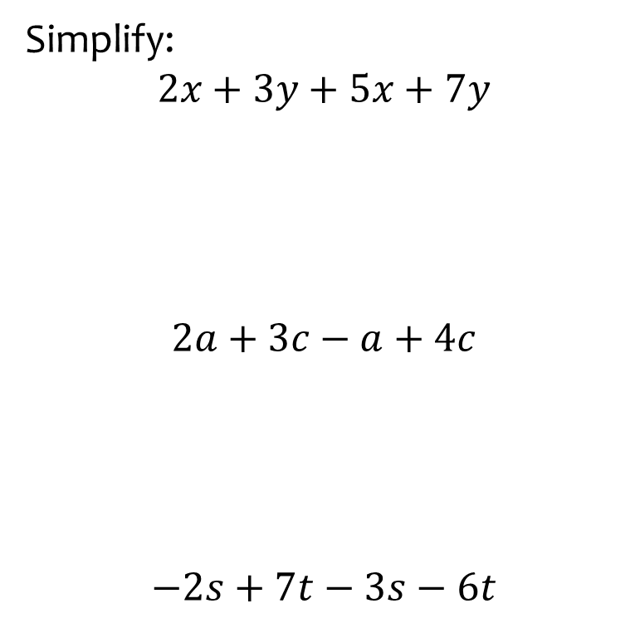
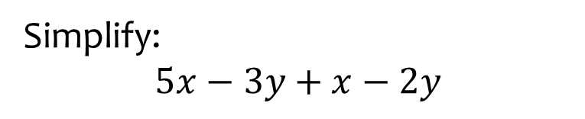

Worked example
Your turn
Simplify:
$$2x+3y+5x+7y$$
$$2a+3c−a+4c$$
$$−2s+7t−3s−6t$$
Simplify:
$$5x−3y+x−2y$$
$$6x−5y$$

Slide 4
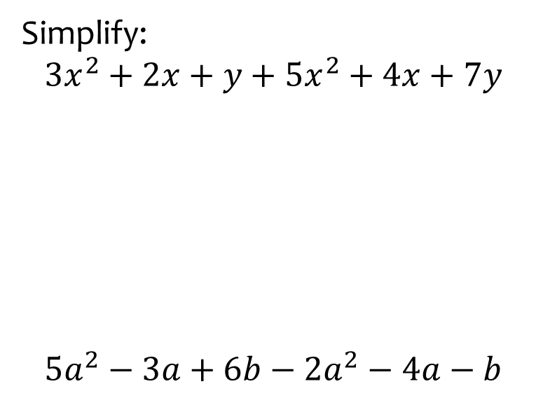
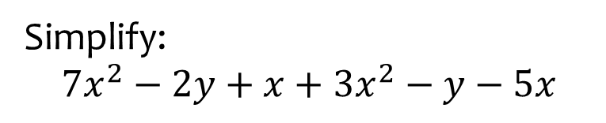

Worked example
Your turn
Simplify:
$$3x^{2}+2x+y+5x^{2}+4x+7y$$
$$5a^{2}−3a+6b−2a^{2}−4a−b$$
Simplify:
$$7x^{2}−2y+x+3x^{2}−y−5x$$
$$10x^{2}+4x−3y$$

Slide 5
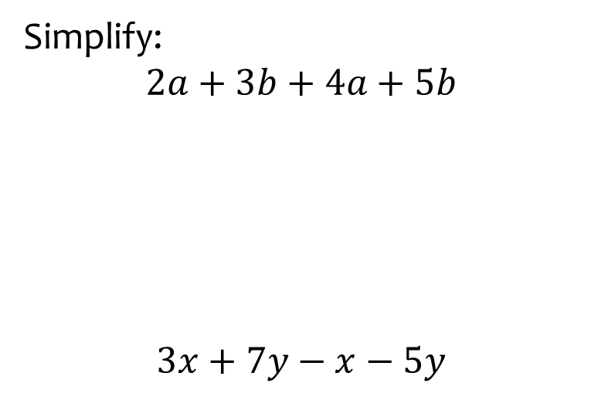
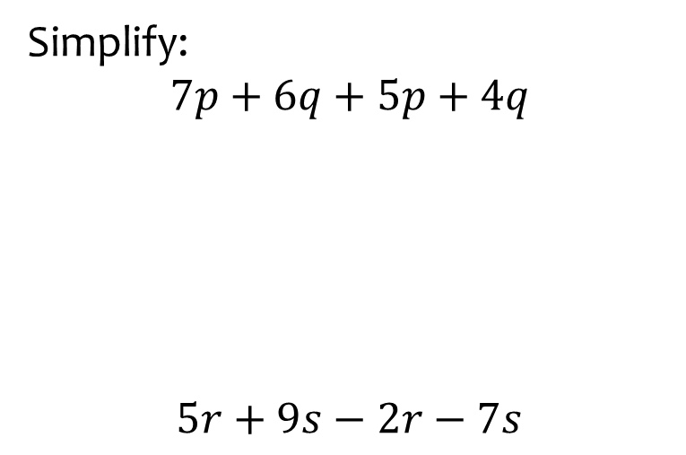


Worked example
Your turn
Simplify:
$$2a+3b+4a+5b$$
$$3x+7y−x−5y$$
Simplify:
$$7p+6q+5p+4q$$
$$5r+9s−2r−7s$$
$$12p+10q$$
$$3r+2s$$

Slide 6
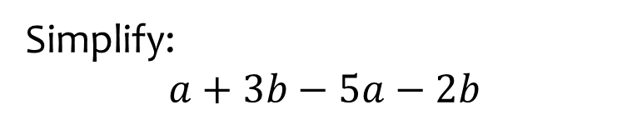
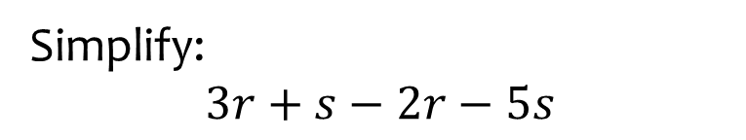

Worked example
Your turn
Simplify:
$$a+3b−5a−2b$$
Simplify:
$$3r+s−2r−5s$$
$$r−4s$$

Slide 7
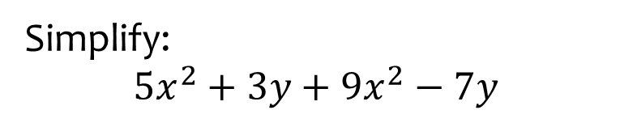
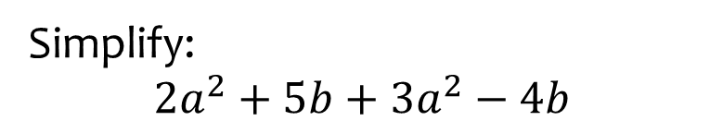

Worked example
Your turn
Simplify:
$$5x^{2}+3y+9x^{2}−7y$$
Simplify:
$$2a^{2}+5b+3a^{2}−4b$$
$$5a^{2}+b$$

Slide 8
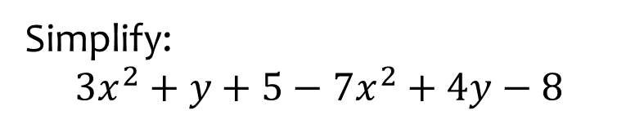
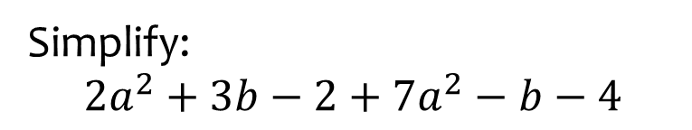

Worked example
Your turn
Simplify:
$$3x^{2}+y+5−7x^{2}+4y−8$$
Simplify:
$$2a^{2}+3b−2+7a^{2}−b−4$$
$$9a^{2}+2b−6$$

Slide 9
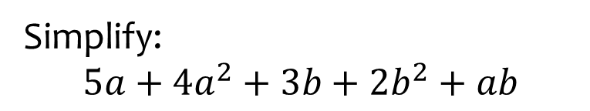
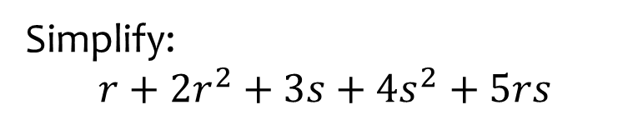

Worked example
Your turn
Simplify:
$$5a+{4a}^{2}+3b+{2b}^{2}+ab$$
Simplify:
$$r+2r^{2}+3s+{4s}^{2}+5rs$$
$$Cannot be simplified$$

