Slide 1
CHANGING THE SUBJECT
CONTENTS

Slide 2
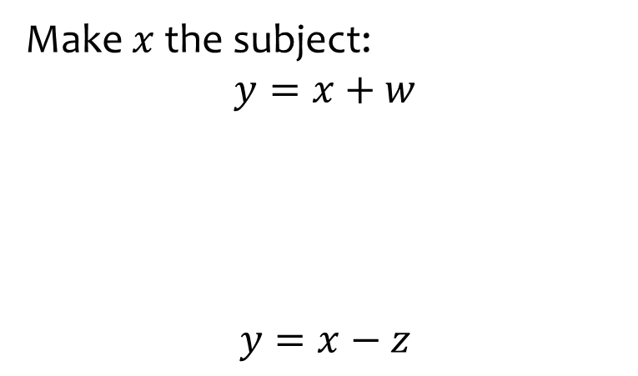


Worked example
Your turn
Make $x$ the subject:
$$y=x+w$$
$$y=x−z$$
Make $x$ the subject:
$$y=x−a$$
$$x=y+a$$

Slide 3
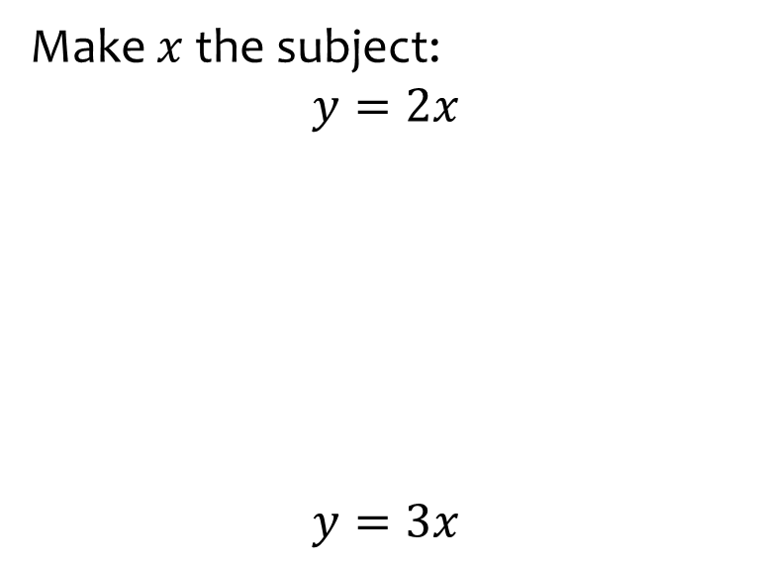


Worked example
Your turn
Make $x$ the subject:
$$y=2x$$
$$y=3x$$
Make $x$ the subject:
$$y=4x$$
$$x=\frac{y}{4}$$

Slide 4
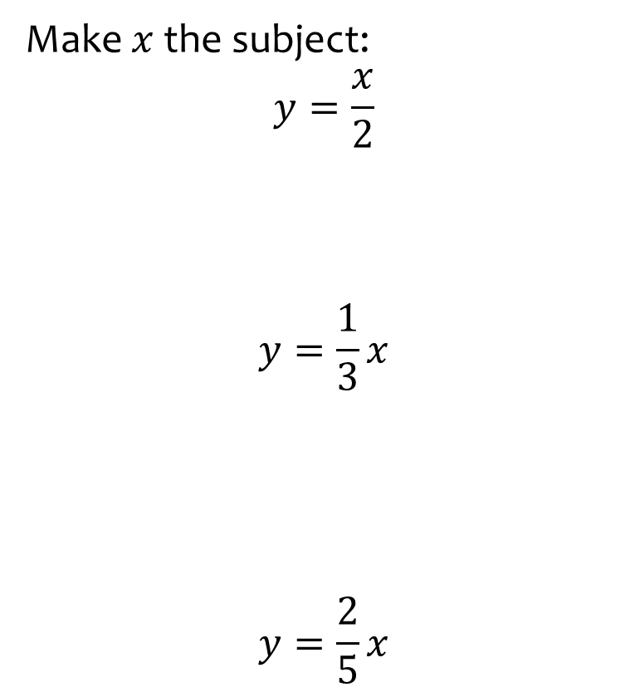
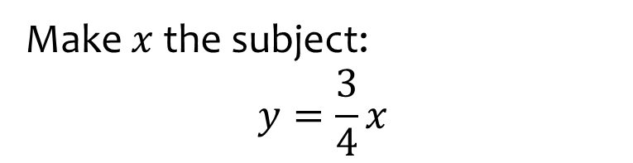

Worked example
Your turn
Make $x$ the subject:
$$y=\frac{x}{2}$$
$$y=\frac{1}{3}x$$
$$y=\frac{2}{5}x$$
Make $x$ the subject:
$$y=\frac{3}{4}x$$
$$x=\frac{4}{3}y$$

Slide 5
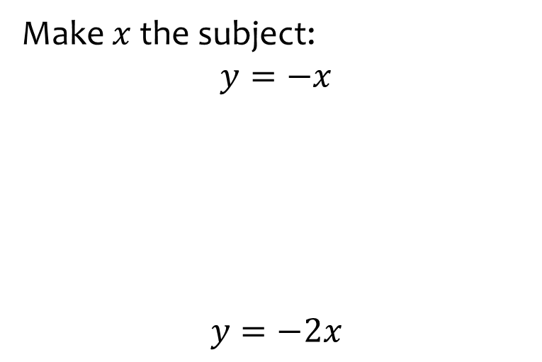


Worked example
Your turn
Make $x$ the subject:
$$y=−x$$
$$y=−2x$$
Make $x$ the subject:
$$y=−3x$$
$$x=−\frac{y}{3}$$

Slide 6
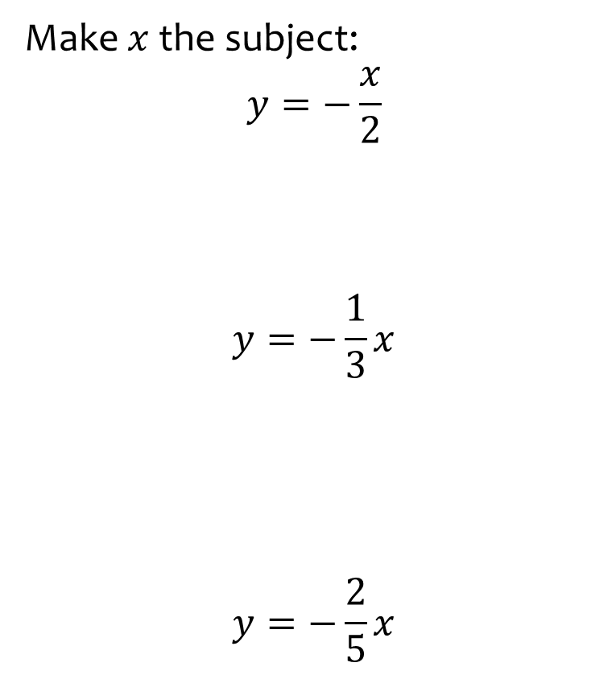
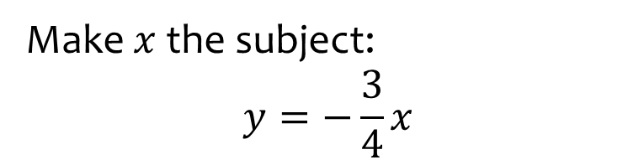

Worked example
Your turn
Make $x$ the subject:
$$y=−\frac{x}{2}$$
$$y=−\frac{1}{3}x$$
$$y=−\frac{2}{5}x$$
Make $x$ the subject:
$$y=−\frac{3}{4}x$$
$$x=−\frac{4}{3}y$$

Slide 7
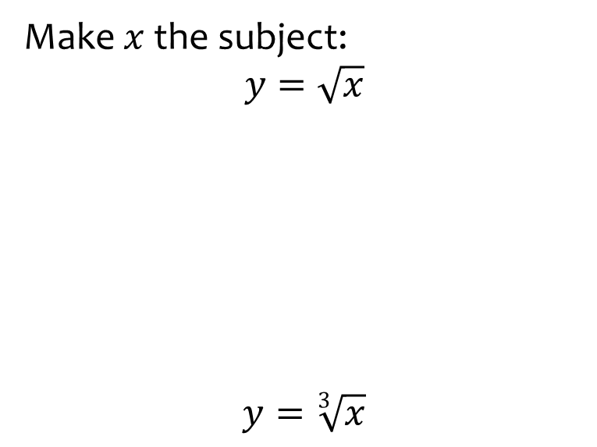


Worked example
Your turn
Make $x$ the subject:
$$y=\sqrt{x}$$
$$y=\sqrt[3]{x}$$
Make $x$ the subject:
$$y=\sqrt[4]{x}$$
$$x=y^{4}$$

Slide 8
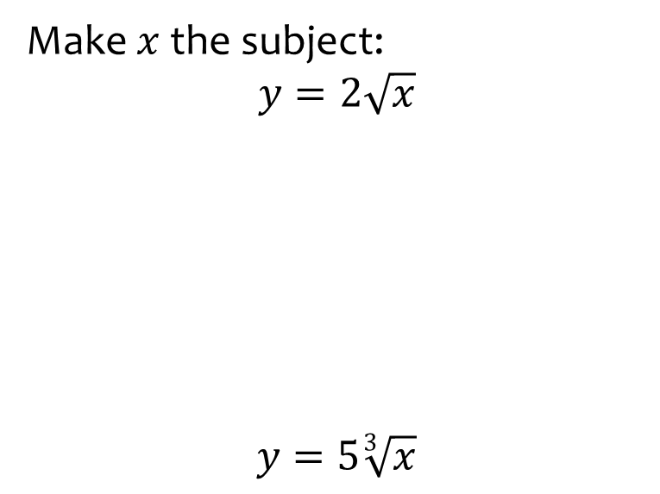


Worked example
Your turn
Make $x$ the subject:
$$y=2\sqrt{x}$$
$$y=5\sqrt[3]{x}$$
Make $x$ the subject:
$$y=3\sqrt[4]{x}$$
$$x=\frac{y^{4}}{81}$$

Slide 9
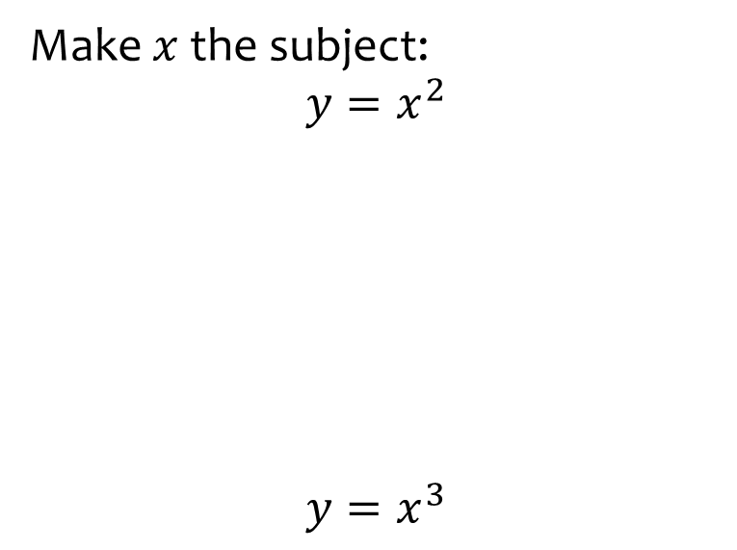


Worked example
Your turn
Make $x$ the subject:
$$y=x^{2}$$
$$y=x^{3}$$
Make $x$ the subject:
$$y=x^{4}$$
$$x=±\sqrt[4]{y}$$

Slide 10
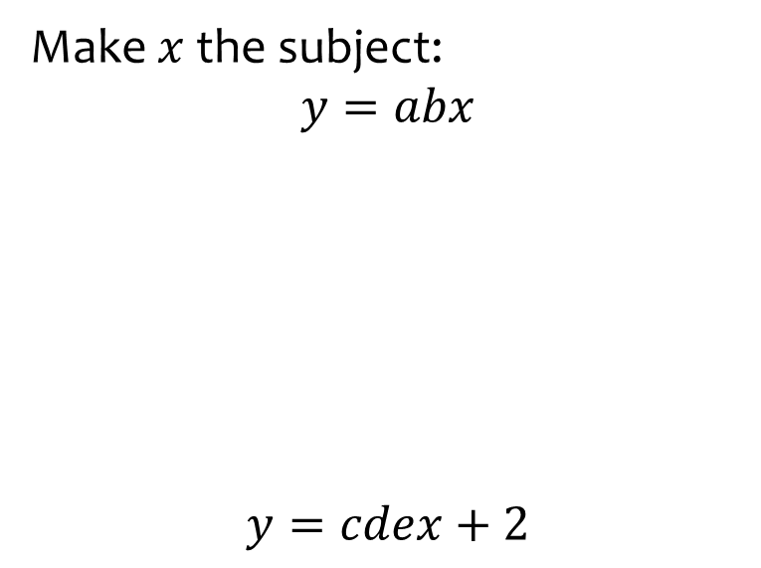


Worked example
Your turn
Make $x$ the subject:
$$y=abx$$
$$y=cdex+2$$
Make $x$ the subject:
$$y=fghix−3$$
$$x=\frac{y+3}{fghi}$$

Slide 11
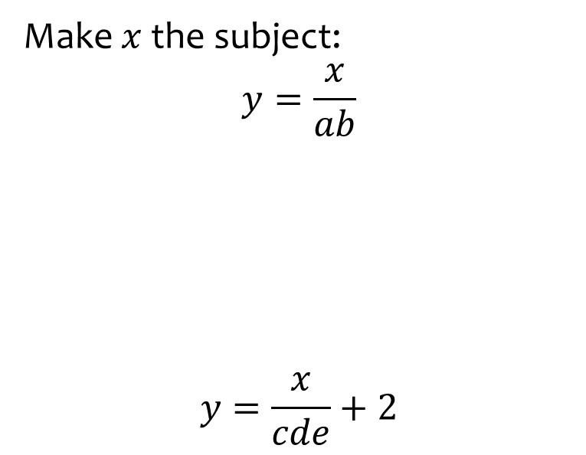
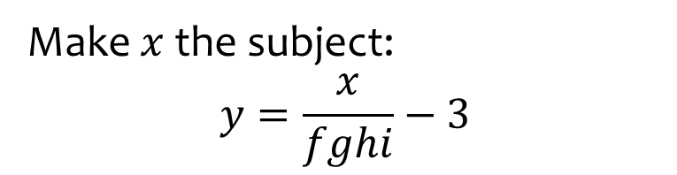

Worked example
Your turn
Make $x$ the subject:
$$y=\frac{x}{ab}$$
$$y=\frac{x}{cde}+2$$
Make $x$ the subject:
$$y=\frac{x}{fghi}−3$$
$$x=fghi(y+3)$$

Slide 12
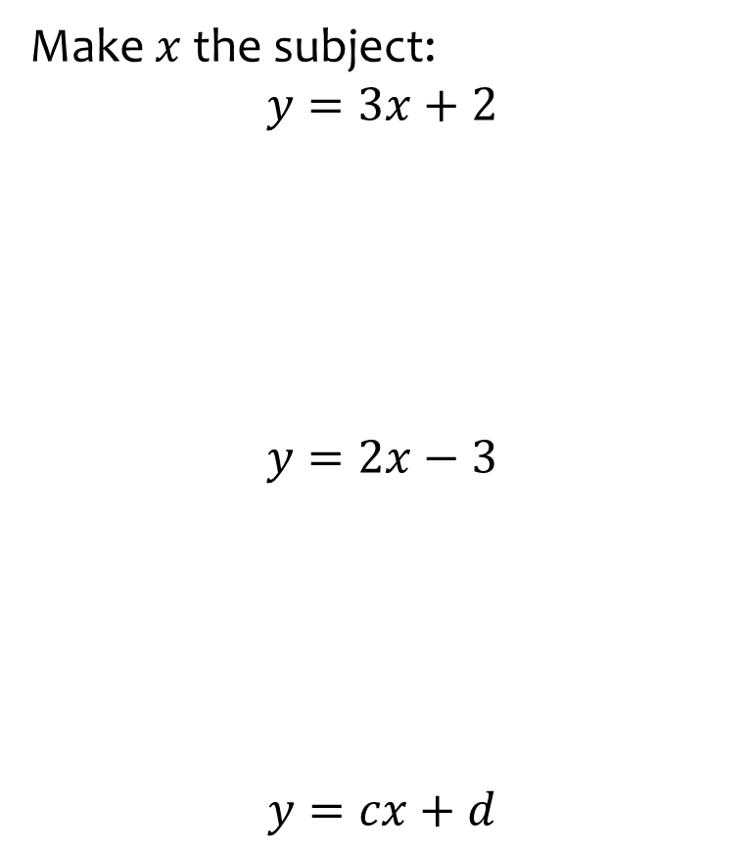

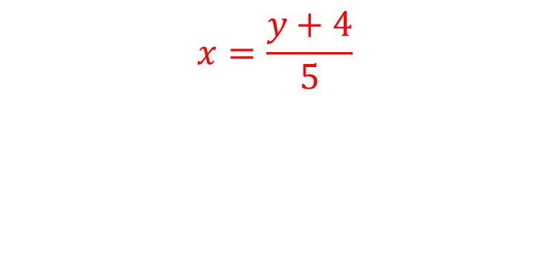
Worked example
Your turn
Make $x$ the subject:
$$y=3x+2$$
$$y=2x−3$$
$$y=cx+d$$
Make $x$ the subject:
$$y=5x−4$$
$$x=\frac{y+4}{5}$$

Slide 13
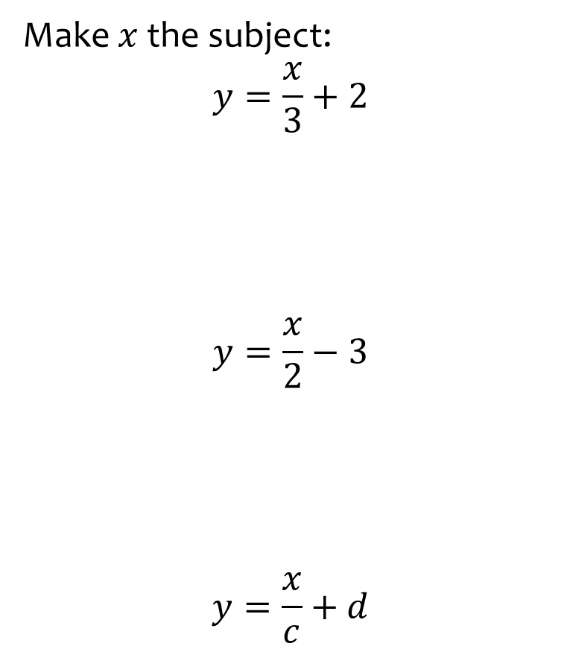


Worked example
Your turn
Make $x$ the subject:
$$y=\frac{x}{3}+2$$
$$y=\frac{x}{2}−3$$
$$y=\frac{x}{c}+d$$
Make $x$ the subject:
$$y=\frac{x}{5}−4$$
$$x=5(y+4)$$

Slide 14
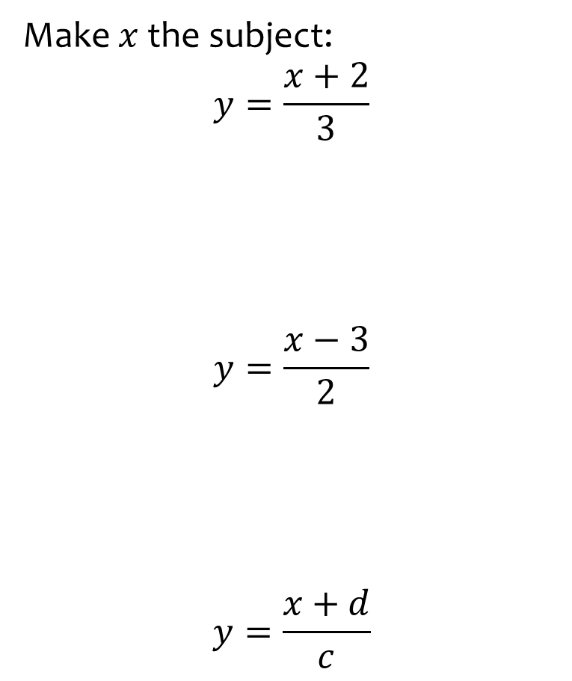
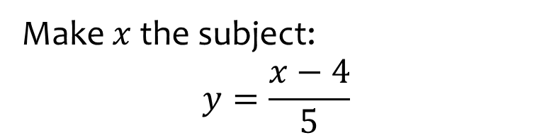

Worked example
Your turn
Make $x$ the subject:
$$y=\frac{x+2}{3}$$
$$y=\frac{x−3}{2}$$
$$y=\frac{x+d}{c}$$
Make $x$ the subject:
$$y=\frac{x−4}{5}$$
$$x=5y+4$$

Slide 15
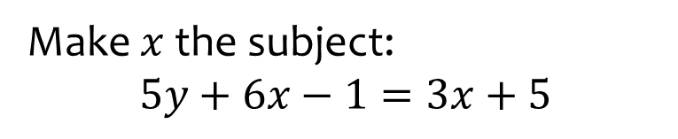
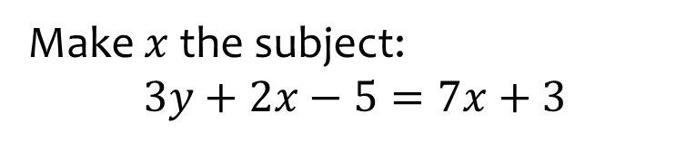

Worked example
Your turn
Make $x$ the subject:
$$5y+6x−1=3x+5$$
Make $x$ the subject:
$$3y+2x−5=7x+3$$
$$x=\frac{3y−8}{5}$$

Slide 16
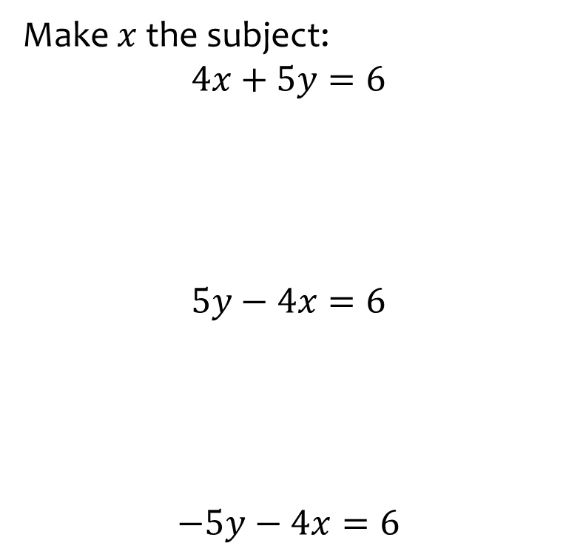


Worked example
Your turn
Make $x$ the subject:
$$4x+5y=6$$
$$5y−4x=6$$
$$−5y−4x=6$$
Make $x$ the subject:
$$6y−7x=8$$
$$x=\frac{6y−8}{7}$$

Slide 17
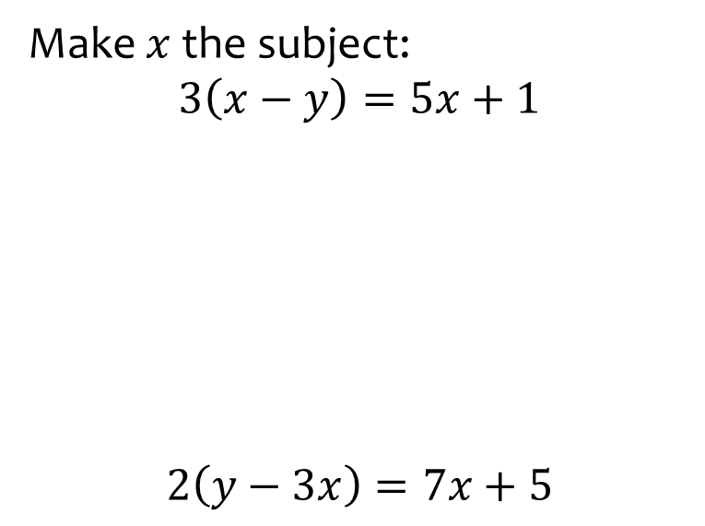
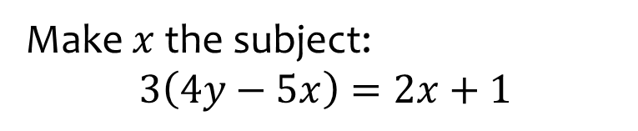

Worked example
Your turn
Make $x$ the subject:
$$3\left(x−y\right)=5x+1$$
$$2\left(y−3x\right)=7x+5$$
Make $x$ the subject:
$$3\left(4y−5x\right)=2x+1$$
$$x=\frac{12y−1}{17}$$

Slide 18

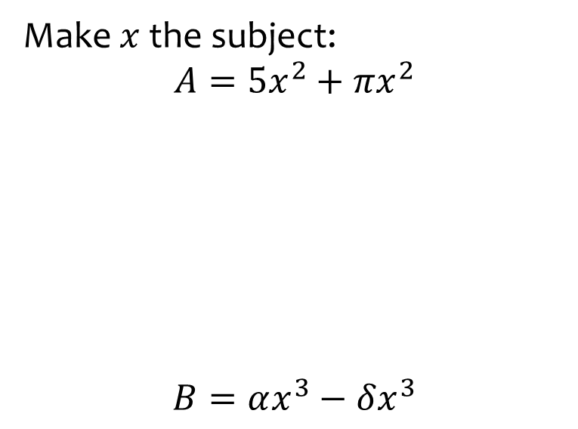

Worked example
Your turn
Make $x$ the subject:
$$A=5x^{2}+πx^{2}$$
$$B=αx^{3}−δx^{3}$$
Make $x$ the subject:
$$C=πx^{2}−3x^{2}$$
$$x=±\sqrt{\frac{C}{π−3}}$$

Slide 19
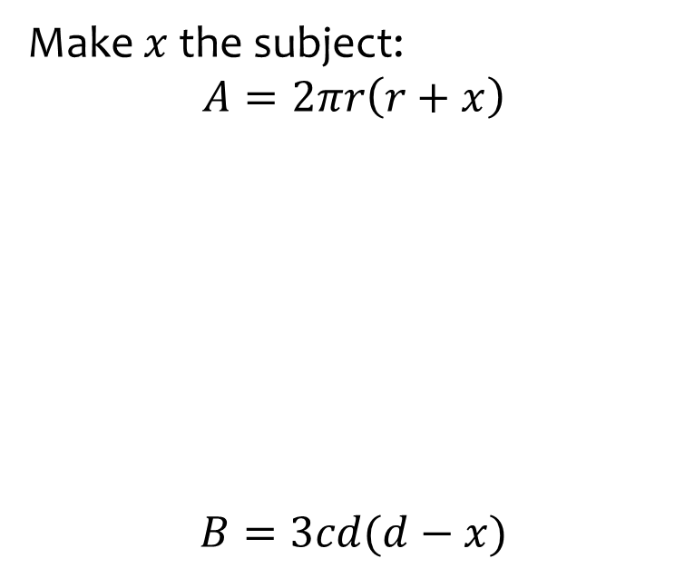


Worked example
Your turn
Make $x$ the subject:
$$A=2πr\left(r+x\right)$$
$$B=3cd(d−x)$$
Make $x$ the subject:
$$C=4ef(g−x)$$
$$x=g−\frac{C}{4ef}$$

Slide 20
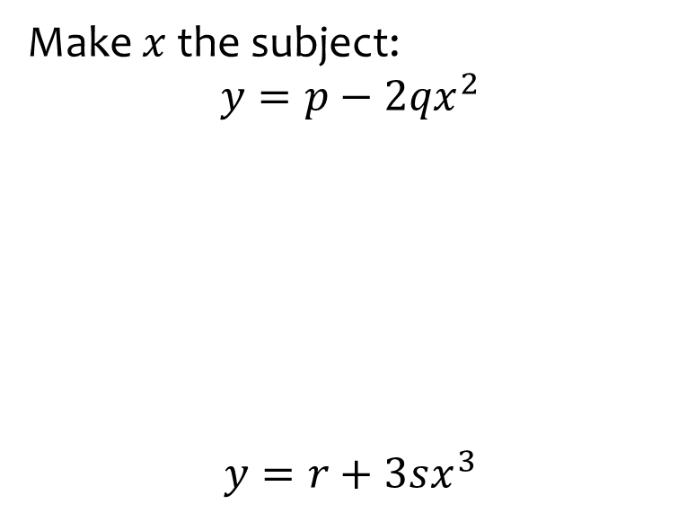


Worked example
Your turn
Make $x$ the subject:
$$y=p−2qx^{2}$$
$$y=r+3sx^{3}$$
Make $x$ the subject:
$$y=t−5ux^{3}$$
$$x=\sqrt[3]{\frac{\left(t−y\right)}{5u}}$$

Slide 21
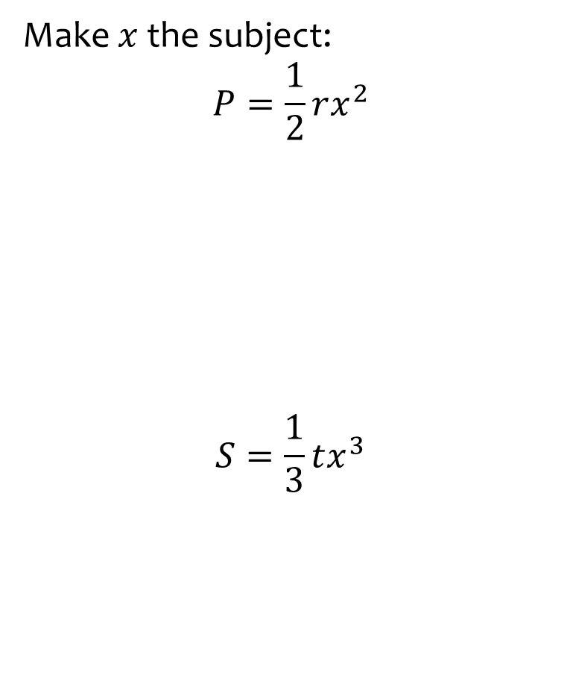
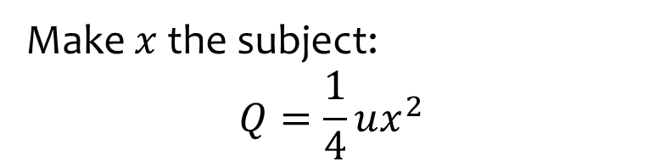

Worked example
Your turn
Make $x$ the subject:
$$P=\frac{1}{2}rx^{2}$$
$$S=\frac{1}{3}tx^{3}$$
Make $x$ the subject:
$$Q=\frac{1}{4}ux^{2}$$
$$x=±\sqrt{\frac{4Q}{u}}$$

Slide 22
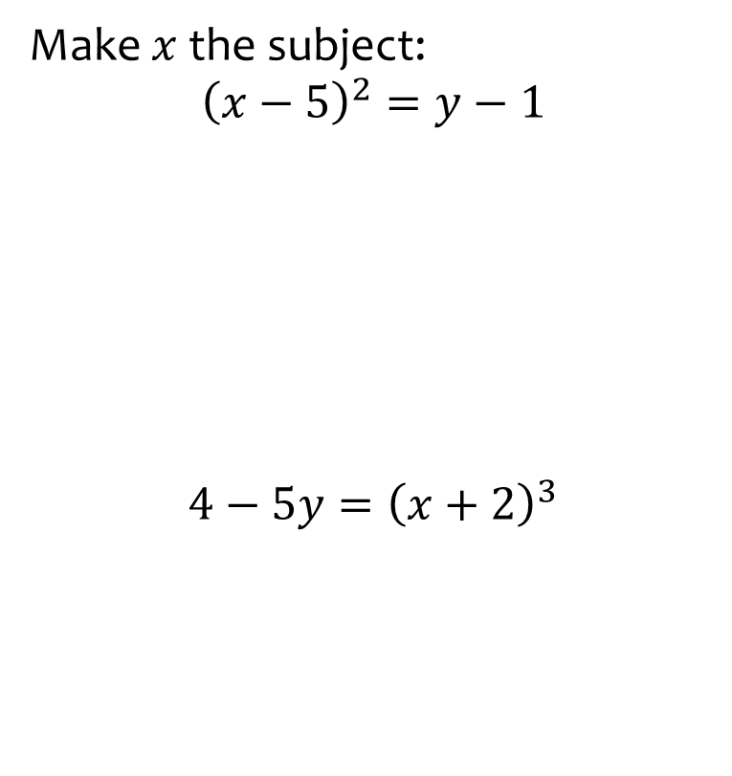


Worked example
Your turn
Make $x$ the subject:
$${\left(x−5\right)}^{2}=y−1$$
$$4−5y={\left(x+2\right)}^{3}$$
Make $x$ the subject:
$$3y−2={\left(x−5\right)}^{2}$$
$$x=5±\sqrt{3y−2}$$

Slide 23
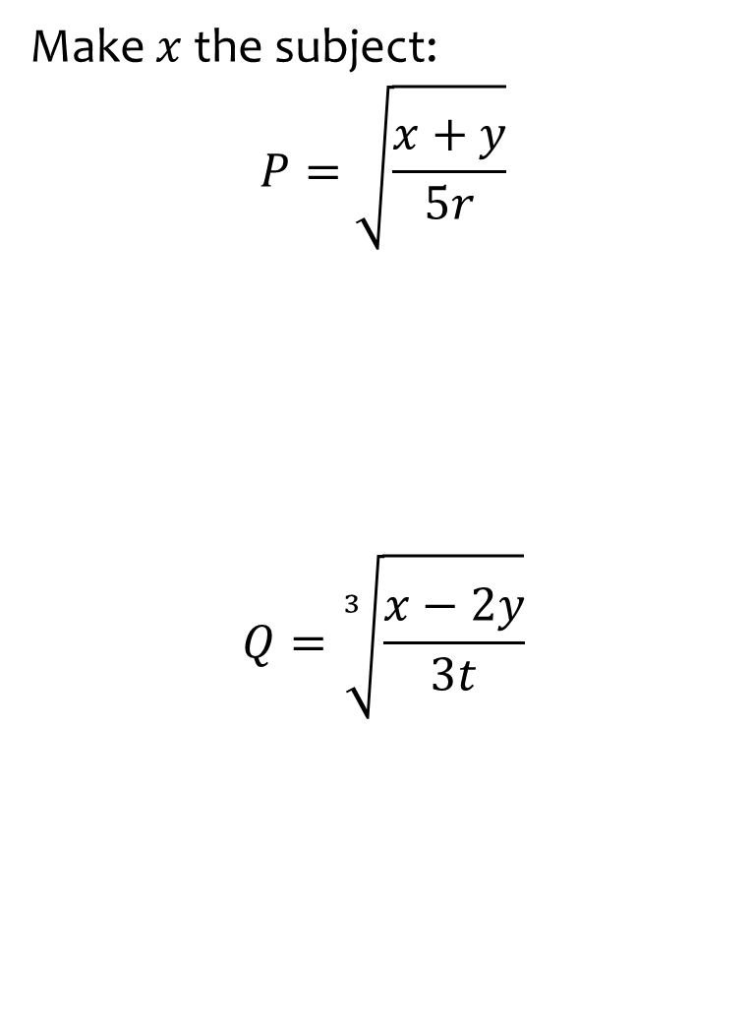
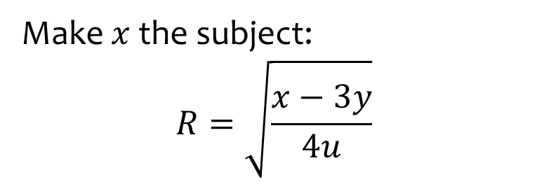

Worked example
Your turn
Make $x$ the subject:
$$P=\sqrt{\frac{x+y}{5r}}$$
$$Q=\sqrt[3]{\frac{x−2y}{3t}}$$
Make $x$ the subject:
$$R=\sqrt{\frac{x−3y}{4u}}$$
$$x=4uR^{2}+3y$$

Slide 24

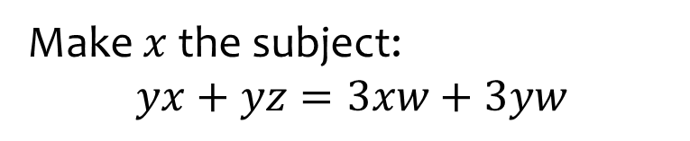
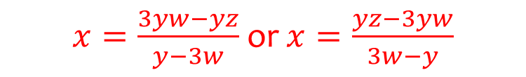
Worked example
Your turn
Make $x$ the subject:
$$ax+ay=cx+by$$
Make $x$ the subject:
$$yx+yz=3xw+3yw$$
$x=\frac{3yw−yz}{y−3w}$ or $x=\frac{yz−3yw}{3w−y}$

Slide 25
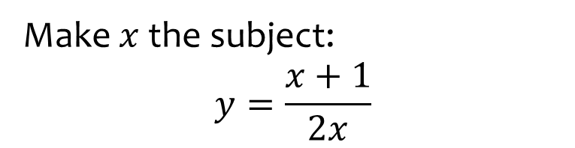
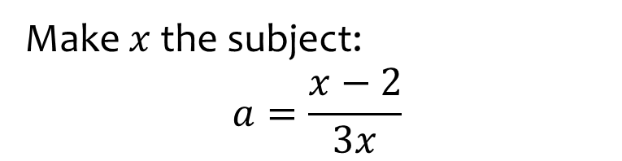

Worked example
Your turn
Make $x$ the subject:
$$y=\frac{x+1}{2x}$$
Make $x$ the subject:
$$a=\frac{x−2}{3x}$$
$$x=−\frac{2}{3a−1}$$

Slide 26
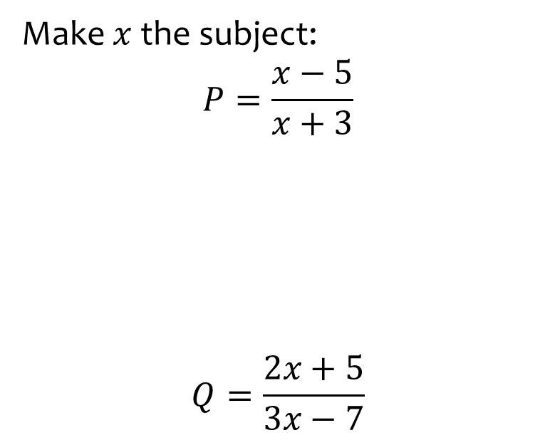
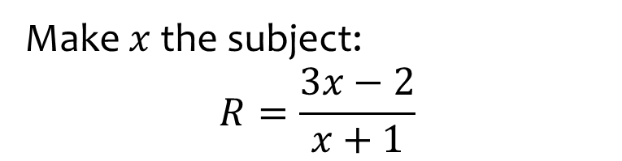

Worked example
Your turn
Make $x$ the subject:
$$P=\frac{x−5}{x+3}$$
$$Q=\frac{2x+5}{3x−7}$$
Make $x$ the subject:
$$R=\frac{3x−2}{x+1}$$
$$x=\frac{R+2}{3−R}$$

Slide 27
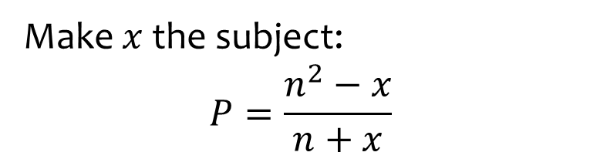
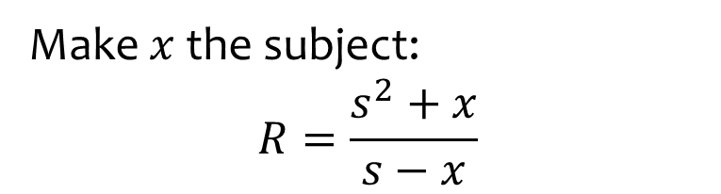

Worked example
Your turn
Make $x$ the subject:
$$P=\frac{n^{2}−x}{n+x}$$
Make $x$ the subject:
$$R=\frac{s^{2}+x}{s−x}$$
$$x=\frac{Rs−s^{2}}{R+1}$$

Slide 28
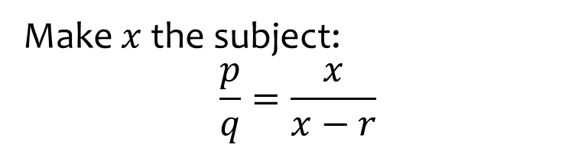
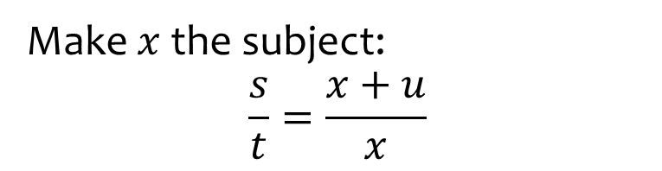

Worked example
Your turn
Make $x$ the subject:
$$\frac{p}{q}=\frac{x}{x−r}$$
Make $x$ the subject:
$$\frac{s}{t}=\frac{x+u}{x}$$
$$x=\frac{ut}{s−t}$$

Slide 29
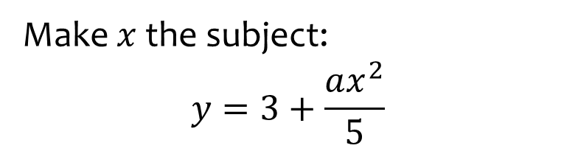
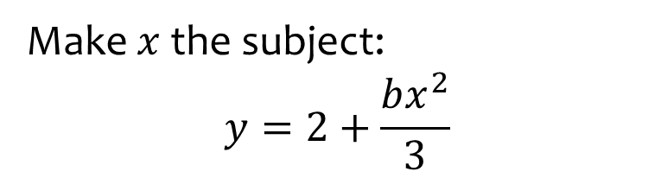

Worked example
Your turn
Make $x$ the subject:
$$y=3+\frac{ax^{2}}{5}$$
Make $x$ the subject:
$$y=2+\frac{bx^{2}}{3}$$
$$x=±\sqrt{\frac{3\left(y−2\right)}{b}}$$

Slide 30
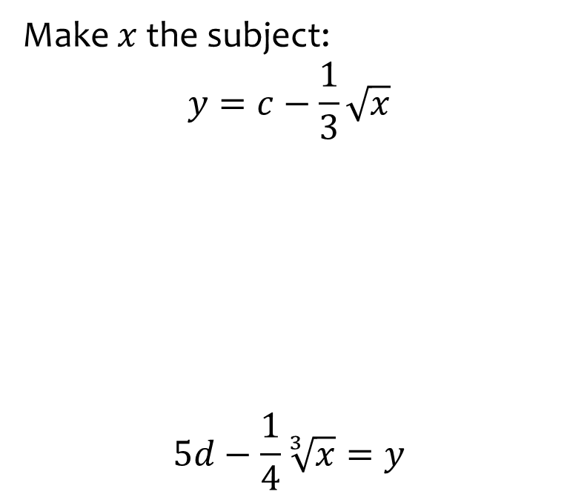
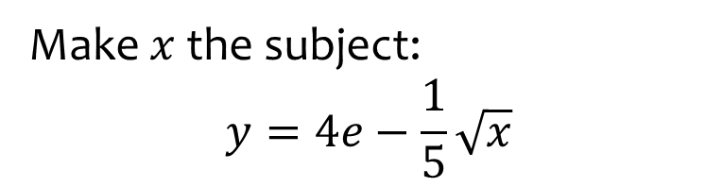

Worked example
Your turn
Make $x$ the subject:
$$y=c−\frac{1}{3}\sqrt{x}$$
$$5d−\frac{1}{4}\sqrt[3]{x}=y$$
Make $x$ the subject:
$$y=4e−\frac{1}{5}\sqrt{x}$$
$$x=25{\left(4e−y\right)}^{2}$$

Slide 31
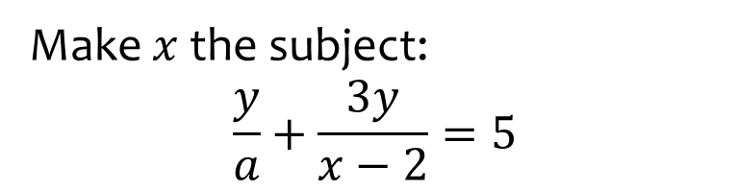
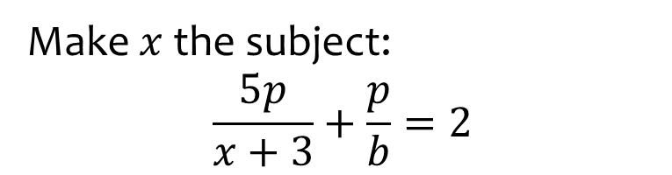

Worked example
Your turn
Make $x$ the subject:
$$\frac{y}{a}+\frac{3y}{x−2}=5$$
Make $x$ the subject:
$$\frac{5p}{x+3}+\frac{p}{b}=2$$
$$x=\frac{5bp+3p−6b}{2b−p}$$

Slide 32
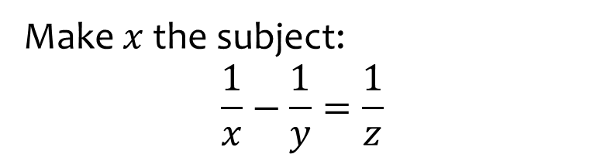
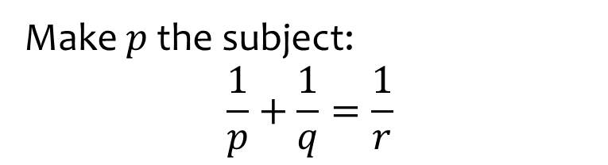

Worked example
Your turn
Make $x$ the subject:
$$\frac{1}{x}−\frac{1}{y}=\frac{1}{z}$$
Make $p$ the subject:
$$\frac{1}{p}+\frac{1}{q}=\frac{1}{r}$$
$$p=\frac{rq}{q−r}$$

Slide 33
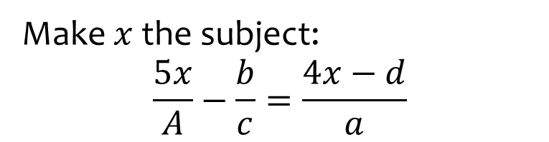


Worked example
Your turn
Make $x$ the subject:
$$\frac{5x}{A}−\frac{b}{c}=\frac{4x−d}{a}$$
Make $p$ the subject:
$$\frac{3x}{E}−\frac{f}{g}=\frac{5x−h}{F}$$
$$x=\frac{EfF−Egh}{3fg−5eg}$$

Slide 34



Worked example
Your turn
Make $x$ the subject:
$$y=x^{2}+6x−2$$
$$y=x^{2}−5x+1$$
Make $x$ the subject:
$$y=x^{2}+8x−3$$
$$x=−4±\sqrt{y+19}$$

Slide 35



Worked example
Your turn
Make $x$ the subject:
$$y={2x}^{2}+16x−2$$
$$y={3x}^{2}−5x+1$$
Make $x$ the subject:
$$y={2x}^{2}+12x−3$$
$$x=−3±\sqrt{\frac{y+21}{2}}$$

Slide 36



Worked example
Your turn
Make $x$ the subject:
$$y=\frac{1}{2}πc^{3}\sqrt{x^{2}−c^{4}}+5$$
Make $x$ the subject:
$$y=\frac{1}{3}kc^{2}\sqrt[3]{x^{2}−c^{5}}−4$$
$$x=±\sqrt{\frac{27{\left(y+4\right)}^{3}}{k^{3}c^{6}}+c^{5}}$$

