Slide 1
ALGEBRAIC FRACTIONS
CONTENTS

Slide 2
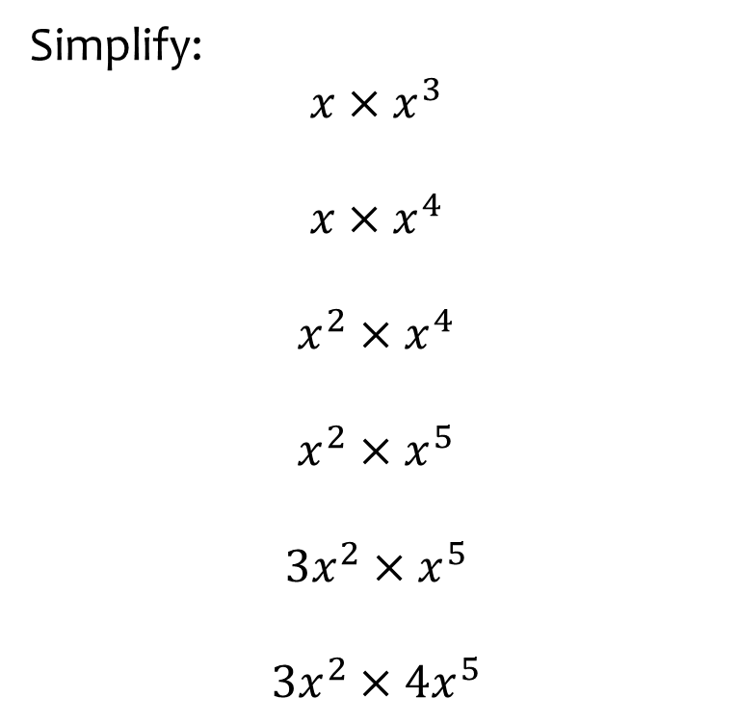


Worked example
Your turn
Simplify:
$$x×x^{3}$$
$$x×x^{4}$$
$$x^{2}×x^{4}$$
$$x^{2}×x^{5}$$
$$3x^{2}×x^{5}$$
$$3x^{2}×4x^{5}$$
Simplify:
$$2x^{3}×5x^{4}$$
$$10x^{7}$$

Slide 3
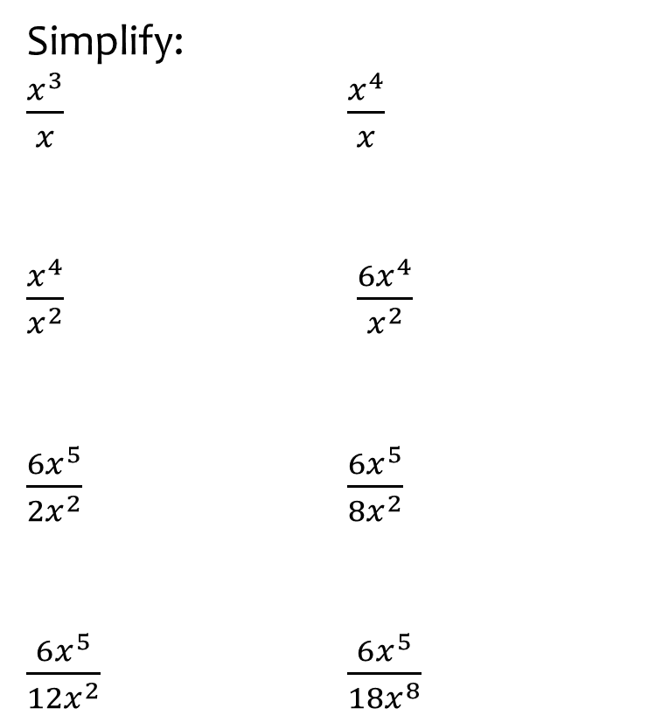
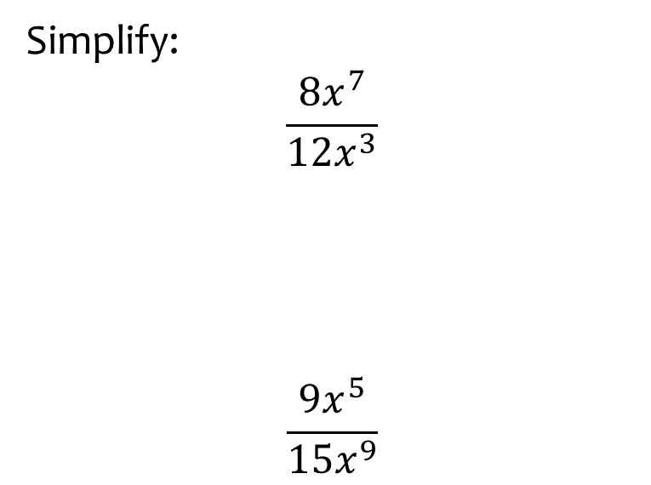
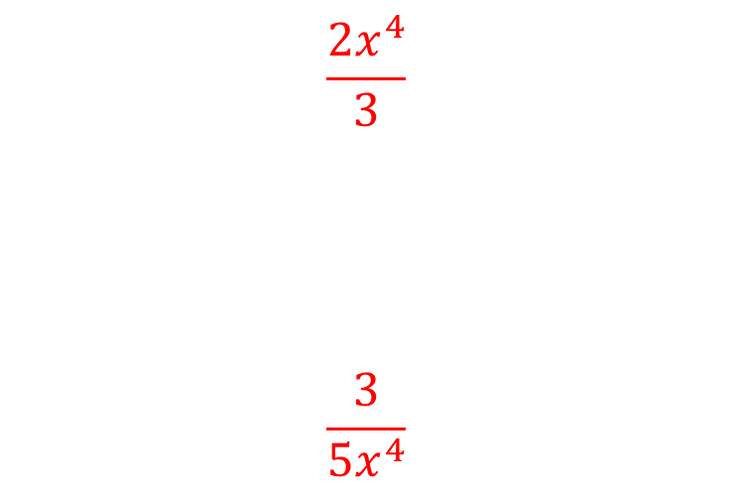
Worked example
Your turn
Simplify:
$\frac{x^{3}}{x}$ $\frac{x^{4}}{x}$
$\frac{x^{4}}{x^{2}}$ $\frac{6x^{4}}{x^{2}}$
$\frac{6x^{5}}{2x^{2}}$ $\frac{6x^{5}}{8x^{2}}$
$\frac{6x^{5}}{12x^{2}}$ $\frac{6x^{5}}{18x^{8}}$
Simplify:
$$\frac{8x^{7}}{12x^{3}}$$
$$\frac{9x^{5}}{15x^{9}}$$
$$\frac{2x^{4}}{3}$$
$$\frac{3}{5x^{4}}$$

Slide 4
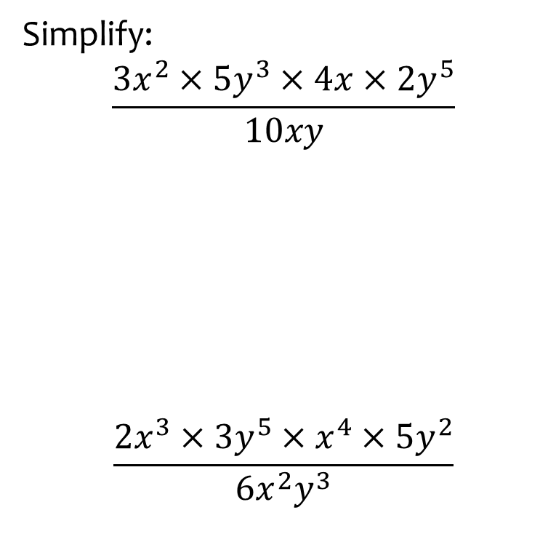
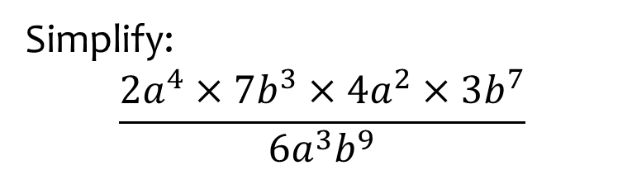

Worked example
Your turn
Simplify:
$$\frac{3x^{2}×5y^{3}×4x×2y^{5}}{10xy}$$
$$\frac{2x^{3}×3y^{5}×x^{4}×5y^{2}}{6x^{2}y^{3}}$$
Simplify:
$$\frac{2a^{4}×7b^{3}×4a^{2}×3b^{7}}{6a^{3}b^{9}}$$
$$28a^{3}b$$

Slide 5
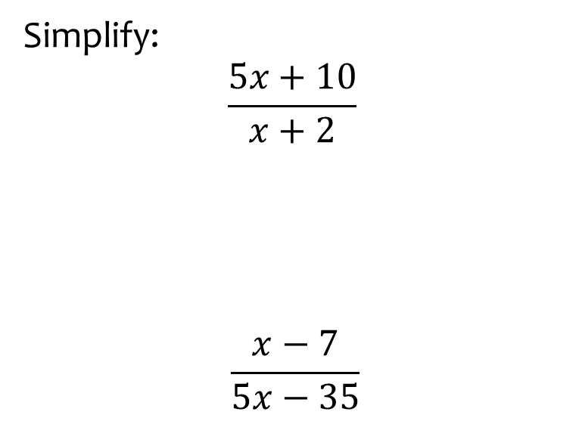
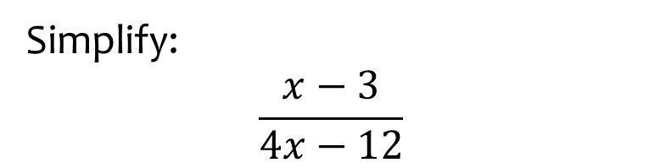

Worked example
Your turn
Simplify:
$$\frac{5x+10}{x+2}$$
$$\frac{x−7}{5x−35}$$
Simplify:
$$\frac{x−3}{4x−12}$$
$$\frac{1}{4}$$

Slide 6
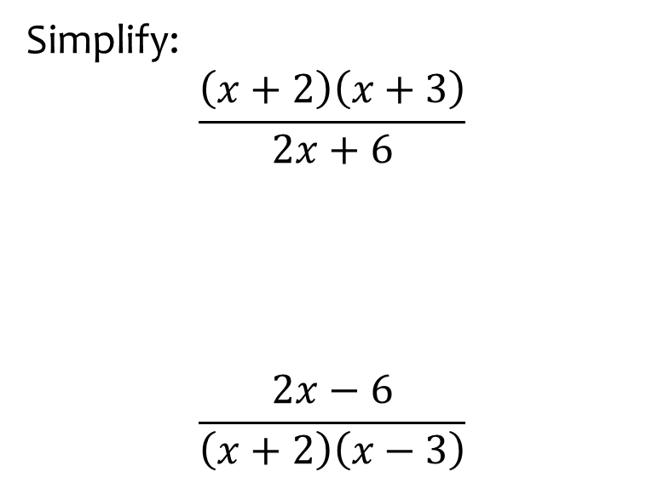


Worked example
Your turn
Simplify:
$$\frac{\left(x+2\right)\left(x+3\right)}{2x+6}$$
$$\frac{2x−6}{\left(x+2\right)\left(x−3\right)}$$
Simplify:
$$\frac{\left(x+3\right)\left(x−4\right)}{2x−8}$$
$$\frac{x+3}{2}$$

Slide 7
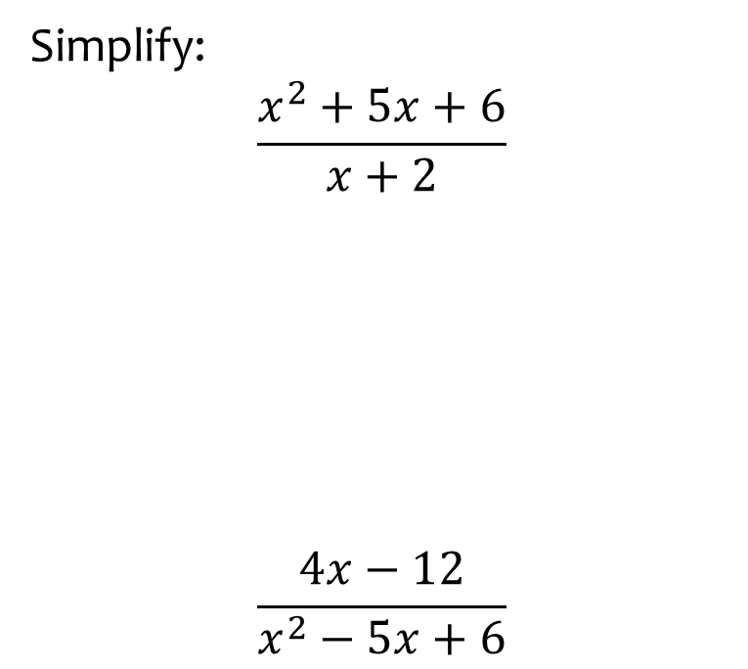
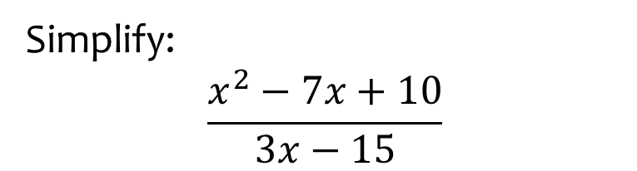

Worked example
Your turn
Simplify:
$$\frac{x^{2}+5x+6}{x+2}$$
$$\frac{4x−12}{x^{2}−5x+6}$$
Simplify:
$$\frac{x^{2}−7x+10}{3x−15}$$
$$\frac{x−2}{3}$$

Slide 8
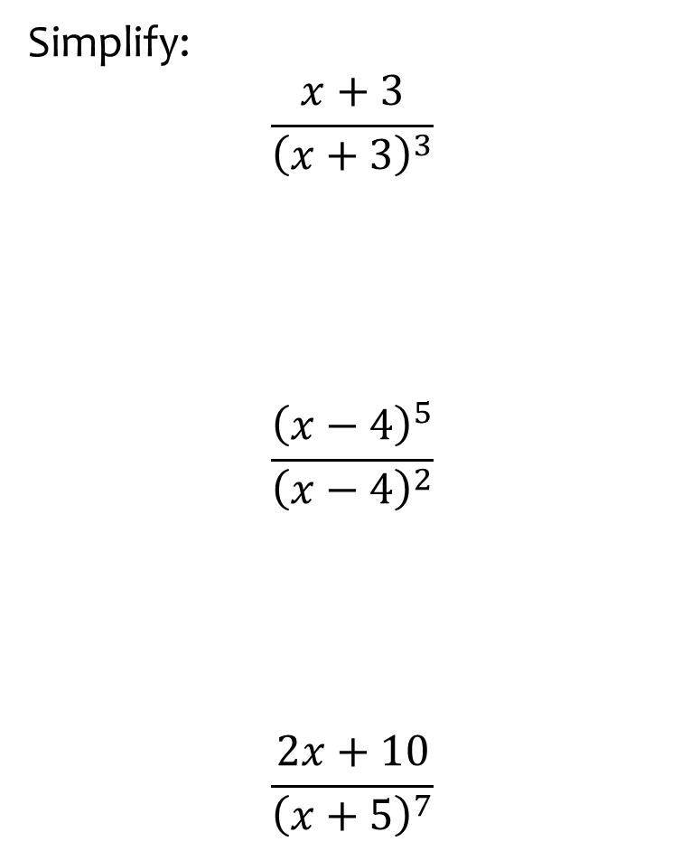
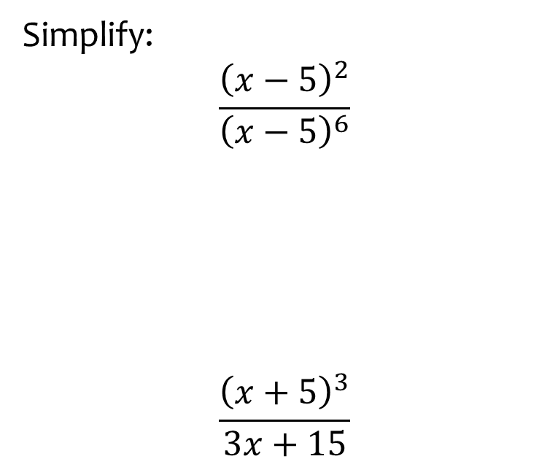
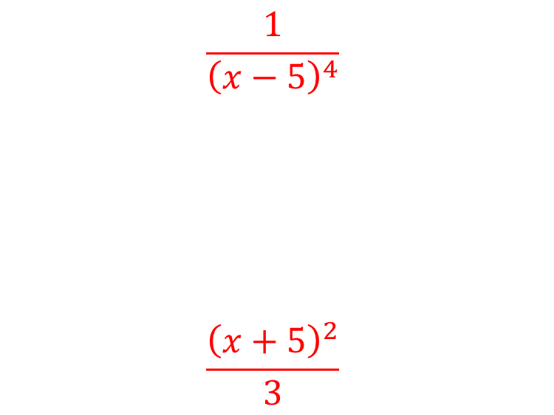
Worked example
Your turn
Simplify:
$$\frac{x+3}{{\left(x+3\right)}^{3}}$$
$$\frac{{\left(x−4\right)}^{5}}{{\left(x−4\right)}^{2}}$$
$$\frac{2x+10}{{\left(x+5\right)}^{7}}$$
Simplify:
$$\frac{{\left(x−5\right)}^{2}}{{\left(x−5\right)}^{6}}$$
$$\frac{{\left(x+5\right)}^{3}}{3x+15}$$
$$\frac{1}{{\left(x−5\right)}^{4}}$$
$$\frac{{\left(x+5\right)}^{2}}{3}$$

Slide 9
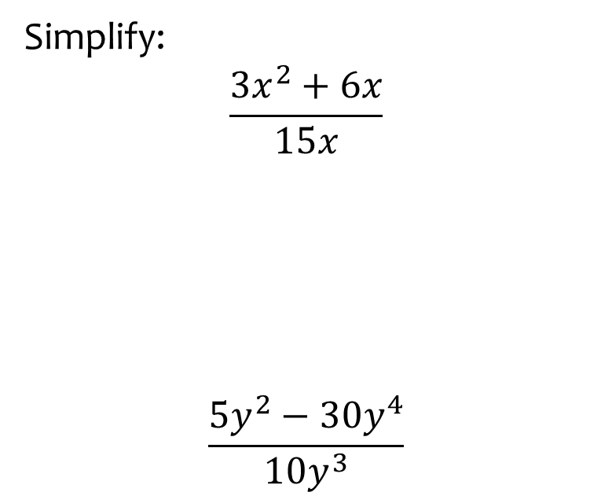
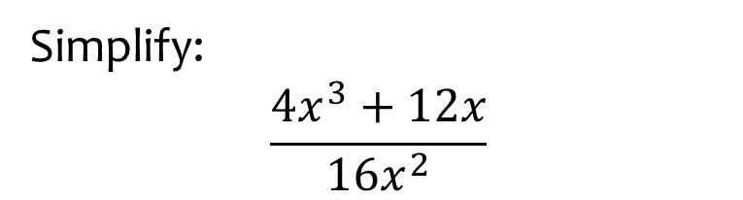

Worked example
Your turn
Simplify:
$$\frac{{3x}^{2}+6x}{15x}$$
$$\frac{5y^{2}−30y^{4}}{10y^{3}}$$
Simplify:
$$\frac{4x^{3}+12x}{16x^{2}}$$
$$\frac{x^{2}+3}{4x}$$

Slide 10
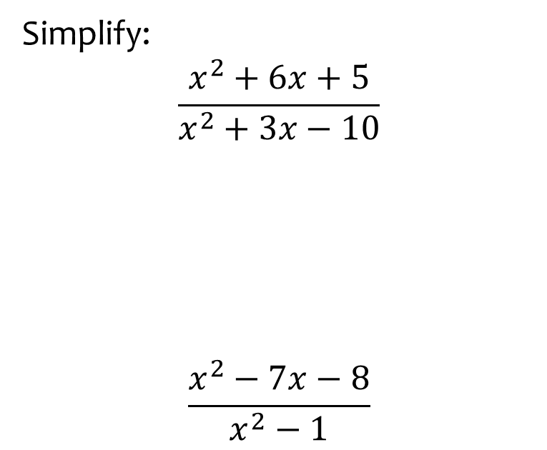
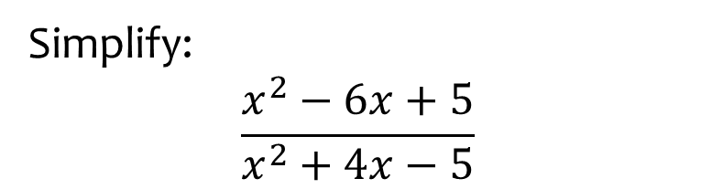

Worked example
Your turn
Simplify:
$$\frac{x^{2}+6x+5}{x^{2}+3x−10}$$
$$\frac{x^{2}−7x−8}{x^{2}−1}$$
Simplify:
$$\frac{x^{2}−6x+5}{x^{2}+4x−5}$$
$$\frac{x−5}{x+5}$$

Slide 11
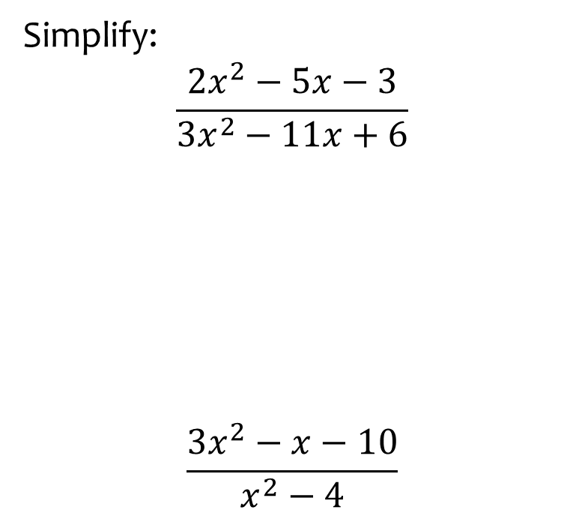
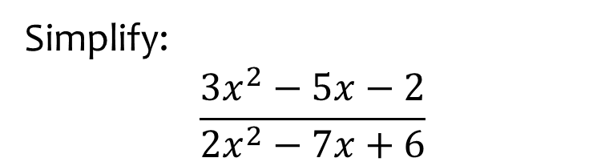

Worked example
Your turn
Simplify:
$$\frac{2x^{2}−5x−3}{3x^{2}−11x+6}$$
$$\frac{3x^{2}−x−10}{x^{2}−4}$$
Simplify:
$$\frac{3x^{2}−5x−2}{2x^{2}−7x+6}$$
$$\frac{3x+1}{2x−3}$$

Slide 12
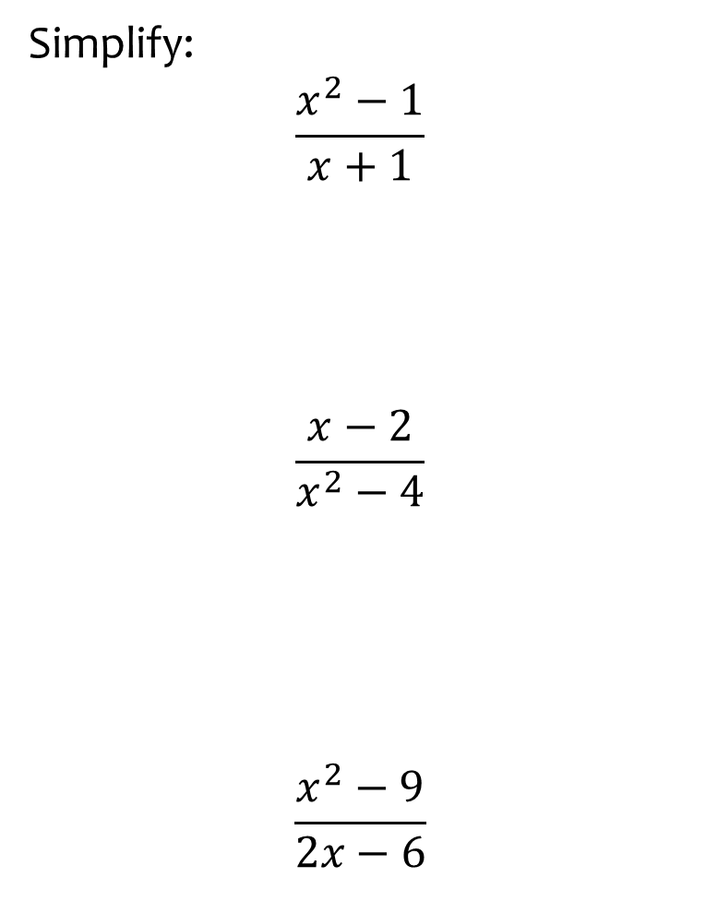
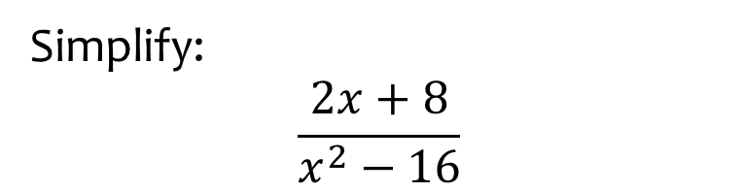

Worked example
Your turn
Simplify:
$$\frac{x^{2}−1}{x+1}$$
$$\frac{x−2}{x^{2}−4}$$
$$\frac{x^{2}−9}{2x−6}$$
Simplify:
$$\frac{2x+8}{x^{2}−16}$$
$$\frac{2}{x−4}$$

Slide 13
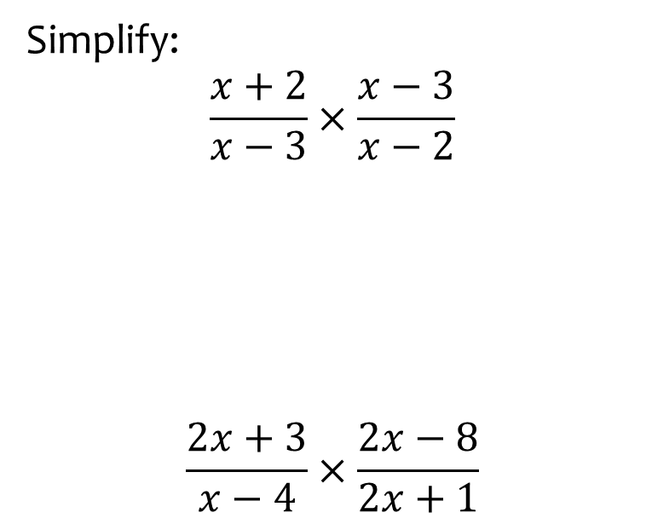
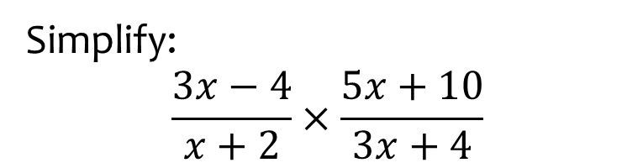

Worked example
Your turn
Simplify:
$$\frac{x+2}{x−3}×\frac{x−3}{x−2}$$
$$\frac{2x+3}{x−4}×\frac{2x−8}{2x+1}$$
Simplify:
$$\frac{3x−4}{x+2}×\frac{5x+10}{3x+4}$$
$$\frac{5\left(3x−4\right)}{3x+4}$$

Slide 14
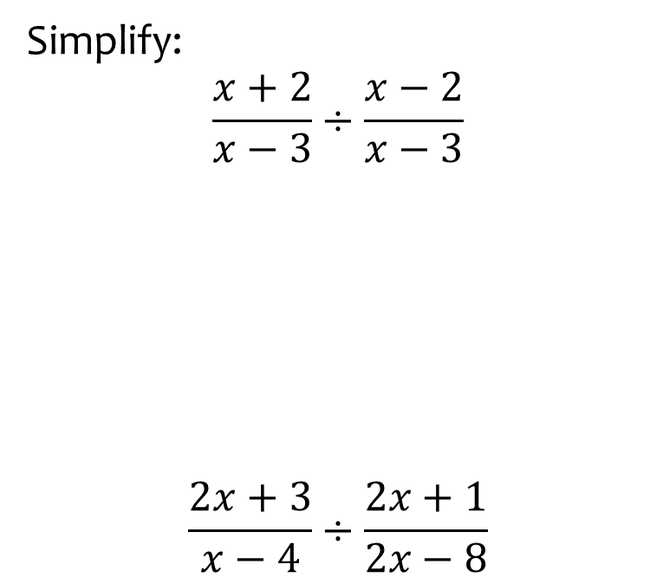
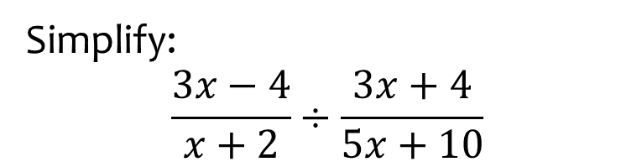

Worked example
Your turn
Simplify:
$$\frac{x+2}{x−3}÷\frac{x−2}{x−3}$$
$$\frac{2x+3}{x−4}÷\frac{2x+1}{2x−8}$$
Simplify:
$$\frac{3x−4}{x+2}÷\frac{3x+4}{5x+10}$$
$$\frac{5\left(3x−4\right)}{3x+4}$$

Slide 15
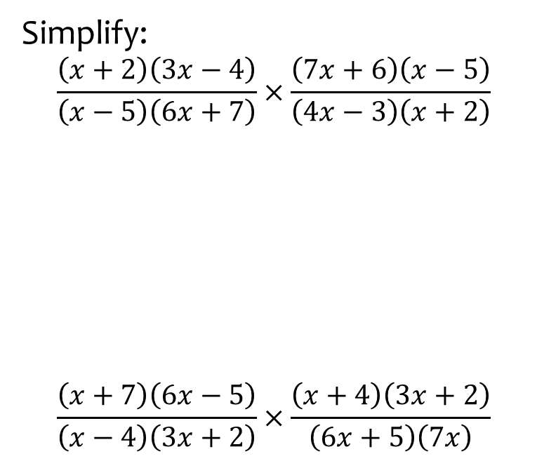
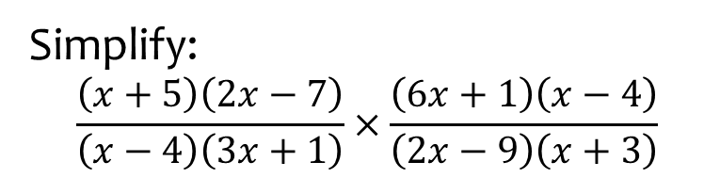
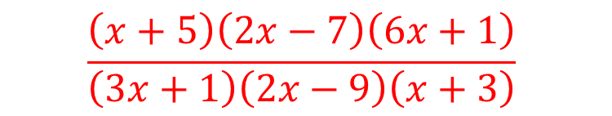
Worked example
Your turn
Simplify:
$$\frac{\left(x+2\right)\left(3x−4\right)}{\left(x−5\right)\left(6x+7\right)}×\frac{\left(7x+6\right)\left(x−5\right)}{\left(4x−3\right)\left(x+2\right)}$$
$$\frac{\left(x+7\right)\left(6x−5\right)}{\left(x−4\right)\left(3x+2\right)}×\frac{\left(x+4\right)\left(3x+2\right)}{\left(6x+5\right)\left(7x\right)}$$
Simplify:
$$\frac{\left(x+5\right)\left(2x−7\right)}{\left(x−4\right)\left(3x+1\right)}×\frac{\left(6x+1\right)\left(x−4\right)}{\left(2x−9\right)\left(x+3\right)}$$
$$\frac{\left(x+5\right)\left(2x−7\right)\left(6x+1\right)}{\left(3x+1\right)\left(2x−9\right)\left(x+3\right)}$$

Slide 16
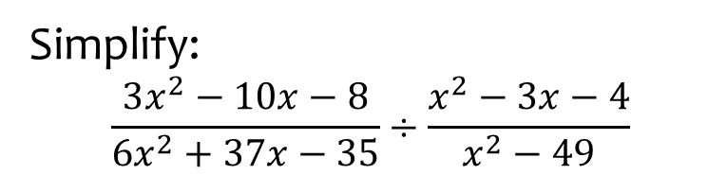
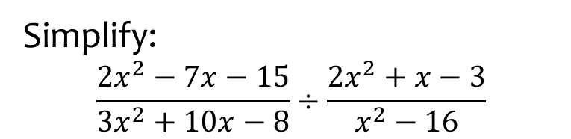

Worked example
Your turn
Simplify:
$$\frac{3x^{2}−10x−8}{6x^{2}+37x−35}÷\frac{x^{2}−3x−4}{x^{2}−49}$$
Simplify:
$$\frac{2x^{2}−7x−15}{3x^{2}+10x−8}÷\frac{2x^{2}+x−3}{x^{2}−16}$$
$$\frac{\left(x−5\right)\left(x−4\right)}{\left(3x−2\right)\left(x−1\right)}$$

Slide 17
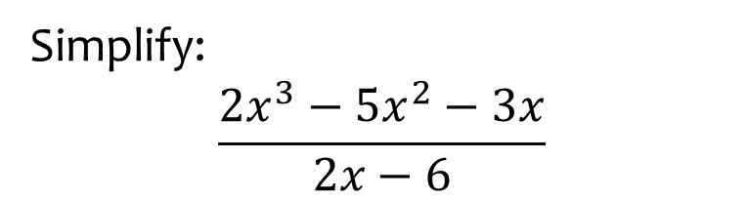
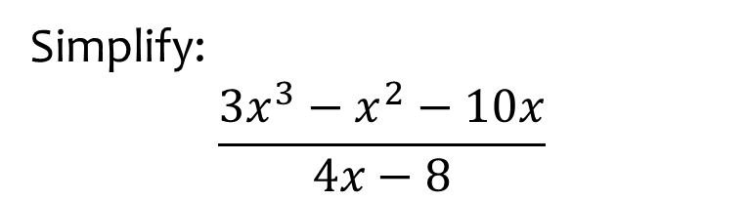

Worked example
Your turn
Simplify:
$$\frac{{2x}^{3}−5x^{2}−3x}{2x−6}$$
Simplify:
$$\frac{3x^{3}−x^{2}−10x}{4x−8}$$
$$\frac{x\left(3x+5\right)}{4}$$

Slide 18
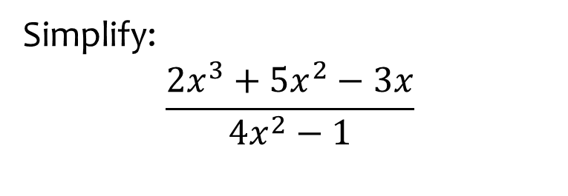
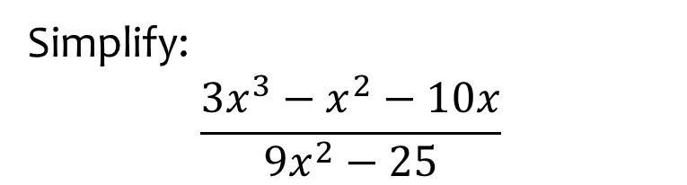

Worked example
Your turn
Simplify:
$$\frac{2x^{3}+5x^{2}−3x}{4x^{2}−1}$$
Simplify:
$$\frac{3x^{3}−x^{2}−10x}{9x^{2}−25}$$
$$\frac{x\left(x−2\right)}{3x−5}$$

Slide 19
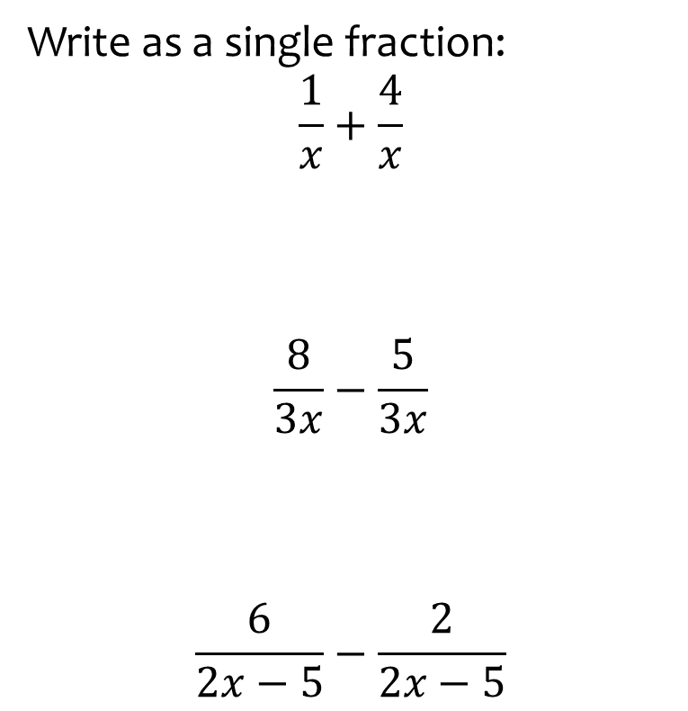


Worked example
Your turn
Write as a single fraction:
$$\frac{1}{x}+\frac{4}{x}$$
$$\frac{8}{3x}−\frac{5}{3x}$$
$$\frac{6}{2x−5}−\frac{2}{2x−5}$$
Simplify:
$$\frac{7}{3x−4}+\frac{9}{3x−4}$$
$$\frac{16}{3x−4}$$

Slide 20
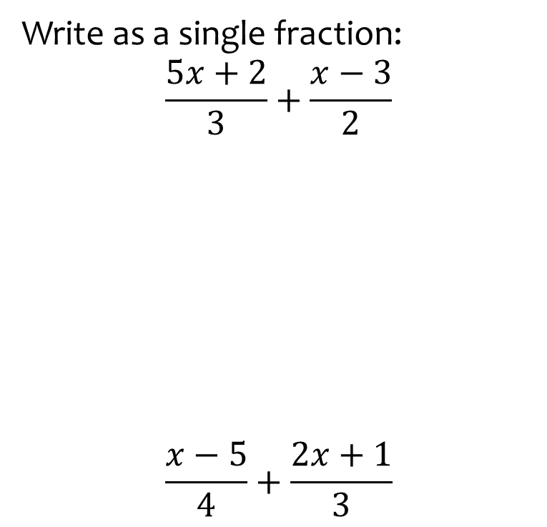
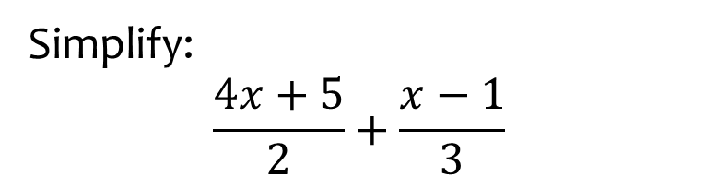

Worked example
Your turn
Write as a single fraction:
$$\frac{5x+2}{3}+\frac{x−3}{2}$$
$$\frac{x−5}{4}+\frac{2x+1}{3}$$
Simplify:
$$\frac{4x+5}{2}+\frac{x−1}{3}$$
$$\frac{14x+13}{6}$$

Slide 21
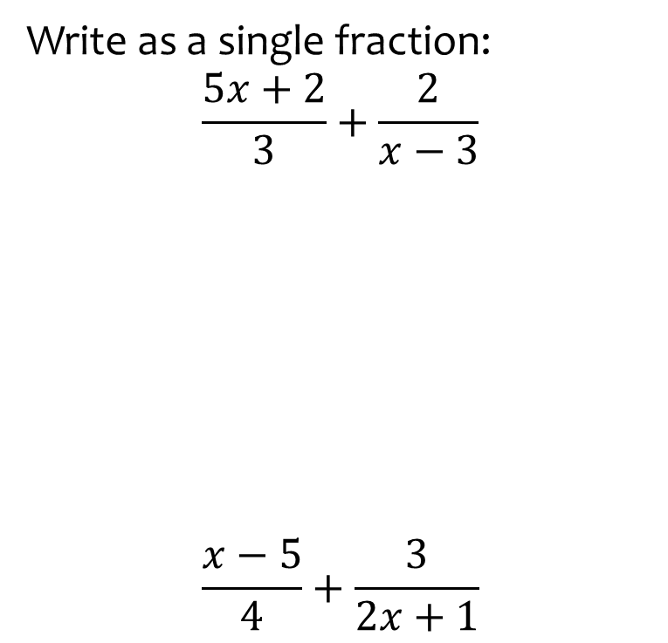
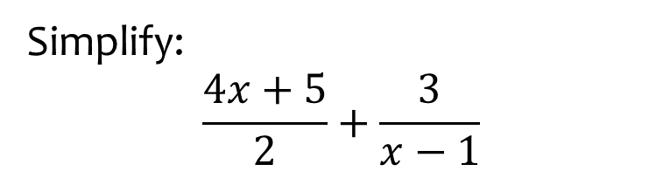

Worked example
Your turn
Write as a single fraction:
$$\frac{5x+2}{3}+\frac{2}{x−3}$$
$$\frac{x−5}{4}+\frac{3}{2x+1}$$
Simplify:
$$\frac{4x+5}{2}+\frac{3}{x−1}$$
$$\frac{4x^{2}+x+1}{2\left(x−1\right)}$$

Slide 22
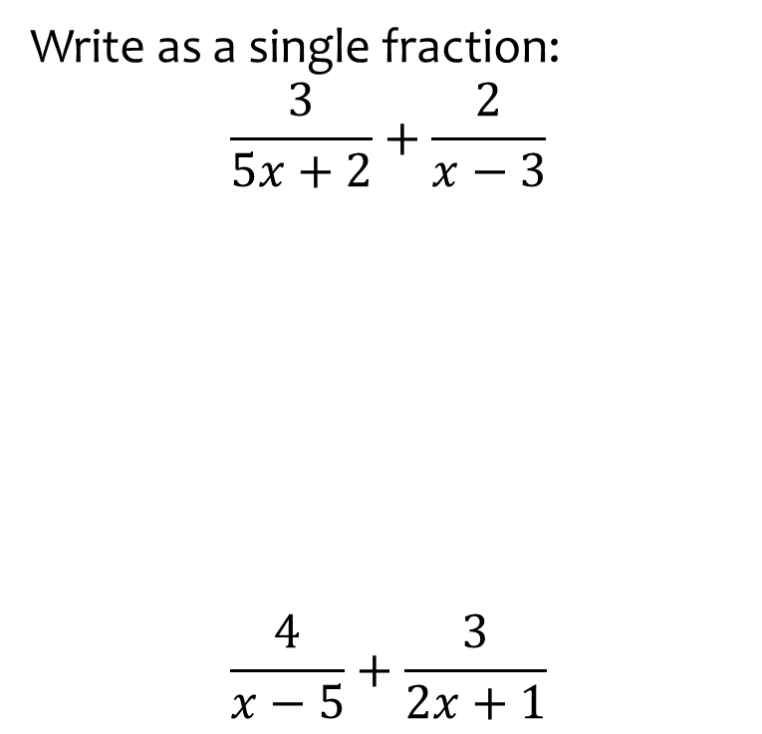
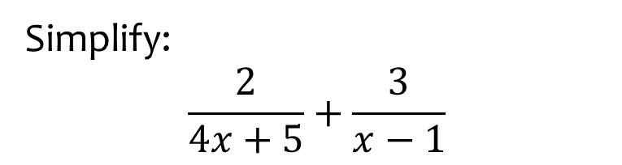

Worked example
Your turn
Write as a single fraction:
$$\frac{3}{5x+2}+\frac{2}{x−3}$$
$$\frac{4}{x−5}+\frac{3}{2x+1}$$
Simplify:
$$\frac{2}{4x+5}+\frac{3}{x−1}$$
$$\frac{10x+13}{\left(4x+5\right)\left(x−1\right)}$$

Slide 23
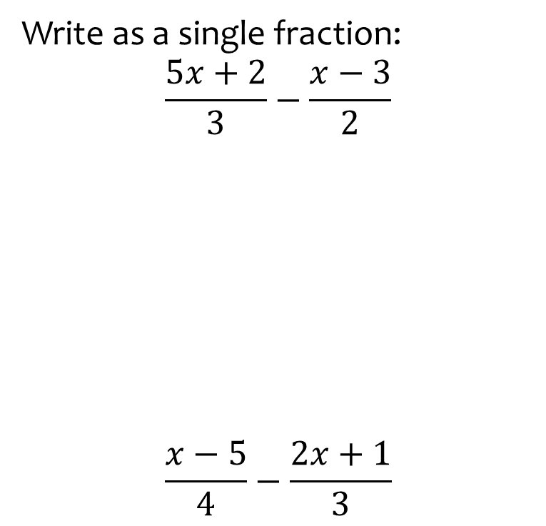
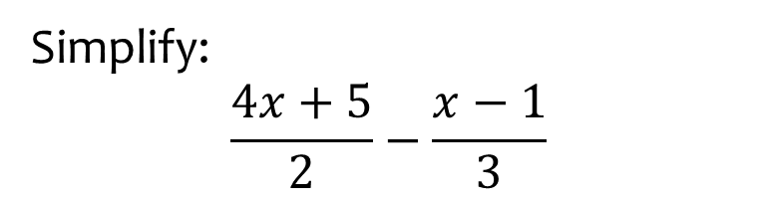

Worked example
Your turn
Write as a single fraction:
$$\frac{5x+2}{3}−\frac{x−3}{2}$$
$$\frac{x−5}{4}−\frac{2x+1}{3}$$
Simplify:
$$\frac{4x+5}{2}−\frac{x−1}{3}$$
$$\frac{10x+17}{6}$$

Slide 24
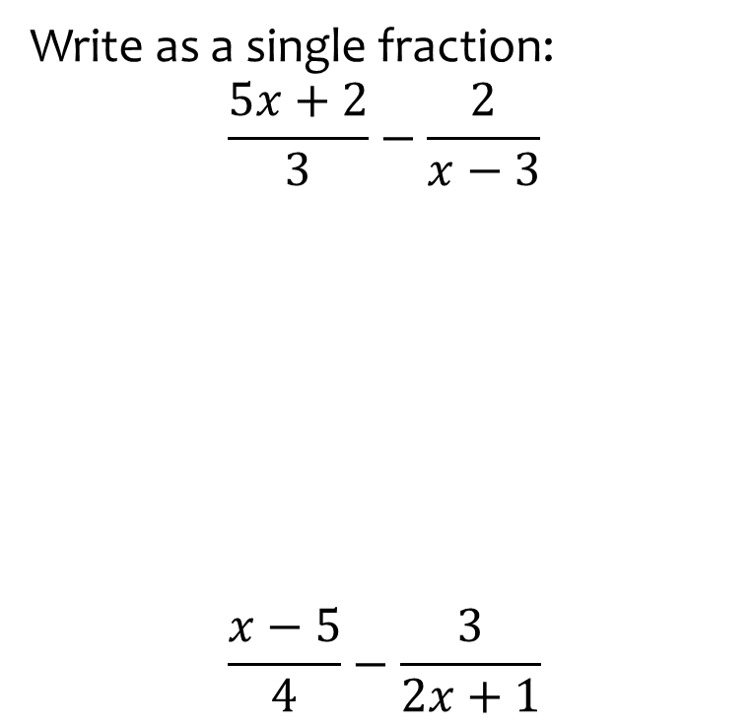
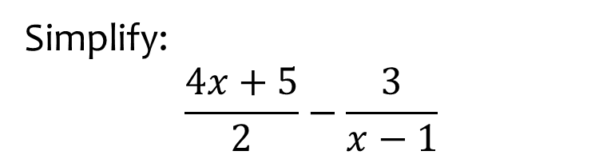

Worked example
Your turn
Write as a single fraction:
$$\frac{5x+2}{3}−\frac{2}{x−3}$$
$$\frac{x−5}{4}−\frac{3}{2x+1}$$
Simplify:
$$\frac{4x+5}{2}−\frac{3}{x−1}$$
$$\frac{4x^{2}+x−11}{2\left(x−1\right)}$$

Slide 25
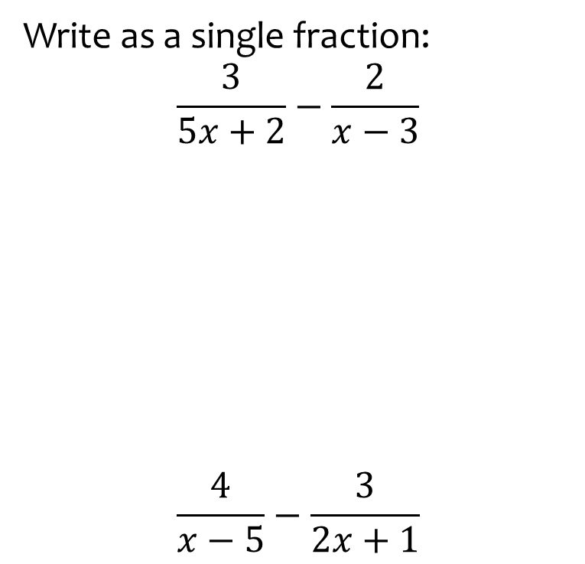
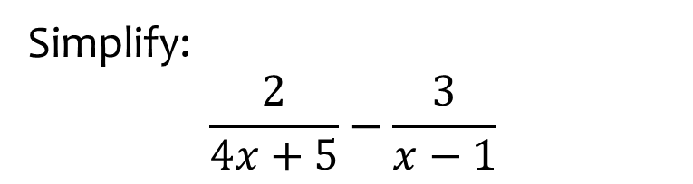

Worked example
Your turn
Write as a single fraction:
$$\frac{3}{5x+2}−\frac{2}{x−3}$$
$$\frac{4}{x−5}−\frac{3}{2x+1}$$
Simplify:
$$\frac{2}{4x+5}−\frac{3}{x−1}$$
$$\frac{−10x−17}{\left(4x+5\right)\left(x−1\right)}$$

Slide 26
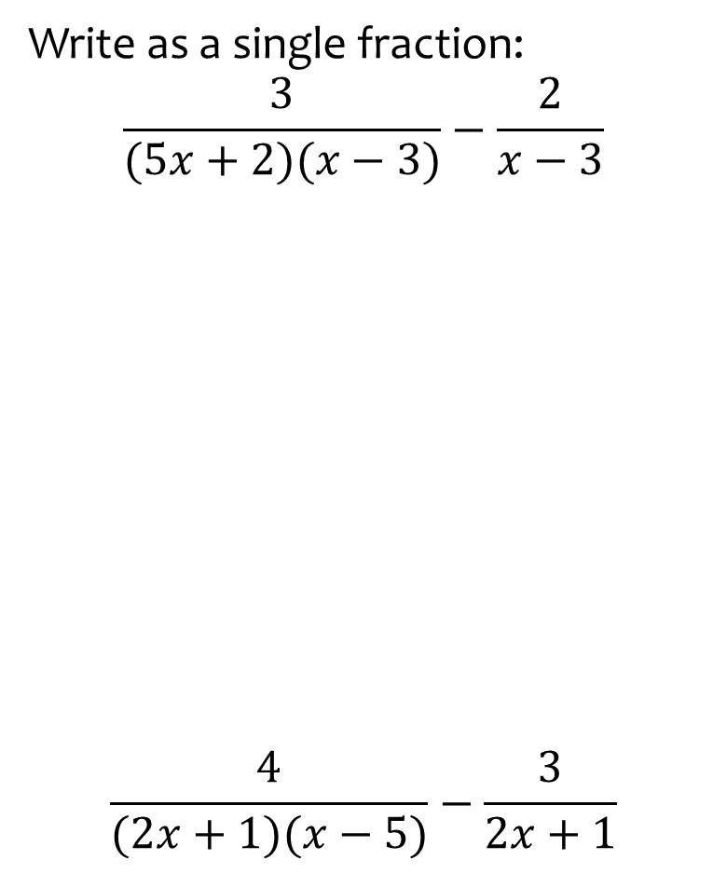
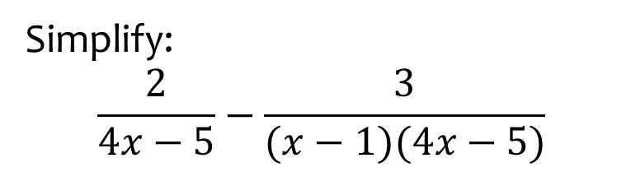

Worked example
Your turn
Write as a single fraction:
$$\frac{3}{(5x+2)(x−3)}−\frac{2}{x−3}$$
$$\frac{4}{(2x+1)(x−5)}−\frac{3}{2x+1}$$
Simplify:
$$\frac{2}{4x−5}−\frac{3}{(x−1)(4x−5)}$$
$$\frac{2x−5}{\left(x−1\right)\left(4x−5\right)}$$

Slide 27



Worked example
Your turn
Write as a single fraction:
$$3+\frac{5}{2x−1}$$
$$2−\frac{3}{5x+4}$$
Write as a single fraction:
$$5−\frac{3}{x+2}$$
$$\frac{5x+7}{x+2}$$

Slide 28



Worked example
Your turn
Write as a single fraction:
$$3−(x−4)÷\frac{x^{2}−16}{x−5}$$
Write as a single simplified fraction:
$$5−(x−2)÷\frac{x^{2}−4}{x+3}$$
$$\frac{4x−13}{x−2}$$

Slide 29



Worked example
Your turn
Write in the form $1+\frac{a}{x+b}$:
$$\frac{x+3}{x−5}$$
$$\frac{x−2}{x+7}$$
Write in the form $1+\frac{a}{x+b}$:
$$\frac{x−5}{x+2}$$
$$1−\frac{7}{x+2}$$

Slide 30



Worked example
Your turn
Simplify:
$$\frac{\frac{3}{x}+2}{1+\frac{5}{x}}$$
$$\frac{\frac{3}{2x}−2}{1−\frac{5}{2x}}$$
Simplify:
$$\frac{\frac{5}{3x}+3}{7+\frac{2}{3x}}$$
$$\frac{9x+5}{21x+2}$$

Slide 31



Worked example
Your turn
Solve:
$$\frac{2x−3}{4}=\frac{5x+6}{7}$$
Solve:
$$\frac{7x−6}{5}=\frac{4x+3}{2}$$
$$x=−\frac{9}{2}$$

Slide 32



Worked example
Your turn
Solve:
$$\frac{7x}{2}+\frac{3x}{5}=4$$
Solve:
$$\frac{2x}{3}+\frac{3x}{4}=5$$
$$x=\frac{60}{17}$$

Slide 33



Worked example
Your turn
Solve:
$$\frac{7x}{2}−\frac{3x}{5}=4$$
Solve:
$$\frac{2x}{3}−\frac{3x}{4}=5$$
$$x=−60$$

Slide 34



Worked example
Your turn
Solve:
$$\frac{1}{x}+\frac{1}{2x}=3$$
$$\frac{2}{x}−\frac{1}{4x}=14$$
Solve:
$$\frac{5}{6x}−\frac{1}{3x}=8$$
$$x=\frac{3}{48}$$

Slide 35



Worked example
Your turn
Solve:
$$\frac{x+3}{2}+\frac{x+4}{5}=6$$
Solve:
$$\frac{x+5}{3}+\frac{x+6}{4}=2$$
$$x=−2$$

Slide 36



Worked example
Your turn
Solve:
$$\frac{x+3}{2}−\frac{x+4}{5}=6$$
Solve:
$$\frac{x+5}{3}−\frac{x+6}{4}=2$$
$$x=\frac{22}{7}$$

Slide 37



Worked example
Your turn
Solve:
$$\frac{7x+3}{2}−\frac{3x+4}{5}=6$$
Solve:
$$\frac{6x+5}{3}−\frac{3x+6}{4}=2$$
$$x=\frac{22}{15}$$

Slide 38



Worked example
Your turn
Solve:
$$\frac{x+3}{2}+\frac{5}{x+4}=6$$
Solve:
$$\frac{x+5}{3}+\frac{4}{x+6}=2$$
$$x=−3, x=−2$$

Slide 39



Worked example
Your turn
Solve:
$$\frac{x+3}{2}−\frac{5}{x+4}=6$$
Solve:
$$\frac{x+5}{3}−\frac{4}{x+6}=2$$
$$x=\frac{−5−\sqrt{97}}{2}, x=\frac{−5+\sqrt{97}}{2}$$

Slide 40



Worked example
Your turn
Solve:
$$\frac{7x+3}{2}−\frac{5}{3x+4}=6$$
Solve:
$$\frac{2x+5}{3}−\frac{4}{3x+6}=2$$
$$x=\frac{−3−\sqrt{57}}{4}, x=\frac{−3+\sqrt{57}}{4}$$

Slide 41



Worked example
Your turn
Solve:
$$\frac{x+3}{x+4}+\frac{2}{x+5}=7$$
Solve:
$$\frac{x+5}{x+3}+\frac{4}{x+2}=6$$
$$x=−\frac{14}{5}, x=−1$$

Slide 42



Worked example
Your turn
Solve:
$$\frac{x+3}{x+4}−\frac{2}{x+5}=7$$
Solve:
$$\frac{x+5}{x+4}−\frac{6}{x+3}=2$$
$$x=−6−\sqrt{3}, x=−6+\sqrt{3}$$

Slide 43



Worked example
Your turn
Solve:
$$\frac{2}{x+3}+\frac{5}{x+4}=6$$
Solve:
$$\frac{2}{x+4}+\frac{6}{x+5}=3$$
$$x=−\frac{13}{3}, x=−2$$

