Slide 1
Andy’s SSDD Questions
Easter Edition
Inspired by Craig Barton’s SSDD Questions, website below:
https://ssddproblems.com/

Slide 2
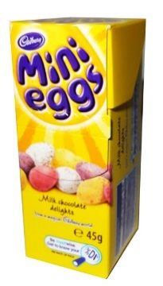
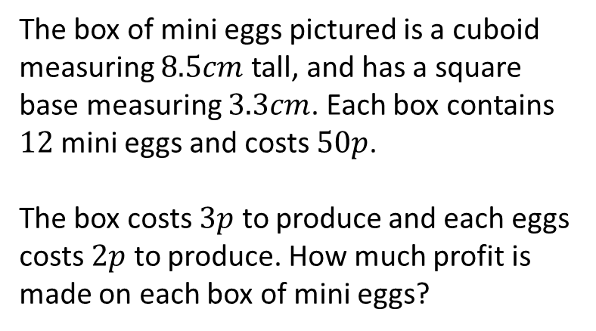
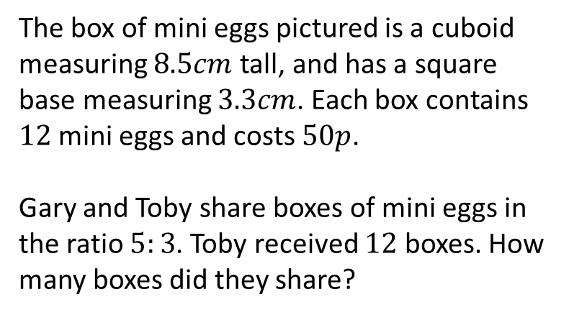
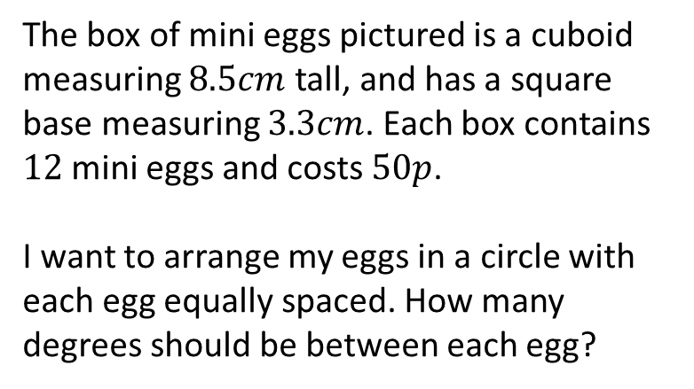
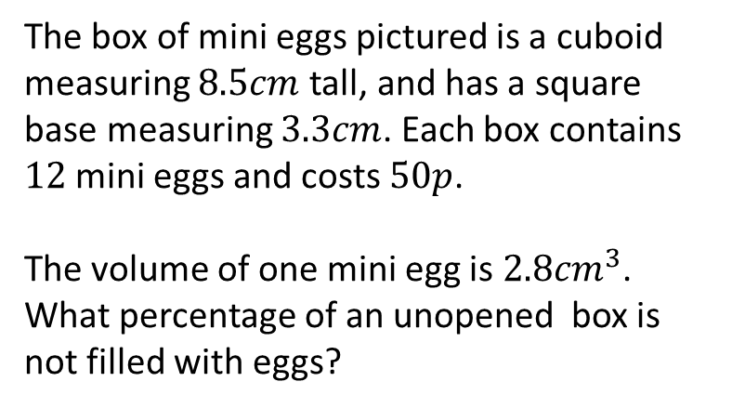
The box of mini eggs pictured is a cuboid measuring $8.5cm$ tall, and has a square base measuring $3.3cm$. Each box contains $12$ mini eggs and costs $50p$.
The box costs $3p$ to produce and each eggs costs $2p$ to produce. How much profit is made on each box of mini eggs?
The box of mini eggs pictured is a cuboid measuring $8.5cm$ tall, and has a square base measuring $3.3cm$. Each box contains $12$ mini eggs and costs $50p$.
Gary and Toby share boxes of mini eggs in the ratio $5:3$. Toby received $12$ boxes. How many boxes did they share?
The box of mini eggs pictured is a cuboid measuring $8.5cm$ tall, and has a square base measuring $3.3cm$. Each box contains $12$ mini eggs and costs $50p$.
I want to arrange my eggs in a circle with each egg equally spaced. How many degrees should be between each egg?
The box of mini eggs pictured is a cuboid measuring $8.5cm$ tall, and has a square base measuring $3.3cm$. Each box contains $12$ mini eggs and costs $50p$.
The volume of one mini egg is $2.8{cm}^{3}$. What percentage of an unopened box is not filled with eggs?

Slide 3




The box of mini eggs pictured is a cuboid measuring $8.5cm$ tall, and has a square base measuring $3.3cm$. Each box contains $12$ mini eggs and costs $50p$.
The box costs $3p$ to produce and each eggs costs $2p$ to produce. How much profit is made on each box of mini eggs?
The box of mini eggs pictured is a cuboid measuring $8.5cm$ tall, and has a square base measuring $3.3cm$. Each box contains $12$ mini eggs and costs $50p$.
Gary and Toby share boxes of mini eggs in the ratio $5:3$. Toby received $12$ boxes. How many boxes did they share?
$$23p$$
$$32$$
The box of mini eggs pictured is a cuboid measuring $8.5cm$ tall, and has a square base measuring $3.3cm$. Each box contains $12$ mini eggs and costs $50p$.
I want to arrange my eggs in a circle with each egg equally spaced. How many degrees should be between each egg?
The box of mini eggs pictured is a cuboid measuring $8.5cm$ tall, and has a square base measuring $3.3cm$. Each box contains $12$ mini eggs and costs $50p$.
The volume of one mini egg is $2.8{cm}^{3}$. What percentage of an unopened box is not filled with eggs?
$$30°$$
$$63.7\%$$

