Slide 1
Andy’s SSDD Questions
Easter Edition
Inspired by Craig Barton’s SSDD Questions, website below:
https://ssddproblems.com/

Slide 2
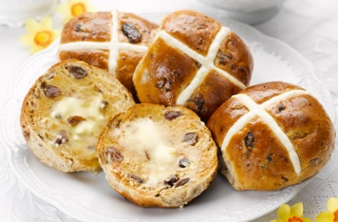
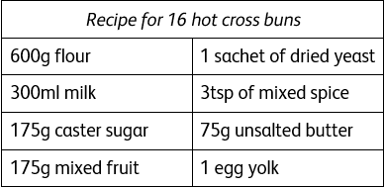
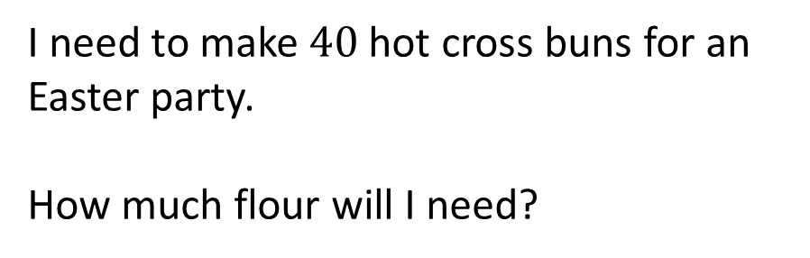
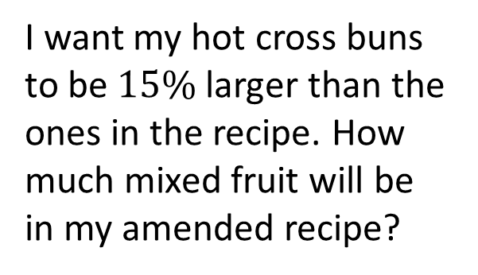
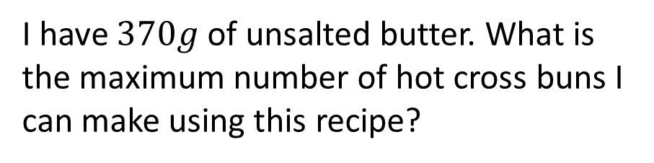
I need to make $40$ hot cross buns for an Easter party.
How much flour will I need?
Write the amount of caster sugar in the recipe as a fraction of the amount of flour.
Give your answer in its simplest form.
I want my hot cross buns to be $15\%$ larger than the ones in the recipe. How much mixed fruit will be in my amended recipe?
I have $370g$ of unsalted butter. What is the maximum number of hot cross buns I can make using this recipe?

Slide 3



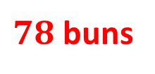
I need to make $40$ hot cross buns for an Easter party.
How much flour will I need?
Write the amount of caster sugar in the recipe as a fraction of the amount of flour.
Give your answer in its simplest form.
$$1500g$$
$$\frac{7}{24}$$
I want my hot cross buns to be $15\%$ larger than the ones in the recipe. How much mixed fruit will be in my amended recipe?
I have $370g$ of unsalted butter. What is the maximum number of hot cross buns I can make using this recipe?
$$201.25g$$
$78$ buns

