Slide 1
Andy’s SSDD Questions
Easter Edition
Inspired by Craig Barton’s SSDD Questions, website below:
https://ssddproblems.com/

Slide 2


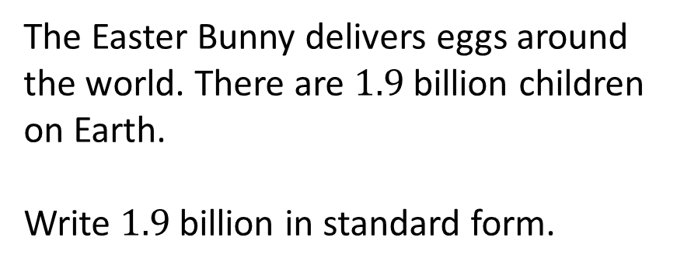
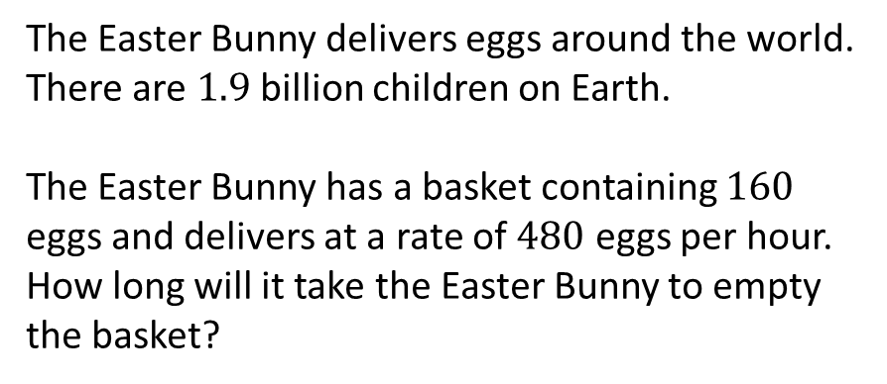
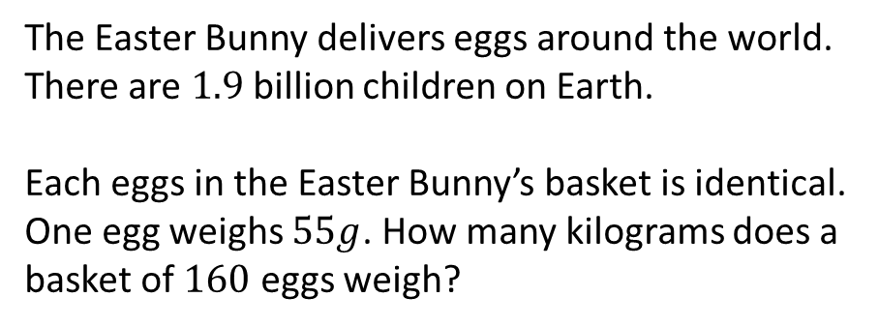
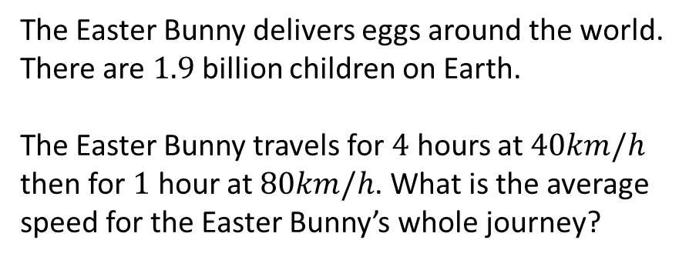
The Easter Bunny delivers eggs around the world. There are $1.9$ billion children on Earth.
Write $1.9$ billion in standard form.
The Easter Bunny delivers eggs around the world. There are $1.9$ billion children on Earth.
The Easter Bunny has a basket containing $160$ eggs and delivers at a rate of $480$ eggs per hour. How long will it take the Easter Bunny to empty the basket?
The Easter Bunny delivers eggs around the world. There are $1.9$ billion children on Earth.
Each eggs in the Easter Bunny’s basket is identical. One egg weighs $55g$. How many kilograms does a basket of $160$ eggs weigh?
The Easter Bunny delivers eggs around the world. There are $1.9$ billion children on Earth.
The Easter Bunny travels for $4$ hours at $40km/h$ then for $1$ hour at $80km/h$. What is the average speed for the Easter Bunny’s whole journey?

Slide 3




The Easter Bunny delivers eggs around the world. There are $1.9$ billion children on Earth.
Write $1.9$ billion in standard form.
The Easter Bunny delivers eggs around the world. There are $1.9$ billion children on Earth.
The Easter Bunny has a basket containing $160$ eggs and delivers at a rate of $480$ eggs per hour. How long will it take the Easter Bunny to empty the basket?
$$1.9×{10}^{9}$$
$20$ minutes
The Easter Bunny delivers eggs around the world. There are $1.9$ billion children on Earth.
Each eggs in the Easter Bunny’s basket is identical. One egg weighs $55g$. How many kilograms does a basket of $160$ eggs weigh?
The Easter Bunny delivers eggs around the world. There are $1.9$ billion children on Earth.
The Easter Bunny travels for $4$ hours at $40km/h$ then for $1$ hour at $80km/h$. What is the average speed for the Easter Bunny’s whole journey?
$$8.8kg$$
$$48km/h$$

