Slide 1

Andy’s SSDD Questions $2$
Inspired by Craig Barton’s SSDD Questions, website below:
https://ssddproblems.com/

Slide 2
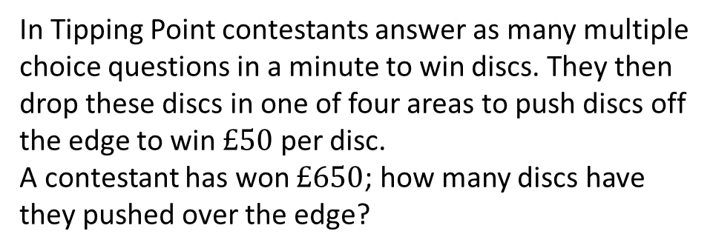
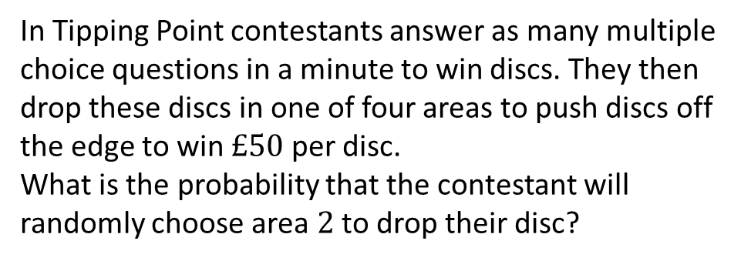
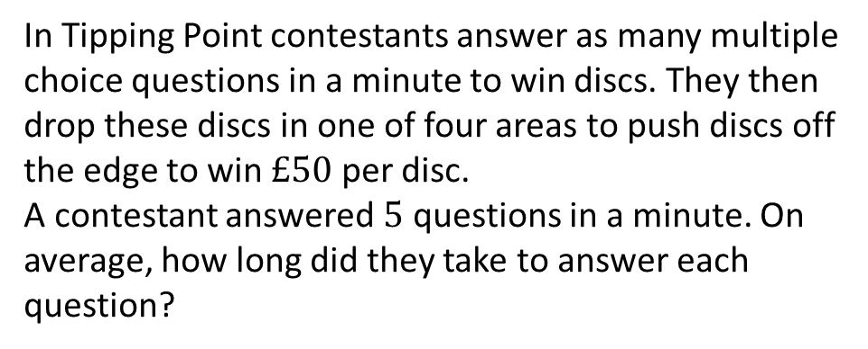
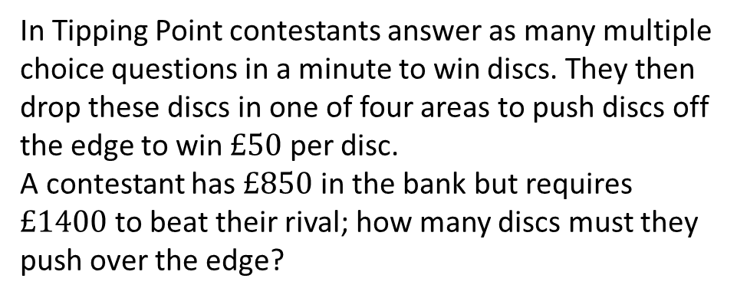
In Tipping Point contestants answer as many multiple choice questions in a minute to win discs. They then drop these discs in one of four areas to push discs off the edge to win $£50$ per disc.
A contestant has won $£650$; how many discs have they pushed over the edge?
In Tipping Point contestants answer as many multiple choice questions in a minute to win discs. They then drop these discs in one of four areas to push discs off the edge to win $£50$ per disc.
What is the probability that the contestant will randomly choose area $2$ to drop their disc?
In Tipping Point contestants answer as many multiple choice questions in a minute to win discs. They then drop these discs in one of four areas to push discs off the edge to win $£50$ per disc.
A contestant answered $5$ questions in a minute. On average, how long did they take to answer each question?
In Tipping Point contestants answer as many multiple choice questions in a minute to win discs. They then drop these discs in one of four areas to push discs off the edge to win $£50$ per disc.
A contestant has $£850$ in the bank but requires $£1400$ to beat their rival; how many discs must they push over the edge?

Slide 3




In Tipping Point contestants answer as many multiple choice questions in a minute to win discs. They then drop these discs in one of four areas to push discs off the edge to win $£50$ per disc.
A contestant has won $£650$; how many discs have they pushed over the edge?
In Tipping Point contestants answer as many multiple choice questions in a minute to win discs. They then drop these discs in one of four areas to push discs off the edge to win $£50$ per disc.
What is the probability that the contestant will randomly choose area $2$ to drop their disc?
$$\frac{1}{4}$$
$$13$$
In Tipping Point contestants answer as many multiple choice questions in a minute to win discs. They then drop these discs in one of four areas to push discs off the edge to win $£50$ per disc.
A contestant answered $5$ questions in a minute. On average, how long did they take to answer each question?
In Tipping Point contestants answer as many multiple choice questions in a minute to win discs. They then drop these discs in one of four areas to push discs off the edge to win $£50$ per disc.
A contestant has $£850$ in the bank but requires $£1400$ to beat their rival; how many discs must they push over the edge?
$12$ seconds
$$11$$

