Slide 1

Andy’s SSDD Questions $2$
Inspired by Craig Barton’s SSDD Questions, website below:
https://ssddproblems.com/

Slide 2
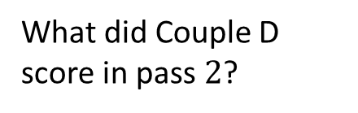
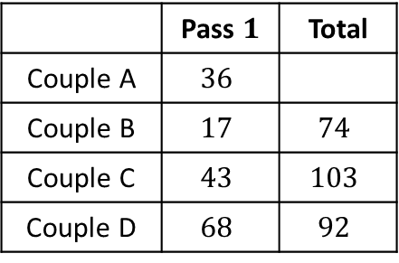
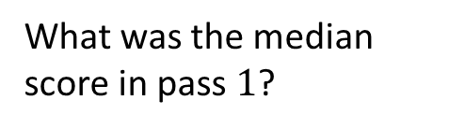
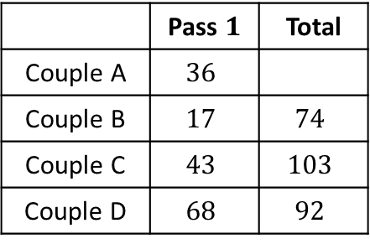
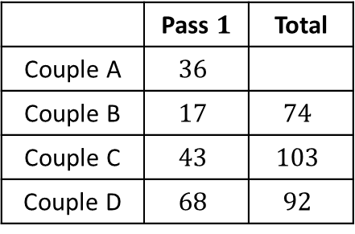
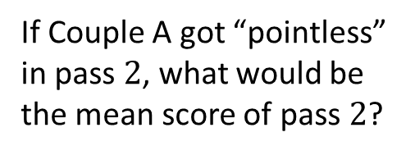
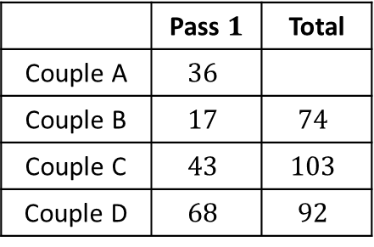
In Pointless they combine scores of two passes.
The couple with the highest score is eliminated.
In Pointless they combine scores of two passes.
The couple with the highest score is eliminated.
 | Pass $1$ | Total
Couple A | $$36$$
Couple B | $$17$$ | $$74$$
Couple C | $$43$$ | $$103$$
Couple D | $$68$$ | $$92$$
 | Pass $1$ | Total
Couple A | $$36$$
Couple B | $$17$$ | $$74$$
Couple C | $$43$$ | $$103$$
Couple D | $$68$$ | $$92$$
What did Couple D score in pass $2$?
What was the median score in pass $1$?
In Pointless they combine scores of two passes.
The couple with the highest score is eliminated.
In Pointless they combine scores of two passes.
The couple with the highest score is eliminated.
 | Pass $1$ | Total
Couple A | $$36$$
Couple B | $$17$$ | $$74$$
Couple C | $$43$$ | $$103$$
Couple D | $$68$$ | $$92$$
 | Pass $1$ | Total
Couple A | $$36$$
Couple B | $$17$$ | $$74$$
Couple C | $$43$$ | $$103$$
Couple D | $$68$$ | $$92$$
What is the maximum Couple A can score and go through to the next round?
If Couple A got “pointless” in pass $2$, what would be the mean score of pass $2$?

Slide 3




In Pointless they combine scores of two passes.
The couple with the highest score is eliminated.
In Pointless they combine scores of two passes.
The couple with the highest score is eliminated.
 | Pass $1$ | Total
Couple A | $$36$$
Couple B | $$17$$ | $$74$$
Couple C | $$43$$ | $$103$$
Couple D | $$68$$ | $$92$$
 | Pass $1$ | Total
Couple A | $$36$$
Couple B | $$17$$ | $$74$$
Couple C | $$43$$ | $$103$$
Couple D | $$68$$ | $$92$$
What did Couple D score in pass $2$?
What was the median score in pass $1$?
$$24$$
$$39.5$$
In Pointless they combine scores of two passes.
The couple with the highest score is eliminated.
In Pointless they combine scores of two passes.
The couple with the highest score is eliminated.
 | Pass $1$ | Total
Couple A | $$36$$
Couple B | $$17$$ | $$74$$
Couple C | $$43$$ | $$103$$
Couple D | $$68$$ | $$92$$
 | Pass $1$ | Total
Couple A | $$36$$
Couple B | $$17$$ | $$74$$
Couple C | $$43$$ | $$103$$
Couple D | $$68$$ | $$92$$
What is the maximum Couple A can score and go through to the next round?
If Couple A got “pointless” in pass $2$, what would be the mean score of pass $2$?
$$66$$
$$35.25$$

