Slide 1

Andy’s SSDD Questions $2$
Inspired by Craig Barton’s SSDD Questions, website below:
https://ssddproblems.com/

Slide 2
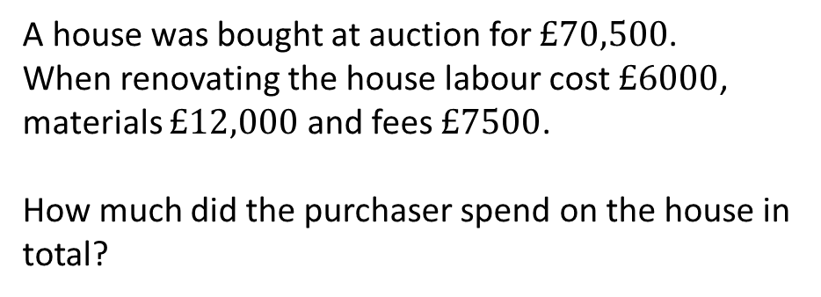
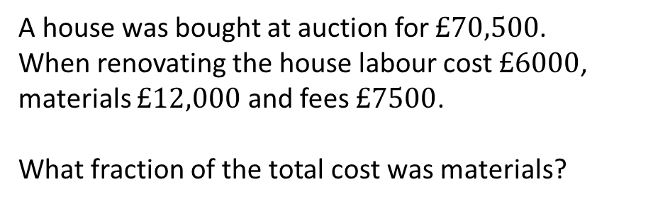
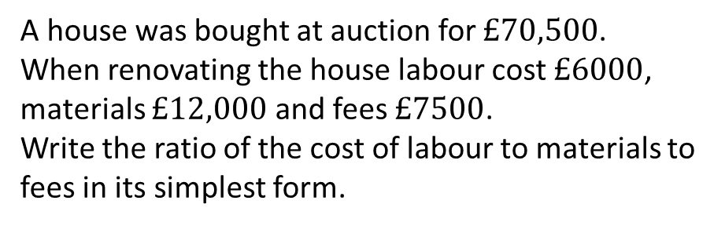
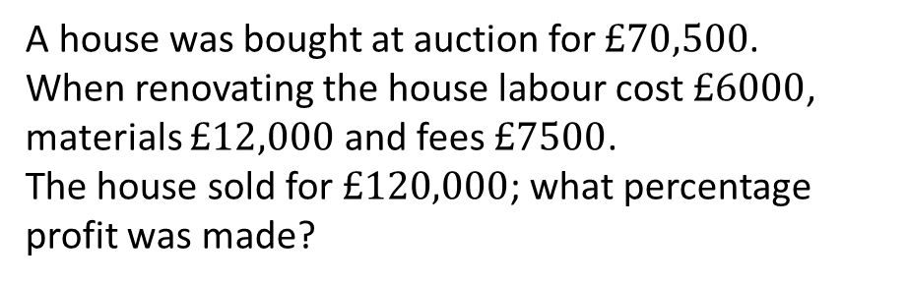
A house was bought at auction for $£70,500$.
When renovating the house labour cost $£6000$, materials $£12,000$ and fees $£7500$.
How much did the purchaser spend on the house in total?
A house was bought at auction for $£70,500$.
When renovating the house labour cost $£6000$, materials $£12,000$ and fees $£7500$.
What fraction of the total cost was materials?
A house was bought at auction for $£70,500$.
When renovating the house labour cost $£6000$, materials $£12,000$ and fees $£7500$.
Write the ratio of the cost of labour to materials to fees in its simplest form.
A house was bought at auction for $£70,500$.
When renovating the house labour cost $£6000$, materials $£12,000$ and fees $£7500$.
The house sold for $£120,000$; what percentage profit was made?

Slide 3
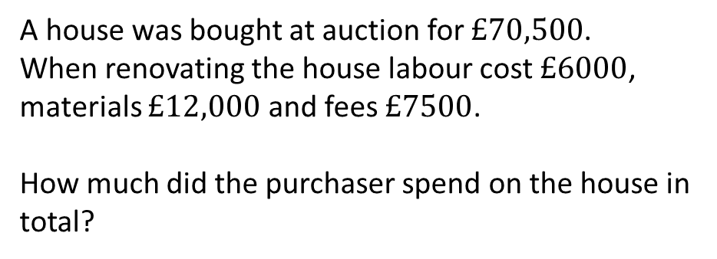
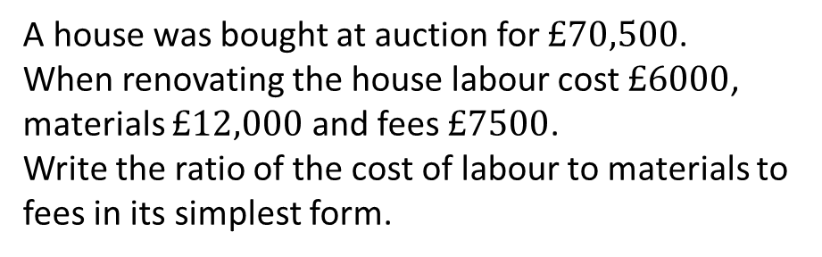
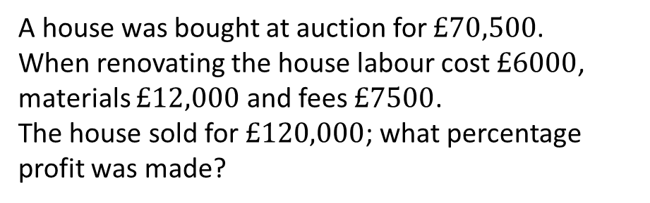




A house was bought at auction for $£70,500$.
When renovating the house labour cost $£6000$, materials $£12,000$ and fees $£7500$.
How much did the purchaser spend on the house in total?
A house was bought at auction for $£70,500$.
When renovating the house labour cost $£6000$, materials $£12,000$ and fees $£7500$.
What fraction of the total cost was materials?
$$\frac{1}{8}$$
$$£96,000$$
A house was bought at auction for $£70,500$.
When renovating the house labour cost $£6000$, materials $£12,000$ and fees $£7500$.
Write the ratio of the cost of labour to materials to fees in its simplest form.
A house was bought at auction for $£70,500$.
When renovating the house labour cost $£6000$, materials $£12,000$ and fees $£7500$.
The house sold for $£120,000$; what percentage profit was made?
$$4:8:5$$
$$20\%$$

