Slide 1

Andy’s SSDD Questions $5$
Inspired by Craig Barton’s SSDD Questions, website below:
https://ssddproblems.com/

Slide 2

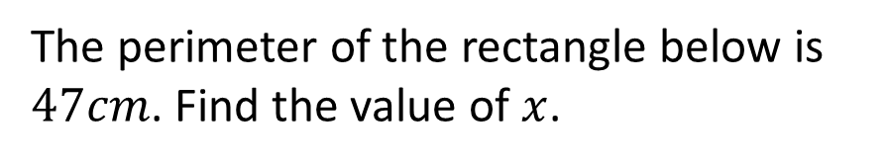
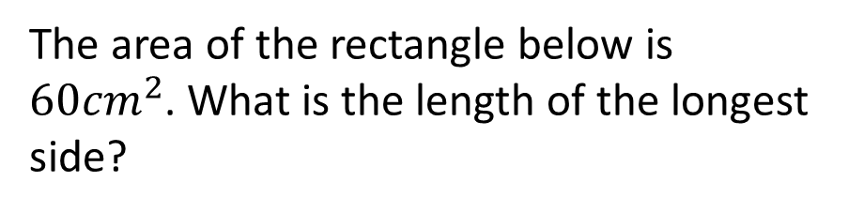
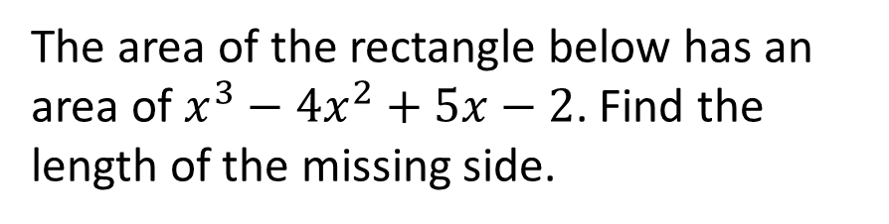







Find the perimeter of the rectangle below:
The perimeter of the rectangle below is $47cm$. Find the value of $x$.
$$2x−1$$
$$2x+3$$
$$3x+5$$
$$3x−2$$
The area of the rectangle below is $60{cm}^{2}$. What is the length of the longest side?
The area of the rectangle below has an area of $x^{3}−4x^{2}+5x−2$. Find the length of the missing side.
$$x−1$$
$$x−1$$
$$x+6$$

Slide 3




Find the perimeter of the rectangle below:
The perimeter of the rectangle below is $47cm$. Find the value of $x$.
$$10x+8$$
$$2x−1$$
$$2x+3$$
$$3x+5$$
$$3x−2$$
$$x=4.5cm$$
The area of the rectangle below is $60{cm}^{2}$. What is the length of the longest side?
The area of the rectangle below has an area of $x^{3}−4x^{2}+5x−2$. Find the length of the missing side.
$$12cm$$
$$x−1$$
$$x−1$$
$$x+6$$
$$x^{2}−3x+2$$

