Slide 1

Andy’s SSDD Questions $5$
Inspired by Craig Barton’s SSDD Questions, website below:
https://ssddproblems.com/

Slide 2

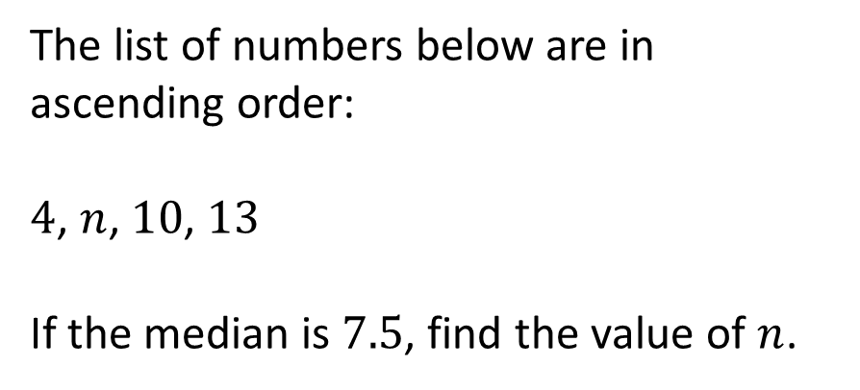
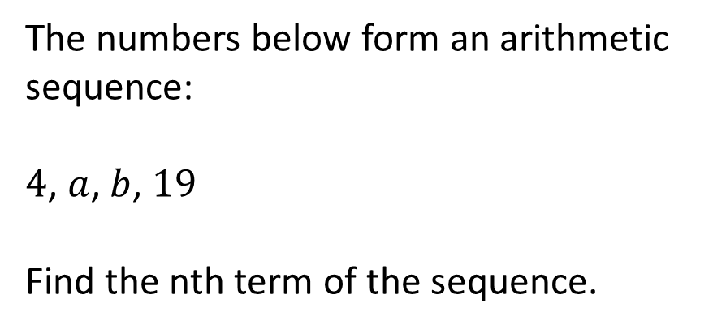
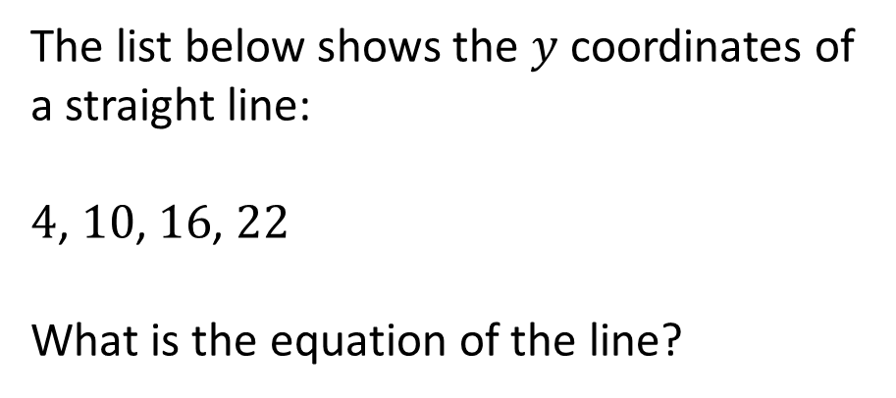
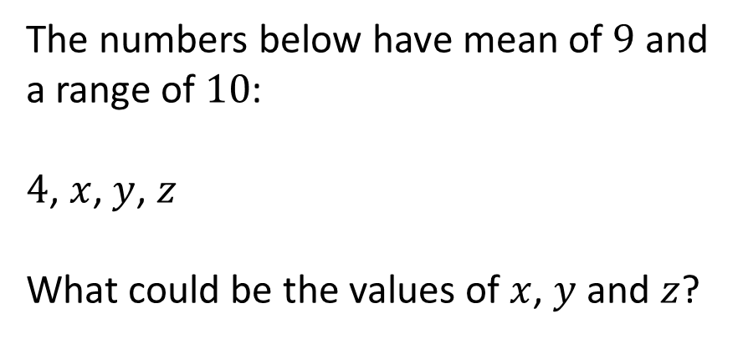
The list of numbers below are in ascending order:
$4$, $n$, $10$, $13$
If the median is $7.5$, find the value of $n$.
The numbers below form an arithmetic sequence:
$4$, $a$, $b$, $19$
Find the nth term of the sequence.
The list below shows the $y$ coordinates of a straight line:
$4$, $10$, $16$, $22$
What is the equation of the line?
The numbers below have mean of $9$ and a range of $10$:
$4$, $x$, $y$, $z$
What could be the values of $x$, $y$ and $z$?

Slide 3



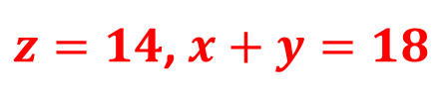
The list of numbers below are in ascending order:
$4$, $n$, $10$, $13$
If the median is $7.5$, find the value of $n$.
The numbers below form an arithmetic sequence:
$4$, $a$, $b$, $19$
Find the nth term of the sequence.
$$n=5$$
$$5n−1$$
The list below shows the $y$ coordinates of a straight line:
$4$, $10$, $16$, $22$
What is the equation of the line?
The numbers below have mean of $9$ and a range of $10$:
$4$, $x$, $y$, $z$
What could be the values of $x$, $y$ and $z$?
$$y=6x−2$$
$z=14$, $x+y=18$

