Slide 1

Andy’s SSDD Questions $5$
Inspired by Craig Barton’s SSDD Questions, website below:
https://ssddproblems.com/

Slide 2


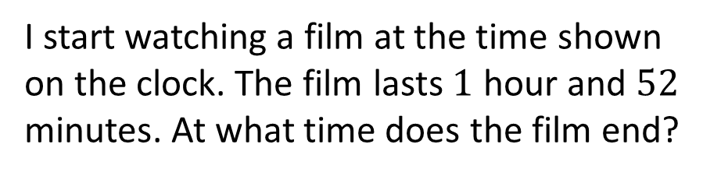
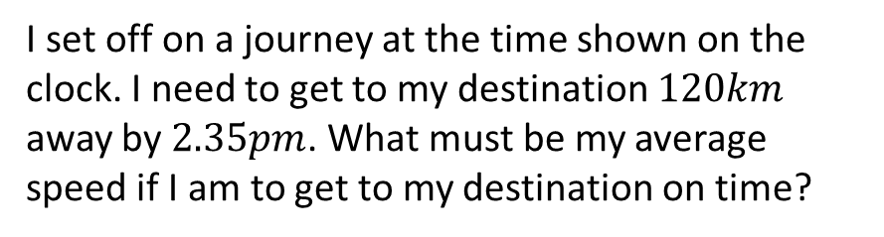
My alarm goes off in $7$ and a half hours. At what time does my alarm go off?
I start watching a film at the time shown on the clock. The film lasts $1$ hour and $52$ minutes. At what time does the film end?
I set off on a journey at the time shown on the clock. I need to get to my destination $120km$ away by $2.35pm$. What must be my average speed if I am to get to my destination on time?
What is the angle between the hands of the clock?

Slide 3




My alarm goes off in $7$ and a half hours. At what time does my alarm go off?
I start watching a film at the time shown on the clock. The film lasts $1$ hour and $52$ minutes. At what time does the film end?
$$7.25am$$
$$1.47pm$$
I set off on a journey at the time shown on the clock. I need to get to my destination $120km$ away by $2.35pm$. What must be my average speed if I am to get to my destination on time?
What is the angle between the hands of the clock?
$$45km/h$$
$30°$ or $330°$

