Slide 1

Andy’s SSDD Questions $4$
Inspired by Craig Barton’s SSDD Questions, website below:
https://ssddproblems.com/

Slide 2

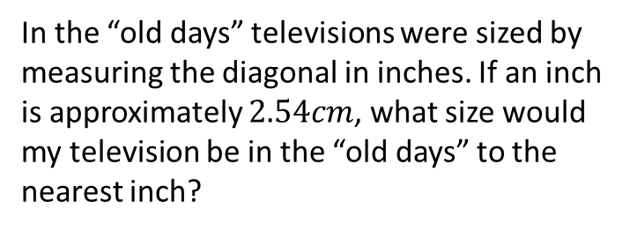
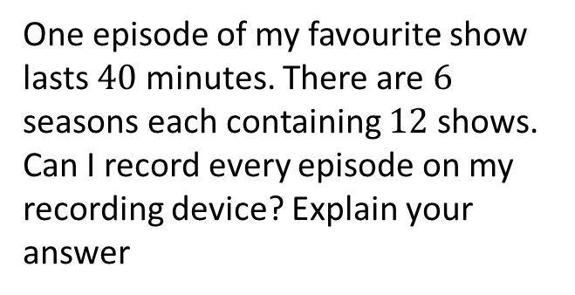
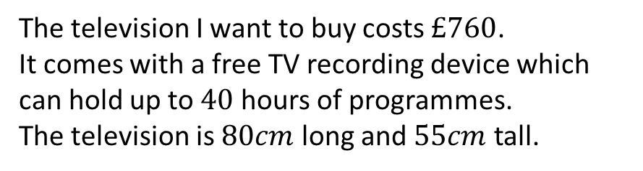
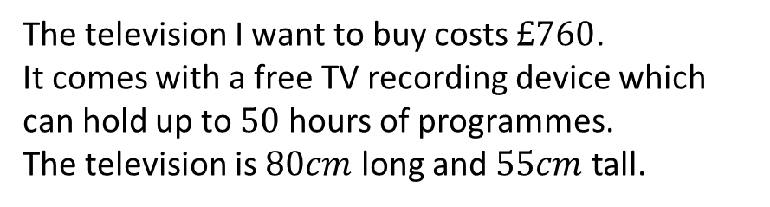
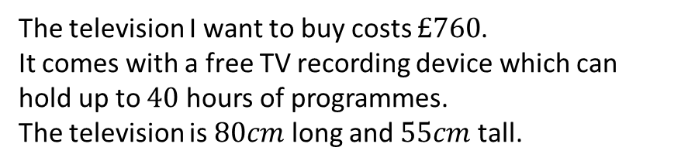
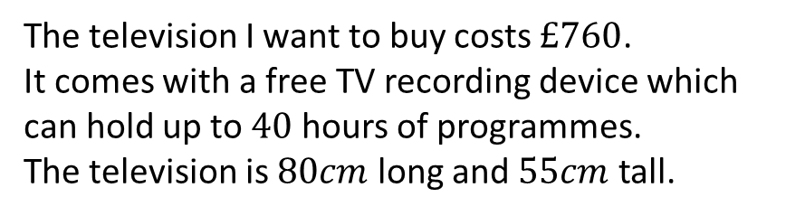
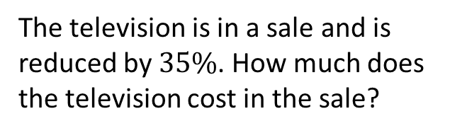
The television I want to buy costs $£760$.
It comes with a free TV recording device which can hold up to $50$ hours of programmes.
The television is $80cm$ long and $55cm$ tall.
The television I want to buy costs $£760$.
It comes with a free TV recording device which can hold up to $40$ hours of programmes.
The television is $80cm$ long and $55cm$ tall.
One episode of my favourite show lasts $40$ minutes. There are $6$ seasons each containing $12$ shows. Can I record every episode on my recording device? Explain your answer
The television is in a sale and is reduced by $35\%$. How much does the television cost in the sale?
The television I want to buy costs $£760$.
It comes with a free TV recording device which can hold up to $40$ hours of programmes.
The television is $80cm$ long and $55cm$ tall.
The television I want to buy costs $£760$.
It comes with a free TV recording device which can hold up to $40$ hours of programmes.
The television is $80cm$ long and $55cm$ tall.
In the “old days” televisions were sized by measuring the diagonal in inches. If an inch is approximately $2.54cm$, what size would my television be in the “old days” to the nearest inch?
Write the ratio of the width to the length of the television in its simplest form.

Slide 3




The television I want to buy costs $£760$.
It comes with a free TV recording device which can hold up to $50$ hours of programmes.
The television is $80cm$ long and $55cm$ tall.
The television I want to buy costs $£760$.
It comes with a free TV recording device which can hold up to $40$ hours of programmes.
The television is $80cm$ long and $55cm$ tall.
One episode of my favourite show lasts $40$ minutes. There are $6$ seasons each containing $12$ shows. Can I record every episode on my recording device? Explain your answer
The television is in a sale and is reduced by $35\%$. How much does the television cost in the sale?
$$760×0.65=£494$$
Yes; $50×60−6×12×40=120$
The television I want to buy costs $£760$.
It comes with a free TV recording device which can hold up to $40$ hours of programmes.
The television is $80cm$ long and $55cm$ tall.
The television I want to buy costs $£760$.
It comes with a free TV recording device which can hold up to $40$ hours of programmes.
The television is $80cm$ long and $55cm$ tall.
In the “old days” televisions were sized by measuring the diagonal in inches. If an inch is approximately $2.54cm$, what size would my television be in the “old days” to the nearest inch?
Write the ratio of the width to the length of the television in its simplest form.
$$16:11$$
$\frac{\sqrt{{80}^{2}+{55}^{2}}}{2.54}=38$ inches

