Slide 1

Andy’s SSDD Questions $4$
Inspired by Craig Barton’s SSDD Questions, website below:
https://ssddproblems.com/

Slide 2


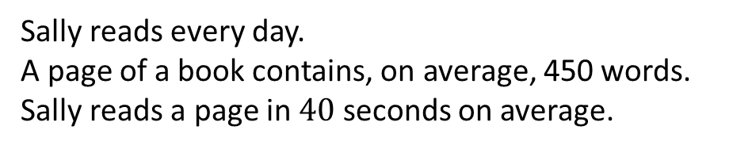
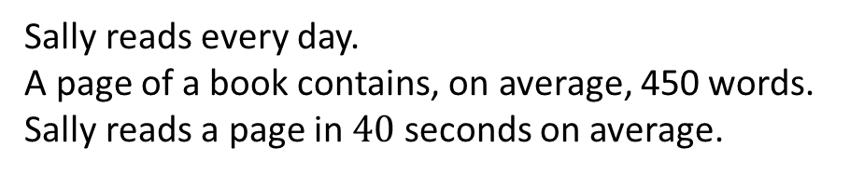
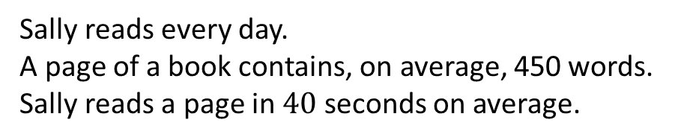
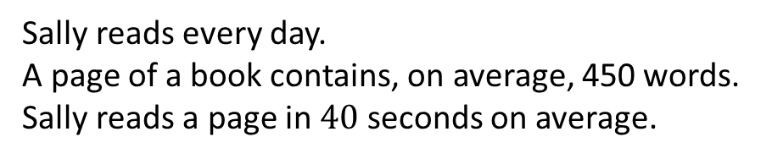
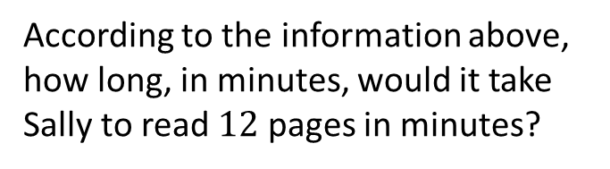
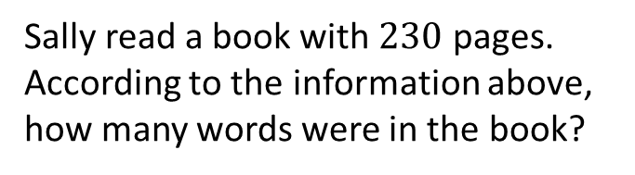
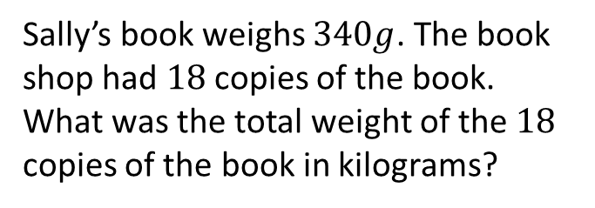
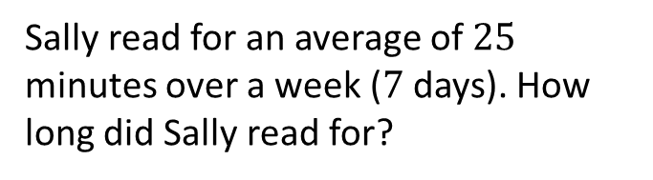
Sally reads every day.
A page of a book contains, on average, 450 words.
Sally reads a page in $40$ seconds on average.
Sally reads every day.
A page of a book contains, on average, 450 words.
Sally reads a page in $40$ seconds on average.
According to the information above, how long, in minutes, would it take Sally to read $12$ pages in minutes?
Sally read a book with $230$ pages. According to the information above, how many words were in the book?
Sally reads every day.
A page of a book contains, on average, 450 words.
Sally reads a page in $40$ seconds on average.
Sally reads every day.
A page of a book contains, on average, 450 words.
Sally reads a page in $40$ seconds on average.
Sally’s book weighs $340g$. The book shop had $18$ copies of the book. What was the total weight of the $18$ copies of the book in kilograms?
Sally read for an average of $25$ minutes over a week ($7$ days). How long did Sally read for?

Slide 3




Sally reads every day.
A page of a book contains, on average, 450 words.
Sally reads a page in $40$ seconds on average.
Sally reads every day.
A page of a book contains, on average, 450 words.
Sally reads a page in $40$ seconds on average.
According to the information above, how long, in minutes, would it take Sally to read $12$ pages in minutes?
Sally read a book with $230$ pages. According to the information above, how many words were in the book?
$\frac{12×40}{60}=8$ minutes
$$230×450=103500$$
Sally reads every day.
A page of a book contains, on average, 450 words.
Sally reads a page in $40$ seconds on average.
Sally reads every day.
A page of a book contains, on average, 450 words.
Sally reads a page in $40$ seconds on average.
Sally’s book weighs $340g$. The book shop had $18$ copies of the book. What was the total weight of the $18$ copies of the book in kilograms?
Sally read for an average of $25$ minutes over a week ($7$ days). How long did Sally read for?
$$0.34×18=6.12kg$$
$7×25=175$ minutes

