Slide 1
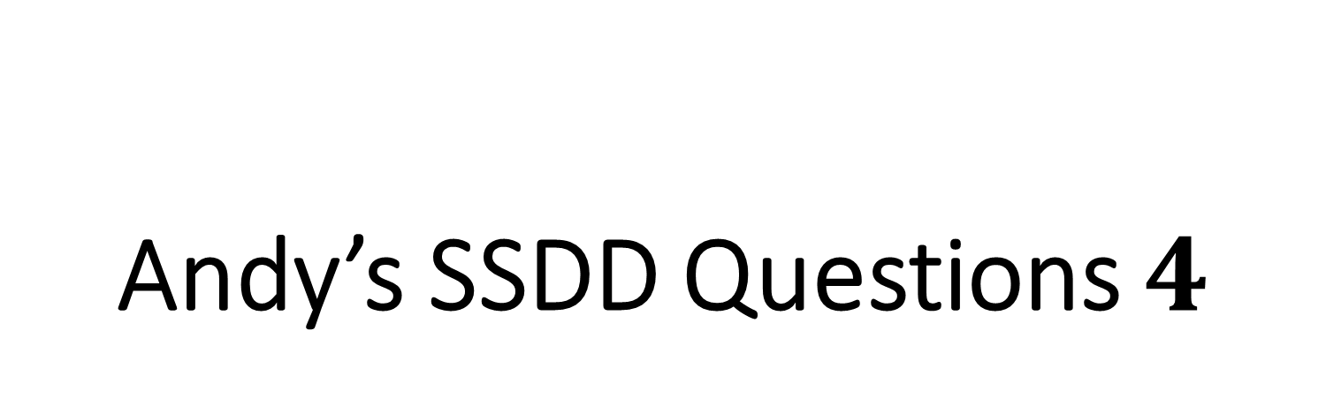
Andy’s SSDD Questions $4$
Inspired by Craig Barton’s SSDD Questions, website below:
https://ssddproblems.com/

Slide 2
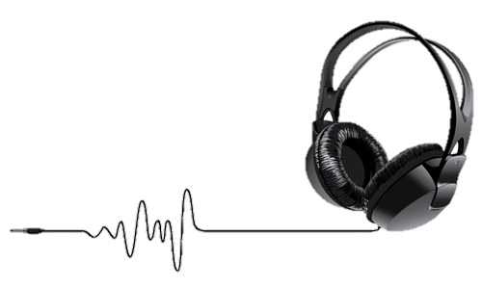
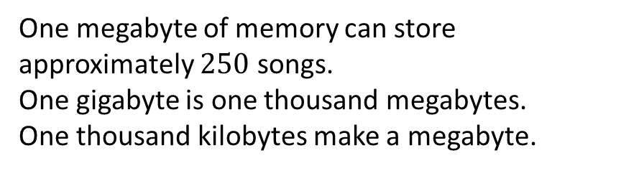
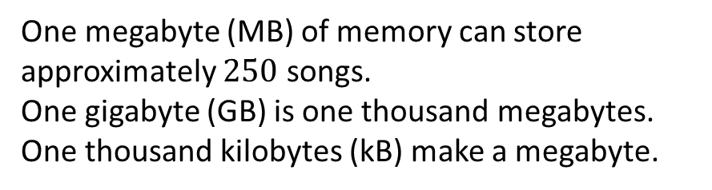
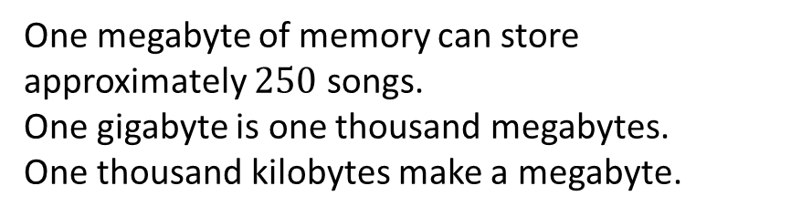
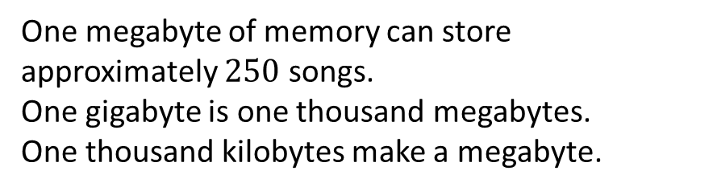
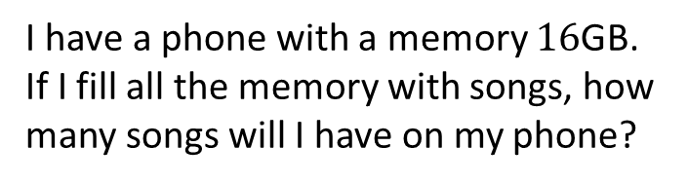
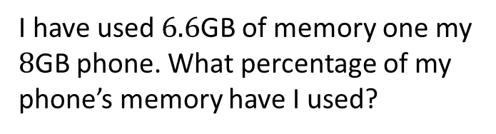
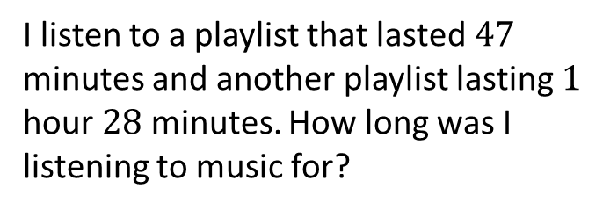
One megabyte of memory can store approximately $250$ songs.
One gigabyte is one thousand megabytes.
One thousand kilobytes make a megabyte.
One megabyte (MB) of memory can store approximately $250$ songs.
One gigabyte (GB) is one thousand megabytes.
One thousand kilobytes (kB) make a megabyte.
According to the information above, how many kilobytes are used to store one song?
I have a phone with a memory $16$GB. If I fill all the memory with songs, how many songs will I have on my phone?
One megabyte of memory can store approximately $250$ songs.
One gigabyte is one thousand megabytes.
One thousand kilobytes make a megabyte.
One megabyte of memory can store approximately $250$ songs.
One gigabyte is one thousand megabytes.
One thousand kilobytes make a megabyte.
I have used $6.6$GB of memory one my $8$GB phone. What percentage of my phone’s memory have I used?
I listen to a playlist that lasted $47$ minutes and another playlist lasting $1$ hour $28$ minutes. How long was I listening to music for?

Slide 3



One megabyte of memory can store approximately $250$ songs.
One gigabyte is one thousand megabytes.
One thousand kilobytes make a megabyte.
One megabyte (MB) of memory can store approximately $250$ songs.
One gigabyte (GB) is one thousand megabytes.
One thousand kilobytes (kB) make a megabyte.
According to the information above, how many kilobytes are used to store one song?
I have a phone with a memory $16$GB. If I fill all the memory with songs, how many songs will I have on my phone?
$1000÷250=4$kB
$$16×250×1000=4 million$$
One megabyte of memory can store approximately $250$ songs.
One gigabyte is one thousand megabytes.
One thousand kilobytes make a megabyte.
One megabyte of memory can store approximately $250$ songs.
One gigabyte is one thousand megabytes.
One thousand kilobytes make a megabyte.
I have used $6.6$GB of memory one my $8$GB phone. What percentage of my phone’s memory have I used?
I listen to a playlist that lasted $47$ minutes and another playlist lasting $1$ hour $28$ minutes. How long was I listening to music for?
$$\frac{6.6}{8}×100=82.5\%$$
$2$ hours $15$ minutes

