Slide 1

Andy’s SSDD Questions $4$
Inspired by Craig Barton’s SSDD Questions, website below:
https://ssddproblems.com/

Slide 2

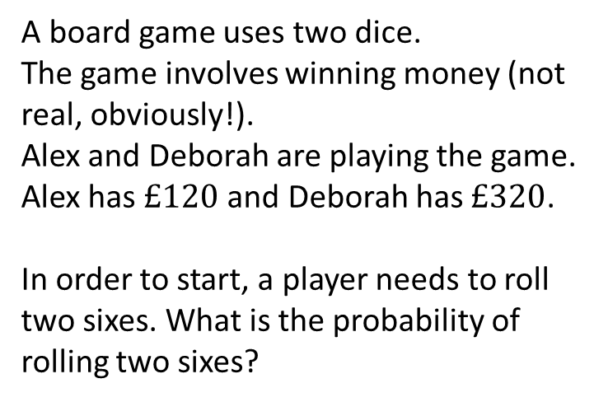
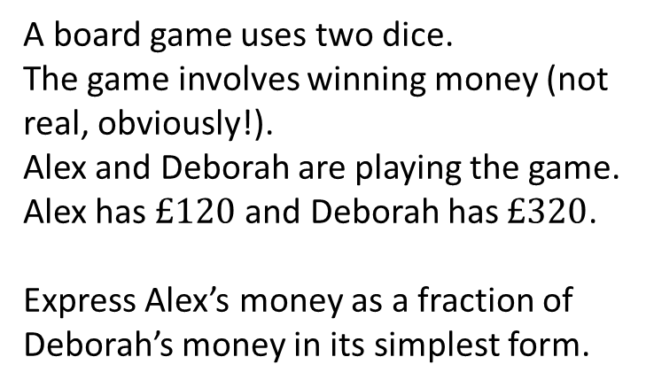
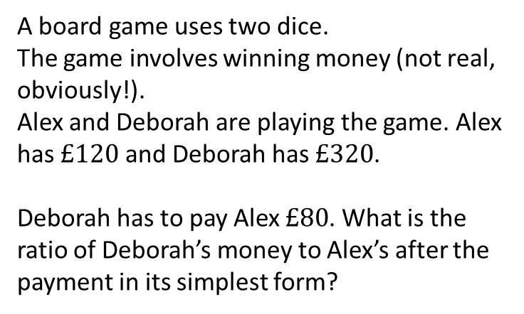
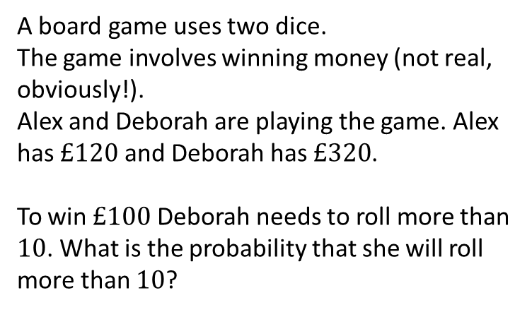
A board game uses two dice.
The game involves winning money (not real, obviously!).
Alex and Deborah are playing the game. Alex has $£120$ and Deborah has $£320$.
In order to start, a player needs to roll two sixes. What is the probability of rolling two sixes?
A board game uses two dice.
The game involves winning money (not real, obviously!).
Alex and Deborah are playing the game. Alex has $£120$ and Deborah has $£320$.
Express Alex’s money as a fraction of Deborah’s money in its simplest form.
A board game uses two dice.
The game involves winning money (not real, obviously!).
Alex and Deborah are playing the game. Alex has $£120$ and Deborah has $£320$.
Deborah has to pay Alex $£80$. What is the ratio of Deborah’s money to Alex’s after the payment in its simplest form?
A board game uses two dice.
The game involves winning money (not real, obviously!).
Alex and Deborah are playing the game. Alex has $£120$ and Deborah has $£320$.
To win $£100$ Deborah needs to roll more than $10$. What is the probability that she will roll more than $10$?

Slide 3




A board game uses two dice.
The game involves winning money (not real, obviously!).
Alex and Deborah are playing the game. Alex has $£120$ and Deborah has $£320$.
In order to start, a player needs to roll two sixes. What is the probability of rolling two sixes?
A board game uses two dice.
The game involves winning money (not real, obviously!).
Alex and Deborah are playing the game. Alex has $£120$ and Deborah has $£320$.
Express Alex’s money as a fraction of Deborah’s money in its simplest form.
$$\frac{1}{6}×\frac{1}{6}=\frac{1}{36}$$
$$\frac{120}{320}=\frac{3}{8}$$
A board game uses two dice.
The game involves winning money (not real, obviously!).
Alex and Deborah are playing the game. Alex has $£120$ and Deborah has $£320$.
Deborah has to pay Alex $£80$. What is the ratio of Deborah’s money to Alex’s after the payment in its simplest form?
A board game uses two dice.
The game involves winning money (not real, obviously!).
Alex and Deborah are playing the game. Alex has $£120$ and Deborah has $£320$.
To win $£100$ Deborah needs to roll more than $10$. What is the probability that she will roll more than $10$?
$$\frac{3}{36}=\frac{1}{12}$$
$$6:5$$

