Slide 1

Andy’s SSDD Questions $3$
Inspired by Craig Barton’s SSDD Questions, website below:
https://ssddproblems.com/

Slide 2
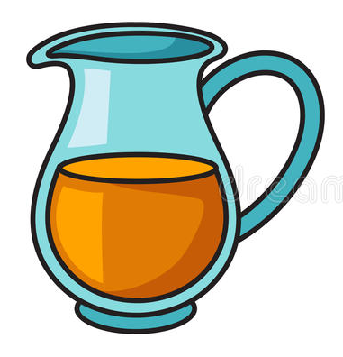
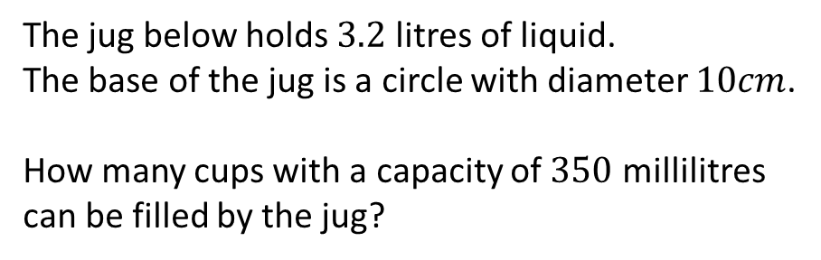
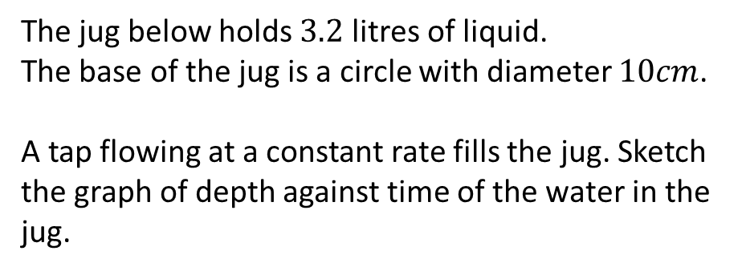
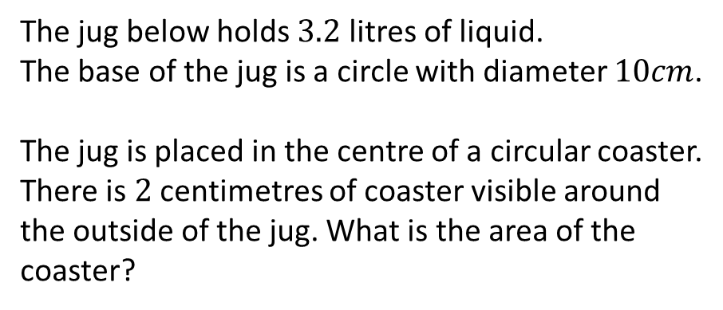
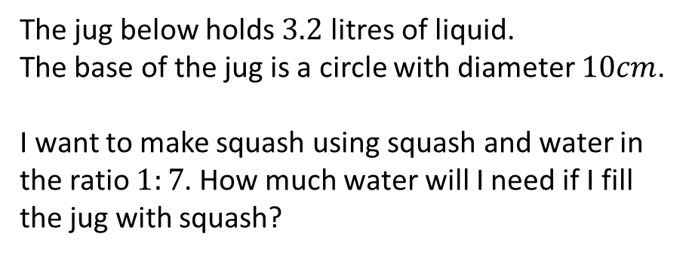
The jug below holds $3.2$ litres of liquid.
The base of the jug is a circle with diameter $10cm$.
How many cups with a capacity of $350$ millilitres can be filled by the jug?
The jug below holds $3.2$ litres of liquid.
The base of the jug is a circle with diameter $10cm$.
A tap flowing at a constant rate fills the jug. Sketch the graph of depth against time of the water in the jug.
The jug below holds $3.2$ litres of liquid.
The base of the jug is a circle with diameter $10cm$.
The jug is placed in the centre of a circular coaster. There is $2$ centimetres of coaster visible around the outside of the jug. What is the area of the coaster?
The jug below holds $3.2$ litres of liquid.
The base of the jug is a circle with diameter $10cm$.
I want to make squash using squash and water in the ratio $1:7$. How much water will I need if I fill the jug with squash?

Slide 3
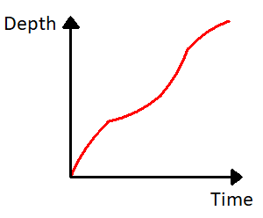




The jug below holds $3.2$ litres of liquid.
The base of the jug is a circle with diameter $10cm$.
How many cups with a capacity of $350$ millilitres can be filled by the jug?
The jug below holds $3.2$ litres of liquid.
The base of the jug is a circle with diameter $10cm$.
A tap flowing at a constant rate fills the jug. Sketch the graph of depth against time of the water in the jug.
$$3200÷350=9.14$$
$9$ full cups
The jug below holds $3.2$ litres of liquid.
The base of the jug is a circle with diameter $10cm$.
The jug is placed in the centre of a circular coaster. There is $2$ centimetres of coaster visible around the outside of the jug. What is the area of the coaster?
The jug below holds $3.2$ litres of liquid.
The base of the jug is a circle with diameter $10cm$.
I want to make squash using squash and water in the ratio $1:7$. How much water will I need if I fill the jug with squash?
$π×7^{2}=49π {cm}^{2}$ or $153.9{cm}^{2}$
$\frac{7}{8}×3.2=2.8$ litres

