Slide 1

Andy’s SSDD Questions $3$
Inspired by Craig Barton’s SSDD Questions, website below:
https://ssddproblems.com/

Slide 2
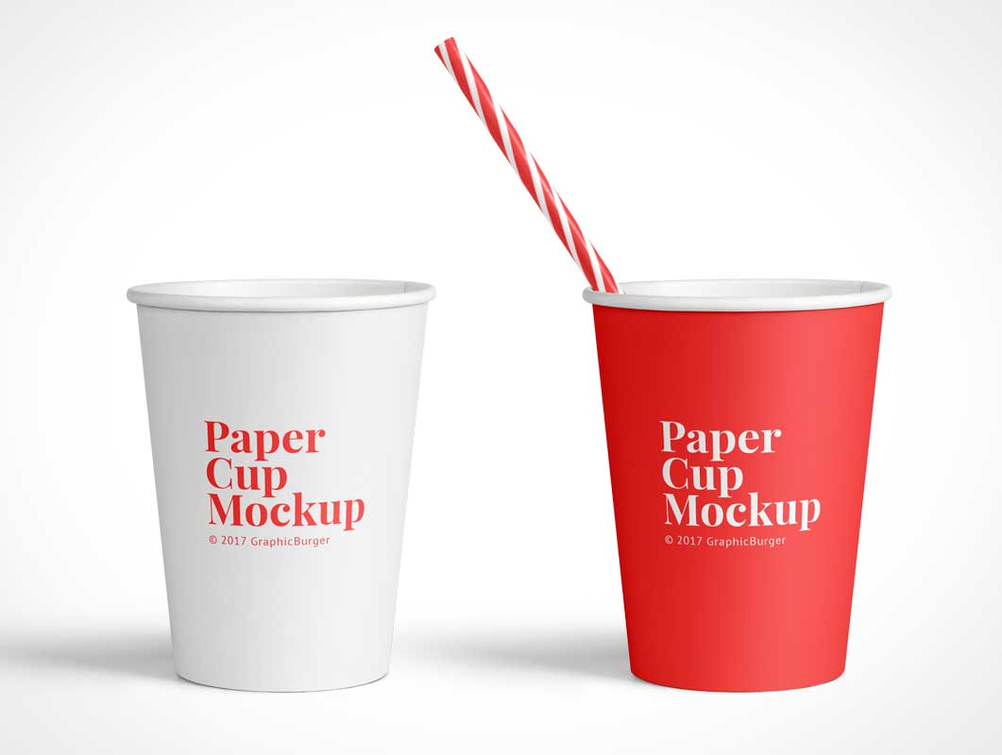
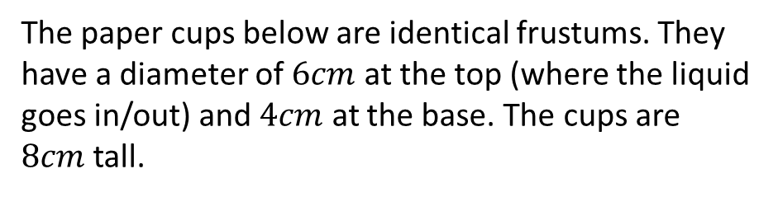
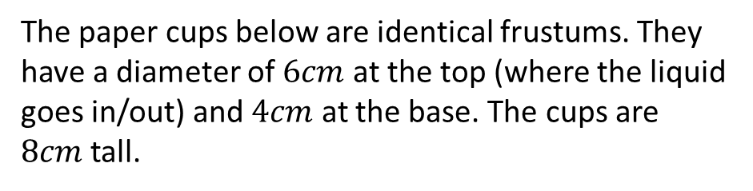
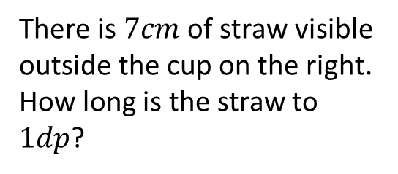
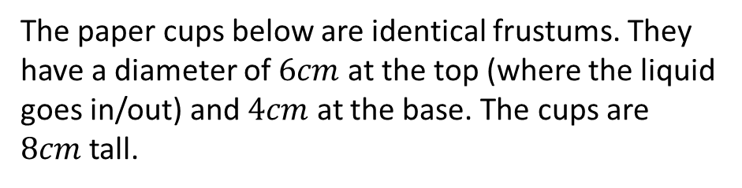
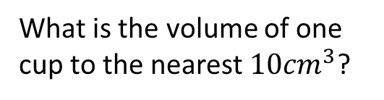
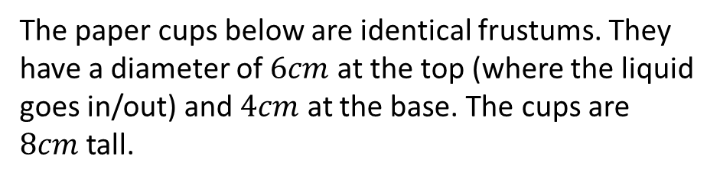
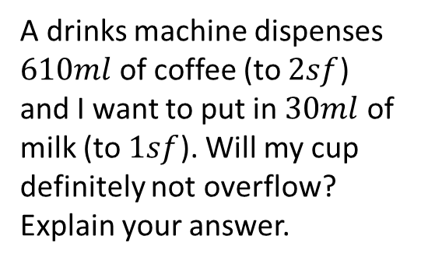
The paper cups below are identical frustums. They have a diameter of $6cm$ at the top (where the liquid goes in/out) and $4cm$ at the base. The cups are $8cm$ tall.
The paper cups below are identical frustums. They have a diameter of $6cm$ at the top (where the liquid goes in/out) and $4cm$ at the base. The cups are $8cm$ tall.
A designer wants to put a coloured trim around the top. What would be the length of the trim on one cup?
There is $7cm$ of straw visible outside the cup on the right. How long is the straw to $1dp$?
The paper cups below are identical frustums. They have a diameter of $6cm$ at the top (where the liquid goes in/out) and $4cm$ at the base. The cups are $8cm$ tall.
The paper cups below are identical frustums. They have a diameter of $6cm$ at the top (where the liquid goes in/out) and $4cm$ at the base. The cups are $8cm$ tall.
What is the volume of one cup to the nearest $10{cm}^{3}$?
A drinks machine dispenses $610ml$ of coffee (to $2sf$) and I want to put in $30ml$ of milk (to $1sf$). Will my cup definitely not overflow? Explain your answer.

Slide 3





The paper cups below are identical frustums. They have a diameter of $6cm$ at the top (where the liquid goes in/out) and $4cm$ at the base. The cups are $8cm$ tall.
The paper cups below are identical frustums. They have a diameter of $6cm$ at the top (where the liquid goes in/out) and $4cm$ at the base. The cups are $8cm$ tall.
A designer wants to put a coloured trim around the top. What would be the length of the trim on one cup?
There is $7cm$ of straw visible outside the cup on the right. How long is the straw to $1dp$?
$6π$ or $18.8cm$
$$7+\sqrt{5^{2}+8^{2}}=16.4cm$$
The paper cups below are identical frustums. They have a diameter of $6cm$ at the top (where the liquid goes in/out) and $4cm$ at the base. The cups are $8cm$ tall.
The paper cups below are identical frustums. They have a diameter of $6cm$ at the top (where the liquid goes in/out) and $4cm$ at the base. The cups are $8cm$ tall.
No; $615+35>640$
What is the volume of one cup to the nearest $10{cm}^{3}$?
A drinks machine dispenses $610ml$ of coffee (to $2sf$) and I want to put in $30ml$ of milk (to $1sf$). Will my cup definitely not overflow? Explain your answer.
$$\frac{1}{3}π×6^{2}×24−\frac{1}{3}π×4^{2}×16$$
$$640{cm}^{3}$$

