Slide 1

Andy’s SSDD Questions $3$
Inspired by Craig Barton’s SSDD Questions, website below:
https://ssddproblems.com/

Slide 2


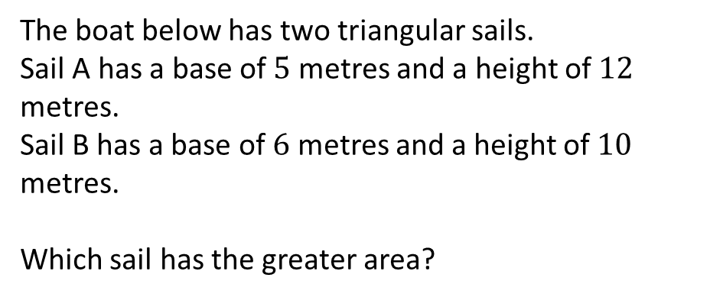
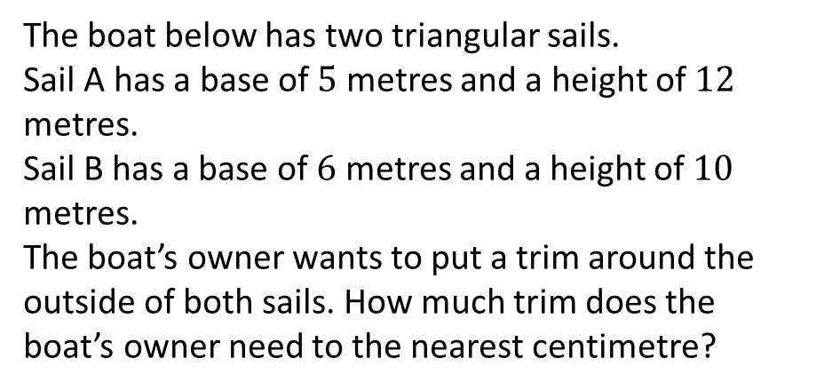
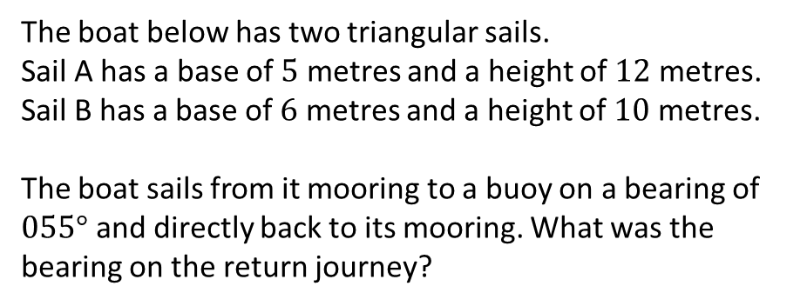
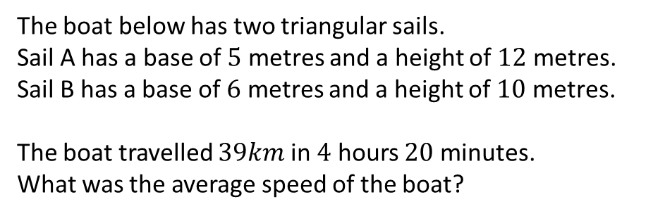
The boat below has two triangular sails.
Sail A has a base of $5$ metres and a height of $12$ metres.
Sail B has a base of $6$ metres and a height of $10$ metres.
Which sail has the greater area?
The boat below has two triangular sails.
Sail A has a base of $5$ metres and a height of $12$ metres.
Sail B has a base of $6$ metres and a height of $10$ metres.
The boat’s owner wants to put a trim around the outside of both sails. How much trim does the boat’s owner need to the nearest centimetre?
The boat below has two triangular sails.
Sail A has a base of $5$ metres and a height of $12$ metres.
Sail B has a base of $6$ metres and a height of $10$ metres.
The boat sails from it mooring to a buoy on a bearing of $055°$ and directly back to its mooring. What was the bearing on the return journey?
The boat below has two triangular sails.
Sail A has a base of $5$ metres and a height of $12$ metres.
Sail B has a base of $6$ metres and a height of $10$ metres.
The boat travelled $39km$ in $4$ hours $20$ minutes.
What was the average speed of the boat?

Slide 3





The boat below has two triangular sails.
Sail A has a base of $5$ metres and a height of $12$ metres.
Sail B has a base of $6$ metres and a height of $10$ metres.
Which sail has the greater area?
The boat below has two triangular sails.
Sail A has a base of $5$ metres and a height of $12$ metres.
Sail B has a base of $6$ metres and a height of $10$ metres.
The boat’s owner wants to put a trim around the outside of both sails. How much trim does the boat’s owner need to the nearest centimetre?
Sail A: $30m^{2}$
They are the same!
$$12+5+\sqrt{5^{2}+{12}^{2}}+6+10+\sqrt{6^{2}+{10}^{2}}$$
Sail B: $30m^{2}$
Total: $57.66m$
The boat below has two triangular sails.
Sail A has a base of $5$ metres and a height of $12$ metres.
Sail B has a base of $6$ metres and a height of $10$ metres.
The boat sails from it mooring to a buoy on a bearing of $055°$ and directly back to its mooring. What was the bearing on the return journey?
The boat below has two triangular sails.
Sail A has a base of $5$ metres and a height of $12$ metres.
Sail B has a base of $6$ metres and a height of $10$ metres.
The boat travelled $39km$ in $4$ hours $20$ minutes.
What was the average speed of the boat?
$$\frac{39}{260}×60=9km/h$$
$$360−\left(180−55\right)=235°$$

