Slide 1

Andy’s SSDD Questions $2$
Inspired by Craig Barton’s SSDD Questions, website below:
https://ssddproblems.com/

Slide 2
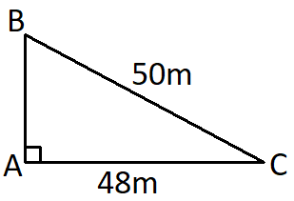
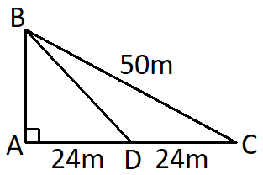
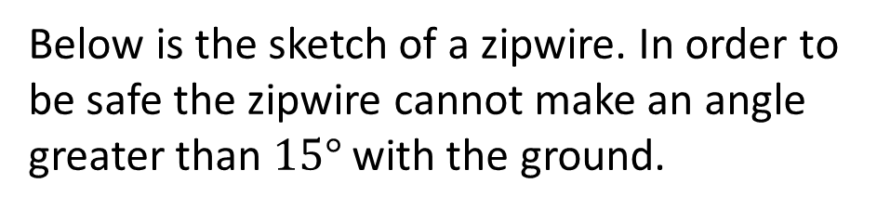
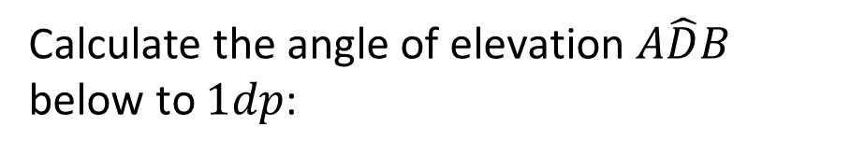
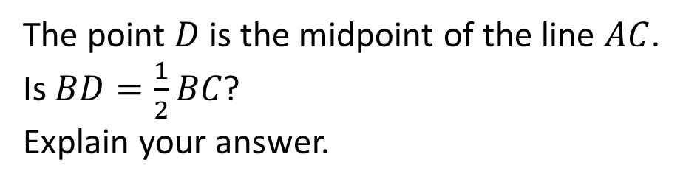
Below is the sketch of a zipwire. In order to be safe the zipwire cannot make an angle greater than $15°$ with the ground.
Find the area and perimeter of this triangle:
Is this zipwire safe? Explain your answer.
The point $D$ is the midpoint of the line $AC$.
Is $BD=\frac{1}{2}BC$?
Explain your answer.
Calculate the angle of elevation $A\hat{D}B$ below to $1dp$:

Slide 3
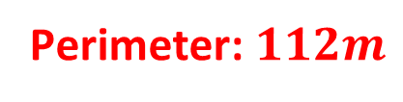
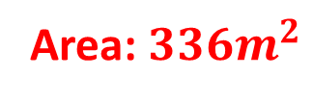
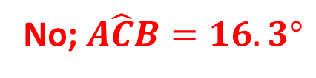
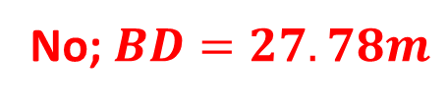

Below is the sketch of a zipwire. In order to be safe the zipwire cannot make an angle greater than $15°$ with the ground.
Find the area and perimeter of this triangle:
No; $A\hat{C}B=16.3°$
Perimeter: $112m$
Is this zipwire safe? Explain your answer.
Area: $336m^{2}$
The point $D$ is the midpoint of the line $AC$.
Is $BD=\frac{1}{2}BC$?
Explain your answer.
Calculate the angle of elevation $A\hat{D}B$ below to $1dp$:
$$A\hat{D}B=30.3°$$
No; $BD=27.78m$

