Slide 1

Andy’s SSDD Questions $2$
Inspired by Craig Barton’s SSDD Questions, website below:
https://ssddproblems.com/

Slide 2
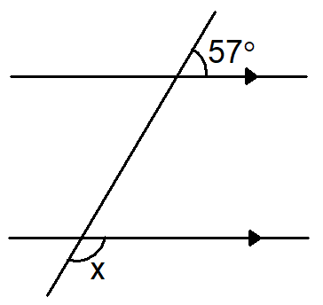
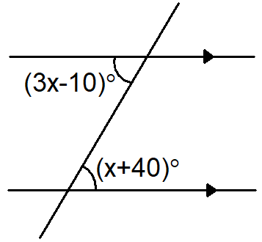
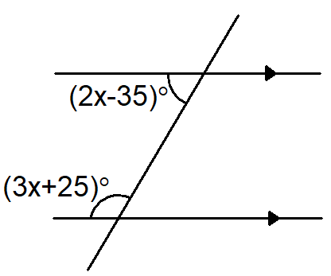
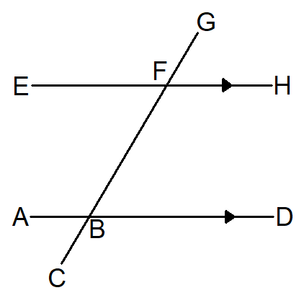
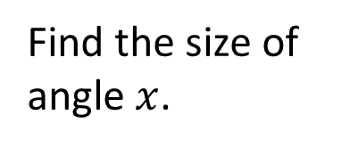
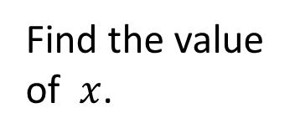
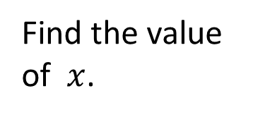
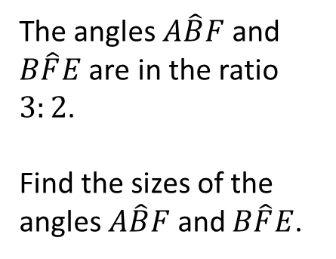
Find the size of angle $x$.
Find the value of $x$.
The angles $A\hat{B}F$ and $B\hat{F}E$ are in the ratio $3:2$.
Find the sizes of the angles $A\hat{B}F$ and $B\hat{F}E$.
Find the value of $x$.

Slide 3




Find the size of angle $x$.
Find the value of $x$.
$$x=123°$$
$$x=25°$$
The angles $A\hat{B}F$ and $B\hat{F}E$ are in the ratio $3:2$.
Find the sizes of the angles $A\hat{B}F$ and $B\hat{F}E$.
Find the value of $x$.
$$x=38°$$
$A\hat{B}F=108°$ and $B\hat{F}E=72°$

