Slide 1
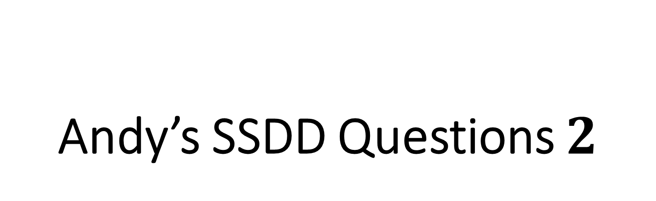
Andy’s SSDD Questions $2$
Inspired by Craig Barton’s SSDD Questions, website below:
https://ssddproblems.com/

Slide 2
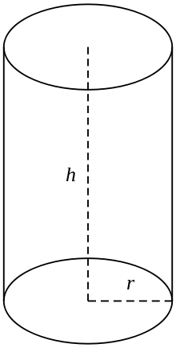
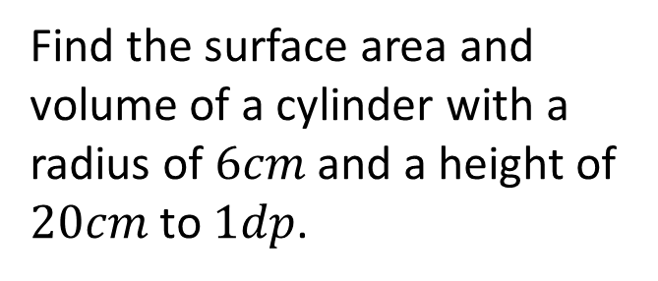
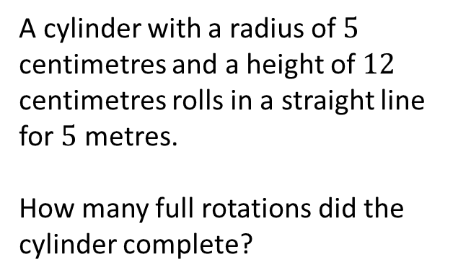
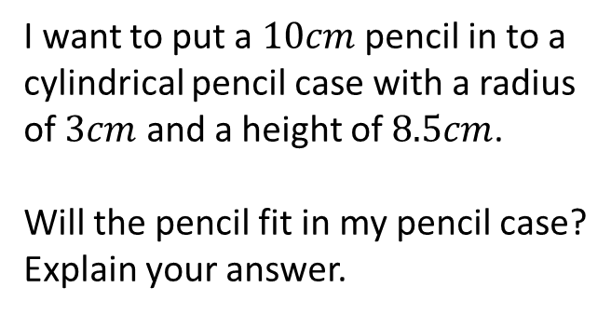
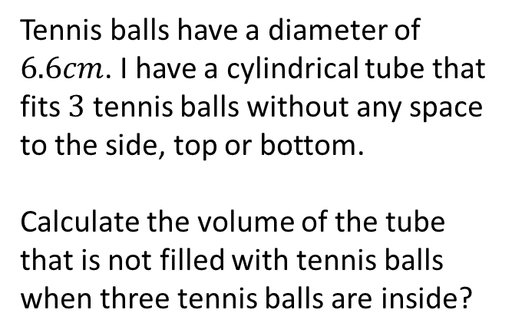
Find the surface area and volume of a cylinder with a radius of $6cm$ and a height of $20cm$ to $1dp$.
A cylinder with a radius of $5$ centimetres and a height of $12$ centimetres rolls in a straight line for $5$ metres.
How many full rotations did the cylinder complete?
Tennis balls have a diameter of $6.6cm$. I have a cylindrical tube that fits $3$ tennis balls without any space to the side, top or bottom.
Calculate the volume of the tube that is not filled with tennis balls when three tennis balls are inside?
I want to put a $10cm$ pencil in to a cylindrical pencil case with a radius of $3cm$ and a height of $8.5cm$.
Will the pencil fit in my pencil case?
Explain your answer.

Slide 3
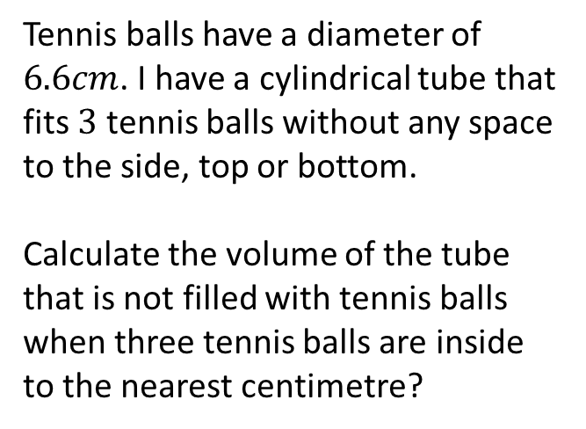
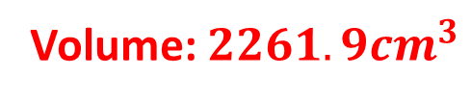
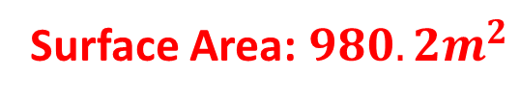

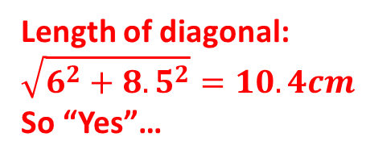
Find the surface area and volume of a cylinder with a radius of $6cm$ and a height of $20cm$ to $1dp$.
A cylinder with a radius of $5$ centimetres and a height of $12$ centimetres rolls in a straight line for $5$ metres.
How many full rotations did the cylinder complete?
Surface Area: $980.2m^{2}$
Volume: $2261.9{cm}^{3}$
$15$ full rotations
Tennis balls have a diameter of $6.6cm$. I have a cylindrical tube that fits $3$ tennis balls without any space to the side, top or bottom.
Calculate the volume of the tube that is not filled with tennis balls when three tennis balls are inside to the nearest centimetre?
I want to put a $10cm$ pencil in to a cylindrical pencil case with a radius of $3cm$ and a height of $8.5cm$.
Will the pencil fit in my pencil case?
Explain your answer.
Length of diagonal:
$$\sqrt{6^{2}+{8.5}^{2}}=10.4cm$$
So “Yes”…
Space: $π×{3.3}^{2}×19.8−3×\frac{4}{3}×π×{3.3}^{3}=226{cm}^{3}$

