Slide 1

Andy’s SSDD Questions $2$
Inspired by Craig Barton’s SSDD Questions, website below:
https://ssddproblems.com/

Slide 2
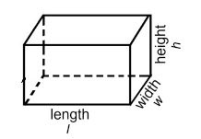
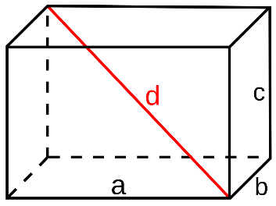
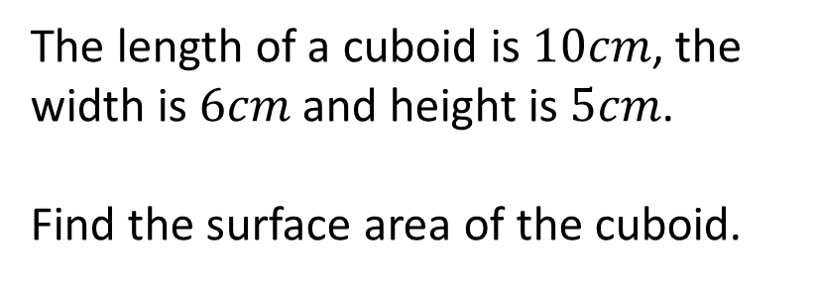
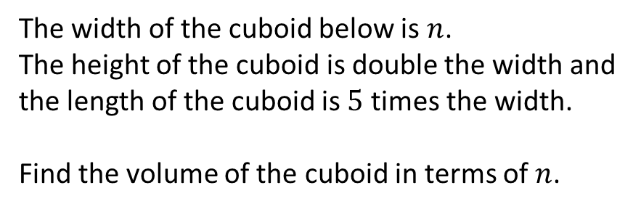
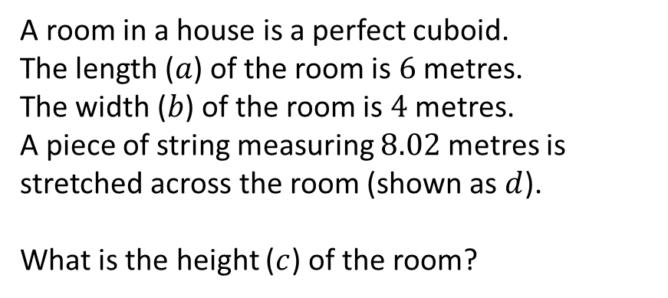
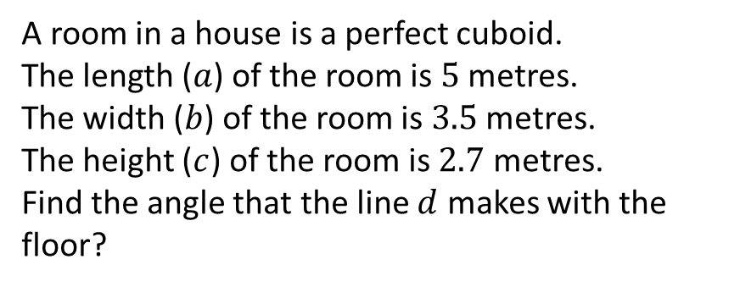
The length of a cuboid is $10cm$, the width is $6cm$ and height is $5cm$.
Find the surface area of the cuboid.
The width of the cuboid below is $n$.
The height of the cuboid is double the width and the length of the cuboid is $5$ times the width.
Find the volume of the cuboid in terms of $n$.
A room in a house is a perfect cuboid.
The length ($a$) of the room is $6$ metres.
The width ($b$) of the room is $4$ metres.
A piece of string measuring $8.02$ metres is stretched across the room (shown as $d$).
What is the height ($c$) of the room?
A room in a house is a perfect cuboid.
The length ($a$) of the room is $5$ metres.
The width ($b$) of the room is $3.5$ metres.
The height ($c$) of the room is $2.7$ metres.
Find the angle that the line $d$ makes with the floor?

Slide 3
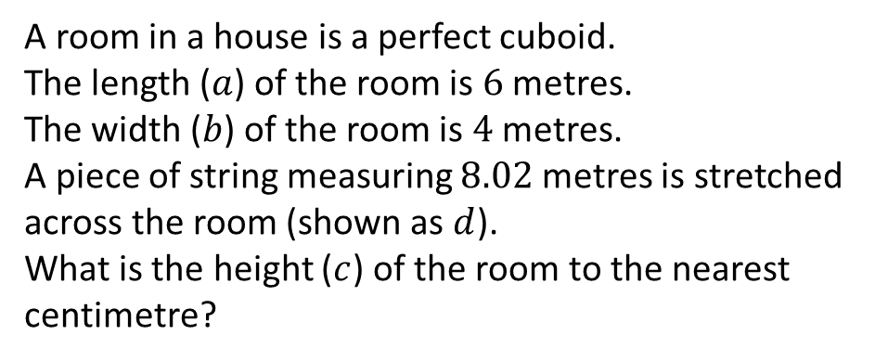
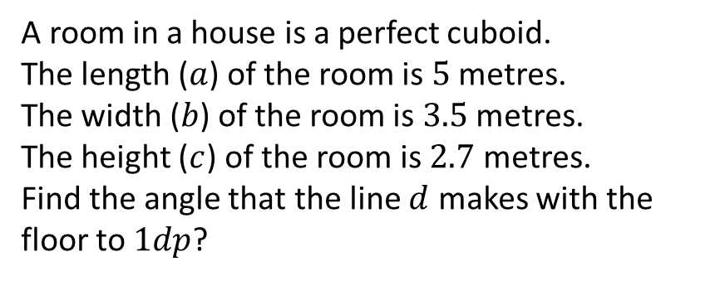




The length of a cuboid is $10cm$, the width is $6cm$ and height is $5cm$.
Find the surface area of the cuboid.
The width of the cuboid below is $n$.
The height of the cuboid is double the width and the length of the cuboid is $5$ times the width.
Find the volume of the cuboid in terms of $n$.
$$280{cm}^{2}$$
$$10n^{3}$$
A room in a house is a perfect cuboid.
The length ($a$) of the room is $6$ metres.
The width ($b$) of the room is $4$ metres.
A piece of string measuring $8.02$ metres is stretched across the room (shown as $d$).
What is the height ($c$) of the room to the nearest centimetre?
A room in a house is a perfect cuboid.
The length ($a$) of the room is $5$ metres.
The width ($b$) of the room is $3.5$ metres.
The height ($c$) of the room is $2.7$ metres.
Find the angle that the line $d$ makes with the floor to $1dp$?
$$3.51m$$
$$23.9°$$

