Slide 1
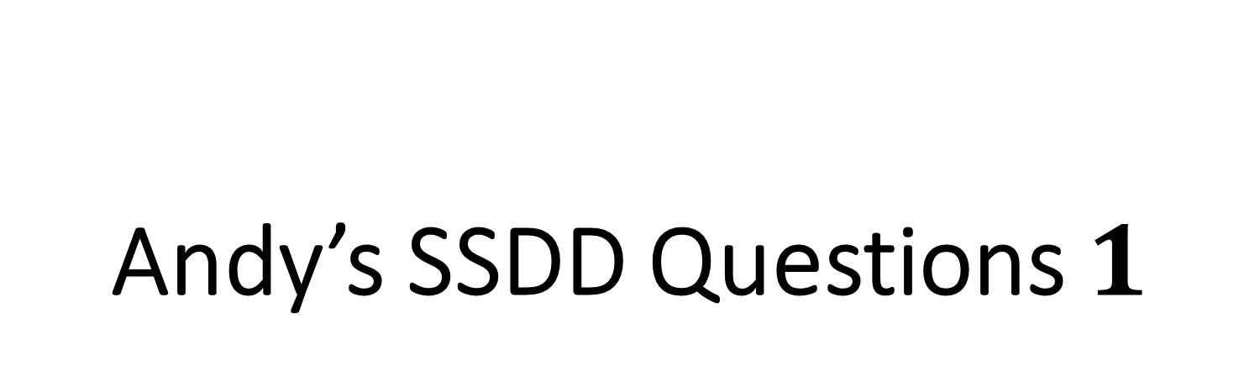
Andy’s SSDD Questions $1$
Inspired by Craig Barton’s SSDD Questions, website below:
https://ssddproblems.com/

Slide 2
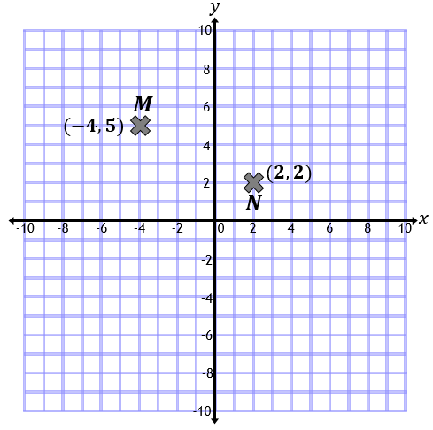
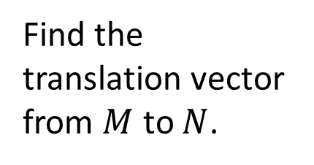
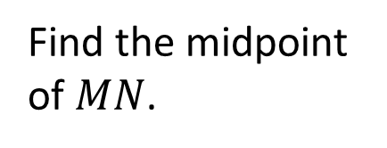
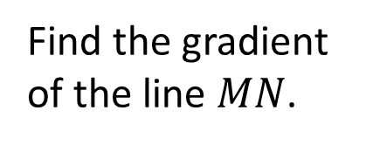
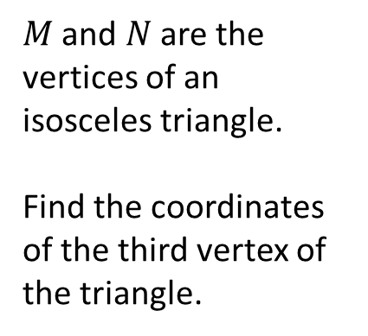
Find the translation vector from $M$ to $N$.
Find the midpoint of $MN$.
$M$ and $N$ are the vertices of an isosceles triangle.
Find the coordinates of the third vertex of the triangle.
Find the gradient of the line $MN$.

Slide 3
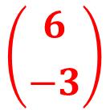


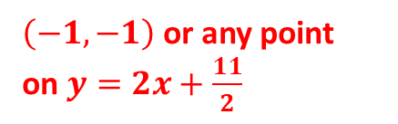
Find the translation vector from $M$ to $N$.
Find the midpoint of $MN$.
$$\left({6 \atop −3}\right)$$
$$\left(−1,3.5\right)$$
$M$ and $N$ are the vertices of an isosceles triangle.
Find the coordinates of the third vertex of the triangle.
Find the gradient of the line $MN$.
$$−\frac{1}{2}$$
$\left(−1,−1\right)$ or any point
on $y=2x+\frac{11}{2}$

