Slide 1
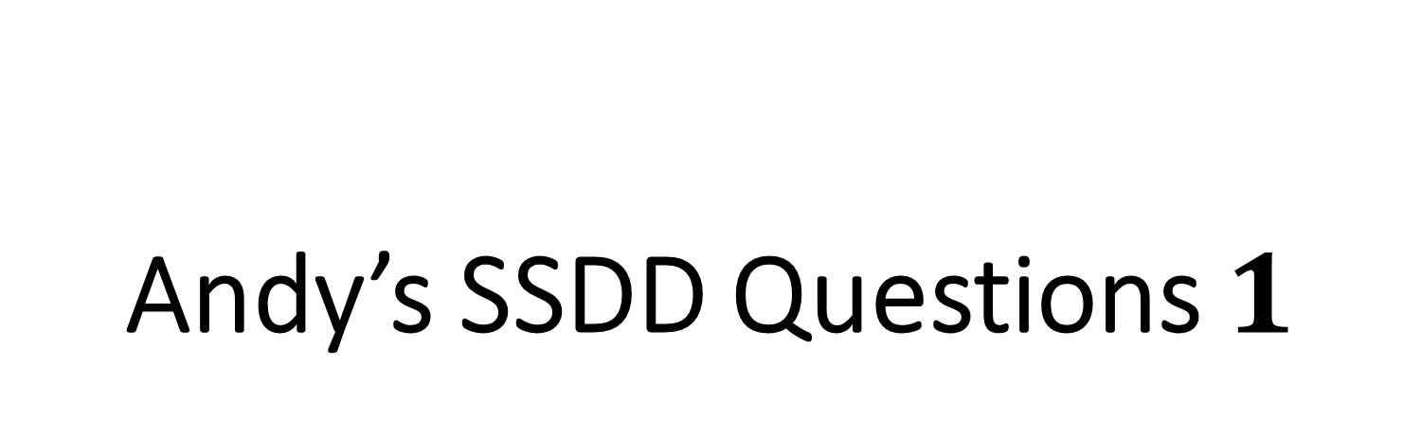
Andy’s SSDD Questions $1$
Inspired by Craig Barton’s SSDD Questions, website below:
https://ssddproblems.com/

Slide 2
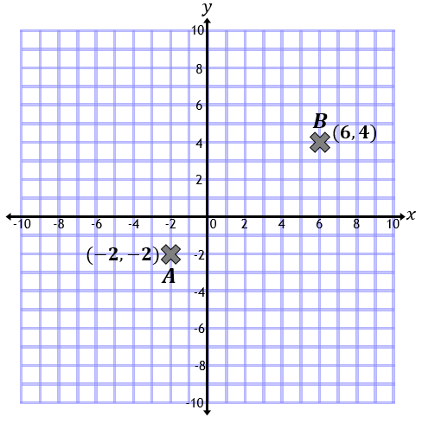
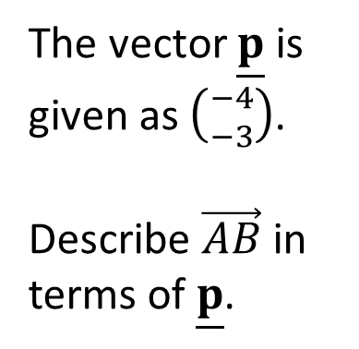
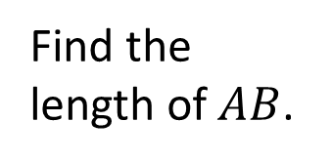
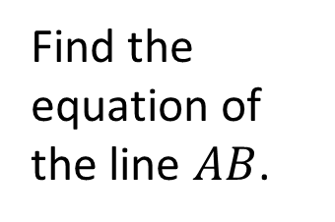
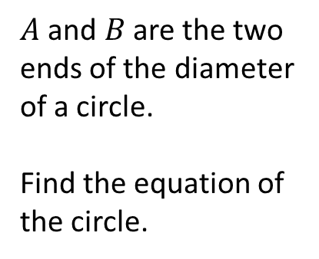
Find the length of $AB$.
The vector $\underline{p}$ is given as $\left({−4 \atop −3}\right)$.
Describe $\vec{AB}$ in terms of $\underline{p}$.
Find the equation of the line $AB$.
$A$ and $B$ are the two ends of the diameter of a circle.
Find the equation of the circle.

Slide 3
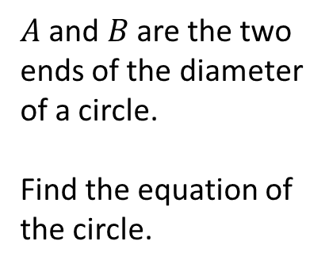



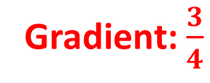


Find the length of $AB$.
The vector $\underline{p}$ is given as $\left({−4 \atop −3}\right)$.
Describe $\vec{AB}$ in terms of $\underline{p}$.
$$\sqrt{8^{2}+6^{2}}$$
$10$ units
$$−2\underline{p}$$
Find the equation of the line $AB$.
$A$ and $B$ are the two ends of the diameter of a circle.
Find the equation of the circle.
Gradient: $\frac{3}{4}$
$$4y−3x+2=0$$
$${\left(x−2\right)}^{2}+{\left(y−1\right)}^{2}=25$$

