Slide 1

Andy’s SSDD Questions $1$
Inspired by Craig Barton’s SSDD Questions, website below:
https://ssddproblems.com/

Slide 2
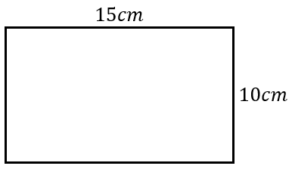
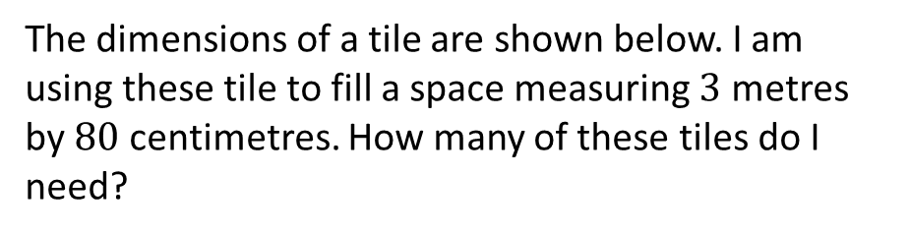
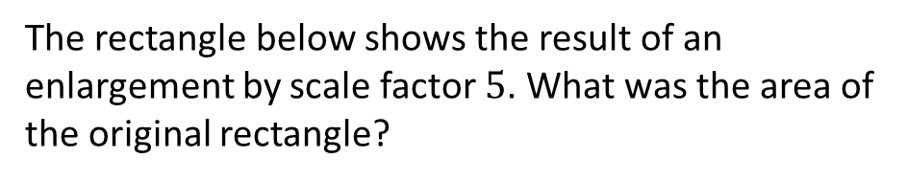
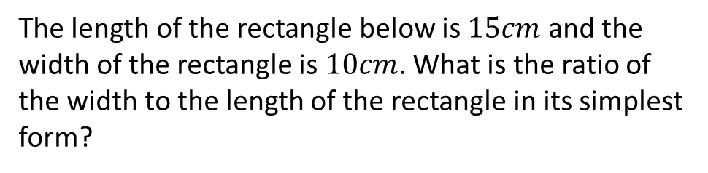
Find the perimeter and area of the rectangle below:
The length of the rectangle below is $15cm$ and the width of the rectangle is $10cm$. What is the ratio of the width to the length of the rectangle in its simplest form?
The dimensions of a tile are shown below. I am using these tile to fill a space measuring $3$ metres by $80$ centimetres. How many of these tiles do I need?
The rectangle below shows the result of an enlargement by scale factor $5$. What was the area of the original rectangle?

Slide 3

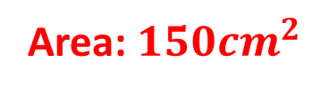



Find the perimeter and area of the rectangle below:
The length of the rectangle below is $15cm$ and the width of the rectangle is $10cm$. What is the ratio of the width to the length of the rectangle in its simplest form?
Perimeter: $50cm$
Area: $150{cm}^{2}$
$$2:3$$
The dimensions of a tile are shown below. I am using these tile to fill a space measuring $3$ metres by $80$ centimetres. How many of these tiles do I need?
The rectangle below shows the result of an enlargement by scale factor $5$. What was the area of the original rectangle?
$20×8=160$ tiles
$$6{cm}^{2}$$

