Slide 1

The Data Games
May the odds (and evens) be ever in your favour

Slide 2
The Data Games
You have been selected in the lottery to represent District F in “The Data Games”, a televised maths competition against all the other districts run by The Capital.
You must answer all the questions correctly to beat the other contestants in head-to-head maths tasks in order to survive.
Calculators are allowed in “The Data Games”.

Slide 3
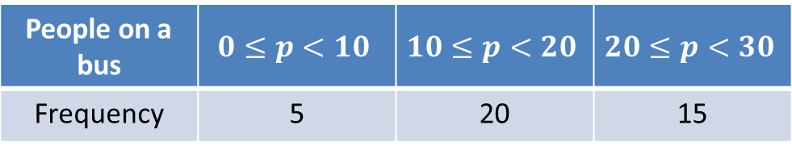
Task 1 vs District A
In this task you must use your knowledge of averages.
Answer the questions to win the battle.
Questions:
Find the median of 7,9,13,12,3,5,7,8.
Find the mean of 7,9,13,12,3,5,7,8.
Estimate the mean of
Median = 7.5
Mean = 8
People on a bus | $$0≤p<10$$ | $$10≤p<20$$ | $$20≤p<30$$
Frequency | 5 | 20 | 15
Estimated mean = 17.5

Slide 4
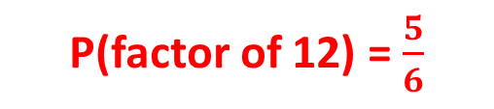
Task 2 vs District B
In this task you must use your knowledge of probability of single events.
Answer the questions correctly to win the battle.
Questions:
What is the probability of rolling a factor of 12 number on a 6 sided dice?
The probability of a football team winning is 0.30. The probability of them losing or drawing is equal. What is the probability of them losing?
P(factor of 12) = $\frac{5}{6}$
P(losing) = 0.35

Slide 5
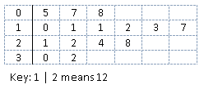
Task 3 vs District C
In this task you must use your knowledge of statistical graphs and charts.
Answer the questions correctly to win the battle.
Questions:
The most popular sport in a sample of 60 was football with 24 votes. How many degrees would this be in a pie chart?
Calculate the inter-quartile range:
Size of sector = 144⁰
IQR = 24 – 10 = 14

Slide 6
Task 4 vs District D
In this task you must use your knowledge of relative frequency.
Us the information given to answer the questions correctly in order to win the battle.
Questions:
I get six 3 times in 20 spins of a spinner. Using this information calculate how many sixes I would expect in 400 spins of the spinner.
The probability of a tennis player winning is 0.65. If the player plays 80 matches in a season, how many would they not win?
Number of 6s = 60
Not winning = 28 matches

Slide 7
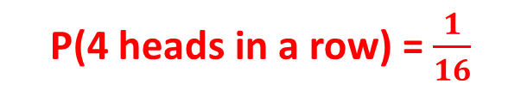
Task 5 vs District E
In this task you must use your knowledge of the probability of independent events.
Answer the questions correctly to win this battle.
Questions:
What is the probability of flipping 4 heads in a row with a normal coin?
The probability that choose a green counter from a bag is 0.4. If I replace the counter I chose first time, what is the probability that I don’t chose 2 greens with 2 picks?
P(4 heads in a row) = $\frac{1}{16}$
P(not 2 green) = 0.84

Slide 8
Game Over!
You live to fight another day...

