Slide 1

The Number Games
May the odds (and evens) be ever in your favour

Slide 2
The Number Games
You have been selected in the lottery to represent District F in “The Number Games”, a televised maths competition against all the other districts run by The Capital.
You must answer all the questions correctly to beat the other contestants in head-to-head maths tasks in order to survive.
Calculators are forbidden!

Slide 3
Task 1 vs District A
Answers:
3 × 4 + 2 = 14
7 - 20 ÷ 4 = 2
(4 + 3) × 5 = 35
(2 + 5) × (3 + 4) = 49
(2 + 12 ÷ 3) × 5 = 30
In this task you must use your knowledge of the order of operations to ensure that the calculations make the totals given.
You may use +, -, ×, ÷ and brackets only.
You may use each as many times as you like.
Questions:
3 _ 4 _ 2 = 14
7 _ 20 _ 4 = 2
4 _ 3 _ 5 = 35
2 _ 5 _ 3 _ 4 = 49
2 _ 12 _ 3 _ 5 = 30

Slide 4
Task 2 vs District B
18
In this task you must use your knowledge of multiples, factors, primes, squares and cubes to calculate each number that’s being described.
Your coach and mentor has warned you to read all the clues carefully first.
Number 1:
I am a multiple of 3.
I am a factor of 72.
I am one less than a prime number.
I am two more than a square number.
I am greater than 10.
Number 2:
I am a factor of 24.
I am a cube number.
I am not a square number
8

Slide 5
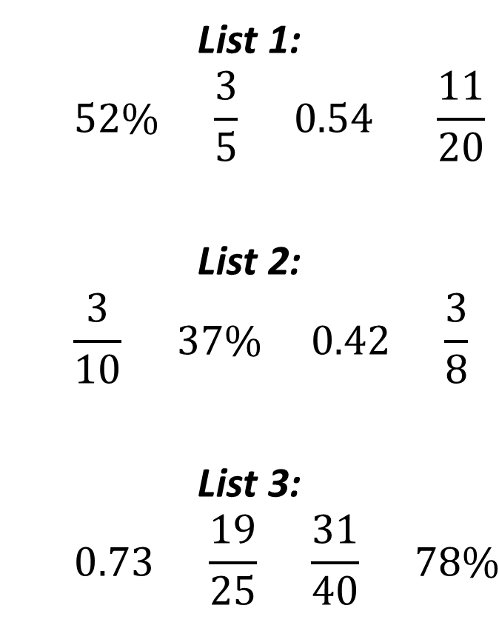
Task 3 vs District C
In this task you must use your knowledge of fractions, decimals and percentages.
You must choose which of the values in each list is the largest.
List 1:
$$52\% \frac{3}{5} 0.54 \frac{11}{20}$$
List 2:
$$\frac{3}{10} 37\% 0.42 \frac{3}{8}$$
List 3:
$$0.73 \frac{19}{25} \frac{31}{40} 78\%$$

Slide 6
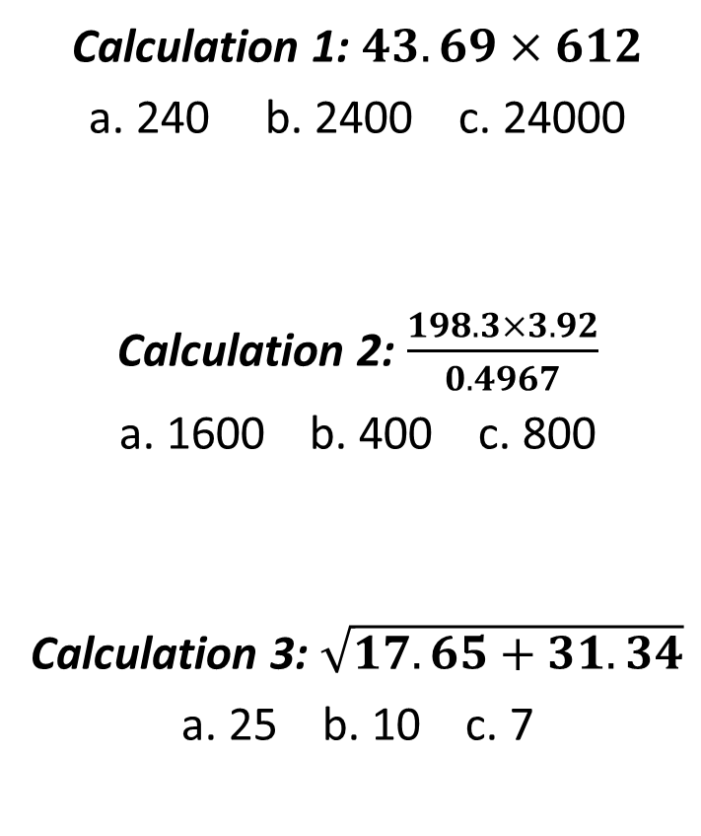
Task 4 vs District D
In this task you must use your knowledge of rounding and estimation.
You must choose the best estimate from each list.
Calculation 1: $43.69×612$
a. 240 b. 2400 c. 24000
Calculation 2: $\frac{198.3×3.92}{0.4967}$
a. 1600 b. 400 c. 800
Calculation 3: $\sqrt{17.65+31.34}$
a. 25 b. 10 c. 7

Slide 7
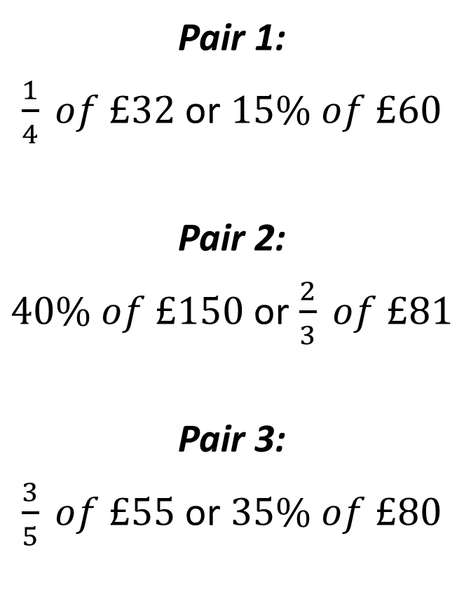
Task 5 vs District E
In this task you must use your knowledge of fractions and percentages of amounts.
You must choose which of the answers gives the lowest value.
Pair 1:
$\frac{1}{4} of £32$ or $15\% of £60$
Pair 2:
$40\% of £150$ or $\frac{2}{3} of £81$
Pair 3:
$\frac{3}{5} of £55$ or $35\% of £80$

Slide 8
Game Over!
You live to fight another day...

