Slide 1
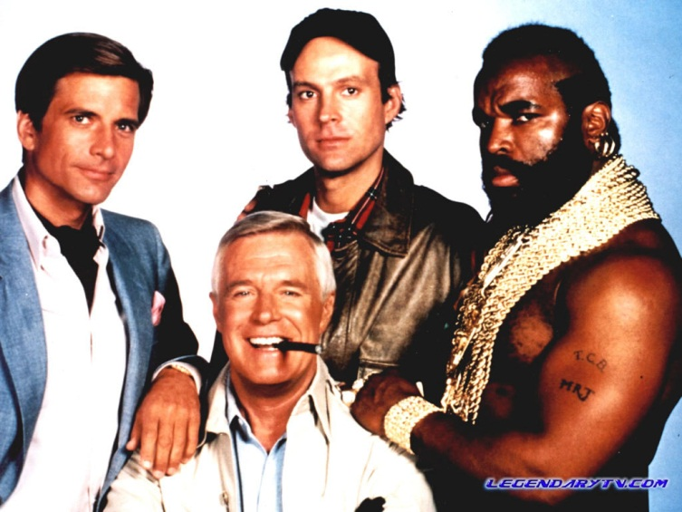
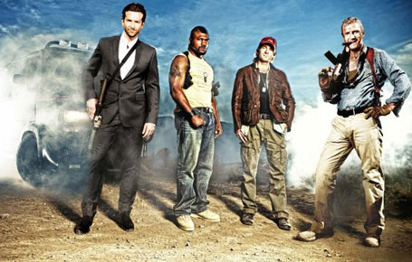
A Team Measures
The “old” A team and “new” A Team have been captured and need to build one of their trademark escape vehicles, but “old” use imperial units and “new” use metric.
Can you help with the conversions?
(Approximations will do in some cases, but be as accurate as you can or the whole escape plan will be ruined!)

Slide 2
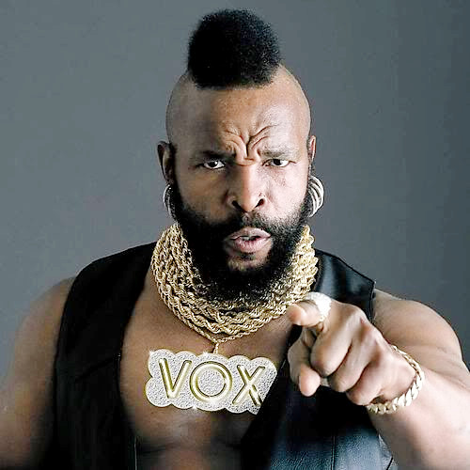

Old
B.A. Baracus
BA wants a piece of wood that is 10 feet long.
What is that in metres?
Answer: 3m

Slide 3
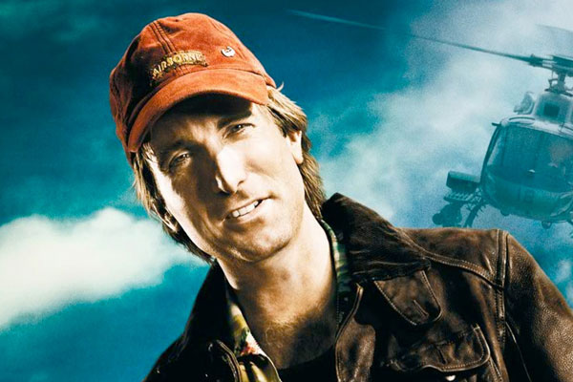
New H.M. “Howling Mad” Murdock
Murdock is looking for some 10cm screws.
What is that in inches?
Answer: 4 inches

Slide 4
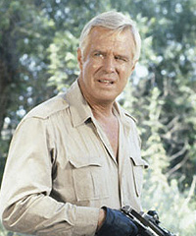
Old John “Hannibal” Smith
Hannibal is looking for 5 pounds of dynamite.
What is that in kilograms?
Answer: 2.27kg

Slide 5

New Templeton “Faceman” Peck
Face requires 6 metres of rope.
What is that in feet?
Answer: 20 feet

Slide 6
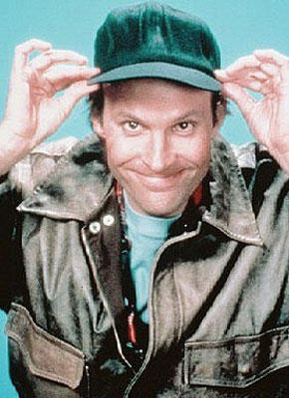
Old H.M. “Howling Mad” Murdock
Murdock is looking for 2 pints of oil.
What is that in centilitres?
Answer: 114cl

Slide 7
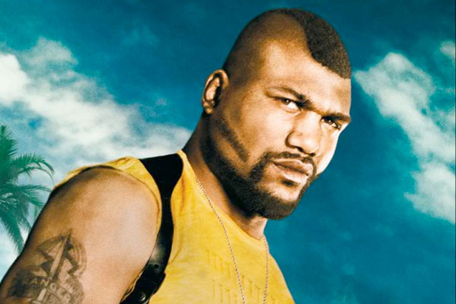
New
B.A. Baracus
BA needs 4.5kg of metal sheeting.
What is that in pounds?
Answer: 10lb

Slide 8
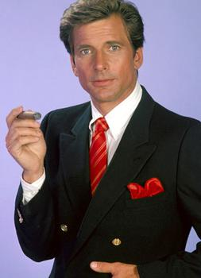
Old Templeton “Faceman” Peck
Face says that they’ll need 5 gallons of fuel.
What is that in litres?
Answer: 22.8l

Slide 9
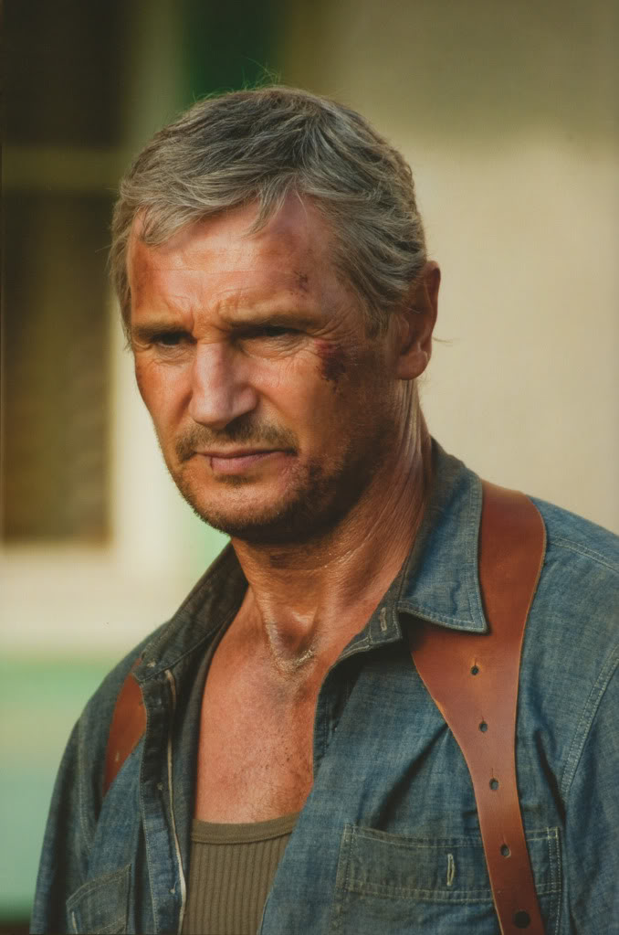
New John “Hannibal” Smith
Hannibal is looking for some 3 inch nails.
What is that in centimetres?
Answer: 7.5cm

Slide 10

thank you for your assistance!

