Slide 1
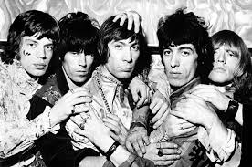

Metric and Imperial Units with…
One Direction
The Rolling Stones

Slide 2

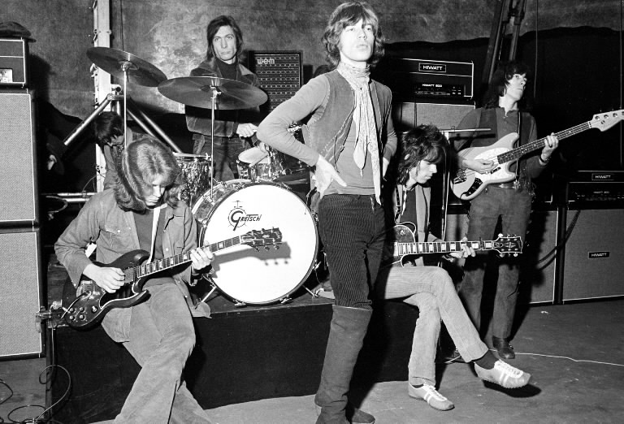
What’s going on?
The two bands have met up at a music awards night and are swapping stories from their careers.
The problem is that 1D were brought up in a metric world and The Stones in an imperial.
Can you do rough conversions for each band so that they understand what the other is saying?

Slide 3
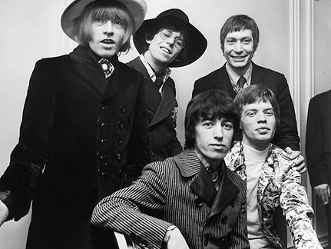
Mick said:
Answer:
300cm or 3m
We once had cardboard cut-outs of ourselves that were 10 feet tall!

Slide 4

Niall said:
We have to run about 16km per day to be fit enough for our routines.
Answer:
10 miles

Slide 5
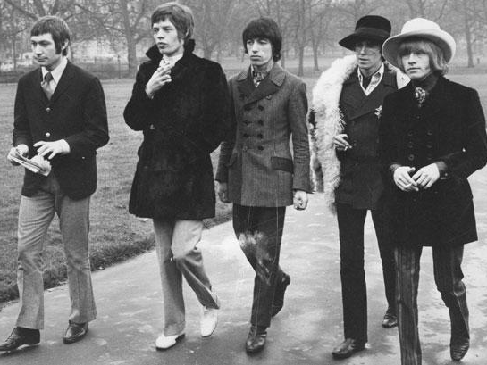
Keith said:
My guitar amp weighed a massive 3 stone for one tour!
Answer:
15-20kg

Slide 6

Louis said:
Answer:
10 inches or just under a foot
Our 1D dolls are about 25 centimetres tall and sell millions worldwide.

Slide 7
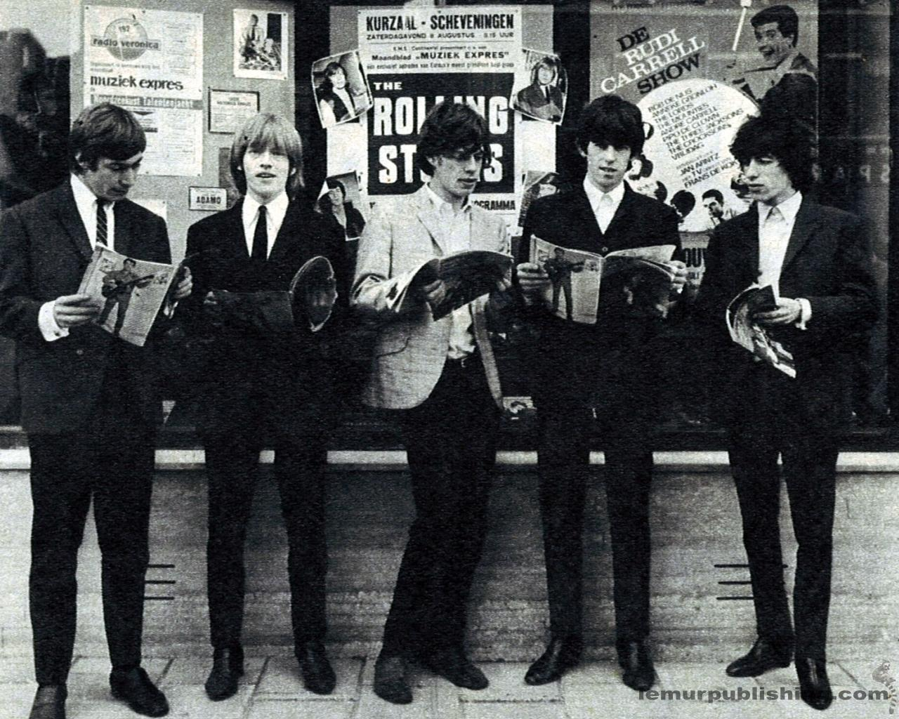
Brian said:
Answer:
7 or 8 litres
We used to get 15 pints of mild each left in the dressing room for after every show.

Slide 8

Liam said:
Answer:
1 stone or 14lb
We insist on a bowl of blue Smarties weighing 7kg.

Slide 9
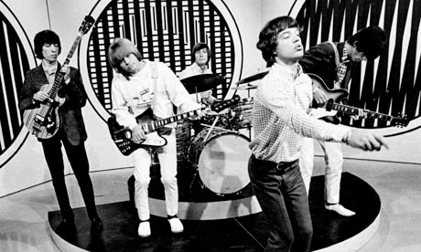
Charlie said:
One gig was so loud that you could hear it 20 miles away.
Answer:
32 km

Slide 10

Zayn said:
I once lost about 14kg on one tour due to all the dancing whilst we perform.
Answer:
2 stone

Slide 11
Bill said:
Answer:
4.5 to 5kg
Our rider used to include 10lb of chocolate each.

Slide 12

Harry said:
We each drink around 6 litres of water every day whilst touring.
Answer:
12 pints

Slide 13
Cheers everyone!
You did the best job ever!
I got some satisfaction!
Clearly neither of these bands actually said any of the stuff in the presentation, it’s just for mathematical purposes!

