Slide 1
Maths Pub Quiz
For GCSE revision purposes…

Slide 2
How the quiz works:
There will be 5 rounds: “Number”, “Algebra”, “Shape and Space”, “Data Handling” and “Using and Applying”.
All rounds will contain 10 questions (5 non-calculator, 5 calculator) except the “Using and Applying” round, which will contain 5 calculator questions.
Questions are worth 1 point each except the Using and Applying question which are worth 3 points each.
You can choose between 2 different quizzes:
“Higher A* to C” or “Foundation C to E”

Slide 3
Choose your quiz:
HigherA* to C
Foundation C to E

Slide 4
Welcome to the A* to C Quiz
HigherA* to C
Strap yourself in and enjoy!
Try to come up with an amusing, but clean, team name!

Slide 5
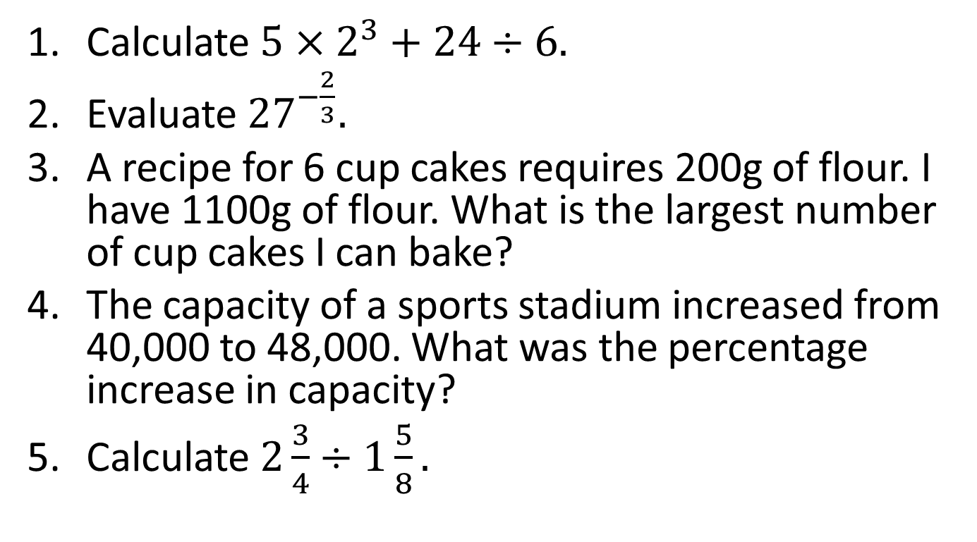
Round 1 – Number (non-calculator)
Calculate $5×2^{3}+24÷6.$
Evaluate ${27}^{−\frac{2}{3}}.$
A recipe for 6 cup cakes requires 200g of flour. I have 1100g of flour. What is the largest number of cup cakes I can bake?
The capacity of a sports stadium increased from 40,000 to 48,000. What was the percentage increase in capacity?
Calculate $2\frac{3}{4}÷1\frac{5}{8}.$

Slide 6
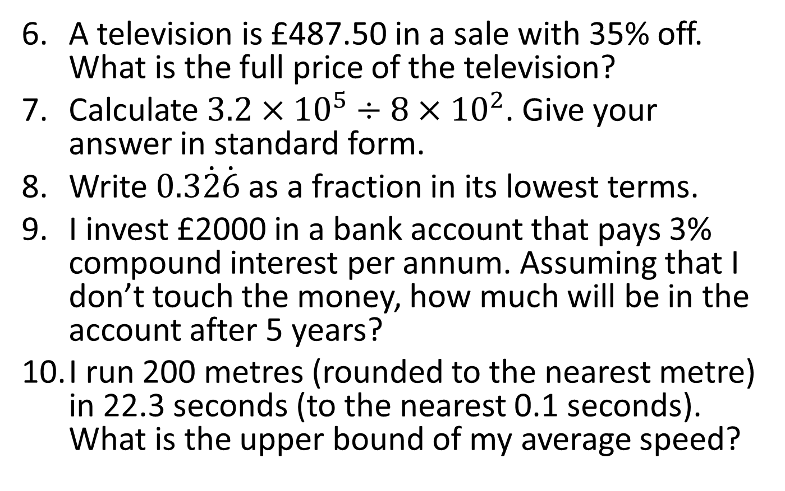
Round 1 - Number
A television is £487.50 in a sale with 35% off. What is the full price of the television?
Calculate $3.2×{10}^{5}÷8×{10}^{2}$. Give your answer in standard form.
Write $0.3\dot{2}\dot{6}$ as a fraction in its lowest terms.
I invest £2000 in a bank account that pays 3% compound interest per annum. Assuming that I don’t touch the money, how much will be in the account after 5 years?
I run 200 metres (rounded to the nearest metre) in 22.3 seconds (to the nearest 0.1 seconds). What is the upper bound of my average speed?

Slide 7
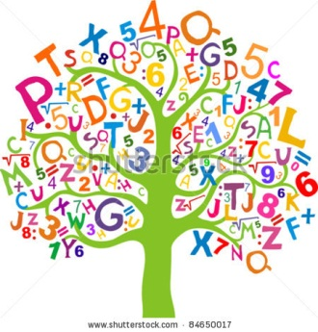
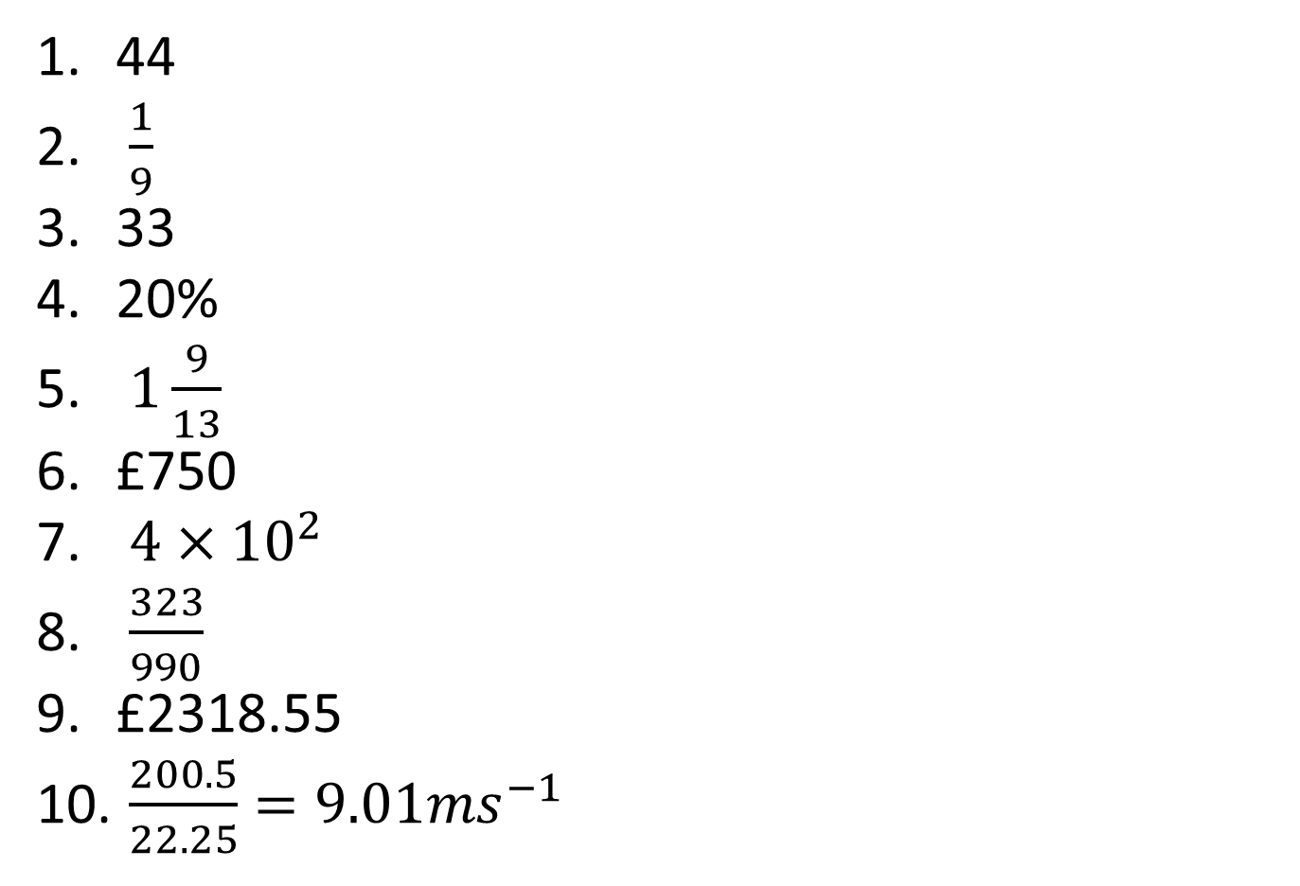
Answers - Number
44
$\frac{1}{9}$
33
20%
$1\frac{9}{13}$
£750
$4×{10}^{2}$
$\frac{323}{990}$
£2318.55
$\frac{200.5}{22.25}=9.01{ms}^{−1}$

Slide 8
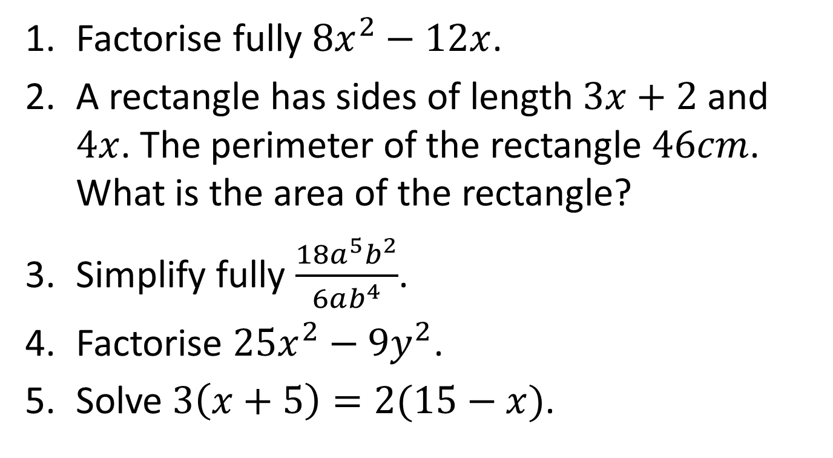
Round 2 – Algebra (non-calculator)
Factorise fully ${8x}^{2}−12x$.
A rectangle has sides of length $3x+2$ and $4x$. The perimeter of the rectangle $46cm$. What is the area of the rectangle?
Simplify fully $\frac{18a^{5}b^{2}}{6ab^{4}}$.
Factorise $25x^{2}−9y^{2}$.
Solve $3\left(x+5\right)=2(15−x)$.

Slide 9
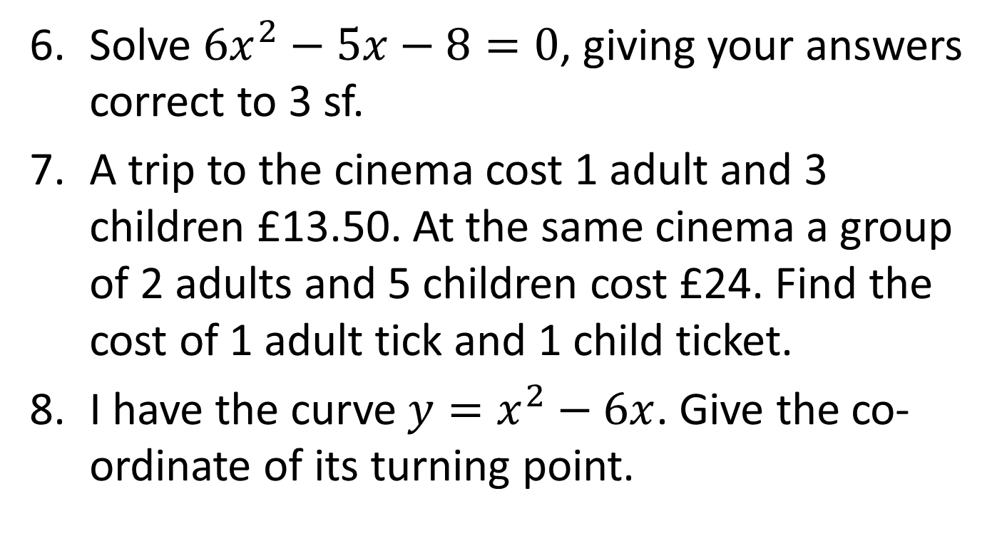
Round 2 - Algebra
Solve ${6x}^{2}−5x−8=0$, giving your answers correct to 3 sf.
A trip to the cinema cost 1 adult and 3 children £13.50. At the same cinema a group of 2 adults and 5 children cost £24. Find the cost of 1 adult tick and 1 child ticket.
I have the curve $y=x^{2}−6x$. Give the co-ordinate of its turning point.

Slide 10
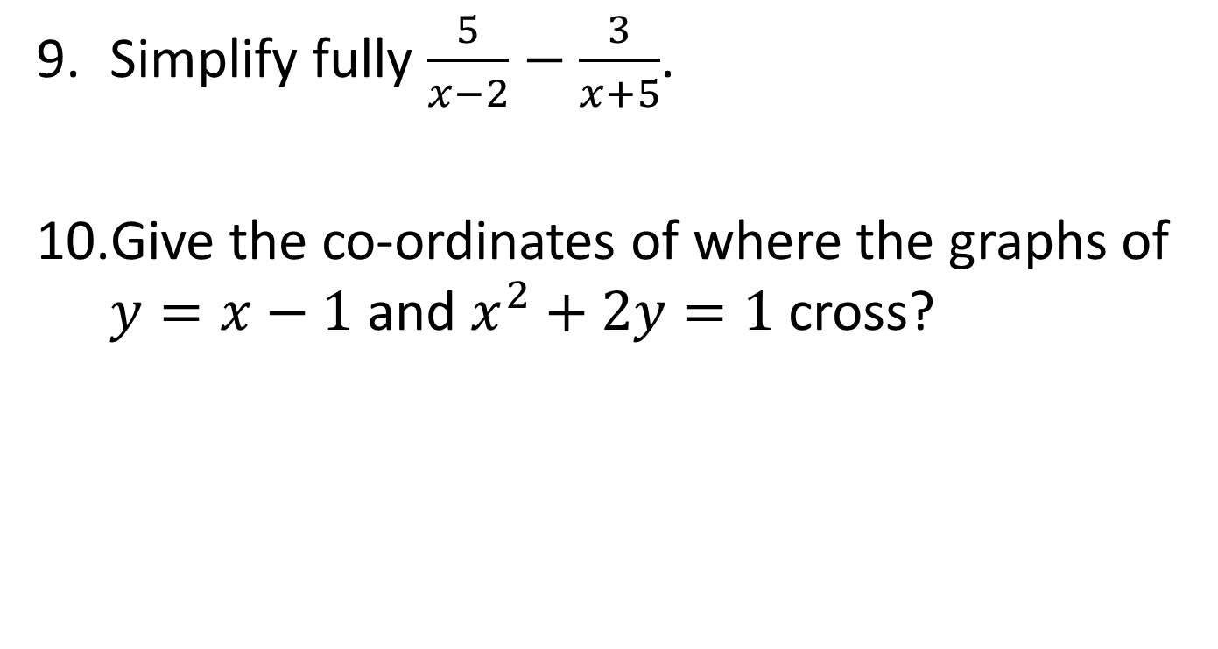
Round 2 - Algebra
Simplify fully $\frac{5}{x−2}−\frac{3}{x+5}$.
Give the co-ordinates of where the graphs of $y=x−1$ and $x^{2}+2y=1$ cross?

Slide 11
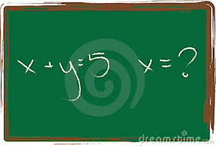
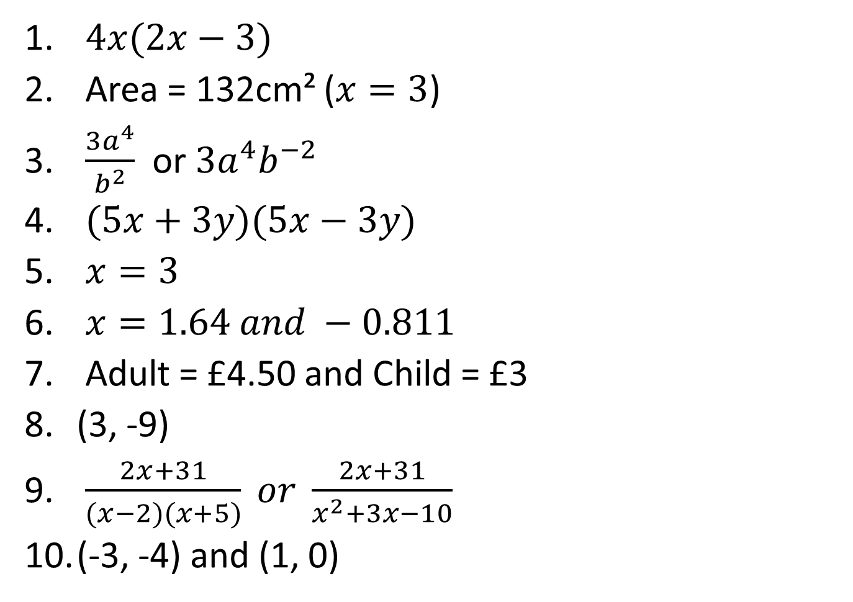
Answers - Algebra
$4x(2x−3)$
Area = 132cm² ($x=3$)
$\frac{{3a}^{4}}{b^{2}}$ or $3a^{4}b^{−2}$
$(5x+3y)(5x−3y)$
$x=3$
$x=1.64 and −0.811$
Adult = £4.50 and Child = £3
(3, -9)
$\frac{2x+31}{(x−2)(x+5)} or \frac{2x+31}{x^{2}+3x−10}$
(-3, -4) and (1, 0)

Slide 12
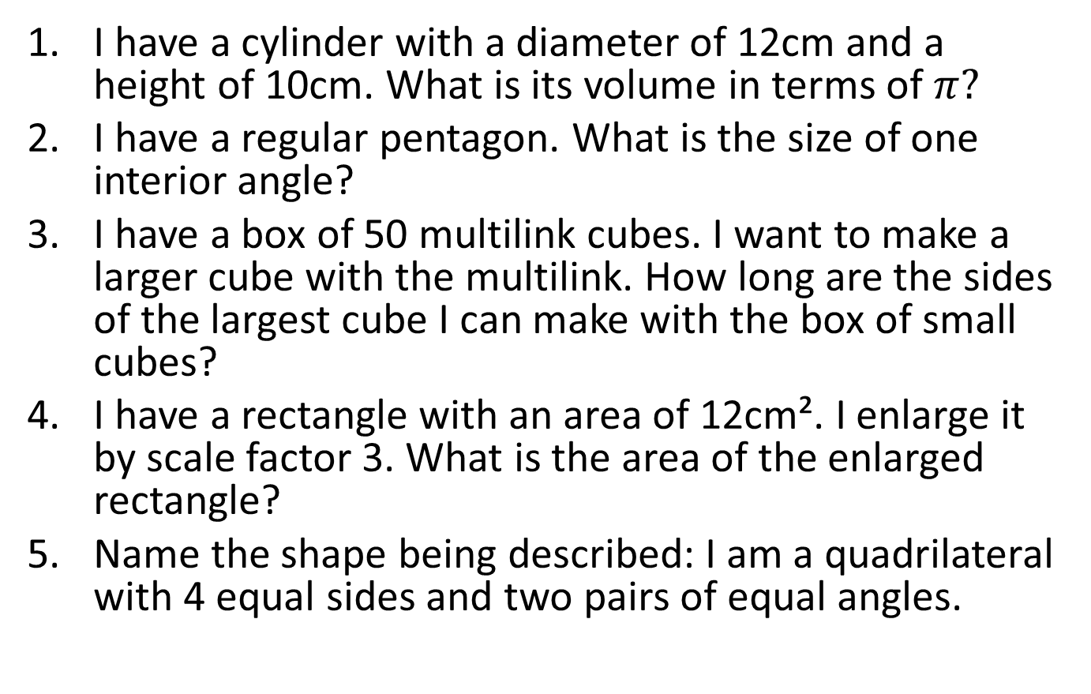
Round 3 – Shape and Space (non-calculator)
I have a cylinder with a diameter of 12cm and a height of 10cm. What is its volume in terms of $π?$
I have a regular pentagon. What is the size of one interior angle?
I have a box of 50 multilink cubes. I want to make a larger cube with the multilink. How long are the sides of the largest cube I can make with the box of small cubes?
I have a rectangle with an area of 12cm². I enlarge it by scale factor 3. What is the area of the enlarged rectangle?
Name the shape being described: I am a quadrilateral with 4 equal sides and two pairs of equal angles.

Slide 13
Round 3 – Shape and Space
I have a triangle with the sides 8cm, 9cm and 4cm. Does my triangle contain a right angle? Explain your answer.
A 3.5 metre ladder leans against a wall. The base of the ladder is 1.3 metres from the base of the wall. To be considered safe, the angle of elevation of the ladder must be between 70⁰ and 80⁰. Is the ladder safe? Explain your answer.

Slide 14
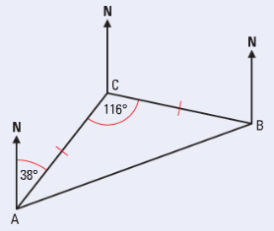
Round 3 – Shape and Space
What is the bearing of B from A?
What is the bearing of C from B?

Slide 15
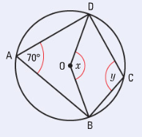
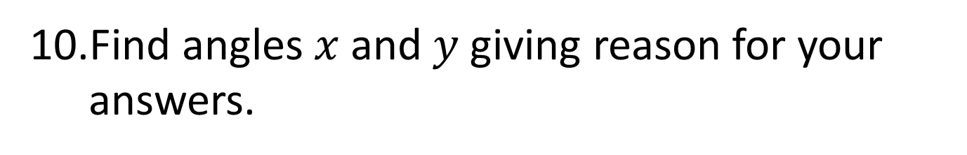
Round 3 – Shape and Space
Find angles $x$and $y$ giving reason for your answers.

Slide 16
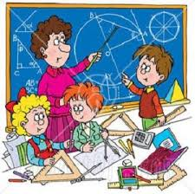
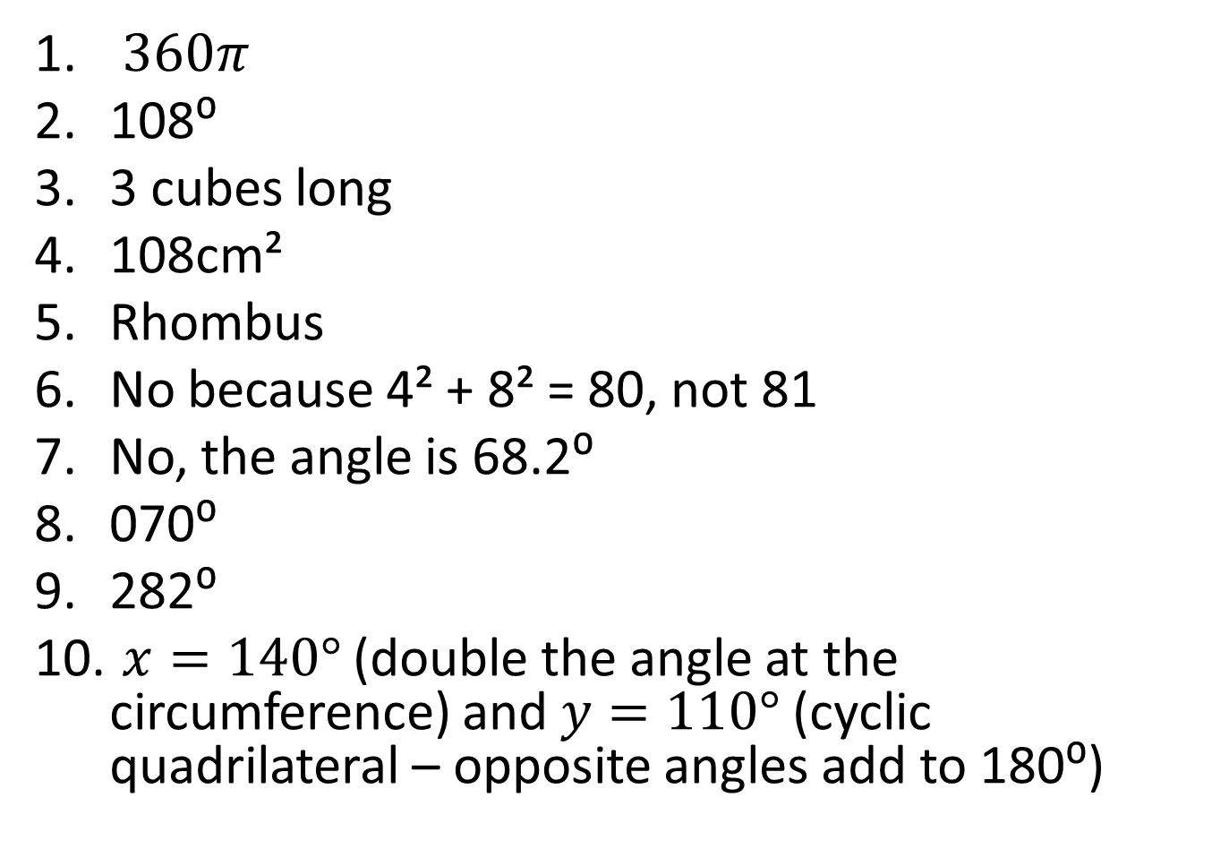
Answers – Shape and Space
$360π$
108⁰
3 cubes long
108cm²
Rhombus
No because 4² + 8² = 80, not 81
No, the angle is 68.2⁰
070⁰
282⁰
$x=140°$ (double the angle at the circumference) and $y=110°$ (cyclic quadrilateral – opposite angles add to 180⁰)

Slide 17
Round 4 – Data Handling (non-calculator)
A basketball team averages 82 points per game after 5 games. After 6 games their average fell to 80 points per game. How many points did they score in their sixth game?
Sandra is doing a questionnaire on how much music people buy. She asked her maths class this question:
How many songs do you download?
0 to 10 10 to 20 20 to 30 More than 30
Give two ways in which Sandra’s question can be improved.

Slide 18
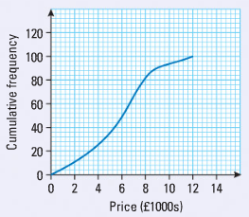
Round 4 – Data Handling (non-calculator)
Find the median price from the graph below.
Find the inter-quartile range from the graph below.

Slide 19
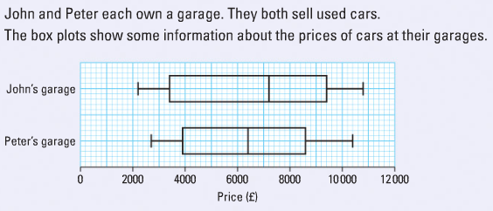
Round 4 – Data Handling (non-calculator)
Give two comparisons of the data below.

Slide 20
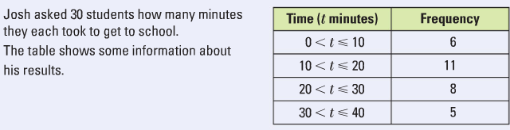
Round 4 – Data Handling
What is the modal group from the table?
Estimate the mean of the data in the table.

Slide 21
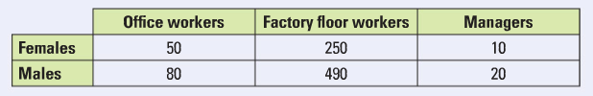
Round 4 – Data Handling
A company plans to do a stratified sample of 60 employees in a factory. Below is the breakdown of each type of employee:
How many female factory floor workers should they select?

Slide 22
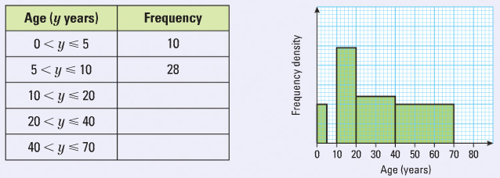
Round 4 – Data Handling
Complete the table.
Estimate how many people were older than 30.

Slide 23
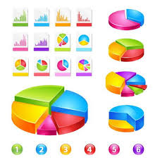
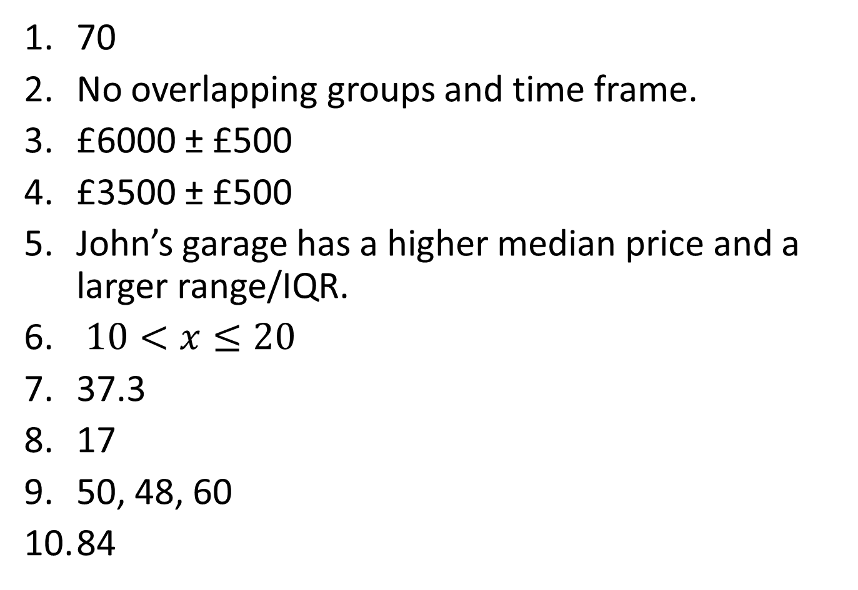
Answers – Data Handling
70
No overlapping groups and time frame.
£6000 ± £500
£3500 ± £500
John’s garage has a higher median price and a larger range/IQR.
$10<x≤20$
37.3
17
50, 48, 60
84

Slide 24
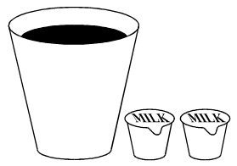
Round 5 – Using and Applying
A coffee machine dispenses 130 millilitres of black coffee into cups with a capacity of 175 millilitres. These values are accurate to 3 significant figures. Milk is supplied in small cartons which contain 21 millilitres, accurate to the nearest millilitre. Beryl likes milky coffee and always puts 2 cartons of milk in her coffee. Will Beryl’s cup ever overflow?

Slide 25
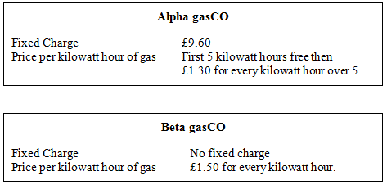
Round 5 – Using and Applying
Two gas supply companies have different ways of charging for the gas they supply.
Find the number of kilowatt hours after which Alpha gasCo becomes cheaper than Beta gasCo.

Slide 26
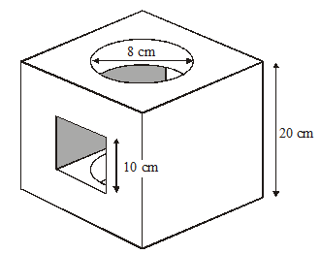
Round 5 – Using and Applying
A solid cube has a square hole cut through horizontally and a circular hole cut through vertically. Both holes are cut centrally in the appropriate faces. The dimensions of the cube and the holes are as shown in the diagram.
Calculate the volume remaining after the holes have been cut.

Slide 27
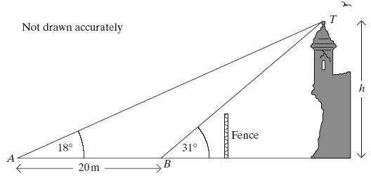
Round 5 – Using and Applying
A ruined tower is fenced off for safety reasons. To find the height of the tower Rashid stands at a point A and measures the angle of elevation as 18°. He then walks 20 metres directly towards the base of the tower to point B where the angle of elevation is 31°.
Calculate the height, h, of the tower.

Slide 28
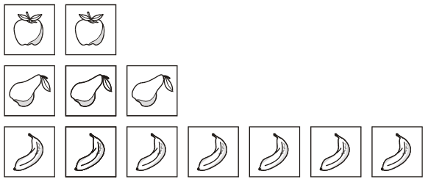
Round 5 – Using and Applying
Ingrid has 12 picture cards.
There are 2 apples, 3 pears and 7 bananas.
Ingrid chooses 2 cards at random. Calculate the probability that both cards are the same.

Slide 29
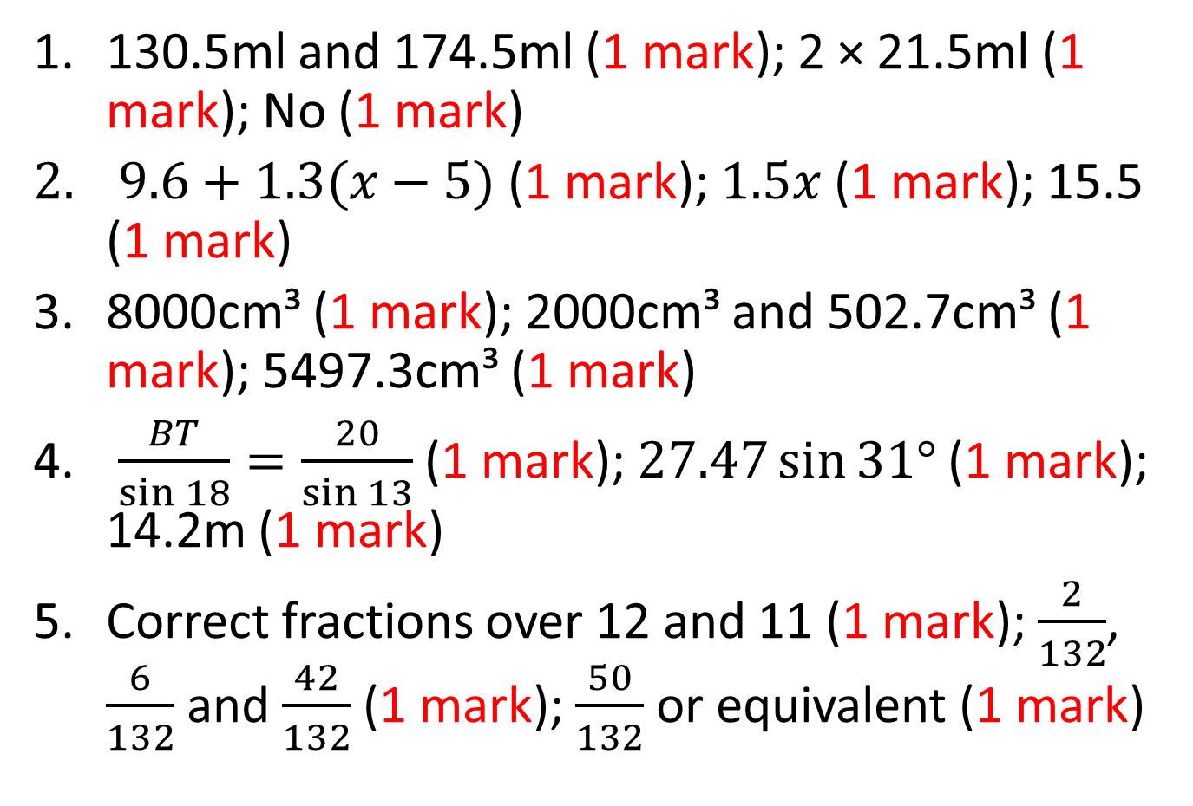
Answers – Using and Applying
130.5ml and 174.5ml (1 mark); 2 × 21.5ml (1 mark); No (1 mark)
$9.6+1.3(x−5)$ (1 mark); $1.5x$ (1 mark); 15.5 (1 mark)
8000cm³ (1 mark); 2000cm³ and 502.7cm³ (1 mark); 5497.3cm³ (1 mark)
$\frac{BT}{\sin{18}}=\frac{20}{\sin{13}}$ (1 mark); $27.47\sin{31°}$ (1 mark); 14.2m (1 mark)
Correct fractions over 12 and 11 (1 mark); $\frac{2}{132}$, $\frac{6}{132}$ and $\frac{42}{132}$ (1 mark); $\frac{50}{132}$ or equivalent (1 mark)

Slide 30
Welcome to the C to E Quiz
Foundation C to E
Strap yourself in and enjoy!
Try to come up with an amusing, but clean, team name!

Slide 31
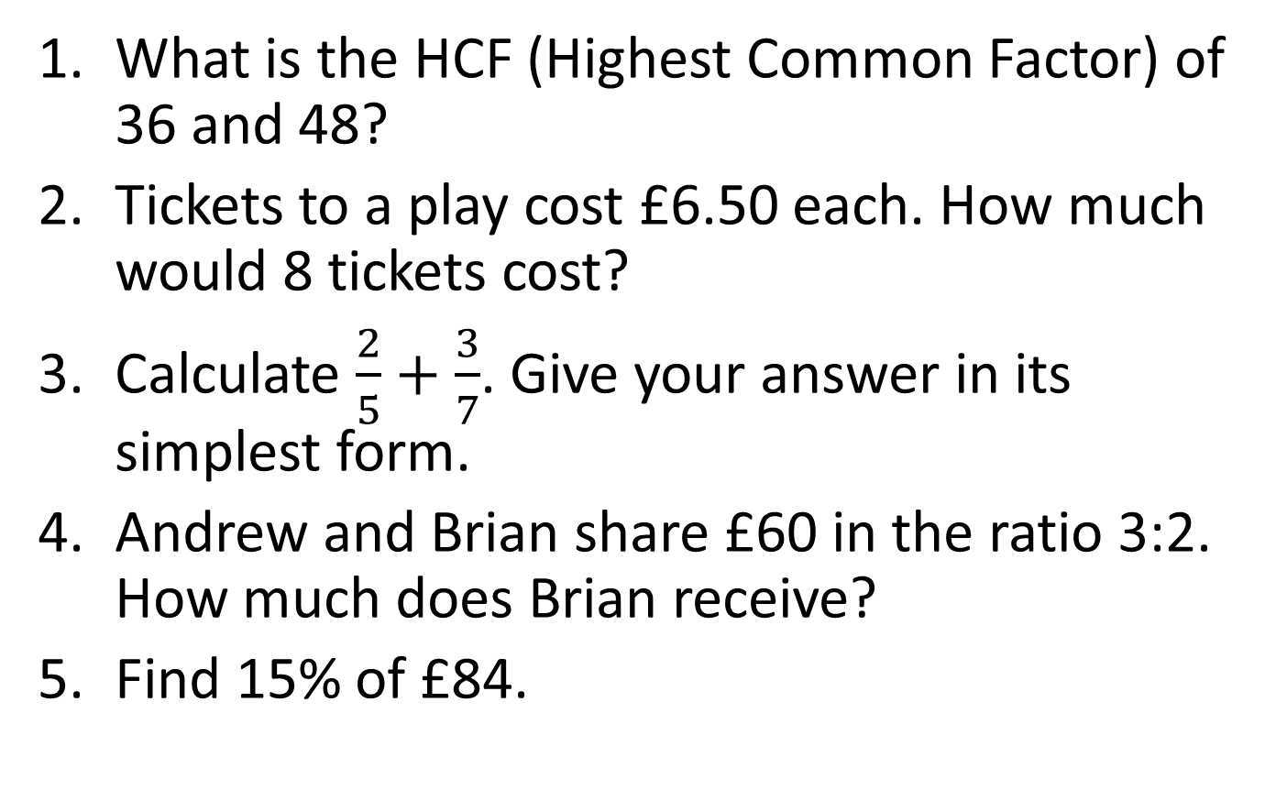
Round 1 – Number (non-calculator)
What is the HCF (Highest Common Factor) of 36 and 48?
Tickets to a play cost £6.50 each. How much would 8 tickets cost?
Calculate $\frac{2}{5}+\frac{3}{7}$. Give your answer in its simplest form.
Andrew and Brian share £60 in the ratio 3:2. How much does Brian receive?
Find 15% of £84.

Slide 32
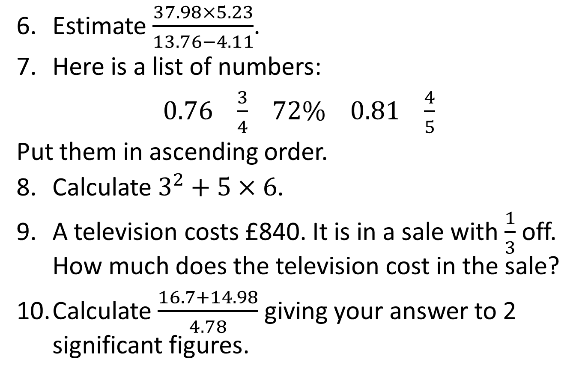
Round 1 - Number
Estimate $\frac{37.98×5.23}{13.76−4.11}$.
Here is a list of numbers:
$0.76$ $\frac{3}{4}$ $72\%$ $0.81$ $\frac{4}{5}$
Put them in ascending order.
Calculate $3^{2}+5×6$.
A television costs £840. It is in a sale with $\frac{1}{3}$ off. How much does the television cost in the sale?
Calculate $\frac{16.7+14.98}{4.78}$ giving your answer to 2 significant figures.

Slide 33
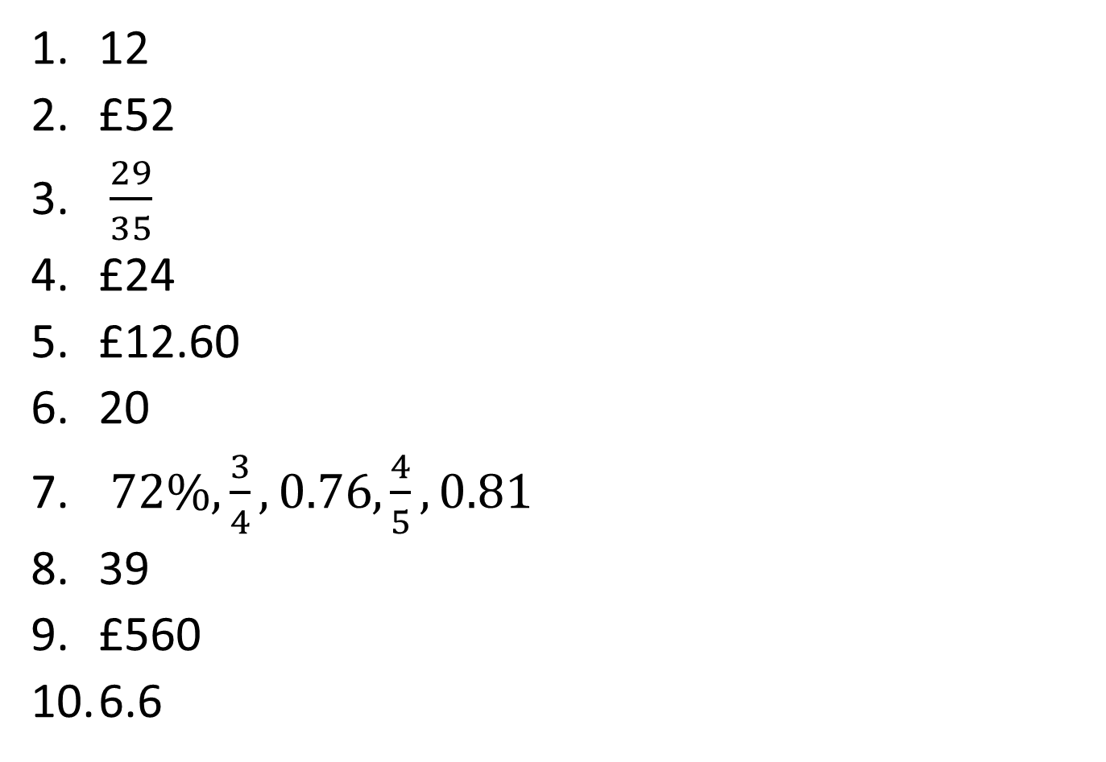
Answers - Number
12
£52
$\frac{29}{35}$
£24
£12.60
20
$72\%, \frac{3}{4},0.76,\frac{4}{5},0.81$
39
£560
6.6

Slide 34
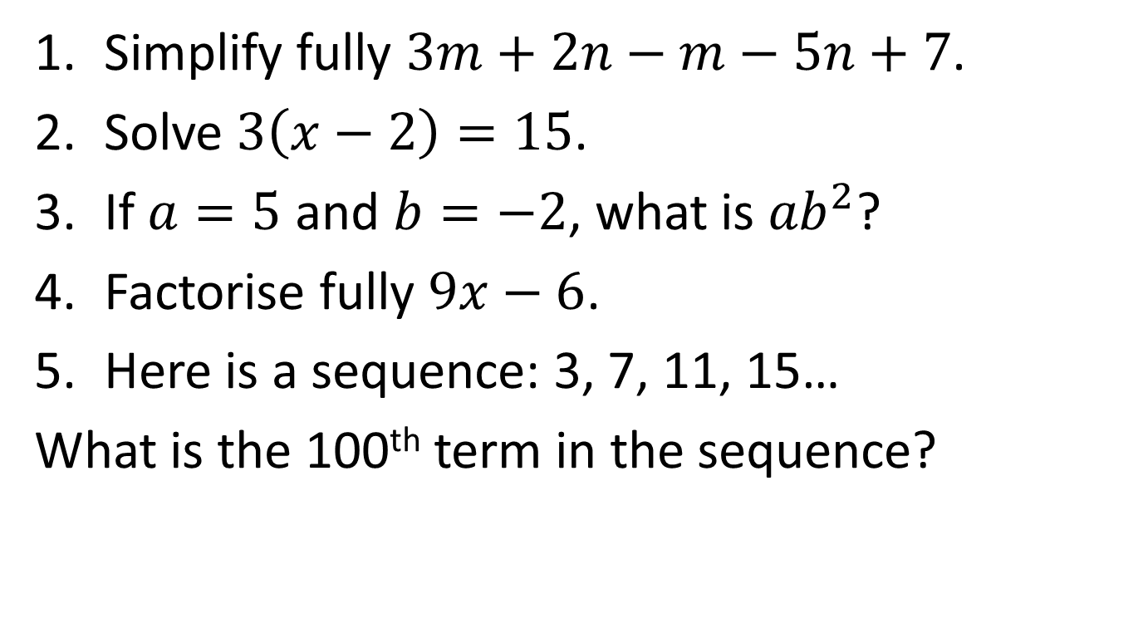
Round 2 – Algebra (non-calculator)
Simplify fully $3m+2n−m−5n+7$.
Solve $3\left(x−2\right)=15$.
If $a=5$ and $b=−2$, what is ${ab}^{2}$?
Factorise fully $9x−6$.
Here is a sequence: 3, 7, 11, 15…
What is the 100th term in the sequence?

Slide 35
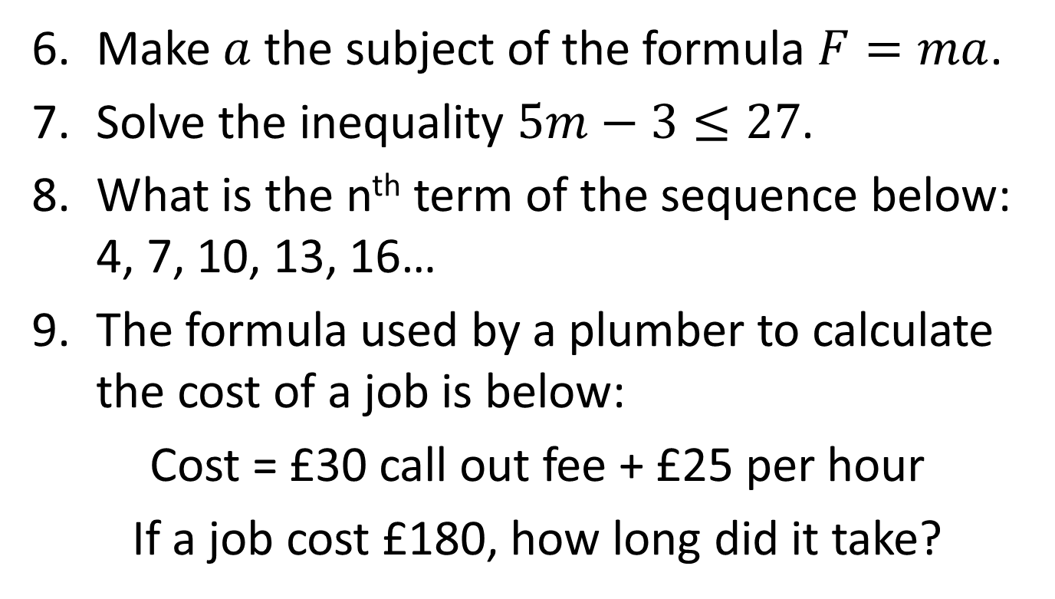
Round 2 - Algebra
Make $a$ the subject of the formula $F=ma$.
Solve the inequality $5m−3≤27$.
What is the n^{th} term of the sequence below: 4, 7, 10, 13, 16…
The formula used by a plumber to calculate the cost of a job is below:
Cost = £30 call out fee + £25 per hour
If a job cost £180, how long did it take?

Slide 36
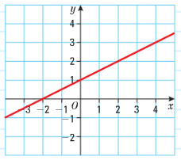
Round 2 - Algebra
What is the gradient of the line below?

Slide 37
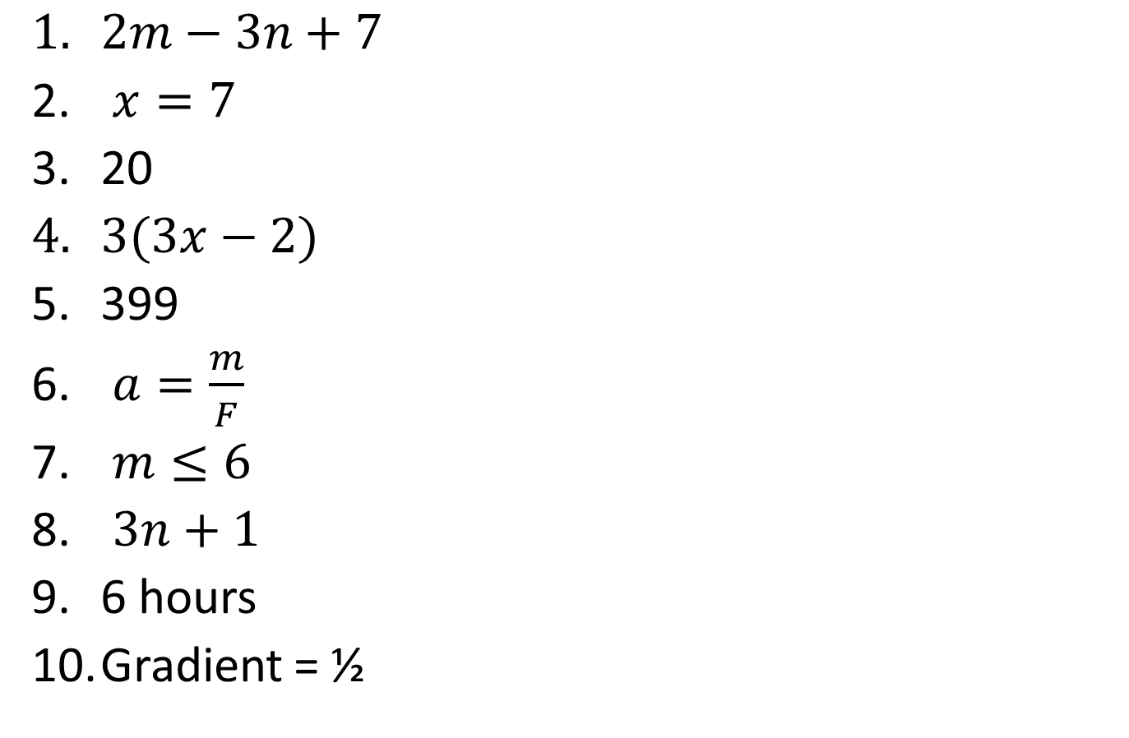
Answers - Algebra
$2m−3n+7$
$x=7$
20
$3(3x−2)$
399
$a=\frac{m}{F}$
$m≤6$
$3n+1$
6 hours
Gradient = ½

Slide 38
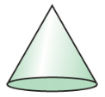
Round 3 – Shape and Space (non-calculator)
How many degrees are there in a quadrilateral?
What is the bearing of West?
I bought a 2 litre bottle of cola. I fill a 600 millilitre cup from the bottle. How much do I have left in the bottle?
Name this shape:

Slide 39
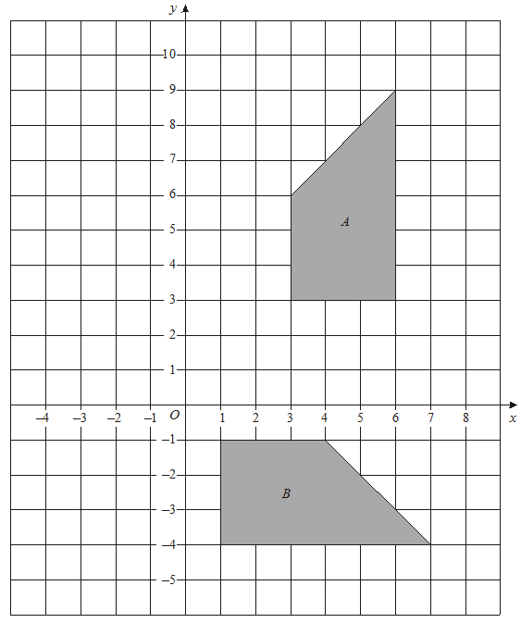
Round 3 – Shape and Space (non-calculator)
Describe fully the single transformation that takes shape A to shape B:

Slide 40
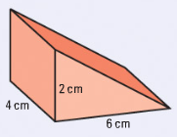
Round 3 – Shape and Space
A film begins at 3.40pm and finishes at 5.25pm. How long is the film?
A scale on a map is given as 1:100000. The road on my map is 6cm long. How many kilometres is the road in real life?
What is the volume of this prism?

Slide 41
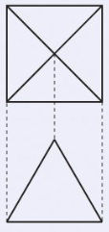
Round 3 – Shape and Space
Below are pictures of the views of a 3D shape from above and the side. Name the shape.

Slide 42
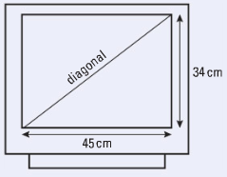
Round 3 – Shape and Space
Find the length of the diagonal on this television below:

Slide 43
Answers – Shape and Space
360⁰
270⁰
1400ml or 1.4 litres
Cone
Rotation, 90⁰ clockwise, centre (0,2)
105 minutes or 1 hour 45 minutes
6km
24cm³
Square based pyramid
56.4cm

Slide 44
Round 4 – Data Handling (non-calculator)
I have a bag containing 5 blue, 3 red and 4 green balls. What is the probability of not picking a blue ball?
The boys in a class got these test results:
12, 9, 8, 13, 15, 7, 8, 6, 8, 15
What is the median mark for the boys?
What is the mode mark for the class?
What is the range of the boys’ marks?

Slide 45
Round 4 – Data Handling (non-calculator)
Jenny is doing a survey about pocket money. She’s decided to ask this question:
How much pocket money do you receive?
£0 to £5 £5 to £10 £10 to £15 £15 to £20
Give two criticisms of Jenny’s question.

Slide 46
Round 4 – Data Handling
I roll a dice 30 times. How many times would I expect to roll a six?
In the experiment in question 6 I actually rolled a six 18 times. Is the dice biased? Explain your answer.
Find the mean of these test scores:
12, 9, 8, 13, 15, 7, 8, 6, 8, 15

Slide 47
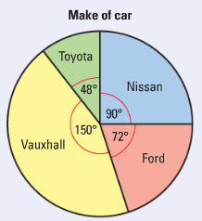
Round 4 – Data Handling
1200 people were asked what make of car they own. The pie chart shows the results:
How many people own a Ford?

Slide 48
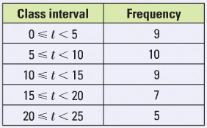
Round 4 – Data Handling
Emma timed her last 40 phone calls. The results are given in the table below:
Estimate the mean length of Emma’s phone calls.

Slide 49
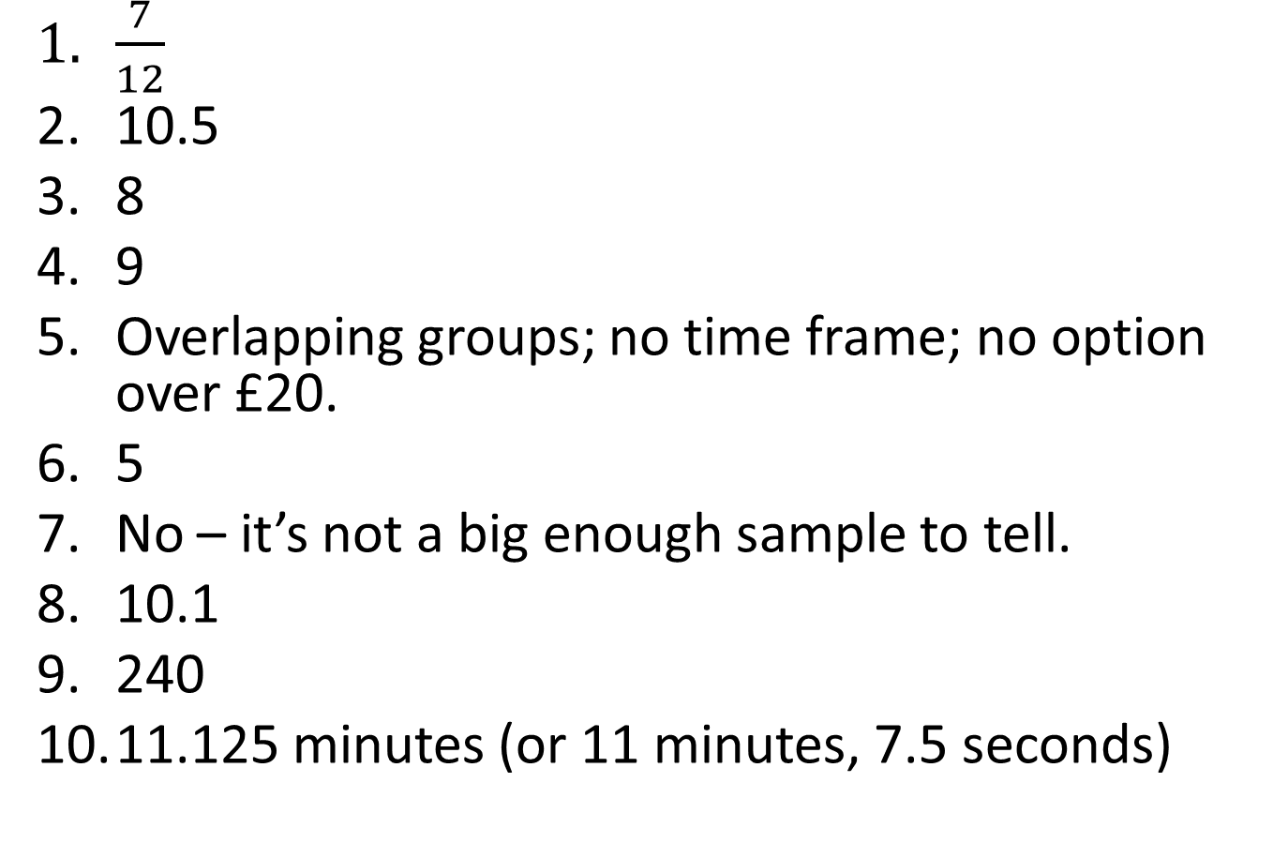
Answers – Data Handling
$\frac{7}{12}$
10.5
8
9
Overlapping groups; no time frame; no option over £20.
5
No – it’s not a big enough sample to tell.
10.1
240
11.125 minutes (or 11 minutes, 7.5 seconds)

Slide 50
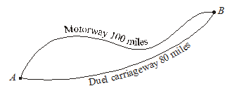
Round 5 – Using and Applying
Two towns, A and B, are connected by a motorway of length 100 miles and a dual carriageway of length 80 miles as shown.
Jack travels from A to B along the motorway at an average speed of 60 mph.
Fred travels from A to B along the dual carriageway at an average speed of 50 mph.
What is the difference in time between the two journeys?
Give your answer in minutes.

Slide 51
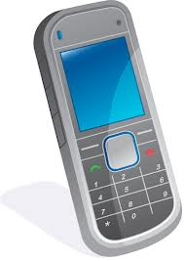
Round 5 – Using and Applying
The cost of a call at peak rate from Bev’s mobile phone is 29p per minute. For how long can Bev talk, at peak rate, for £10?
Give your answer in minutes and seconds.

Slide 52

Round 5 – Using and Applying
Mike took 400 books to sell at a Saturday market. By 3 pm, he had sold 310 books at 80 pence each. Mike then reduced the selling price of the remaining books to 50 pence each. He was left with 24 unsold books which he gave away. Find the total amount Mike received from selling the books.

Slide 53
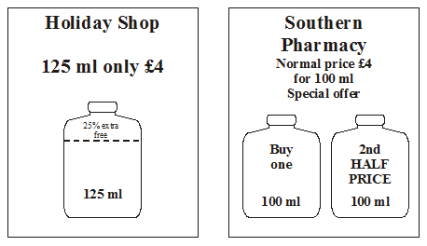
Round 5 – Using and Applying
Two advertisements for the same type of sun oil are shown. The sun oil is usually sold in 100 ml bottles which cost £4 each.
Which offer gives the better value for money?

Slide 54
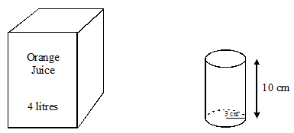
Round 5 – Using and Applying
A large carton contains 4 litres of orange juice. Cylindrical glasses of height 10 cm and radius 3 cm are to be filled from the carton. How many glasses can be filled?

Slide 55
Answers – Using and Applying
100 mins (1 mark); 96 mins (1 mark); 4 mins (1 mark)
£10 ÷ 29p (1 mark); 34.48 mins (1 mark); 34 mins 29 seconds (1 mark)
310 × 80p = £248 (1 mark); 66 × 50p = £33 (1 mark); Total = £281 (1 mark)
£4 ÷ 125ml = 3.2p (1 mark); £6 ÷ 200ml = 3p (1 mark); Southern Pharmacy is better value (1 mark)
π × 3² × 10 = 282.7cm³ (1 mark); 4000 ÷ 282.7 = 14.15 (1 mark); 14 (1 mark)

