Slide 1
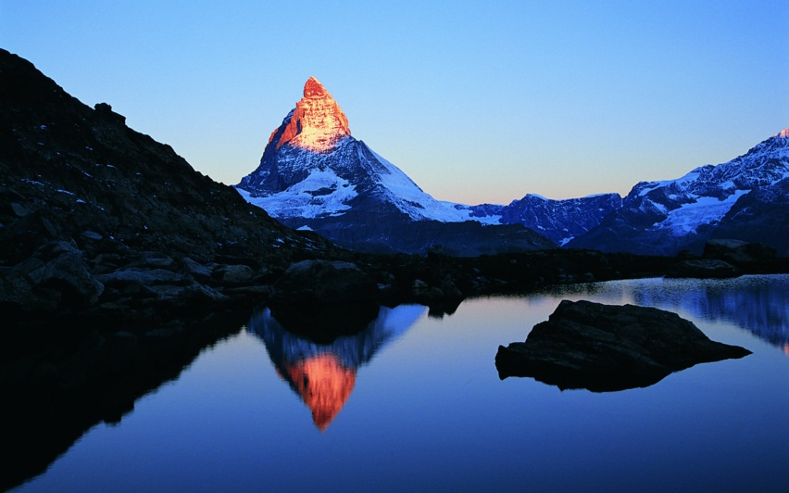
Mountain Trigonometry
Grades A to A*

Slide 2
Tunnelling Under Mountains
To avoid destroying the beautiful view, the government of a particularly mountainous nation have decided to tunnel through mountains rather than go around them.
Using trigonometry, can you help them with the following calculations so that costs can be estimated for each project?

Slide 3
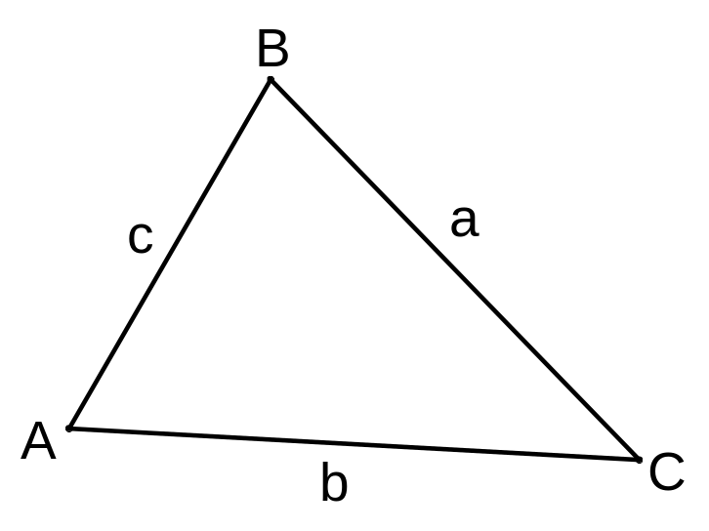
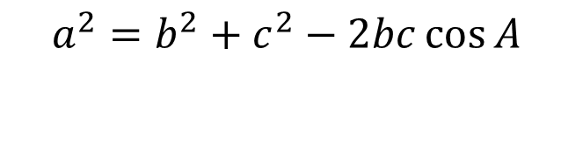
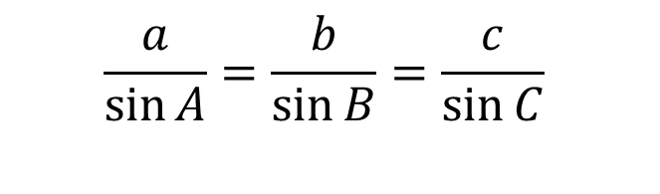
Formulae That Might Be Useful
Sine Rule
Cosine Rule
$$\frac{a}{\sin{A}}=\frac{b}{\sin{B}}=\frac{c}{\sin{C}}$$
$$a^{2}=b^{2}+c^{2}−2bc\cos{A}$$
You may need to rearrange these depending on what you are asked to calculate.

Slide 4

Tunnel 1
Mark on the information we have:
72⁰
113m
161m
a

Slide 5
Tunnel 1
72⁰
113m
161m
a
Find the length of the tunnel to 1 decimal place.

Slide 6
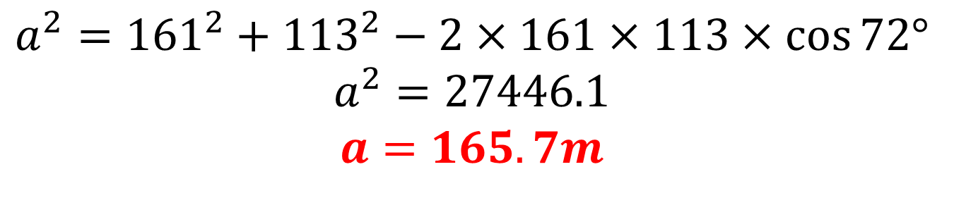
Tunnel 1
72⁰
113m
161m
a
$$a^{2}={161}^{2}+{113}^{2}−2×161×113×\cos{72°}$$
$$a^{2}=27446.1$$
$$a=165.7m$$

Slide 7
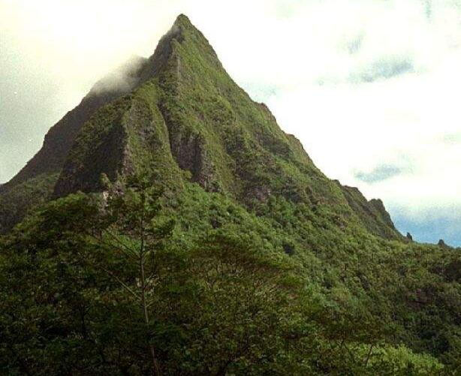
Tunnel 2
Mark on the information we have:
85⁰
97m
117m
34⁰
b

Slide 8
Tunnel 2
85⁰
97m
117m
34⁰
b
Find the length of the tunnel to 1 decimal place.

Slide 9

Tunnel 2
85⁰
97m
117m
34⁰
b
$$\frac{b}{\sin{85°}}=\frac{97}{\sin{34°}}$$
$$b=\frac{97×\sin{85°}}{\sin{34°}}$$
$$b=172.8m$$

