Slide 1
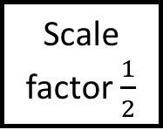

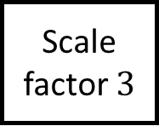


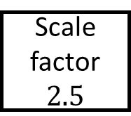
Scale factor $\frac{1}{2}$
Scale factor $3$
Calculate the missing side(s) and/or the scale factors of enlargement
$$6cm$$
Similarity Spider 1
$$5cm$$
Scale factor $2.5$
Scale factor .
$$30cm$$
All the shapes are mathematically similar

Slide 2


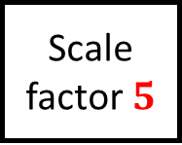





$$3cm$$
$$18cm$$
$$2.5cm$$
$$15cm$$
Scale factor $\frac{1}{2}$
Scale factor $3$
Calculate the missing side(s) and/or the scale factors of enlargement
$$6cm$$
Similarity Spider 1 – Answers
$$5cm$$
$$15cm$$
Scale factor $2.5$
Scale factor $5$
$$30cm$$
$$12.5cm$$
All the shapes are mathematically similar
$$25cm$$

Slide 3





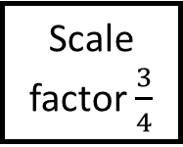

$$12.25cm$$
Scale factor .
Scale factor .
$$20cm$$
Calculate the missing side(s) and/or the scale factors of enlargement
Similarity Spider 2
$$8cm$$
$$7cm$$
$$10cm$$
Scale factor $\frac{3}{4}$
Scale factor .
$$12cm$$
All the shapes are mathematically similar

Slide 4


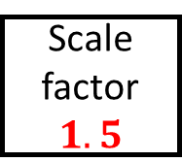

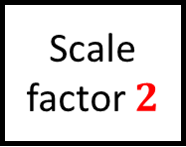





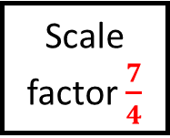


$$12.25cm$$
$$14cm$$
$$14cm$$
$$16cm$$
Scale factor $\frac{7}{4}$
Scale factor $2$
$$17.5cm$$
$$20cm$$
Calculate the missing side(s) and/or the scale factors of enlargement
Similarity Spider 2 – Answers
$$8cm$$
$$7cm$$
$$10cm$$
Scale factor $\frac{3}{4}$
Scale factor $1.5$
$$5.25cm$$
$$6cm$$
$$10.5cm$$
$$12cm$$
All the shapes are mathematically similar
$$7.5cm$$
$$15cm$$

Slide 5


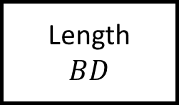


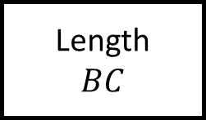
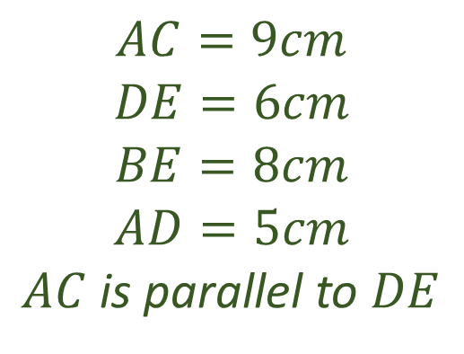

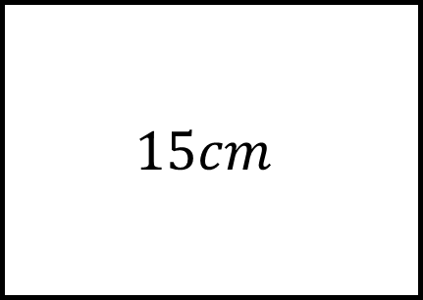


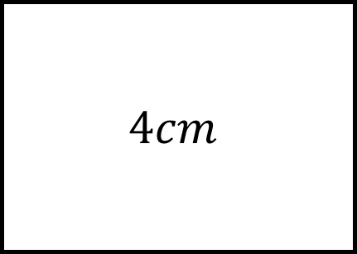


$$15cm$$
Length
Length
$$BC$$
$$B$$
$$AC=9cm$$
$$DE=6cm$$
$$BE=8cm$$
$$AD=5cm$$
$AC$ is parallel to $DE$
Similarity Spider 3
$$8cm$$
$$D$$
$$E$$
$$6cm$$
$$5cm$$
$$A$$
$$C$$
$$9cm$$
$$4cm$$
Length
Length
$$BD$$

Slide 6
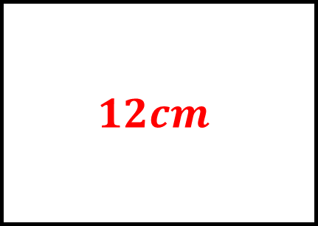
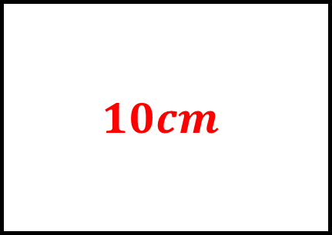
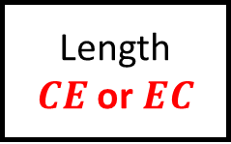

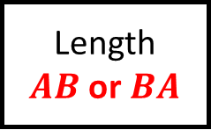
$$15cm$$
$$12cm$$
Length
$AB$ or $BA$
Length
$$BC$$
$$B$$
$$AC=9cm$$
$$DE=6cm$$
$$BE=8cm$$
$$AD=5cm$$
$AC$ is parallel to $DE$
Similarity Spider 3 – Answers
$$8cm$$
$$D$$
$$E$$
$$6cm$$
$$5cm$$
$$A$$
$$C$$
$$9cm$$
$$4cm$$
$$10cm$$
Length
$CE$ or $EC$
Length
$$BD$$

Slide 7

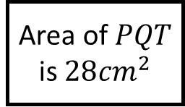
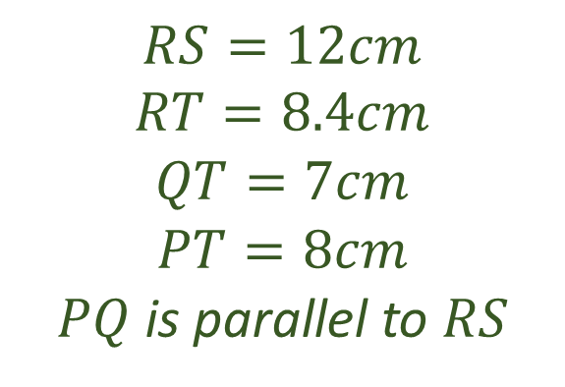

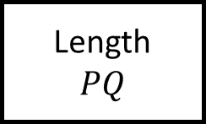
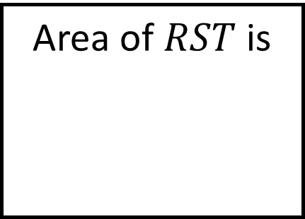

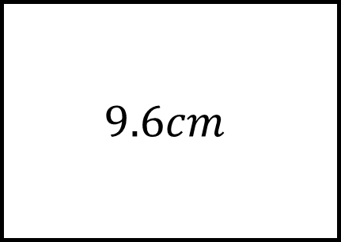

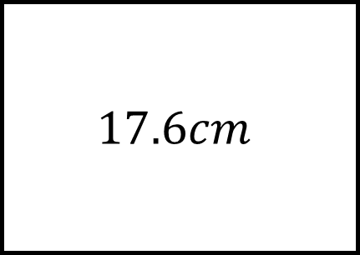

Area of $RST$ is
Area of $PQT$ is $28{cm}^{2}$
Length
$$PQ$$
$$R$$
$$S$$
$$RS=12cm$$
$$RT=8.4cm$$
$$QT=7cm$$
$$PT=8cm$$
$PQ$ is parallel to $RS$
Similarity Spider 4
$$T$$
$$P$$
$$Q$$
$$9.6cm$$
$$17.6cm$$
Length
Length

Slide 8
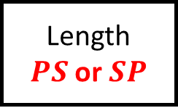
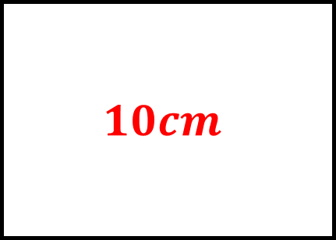
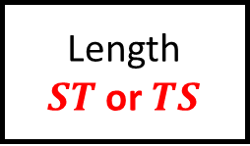
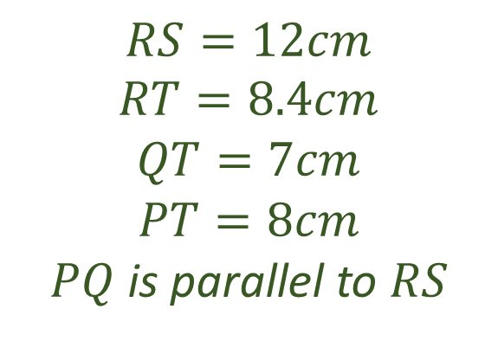
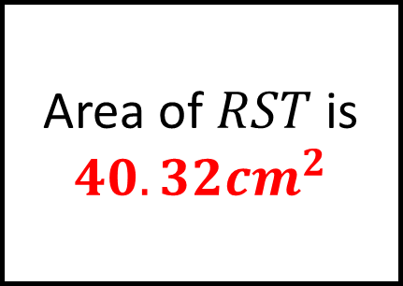
Area of $RST$ is
$$40.32{cm}^{2}$$
$$10cm$$
Area of $PQT$ is $28{cm}^{2}$
Length
$$PQ$$
$$R$$
$$S$$
$$RS=12cm$$
$$RT=8.4cm$$
$$QT=7cm$$
$$PT=8cm$$
$PQ$ is parallel to $RS$
Similarity Spider 4 – Answers
$$T$$
$$P$$
$$Q$$
$$9.6cm$$
$$17.6cm$$
Length
$ST$ or $TS$
Length
$PS$ or $SP$

Slide 9
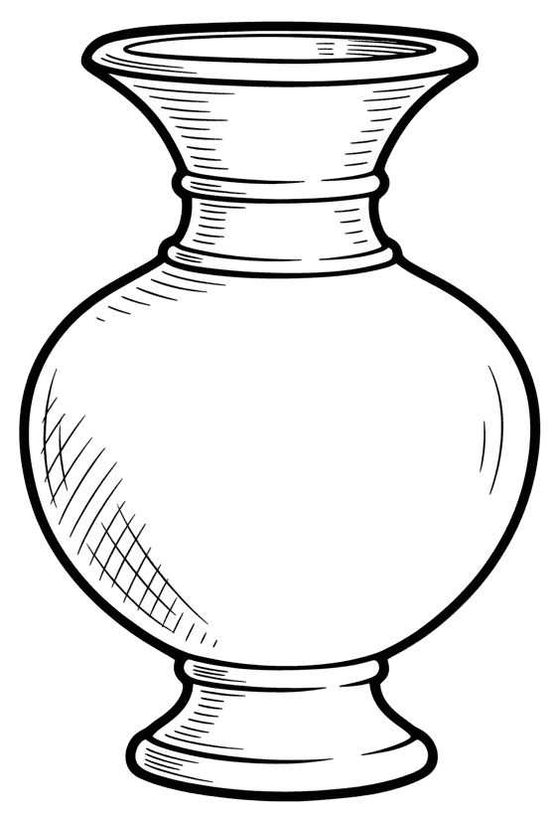

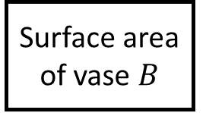

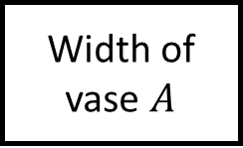
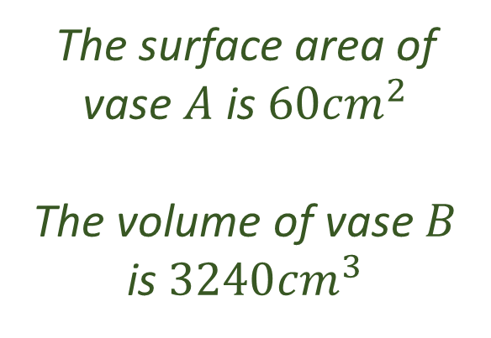

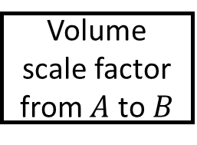

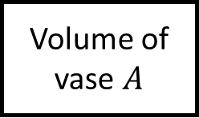

Volume of vase $A$
Width of vase $A$
$$18cm$$
The surface area of vase $A$ is $60{cm}^{2}$
The volume of vase $B$ is $3240{cm}^{3}$
Similarity Spider 5
$$30cm$$
$$B$$
$$10cm$$
$$A$$
Volume scale factor from $A$ to $B$
Surface area of vase $B$
The vases are mathematically similar

Slide 10
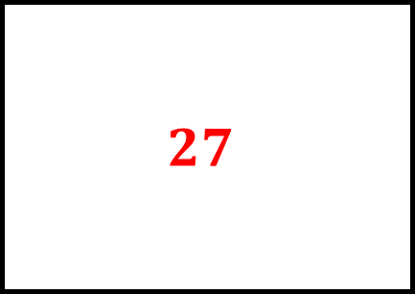
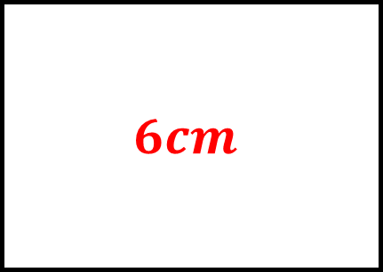
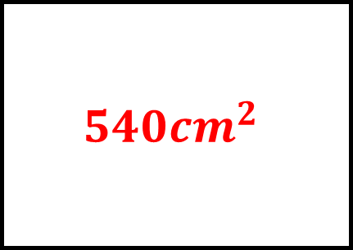

$$120{cm}^{3}$$
$$6cm$$
Volume of vase $A$
Width of vase $A$
$$18cm$$
The surface area of vase $A$ is $60{cm}^{2}$
The volume of vase $B$ is $3240{cm}^{3}$
Similarity Spider 5 – Answers
$$30cm$$
$$B$$
$$10cm$$
$$A$$
$$27$$
$$540{cm}^{2}$$
Volume scale factor from $A$ to $B$
Surface area of vase $B$
The vases are mathematically similar

Slide 11
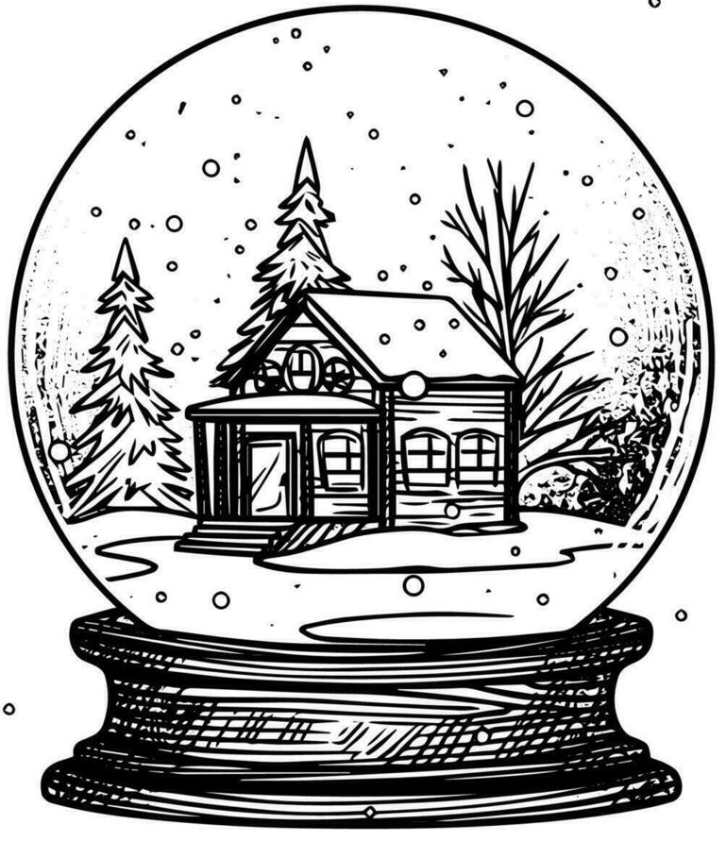

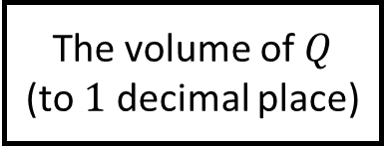

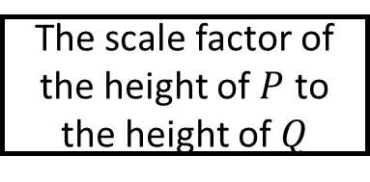
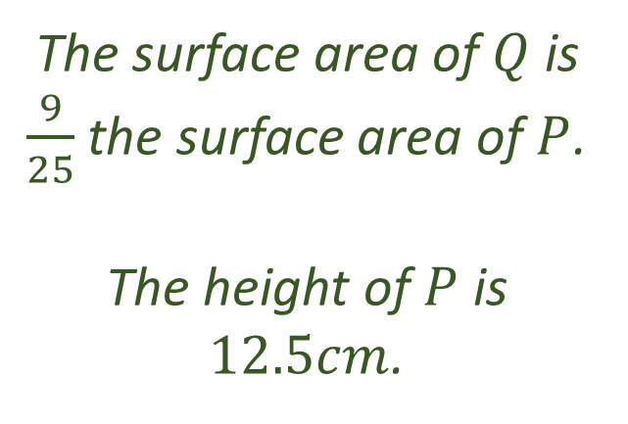
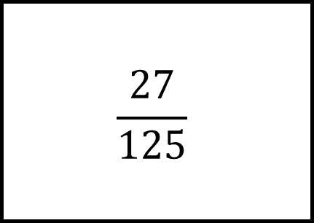
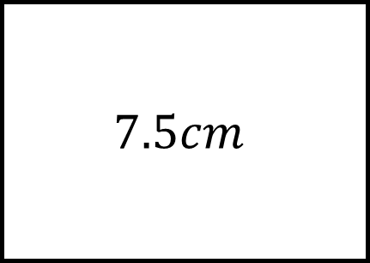
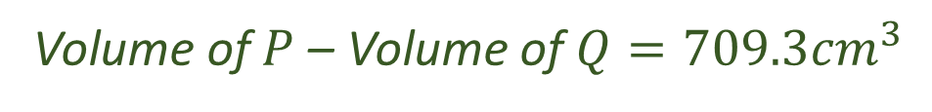
The snow globes are mathematically similar
The volume of $Q$
(to $1$ decimal place)
The scale factor of the height of $P$ to the height of $Q$
The surface area of $Q$ is $\frac{9}{25}$ the surface area of $P$.
The height of $P$ is $12.5cm$.
Similarity Spider 6
$$P$$
$$Q$$
$$\frac{27}{125}$$
$$7.5cm$$
Volume of $P$ – Volume of $Q=709.3{cm}^{3}$

Slide 12
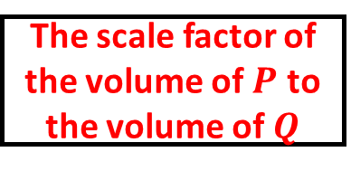
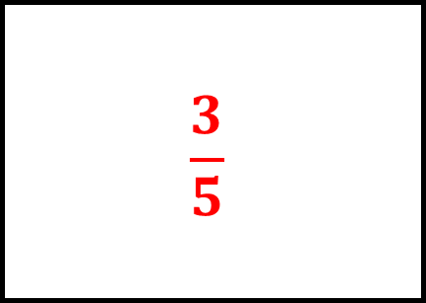

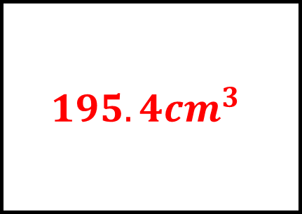
The snow globes are mathematically similar
$$195.4{cm}^{3}$$
$$\frac{3}{5}$$
The volume of $Q$
(to $1$ decimal place)
The scale factor of the height of $P$ to the height of $Q$
The surface area of $Q$ is $\frac{9}{25}$ the surface area of $P$.
The height of $P$ is $12.5cm$.
Similarity Spider 6 – Answers
$$P$$
$$Q$$
$$\frac{27}{125}$$
$$7.5cm$$
The scale factor of the volume of $P$ to the volume of $Q$
The height of $Q$
Volume of $P$ – Volume of $Q=709.3{cm}^{3}$

Slide 13
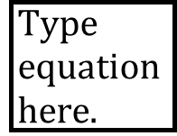
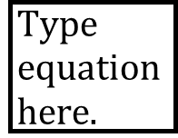
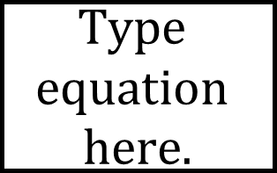



















Topic Spider – Blank
Question
Fill in the gap with the stages of your workings

