Slide 1
Simultaneous Equations in places you wouldn’t expect
Form and solve the simultaneous equations in each situation…

Slide 2
Pick Your Problem:
Parallel Lines
Venn Diagram
Percentage Change
Ratio
Perimeter and Area
Probability
Averages
Sequences

Slide 3


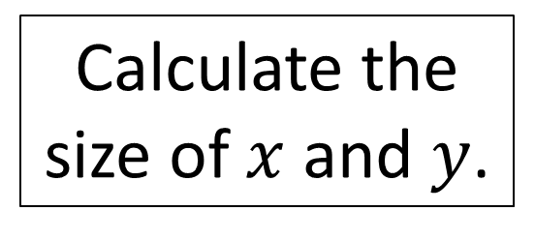


Problem A – Parallel Lines
Option page
$$y$$
$$x$$
Calculate the size of $x$ and $y$.
$$3x$$
$$75°$$

Slide 4
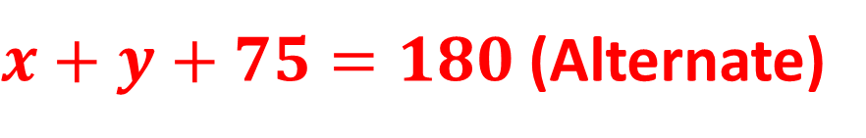
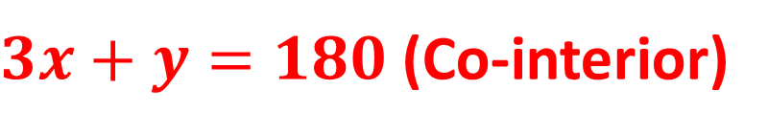



Problem A – Parallel Lines
Option page
Possible solution – there are many!
$$y$$
$3x+y=180$ (Co-interior)
$$x$$
Calculate the size of $x$ and $y$.
$x+y+75=180$ (Alternate)
$$2x=75$$
$$3x$$
$$75°$$
$$x=37.5°$$
$$y=67.5°$$

Slide 5


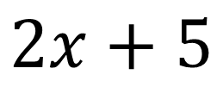



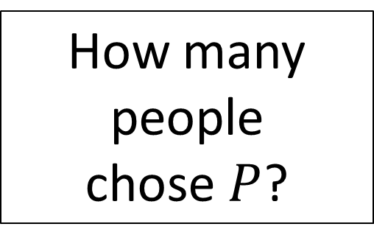



Problem B – Venn Diagram Of Survey Results
Option page
$$ε$$
$$n\left(Q\right)=15$$
$$P$$
$$Q$$
$$n\left(P∪Q\right)=38$$
$$2x+5$$
$$x$$
$$y$$
How many people
chose $P$?
$$7$$

Slide 6






Problem B – Venn Diagram Of Survey Results
Option page
Solution
$$ε$$
$$n\left(Q\right)=15$$
$$P$$
$$Q$$
$$x+y=15$$
$$n\left(P∪Q\right)=38$$
$$3x+y+5=38$$
$$2x+5$$
$$x$$
$$y$$
$$2x=18$$
How many people
chose $P$?
$$x=9$$
$$7$$
$$y=6$$
$$n(P)=32$$

Slide 7
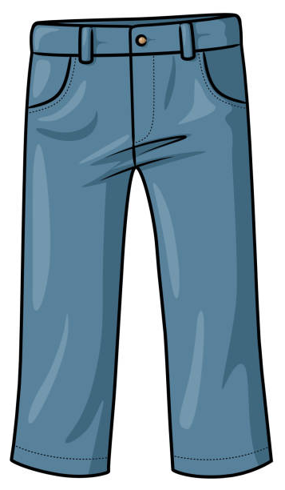

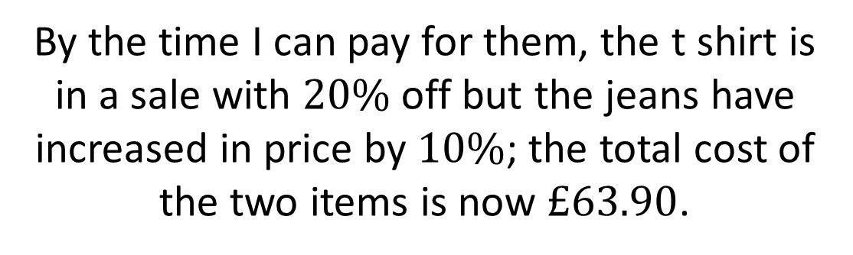

Problem C – Percentage Change
Option page
I put a t shirt and a pair of jeans in my online basket and their total cost is $£63$, but I must wait until I can afford to buy them.
By the time I can pay for them, the t shirt is in a sale with $20\%$ off but the jeans have increased in price by $10\%$; the total cost of the two items is now $£63.90$.
Calculate the individual cost of the t shirt and the jeans before their prices changed.

Slide 8


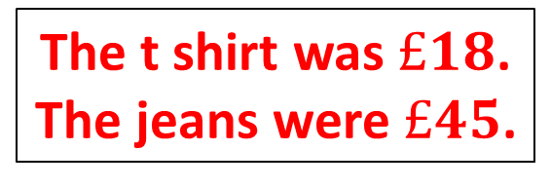




Problem C – Percentage Change
Option page
Solution
I put a t shirt and a pair of jeans in my online basket and their total cost is $£63$, but I must wait until I can afford to buy them.
By the time I can pay for them, the t shirt is in a sale with $20\%$ off but the jeans have increased in price by $10\%$; the total cost of the two items is now $£63.90$.
$$x+y=63$$
$$y=45$$
$$0.8x+1.1y=63.9$$
$$x=18$$
$$0.8x+0.8y=50.4$$
Calculate the individual cost of the t shirt and the jeans before their prices changed.
The t shirt was $£18$.
The jeans were $£45$.
$$0.3y=13.5$$

Slide 9


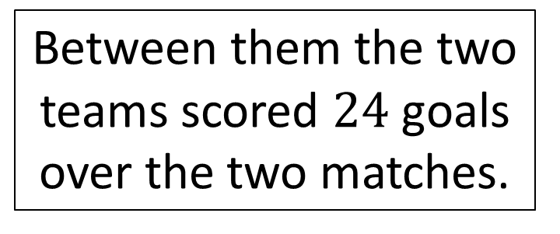
Problem D - Ratio
Option page
Two football teams play each other twice in a season.
The same number of goals was scored in total in each match.
The first match between the teams was a draw.
Between them the two teams scored $24$ goals over the two matches.
The second match between the teams saw one team scored twice as many goals as their opponents.
What were the results of the two games?

Slide 10
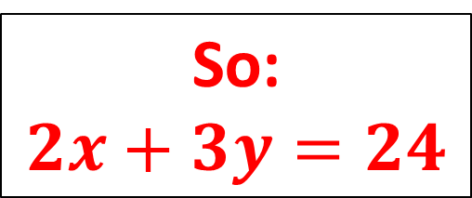
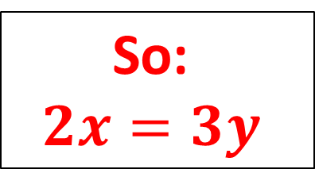
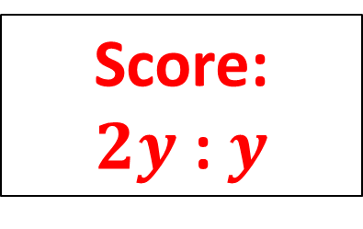
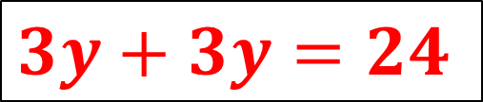
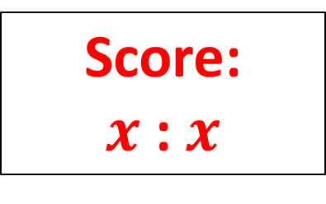
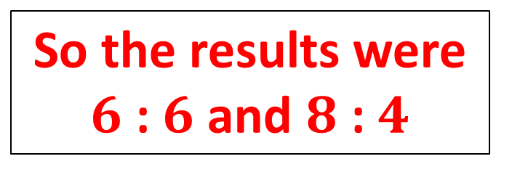
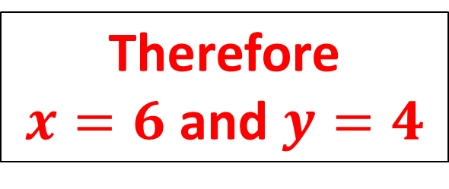
Problem D - Ratio
Option page
Two football teams play each other twice in a season.
Solution
The same number of goals was scored in total in each match.
So:
$$2x=3y$$
The first match between the teams was a draw.
Score:
$x$ : $x$
So:
$$2x+3y=24$$
Between them the two teams scored $24$ goals over the two matches.
The second match between the teams saw one team scored twice as many goals as their opponents.
Score:
$2y$ : $y$
$$3y+3y=24$$
What were the results of the two games?
Therefore
$x=6$ and $y=4$
So the results were
$6$ : $6$ and $8$ : $4$

Slide 11


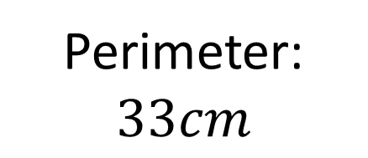
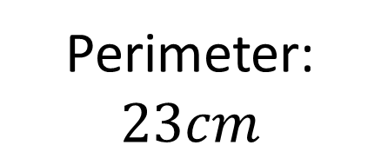

Problem E – Perimeter and Area
Option page
Rectangle
$$y$$
Equilateral triangle
$$x$$
Perimeter: $23cm$
$$2x−y$$
Perimeter: $33cm$
What is the area of the rectangle?

Slide 12




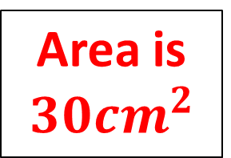


Problem E – Perimeter and Area
Option page
Solution
Rectangle
$$2x+2y=23$$
$$y$$
$$6x+6y=69$$
Equilateral triangle
$$6x−3y=33$$
$$x$$
$$9y=36$$
Perimeter: $23cm$
$$2x−y$$
$$y=4cm$$
Perimeter: $33cm$
$$x=7.5cm$$
What is the area of the rectangle?
Area is $30{cm}^{2}$

Slide 13

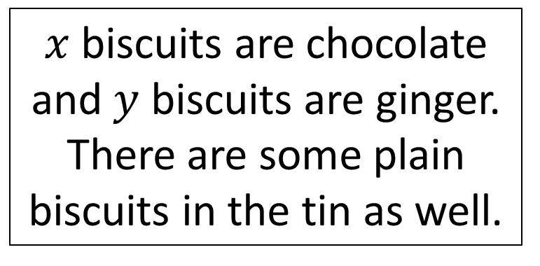
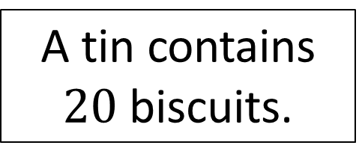
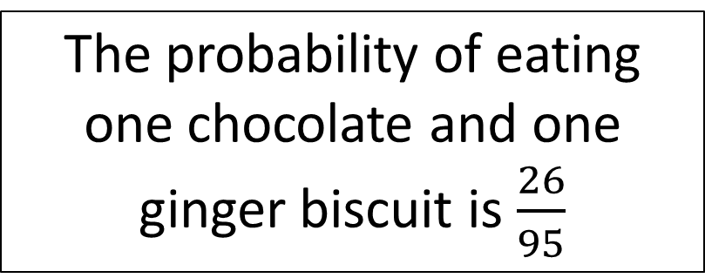
Problem F - Probability
Option page
The probability of eating one chocolate and one ginger biscuit is $\frac{26}{95}$
A tin contains $20$ biscuits.
$x$ biscuits are chocolate and $y$ biscuits are ginger. There are some plain biscuits in the tin as well.
If I eat a ginger biscuit first there are three times as many ginger biscuits as chocolate biscuits.
How many plain biscuits were in the tin to start with?

Slide 14

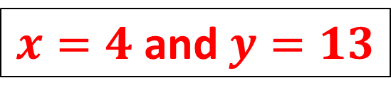
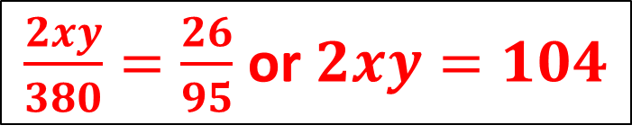
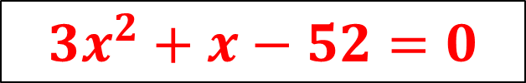
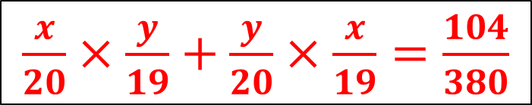

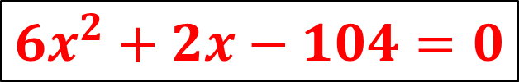

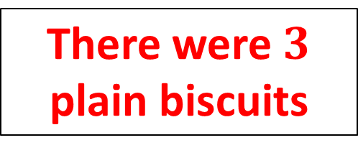
Problem F - Probability
Option page
Solution
The probability of eating one chocolate and one ginger biscuit is $\frac{26}{95}$
$\frac{x}{20}×\frac{y}{19}+\frac{y}{20}×\frac{x}{19}=\frac{104}{380}$
A tin contains $20$ biscuits.
$\frac{2xy}{380}=\frac{26}{95}$ or $2xy=104$
$x$ biscuits are chocolate and $y$ biscuits are ginger. There are some plain biscuits in the tin as well.
If I eat a ginger biscuit first there are three times as many ginger biscuits as chocolate biscuits.
$y−1=3x$
$2x(3x+1)=104$
$6x^{2}+2x−104=0$
How many plain biscuits were in the tin to start with?
$\left(3x+13\right)\left(x−4\right)=0$
There were $3$ plain biscuits
$3x^{2}+x−52=0$
$x=4$ and $y=13$

Slide 15

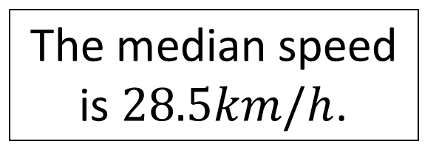
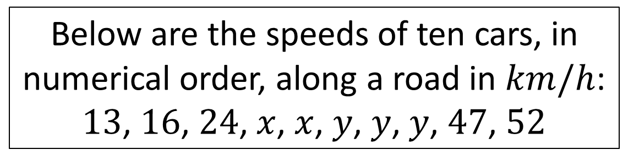
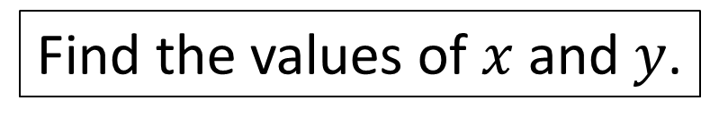
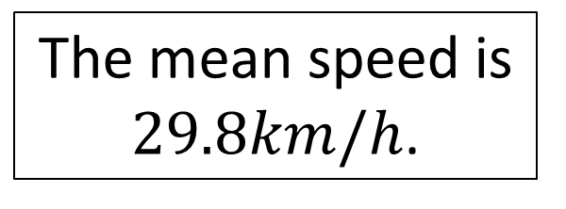
Problem G – Averages
Option page
Below are the speeds of ten cars, in numerical order, along a road in $km/h$:
$13$, $16$, $24$, $x$, $x$, $y$, $y$, $y$, $47$, $52$
The median speed is $28.5km/h$.
The mean speed is $29.8km/h$.
Find the values of $x$ and $y$.

Slide 16
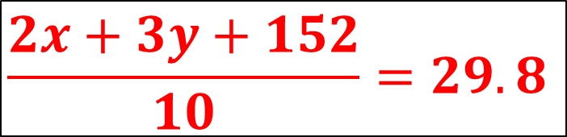

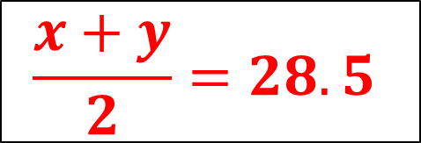




Problem G – Averages
Option page
Solution
Below are the speeds of ten cars, in numerical order, along a road in $km/h$:
$13$, $16$, $24$, $x$, $x$, $y$, $y$, $y$, $47$, $52$
The median speed is $28.5km/h$.
The mean speed is $29.8km/h$.
$$\frac{x+y}{2}=28.5$$
$$\frac{2x+3y+152}{10}=29.8$$
$$x+y=57$$
$$2x+3y=146$$
Find the values of $x$ and $y$.
$$2x+2y=114$$
$$x=25$$
$$y=32$$

Slide 17
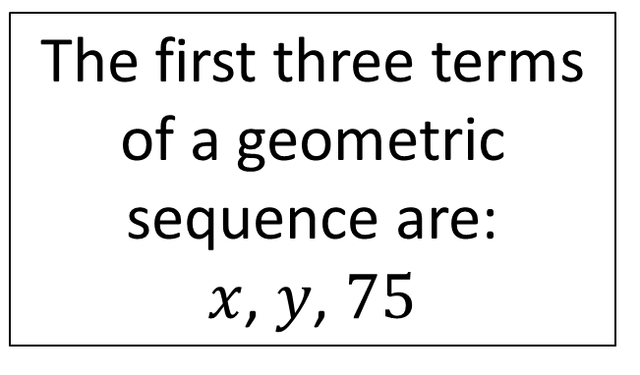
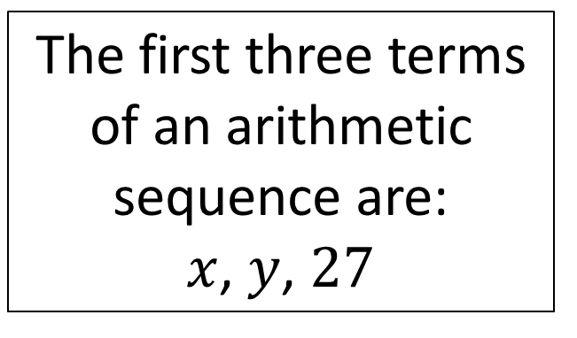
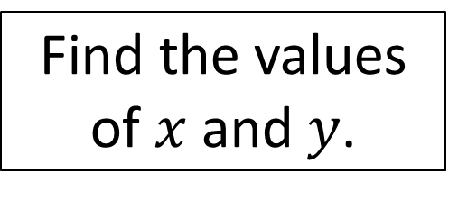
Problem H – Sequences
Option page
The first three terms of an arithmetic sequence are:
$x$, $y$, $27$
The first three terms of a geometric sequence are:
$x$, $y$, $75$
Find the values of $x$ and $y$.

Slide 18
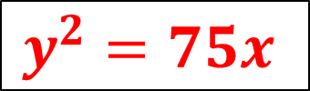



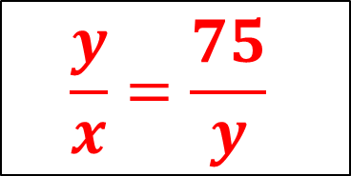
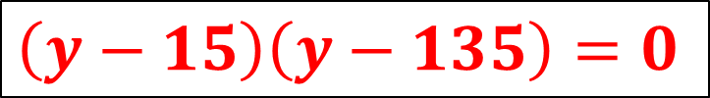

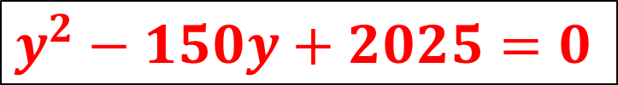
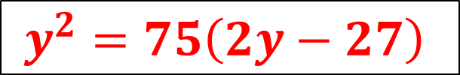
Problem H – Sequences
Option page
Solution
The first three terms of an arithmetic sequence are:
$x$, $y$, $27$
The first three terms of a geometric sequence are:
$x$, $y$, $75$
$$\frac{y}{x}=\frac{75}{y}$$
$$y−x=27−y$$
$$2y−27=x$$
$$y^{2}=75x$$
Find the values of $x$ and $y$.
$$y^{2}=75\left(2y−27\right)$$
$$y^{2}−150y+2025=0$$
$$y=15$$
$$\left(y−15\right)\left(y−135\right)=0$$
$$x=3$$
Doesn’t work for both sequences

