Slide 1
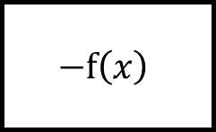
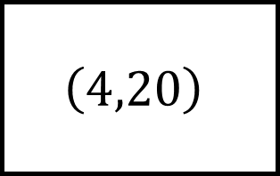

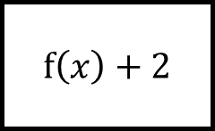
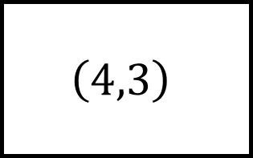
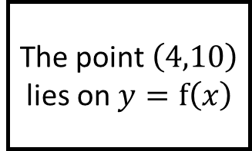

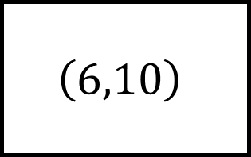

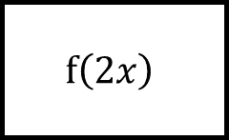

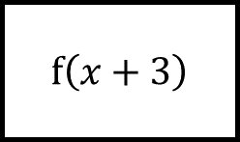
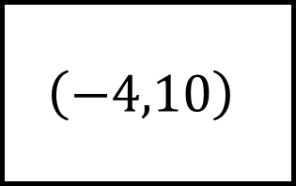
$$\left( , \right)$$
$$\left(−4,10\right)$$
$$\left(4,3\right)$$
$$f\left(x\right)+2$$
Transforming Functions (Coordinates) Spider 1
$$\left( , \right)$$
The point $\left(4,10\right)$ lies on $y=f\left(x\right)$
$$\left( , \right)$$
$$f\left(2x\right)$$
$$−f\left(x\right)$$
Find where the point is after each transformation
There are multiple answers for each blank functions
$$f\left(x+3\right)$$
$$\left(4,20\right)$$
$$\left(6,10\right)$$
$$\left( , \right)$$

Slide 2
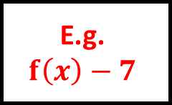
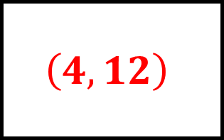
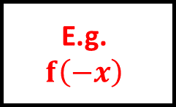
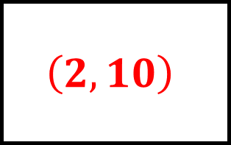
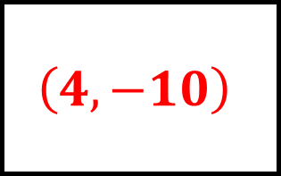
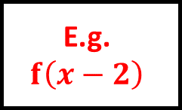
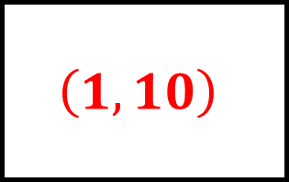
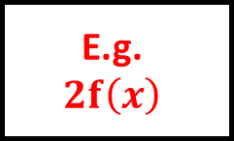
$$\left(4,12\right)$$
$$\left(−4,10\right)$$
$$\left(4,3\right)$$
E.g.
$$f\left(−x\right)$$
$$f\left(x\right)+2$$
E.g.
$$f\left(x\right)−7$$
Transforming Functions (Coordinates) Spider 1 – Answers
$$\left(2,10\right)$$
The point $\left(4,10\right)$ lies on $y=f\left(x\right)$
$$\left(4,−10\right)$$
$$f\left(2x\right)$$
$$−f\left(x\right)$$
Find where the point is after each transformation
There are multiple answers for each blank functions
E.g.
$$2f\left(x\right)$$
$$f\left(x+3\right)$$
E.g.
$$f\left(x−2\right)$$
$$\left(4,20\right)$$
$$\left(6,10\right)$$
$$\left(1,10\right)$$

Slide 3
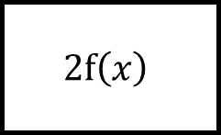
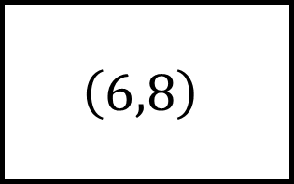
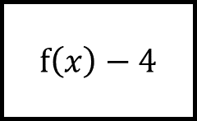
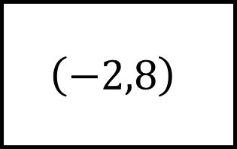
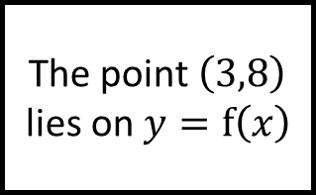
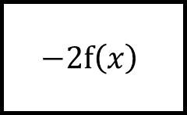

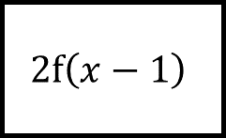
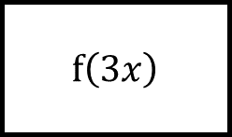
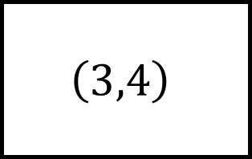
$$\left( , \right)$$
$$\left( , \right)$$
$$\left(6,8\right)$$
$$2f\left(x−1\right)$$
$$f\left(x\right)−4$$
Transforming Functions (Coordinates) Spider 2
$$\left( , \right)$$
The point $\left(3,8\right)$ lies on $y=f\left(x\right)$
$$\left( , \right)$$
$$−2f\left(x\right)$$
$$2f\left(x\right)$$
Find where the point is after each transformation
There are multiple answers for each blank functions
$$f\left(3x\right)$$
$$\left(3,4\right)$$
$$\left(−2,8\right)$$
$$\left( , \right)$$

Slide 4
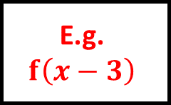
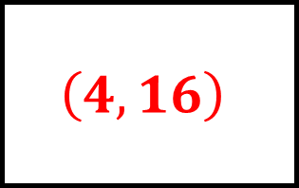
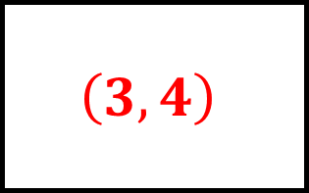
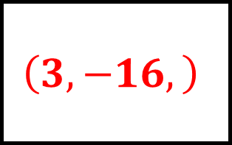
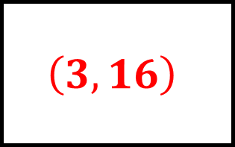

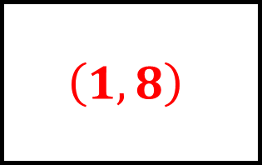
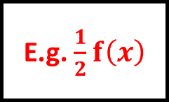
$$\left(3,4\right)$$
$$\left(4,16\right)$$
$$\left(6,8\right)$$
$$2f\left(x−1\right)$$
$$f\left(x\right)−4$$
E.g.
$$f\left(x−3\right)$$
Transforming Functions (Coordinates) Spider 2 – Answers
$$\left(3,−16,\right)$$
The point $\left(3,8\right)$ lies on $y=f\left(x\right)$
$$\left(3,16\right)$$
$$−2f\left(x\right)$$
$$2f\left(x\right)$$
Find where the point is after each transformation
There are multiple answers for each blank functions
E.g. $\frac{1}{2}f\left(x\right)$
$$f\left(3x\right)$$
E.g.
$$f\left(x+5\right)$$
$$\left(3,4\right)$$
$$\left(−2,8\right)$$
$$\left(1,8\right)$$

Slide 5
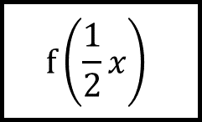

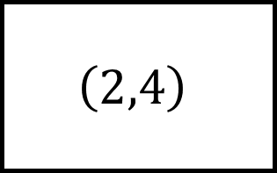
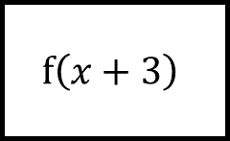

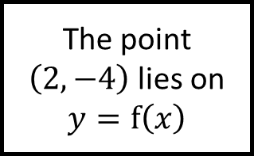
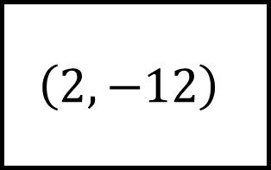

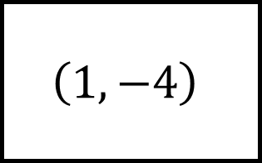
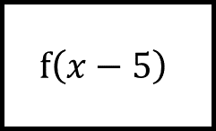
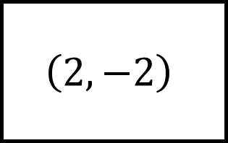
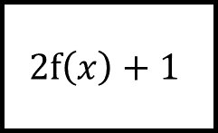
$$\left(2,4\right)$$
$$\left( , \right)$$
$$\left( , \right)$$
$$2f\left(x\right)+1$$
$$f\left(x+3\right)$$
Transforming Functions (Coordinates) Spider 3
$$\left(2,−12\right)$$
The point $\left(2,−4\right)$ lies on $y=f\left(x\right)$
$$\left(1,−4\right)$$
Find where the point is after each transformation
There are multiple answers for each blank functions
$$f\left(x−5\right)$$
$$f\left(\frac{1}{2}x\right)$$
$$\left( , \right)$$
$$\left( , \right)$$
$$\left(2,−2\right)$$

Slide 6
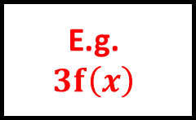
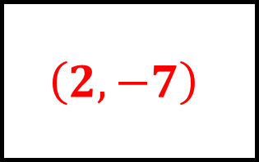
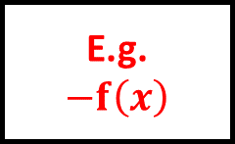
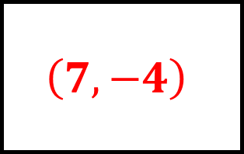
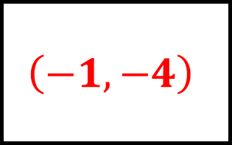
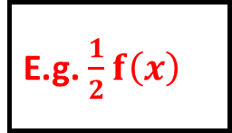
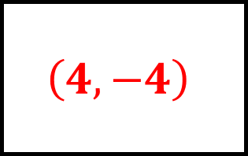
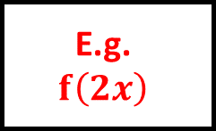
$$\left(2,4\right)$$
$$\left(2,−7\right)$$
$$\left(−1,−4\right)$$
$$2f\left(x\right)+1$$
E.g.
$$−f\left(x\right)$$
$$f\left(x+3\right)$$
Transforming Functions (Coordinates) Spider 3 – Answers
$$\left(2,−12\right)$$
The point $\left(2,−4\right)$ lies on $y=f\left(x\right)$
$$\left(1,−4\right)$$
E.g.
$$3f\left(x\right)$$
E.g.
$$f\left(2x\right)$$
Find where the point is after each transformation
There are multiple answers for each blank functions
$$f\left(x−5\right)$$
E.g. $\frac{1}{2}f\left(x\right)$
$$f\left(\frac{1}{2}x\right)$$
$$\left(7,−4\right)$$
$$\left(4,−4\right)$$
$$\left(2,−2\right)$$

Slide 7









$$\left(−1,−2\right)$$
$$\left( , \right)$$
$$\left( , \right)$$
$$3−f\left(x\right)$$
$$f\left(−x\right)$$
Transforming Functions (Coordinates) Spider 4
$$\left(−2,−12\right)$$
The point $\left(−1,−6\right)$ lies on $y=f\left(x\right)$
$$\left(4,−2\right)$$
Find where the point is after each transformation
There are multiple answers for each blank functions
$$−f\left(x−2\right)$$
$$f\left(3x\right)$$
$$\left( , \right)$$
$$\left( , \right)$$
$$\left(−1,−2\right)$$

Slide 8








$$\left(−1,−2\right)$$
$$\left(−1,9\right)$$
$$\left(1,−6\right)$$
$$3−f\left(x\right)$$
E.g.
$$f\left(x\right)+4$$
$$f\left(−x\right)$$
Transforming Functions (Coordinates) Spider 4 – Answers
$$\left(−2,−12\right)$$
The point $\left(−1,−6\right)$ lies on $y=f\left(x\right)$
$$\left(4,−2\right)$$
E.g. $2f\left(x+1\right)$
E.g.
$$\frac{1}{3}f\left(x−5\right)$$
Find where the point is after each transformation
There are multiple answers for each blank functions
$$−f\left(x−2\right)$$
E.g. $\frac{1}{3}f\left(x\right)$
$$f\left(3x\right)$$
$$\left(1,6\right)$$
$$\left(−\frac{1}{3},−6\right)$$
$$\left(−1,−2\right)$$

Slide 9

















$$\left(,\right)$$
$$\left(,\right)$$
$$\left(,\right)$$
$$f\left(x\right)$$
$$f\left(x\right)$$
$$f\left(x\right)$$
Transforming Functions Spider n – Answers
$$\left(,\right)$$
The point $\left(,\right)$ lies on $y=f\left(x\right)$
$$\left(,\right)$$
$$f\left(x\right)$$
$$f\left(x\right)$$
Find where the point is after each transformation
There are multiple answers for each blank functions
$$f\left(x\right)$$
$$f\left(x\right)$$
$$f\left(x\right)$$
$$\left(,\right)$$
$$\left(,\right)$$
$$\left(,\right)$$

Slide 10






















Topic Spider – Blank
Question
Fill in the gap with the stages of your workings

