Slide 1
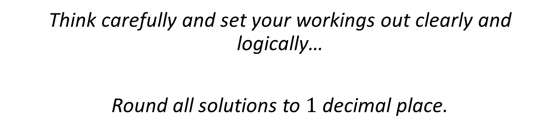
Trigonometry and Circle Theorems Problems
Think carefully and set your workings out clearly and logically…
Round all solutions to $1$ decimal place.

Slide 2
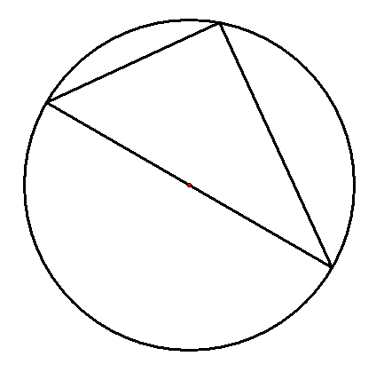




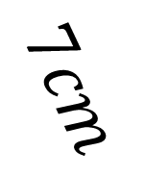

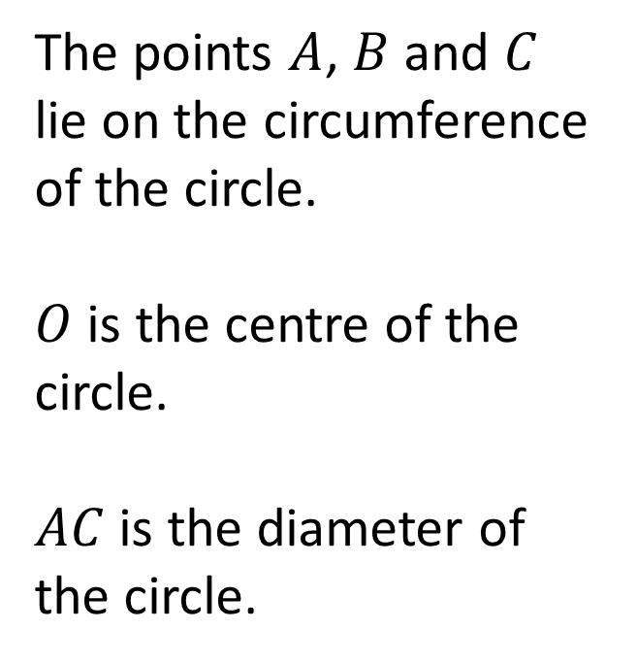
$$B$$
The points $A$, $B$ and $C$ lie on the circumference of the circle.
$O$ is the centre of the circle.
$AC$ is the diameter of the circle.
$$A$$
$$53°$$
$$7cm$$
$$O$$
$$C$$
Calculate the area of the circle.

Slide 3

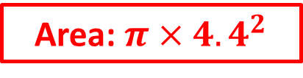
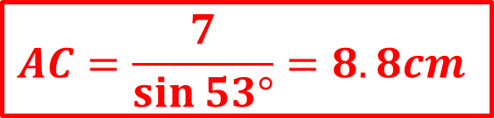
Right angle as it is subtended from the diameter
$$B$$
The points $A$, $B$ and $C$ lie on the circumference of the circle.
$O$ is the centre of the circle.
$AC$ is the diameter of the circle.
Answer
$$A$$
$$53°$$
$$7cm$$
$$O$$
$$AC=\frac{7}{\sin{53°}}=8.8cm$$
$$C$$
Calculate the area of the circle.
Area: $π×{4.4}^{2}$
Answer: $60.3 {cm}^{2}$

Slide 4
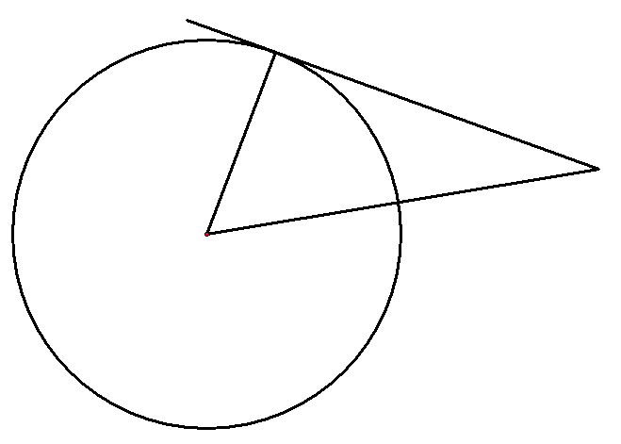





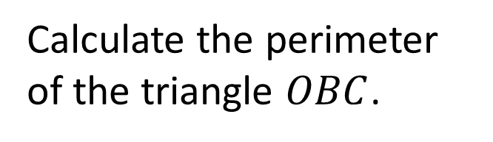
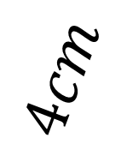
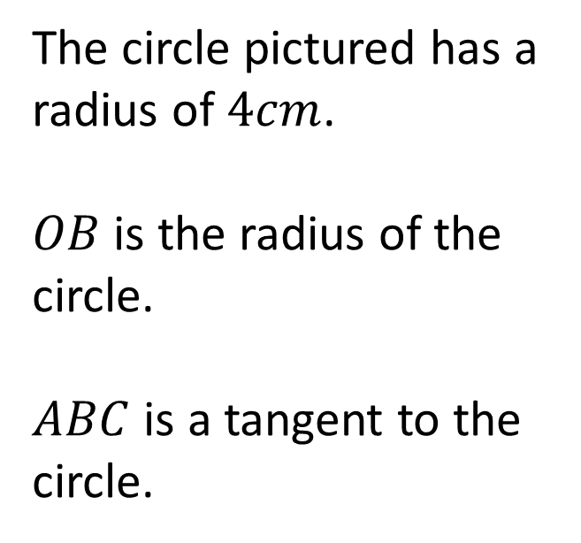
The circle pictured has a radius of $4cm$.
$OB$ is the radius of the circle.
$ABC$ is a tangent to the circle.
$$A$$
$$B$$
$$4cm$$
$$28°$$
$$C$$
$$O$$
Calculate the perimeter of the triangle $OBC$.

Slide 5

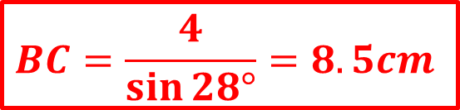
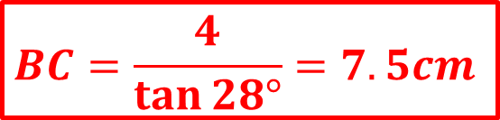
Right angle as it is a radius meeting a tangent
The circle pictured has a radius of $4cm$.
$OB$ is the radius of the circle.
$ABC$ is a tangent to the circle.
$$A$$
$$B$$
Answer
$$BC=\frac{4}{\tan{28°}}=7.5cm$$
$$4cm$$
$$28°$$
$$C$$
$$O$$
$$BC=\frac{4}{\sin{28°}}=8.5cm$$
Calculate the perimeter of the triangle $OBC$.
Answer: $20.0 cm$

Slide 6
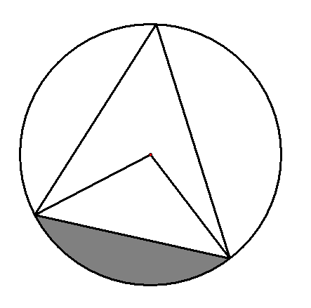
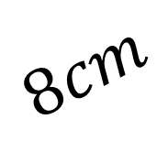





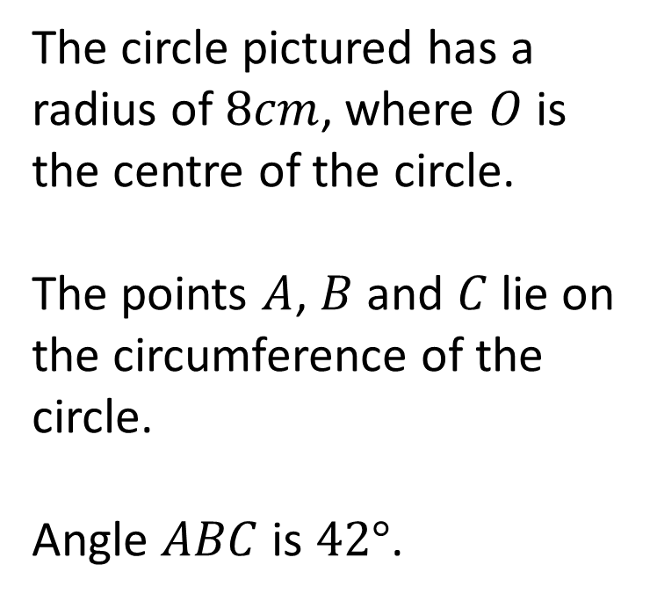
$$B$$
The circle pictured has a radius of $8cm$, where $O$ is the centre of the circle.
The points $A$, $B$ and $C$ lie on the circumference of the circle.
Angle $ABC$ is $42°$.
$$42°$$
$$O$$
$$8cm$$
$$A$$
$$C$$
Work out the shaded area.

Slide 7

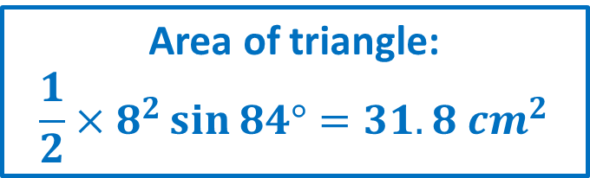
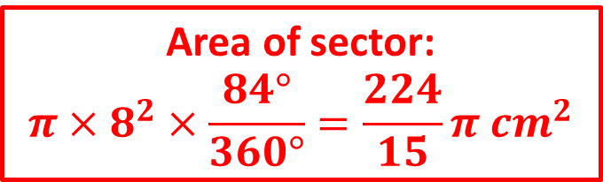
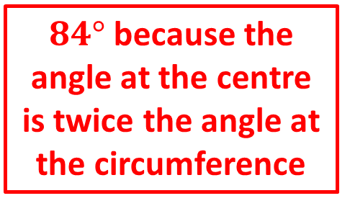
$84°$ because the angle at the centre is twice the angle at the circumference
$$B$$
The circle pictured has a radius of $8cm$, where $O$ is the centre of the circle.
The points $A$, $B$ and $C$ lie on the circumference of the circle.
Angle $ABC$ is $42°$.
Answer
$$42°$$
Area of sector:
$$π×8^{2}×\frac{84°}{360°}=\frac{224}{15}π {cm}^{2}$$
$$O$$
$$8cm$$
$$A$$
Area of triangle:
$$\frac{1}{2}×8^{2}\sin{84°}=31.8 {cm}^{2}$$
$$C$$
Work out the shaded area.
Answer: $15.1 {cm}^{2}$

Slide 8
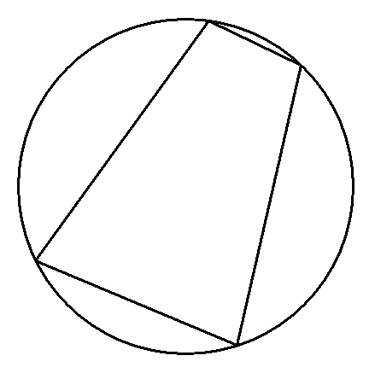

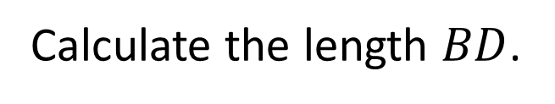


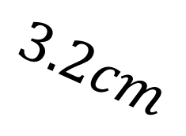

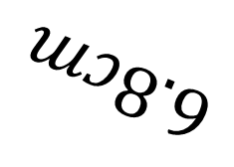

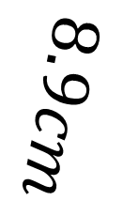

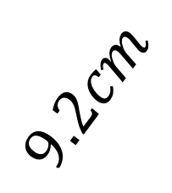
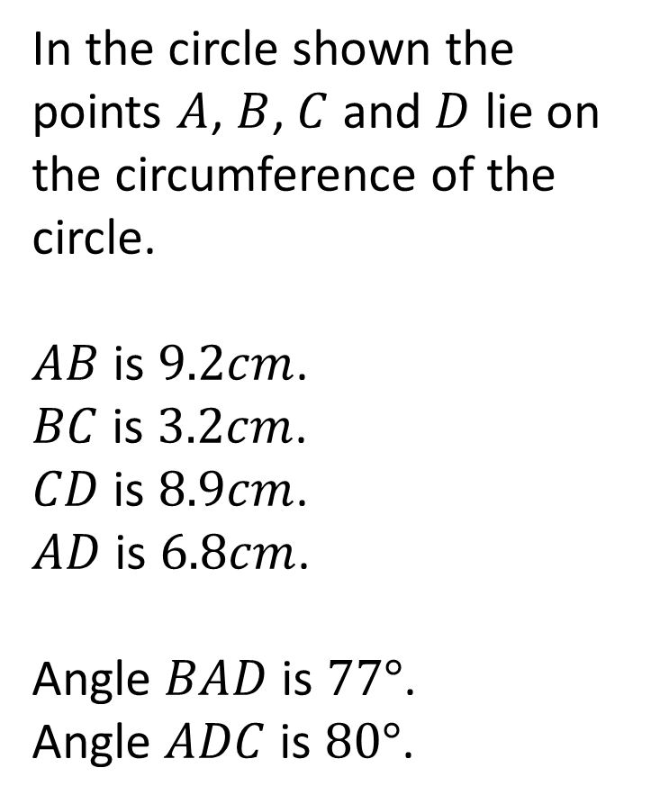
In the circle shown the points $A$, $B$, $C$ and $D$ lie on the circumference of the circle.
$AB$ is $9.2cm$.
$BC$ is $3.2cm$.
$CD$ is $8.9cm$.
$AD$ is $6.8cm$.
Angle $BAD$ is $77°$.
Angle $ADC$ is $80°$.
$$B$$
$$3.2cm$$
$$C$$
$$9.2cm$$
$$8.9cm$$
$$77°$$
$$A$$
$$80°$$
$$6.8cm$$
$$D$$
Calculate the length $BD$.

Slide 9


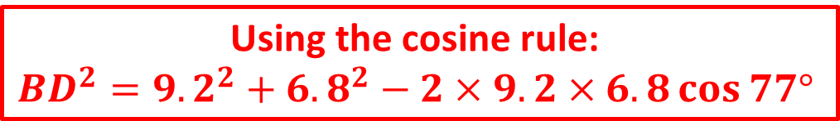
In the circle shown the points $A$, $B$, $C$ and $D$ lie on the circumference of the circle.
$AB$ is $9.2cm$.
$BC$ is $3.2cm$.
$CD$ is $8.9cm$.
$AD$ is $6.8cm$.
Angle $BAD$ is $77°$.
Angle $ADC$ is $80°$.
$$B$$
Answer
$$3.2cm$$
$$C$$
$$9.2cm$$
$$8.9cm$$
$$77°$$
$$A$$
$$80°$$
$$6.8cm$$
Using the cosine rule:
$${BD}^{2}={9.2}^{2}+{6.8}^{2}−2×9.2×6.8\cos{77°}$$
$$D$$
Calculate the length $BD$.
Answer: $10.1 cm$

Slide 10
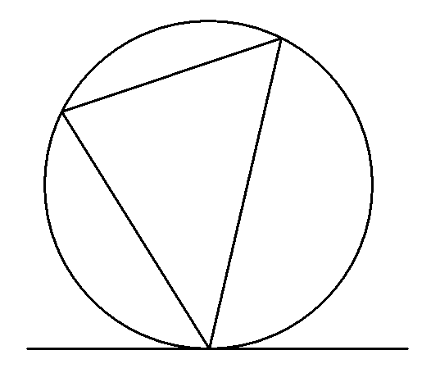



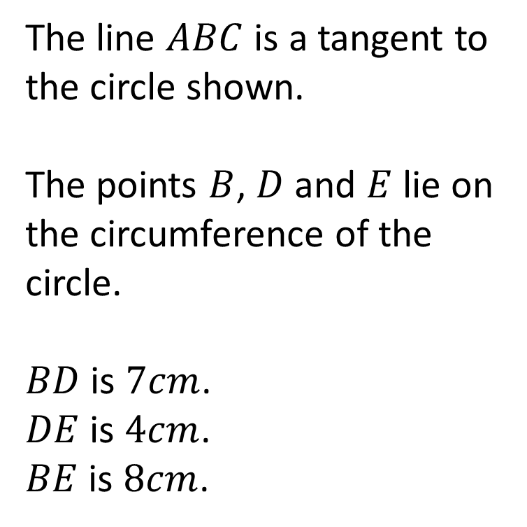

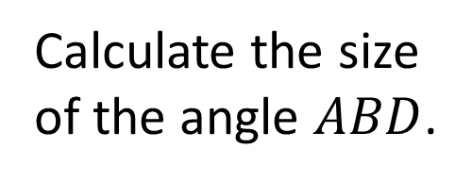

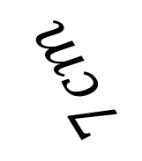
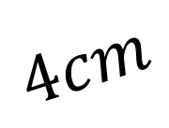
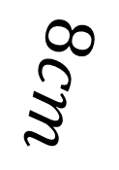
The line $ABC$ is a tangent to the circle shown.
The points $B$, $D$ and $E$ lie on the circumference of the circle.
$BD$ is $7cm$.
$DE$ is $4cm$.
$BE$ is $8cm$.
$$E$$
$$4cm$$
$$D$$
$$8cm$$
$$7cm$$
Calculate the size of the angle $ABD$.
$$A$$
$$C$$
$$B$$

Slide 11
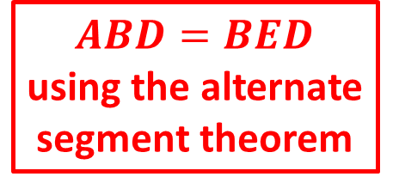

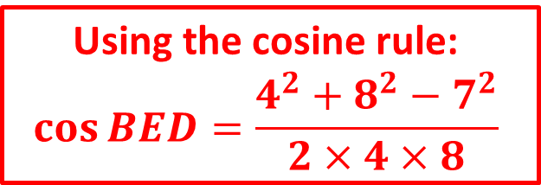
The line $ABC$ is a tangent to the circle shown.
The points $B$, $D$ and $E$ lie on the circumference of the circle.
$BD$ is $7cm$.
$DE$ is $4cm$.
$BE$ is $8cm$.
$$E$$
$$4cm$$
Answer
$$D$$
$ABD=BED$
using the alternate segment theorem
$$8cm$$
$$7cm$$
Using the cosine rule:
$$\cos{BED}=\frac{4^{2}+8^{2}−7^{2}}{2×4×8}$$
Calculate the size of the angle $ABD$.
$$A$$
$$C$$
$$B$$
Answer: $61.0°$

