Slide 1
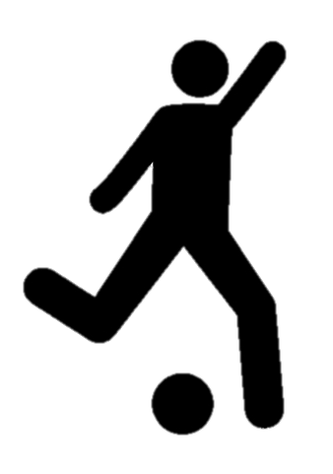
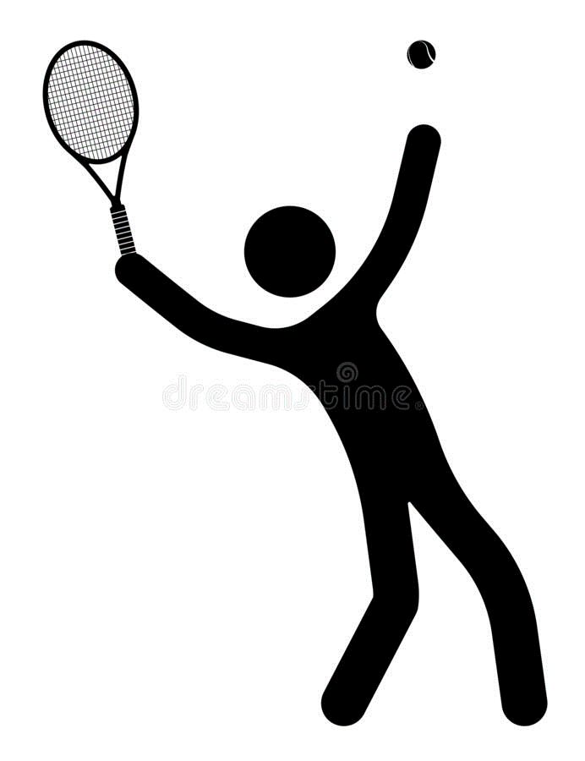

Sporting Bounds
The potential error in cricket, tennis and football decisions…

Slide 2
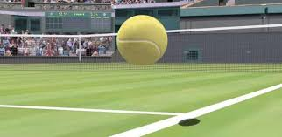
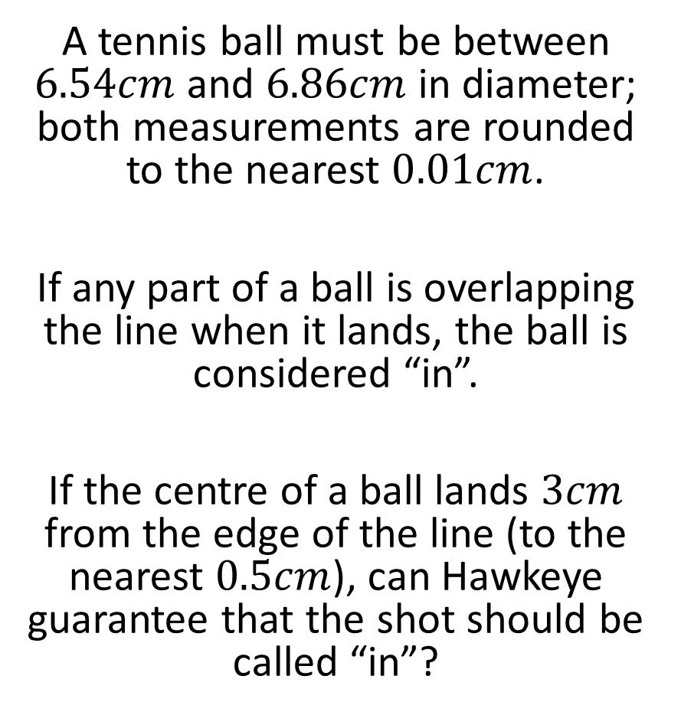
Tennis – Hawkeye
A tennis ball must be between $6.54cm$ and $6.86cm$ in diameter; both measurements are rounded to the nearest $0.01cm$.
If any part of a ball is overlapping the line when it lands, the ball is considered “in”.
If the centre of a ball lands $3cm$ from the edge of the line (to the nearest $0.5cm$), can Hawkeye guarantee that the shot should be called “in”?

Slide 3



Tennis – Hawkeye
A tennis ball must be between $6.54cm$ and $6.86cm$ in diameter; both measurements are rounded to the nearest $0.01cm$.
If any part of a ball is overlapping the line when it lands, the ball is considered “in”.
If the centre of a ball lands $3cm$ from the edge of the line (to the nearest $0.5cm$), can Hawkeye guarantee that the shot should be called “in”?
Answer
Smallest radius of the ball is $\frac{6.535}{2}=3.2675cm$
The ball lands a maximum of $3.25cm$ from the edge of the line
Yes, Hawkeye can guarantee that the ball has landed “in” because $3.2675>3.25$

Slide 4
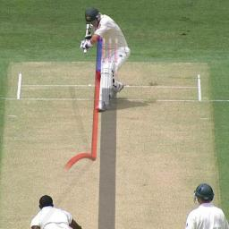
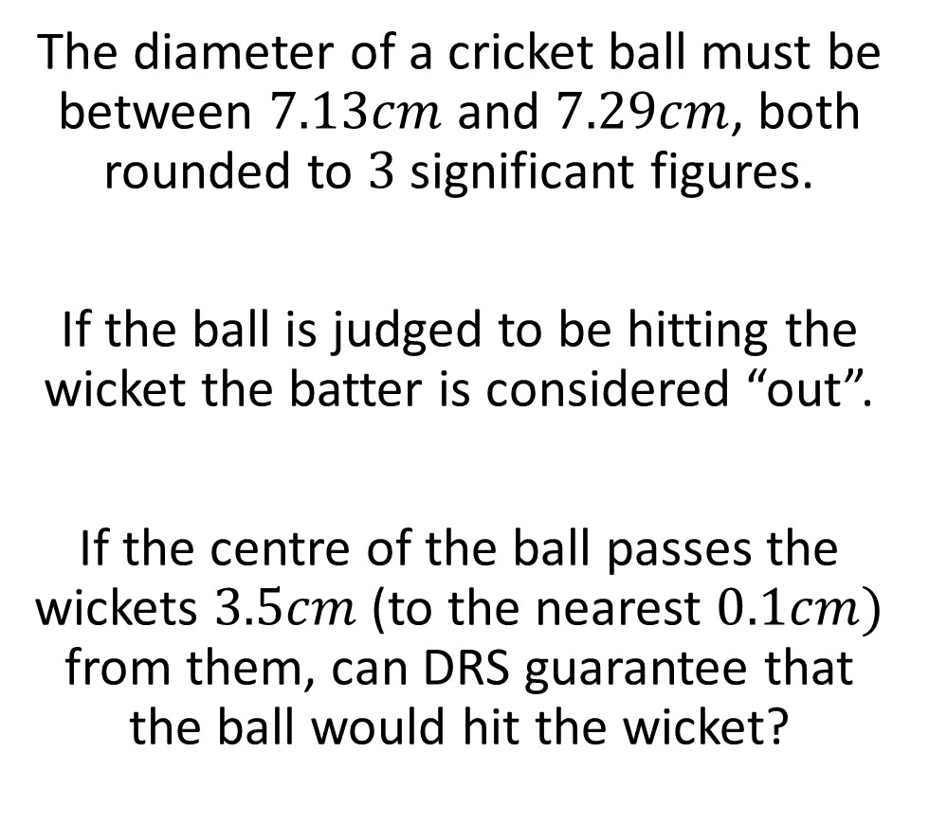
Cricket – DRS 1
The diameter of a cricket ball must be between $7.13cm$ and $7.29cm$, both rounded to $3$ significant figures.
If the ball is judged to be hitting the wicket the batter is considered “out”.
If the centre of the ball passes the wickets $3.5cm$ (to the nearest $0.1cm)$ from them, can DRS guarantee that the ball would hit the wicket?

Slide 5
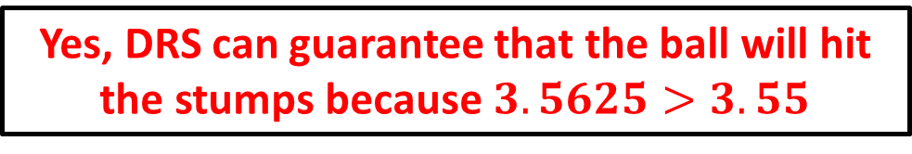


Cricket – DRS 1
The diameter of a cricket ball must be between $7.13cm$ and $7.29cm$, both rounded to $3$ significant figures.
If the ball is judged to be hitting the wicket the batter is considered “out”.
If the centre of the ball passes the wickets $3.5cm$ (to the nearest $0.1cm)$ from them, can DRS guarantee that the ball would hit the wicket?
Answer
Maximum distance ball from wicket: $3.55cm$
Minimum width of ball: $\frac{7.125}{2}=3.5625cm$
Yes, DRS can guarantee that the ball will hit the stumps because $3.5625>3.55$

Slide 6
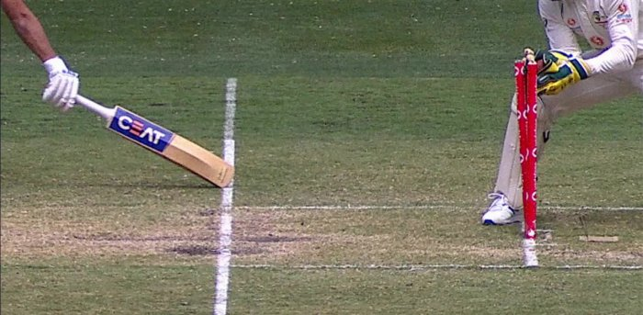
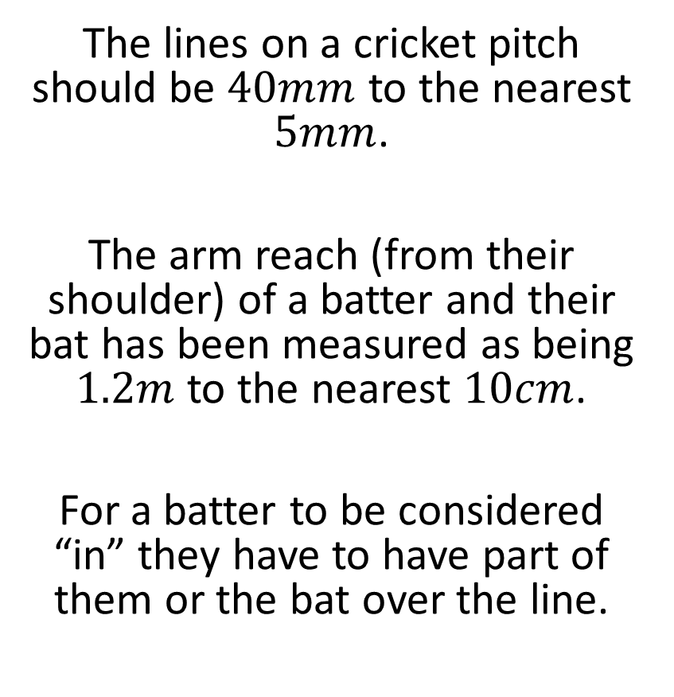
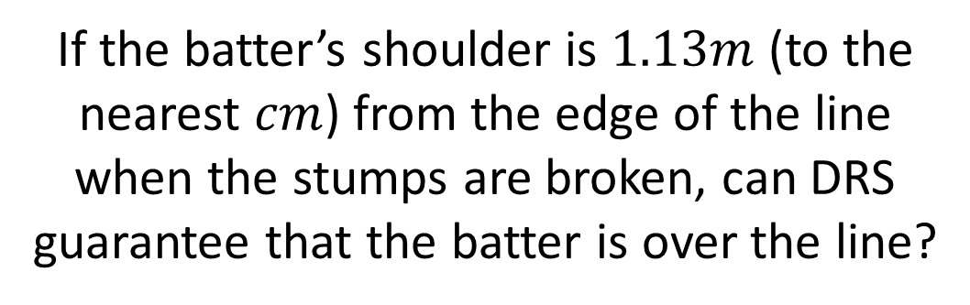
Cricket – DRS 2
The lines on a cricket pitch should be $40mm$ to the nearest $5mm$.
The arm reach (from their shoulder) of a batter and their bat has been measured as being $1.2m$ to the nearest $10cm$.
For a batter to be considered “in” they have to have part of them or the bat over the line.
If the batter’s shoulder is $1.13m$ (to the nearest $cm$) from the edge of the line when the stumps are broken, can DRS guarantee that the batter is over the line?

Slide 7
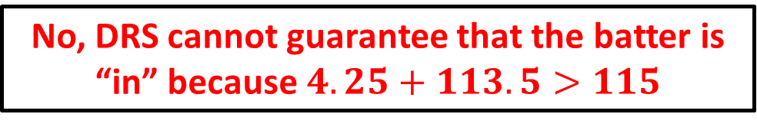



Cricket – DRS 2
The lines on a cricket pitch should be $40mm$ to the nearest $5mm$.
The arm reach (from their shoulder) of a batter and their bat has been measured as being $1.2m$ to the nearest $10cm$.
For a batter to be considered “in” they have to have part of them or the bat over the line.
Answer
Maximum width of the line: $4.25cm$
Maximum distance from the line: $113.5cm$
Minimum stretch of the batter’s arm: $115cm$
If the batter’s shoulder is $1.13m$ (to the nearest $cm$) from the edge of the line when the stumps are broken, can DRS guarantee that the batter is over the line?
No, DRS cannot guarantee that the batter is “in” because $4.25+113.5>115$

Slide 8
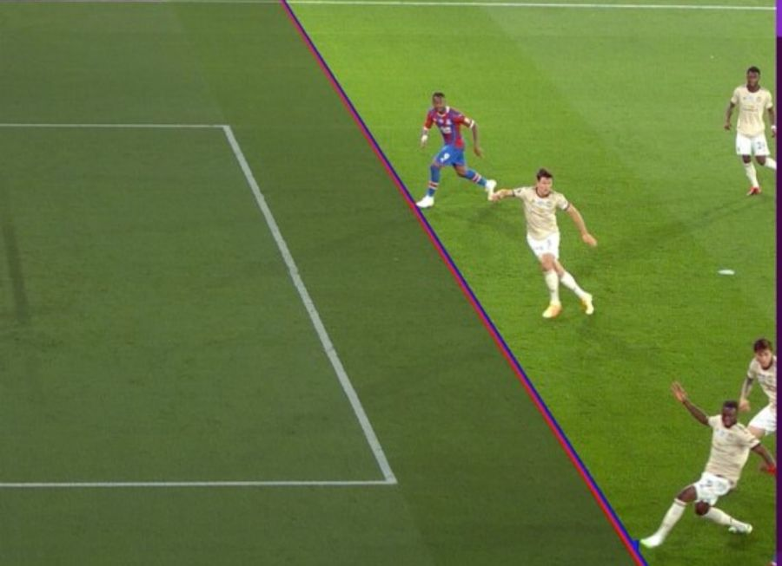
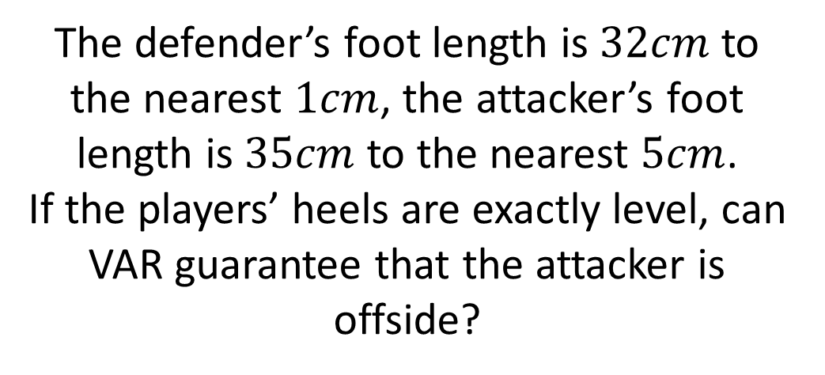
Football – VAR
If any part of the attacking player (in red and blue) is beyond the defensive player (in white) they are deemed “offside” (there must be a minimum of two defensive players when the ball is played forward).
Due to the pixels on the screen, the potential error in measurement is different based upon a player’s position on the field (ie. how close they are to the camera).
The defender’s foot length is $32cm$ to the nearest $1cm$, the attacker’s foot length is $35cm$ to the nearest $5cm$.
If the players’ heels are exactly level, can VAR guarantee that the attacker is offside?

Slide 9

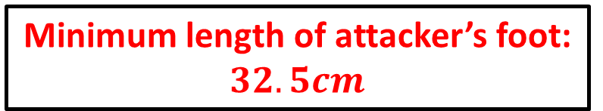
Football – VAR
Answer
If any part of the attacking player (in red and blue) is beyond the defensive player (in white) they are deemed “offside” (there must be a minimum of two defensive players when the ball is played forward).
Due to the pixels on the screen, the potential error in measurement is different based upon a player’s position on the field (ie. how close they are to the camera).
Minimum length of attacker’s foot: $32.5cm$
Maximum length of defender’s foot: $32.5cm$
The defender’s foot length is $32cm$ to the nearest $1cm$, the attacker’s foot length is $35cm$ to the nearest $5cm$.
If the players’ heels are exactly level, can VAR guarantee that the attacker is offside?
No, VAR cannot guarantee that the attacker is offside because the two bounds are equal so the attacker is not beyond the defender.

