Slide 1




Explain The Errors… Transforming Functions
Four friends (Ade, Belle, Chloe and Dean) have been doing some maths questions.
In each case, just one of the friends has got the question correct.
Work out who got the correct answer, then work out what those who got the question incorrect have done to get their answer.

Slide 2
Choose a question!
Question 1
Translation 1
Question 2
Describe a translation
Question 3
Translation 2
Question 4
Describe a stretch
Question 5
Coordinate mapping 1
Question 6
Coordinate mapping 2
Question 7
Coordinate mapping 3
Question 8
Trigonometry 1
Question 9
Trigonometry 2
Question 10
Trigonometry 3

Slide 3
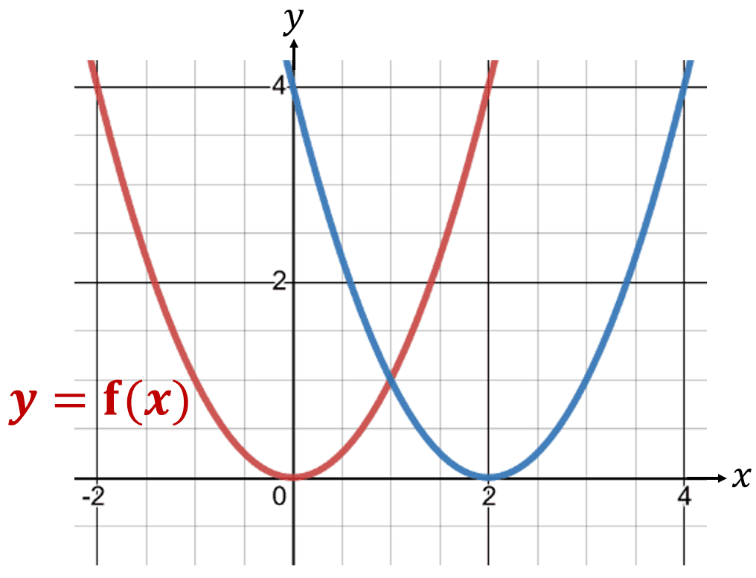


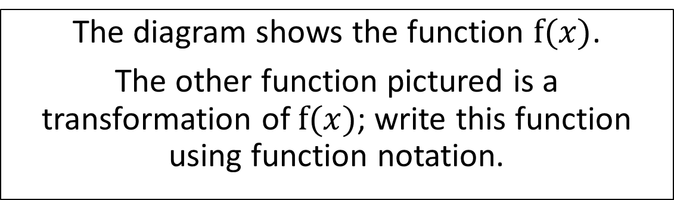


Question 1
The diagram shows the function $f(x)$.
The other function pictured is a transformation of $f(x)$; write this function using function notation.
Ade’s answer:
$$y=f\left(x+2\right)$$
Belle’s answer:
$$y=f\left(x−2\right)$$
Chloe’s answer:
$$y=f\left(x\right)+2$$
Dean’s answer:
$$y=f\left(x\right)−2$$

Slide 4

Question 1 – Answer
Return to “Choose a question” screen
End the activity
The diagram shows the function $f(x)$.
The other function pictured is a transformation of $f(x)$; write this function using function notation.
Correct!
Ade’s answer:
$$y=f\left(x+2\right)$$
Belle’s answer:
$$y=f\left(x−2\right)$$
Chloe’s answer:
$$y= f\left(x\right)+2$$
Dean’s answer:
$$y=f\left(x\right)−2$$

Slide 5
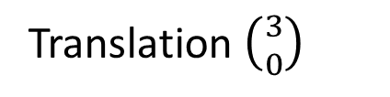
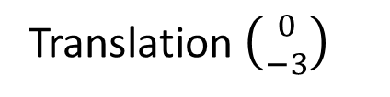
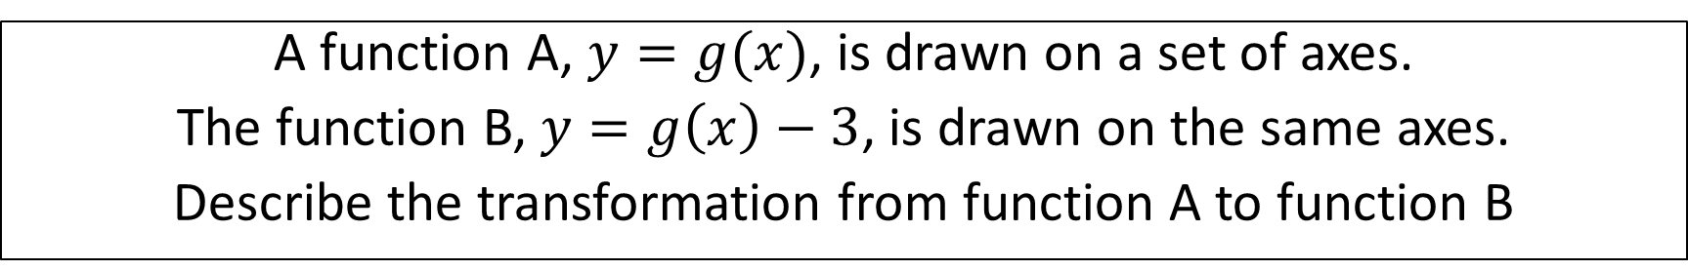
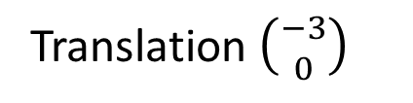
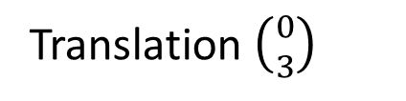
Question 2
A function A, $y=g(x)$, is drawn on a set of axes.
The function B, $y=g\left(x\right)−3$, is drawn on the same axes.
Describe the transformation from function A to function B
Ade’s answer:
Translation $\left({−3 \atop 0}\right)$
Belle’s answer:
Translation $\left({3 \atop 0}\right)$
Chloe’s answer:
Translation $\left({0 \atop −3}\right)$
Dean’s answer:
Translation $\left({0 \atop 3}\right)$

Slide 6
Question 2 – Answer
Return to “Choose a question” screen
End the activity
A function A, $y=g(x)$, is drawn on a set of axes.
The function B, $y=g\left(x\right)−3$, is drawn on the same axes.
Describe the transformation from function A to function B
Ade’s answer:
Translation $\left({−3 \atop 0}\right)$
Belle’s answer:
Translation $\left({3 \atop 0}\right)$
Correct!
Translation $\left({0 \atop −3}\right)$
Translation $\left({0 \atop 3}\right)$
Chloe’s answer:
Dean’s answer:

Slide 7
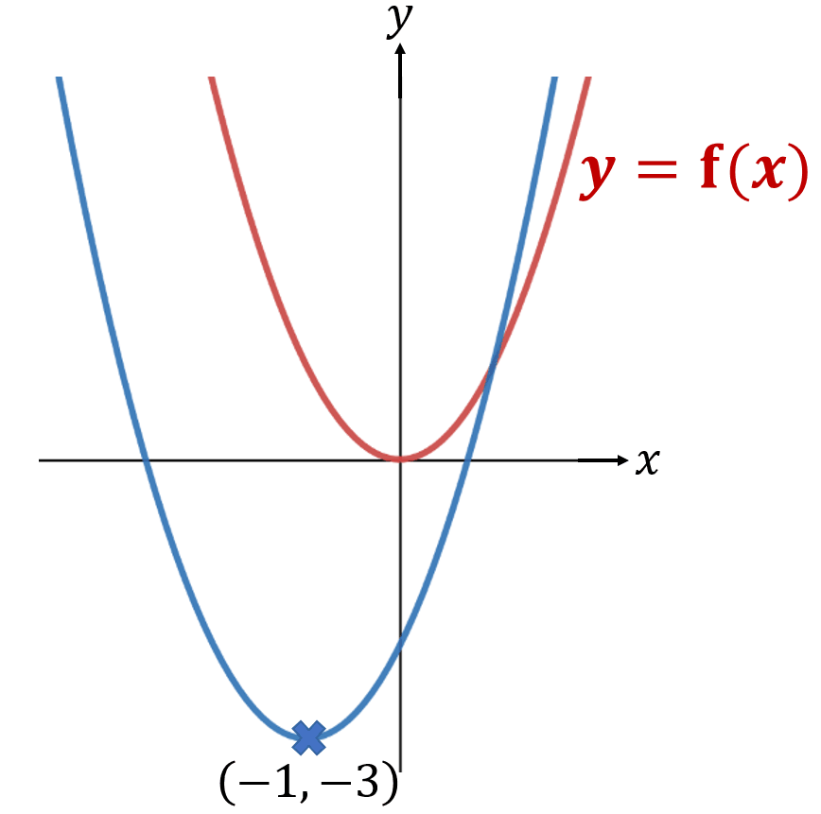


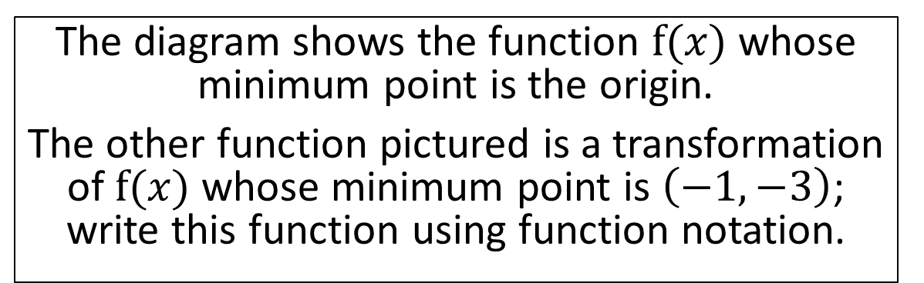


Question 3
The diagram shows the function $f(x)$ whose minimum point is the origin.
The other function pictured is a transformation of $f(x)$ whose minimum point is $\left(−1,−3\right)$; write this function using function notation.
Ade’s answer:
Belle’s answer:
$$y=f\left(x+3\right)−1$$
$$y=f\left(x−1\right)−3$$
Chloe’s answer:
Dean’s answer:
$$y=f\left(x+1\right)+3$$
$$y=f\left(x+1\right)−3$$

Slide 8
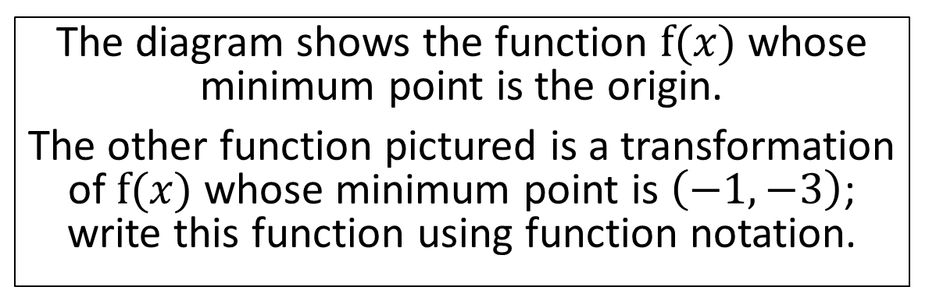
Question 3 – Answer
Return to “Choose a question” screen
End the activity
The diagram shows the function $f(x)$ whose minimum point is the origin.
The other function pictured is a transformation of $f(x)$ whose minimum point is $\left(−1,−3\right)$; write this function using function notation.
Ade’s answer:
Belle’s answer:
$$y=f\left(x+3\right)−1$$
$$y=f\left(x−1\right)−3$$
Chloe’s answer:
Dean’s answer:
Correct!
$$y=f\left(x+1\right)+3$$
$$y=f\left(x+1\right)−3$$

Slide 9
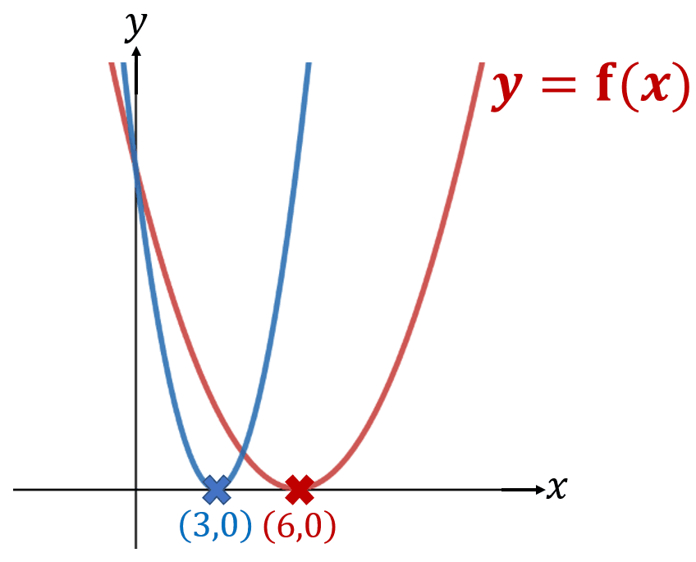


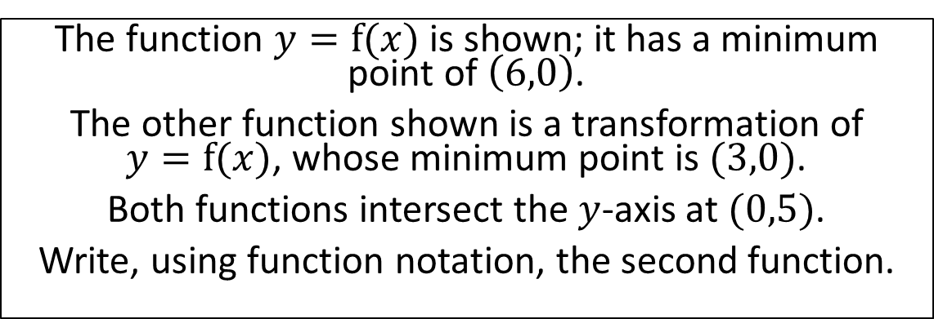

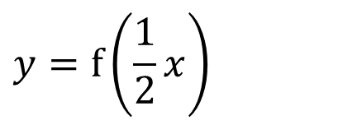
Question 4
The function $y=f(x)$ is shown; it has a minimum point of $\left(6,0\right)$.
The other function shown is a transformation of
$y=f(x)$, whose minimum point is $(3,0)$.
Both functions intersect the $y$-axis at $(0,5)$.
Write, using function notation, the second function.
Ade’s answer:
$$y=2f(x)$$
Belle’s answer:
$$y=f(x+3)$$
$$y=f\left(\frac{1}{2}x\right)$$
Chloe’s answer:
$$y=f(2x)$$
Dean’s answer:

Slide 10
Question 4 – Answer
Return to “Choose a question” screen
End the activity
The function $y=f(x)$ is shown; it has a minimum point of $\left(6,0\right)$.
The other function shown is a transformation of
$y=f(x)$, whose minimum point is $(3,0)$.
Both functions intersect the $y$-axis at $(0,5)$.
Write, using function notation, the second function.
Ade’s answer:
$$y=2f(x)$$
Belle’s answer:
$$y=f(x+3)$$
$$y=f\left(\frac{1}{2}x\right)$$
Correct!
Chloe’s answer:
$$y=f(2x)$$
Dean’s answer:

Slide 11
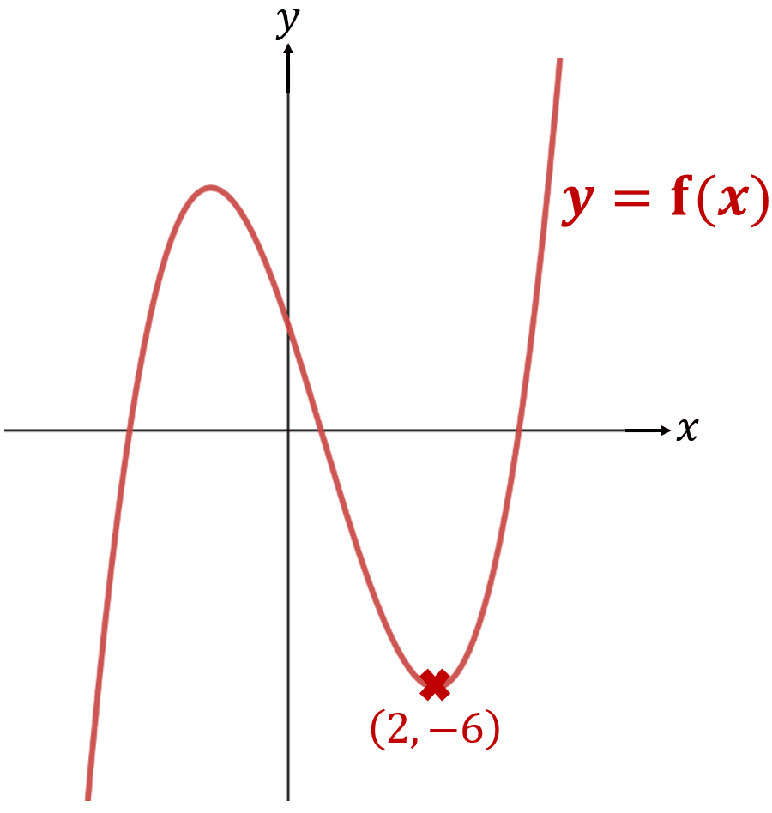


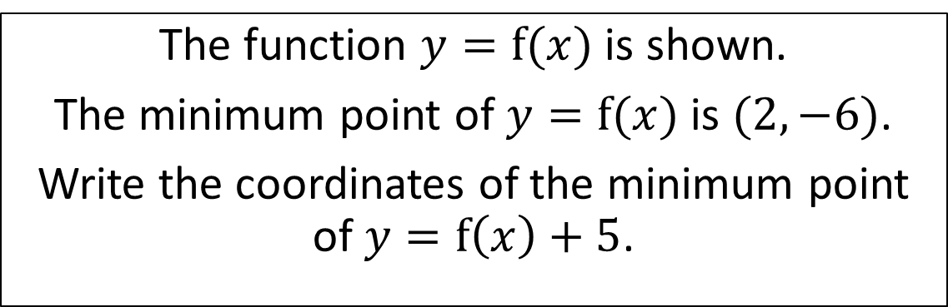


Question 5
The function $y=f(x)$ is shown.
The minimum point of $y=f(x)$ is $(2,−6)$.
Write the coordinates of the minimum point of $y=f\left(x\right)+5$.
Ade’s answer:
Belle’s answer:
$$\left(2,−1\right)$$
$$\left(7,−6\right)$$
Chloe’s answer:
Dean’s answer:
$$\left(7,−1\right)$$
$$\left(−3,−6\right)$$

Slide 12
Question 5 – Answer
Return to “Choose a question” screen
End the activity
The function $y=f(x)$ is shown.
The minimum point of $y=f(x)$ is $(2,−6)$.
Write the coordinates of the minimum point of $y=f\left(x\right)+5$.
Ade’s answer:
Belle’s answer:
Correct!
$$\left(2,−1\right)$$
$$\left(7,−6\right)$$
Chloe’s answer:
Dean’s answer:
$$\left(7,−1\right)$$
$$\left(−3,−6\right)$$

Slide 13


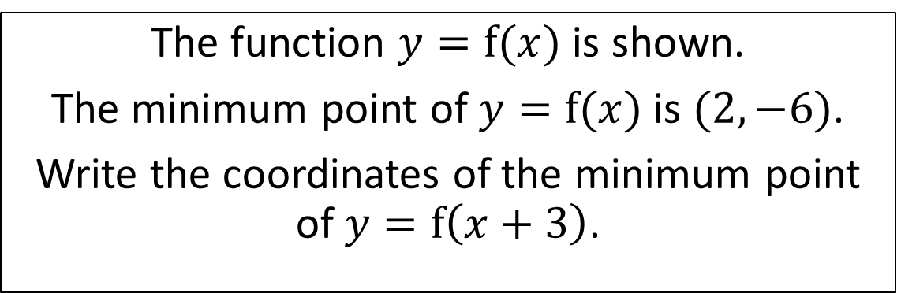


Question 6
The function $y=f(x)$ is shown.
The minimum point of $y=f(x)$ is $(2,−6)$.
Write the coordinates of the minimum point of $y=f\left(x+3\right)$.
Ade’s answer:
Belle’s answer:
$$\left(−1,−6\right)$$
$$\left(5,6\right)$$
Chloe’s answer:
Dean’s answer:
$$\left(2,−3\right)$$
$$\left(2,−2\right)$$

Slide 14
Question 6 – Answer
Return to “Choose a question” screen
End the activity
The function $y=f(x)$ is shown.
The minimum point of $y=f(x)$ is $(2,−6)$.
Write the coordinates of the minimum point of $y=f\left(x+3\right)$.
Ade’s answer:
Belle’s answer:
Correct!
$$\left(−1,−6\right)$$
$$\left(5,6\right)$$
Chloe’s answer:
Dean’s answer:
$$\left(2,−3\right)$$
$$\left(2,−2\right)$$

Slide 15

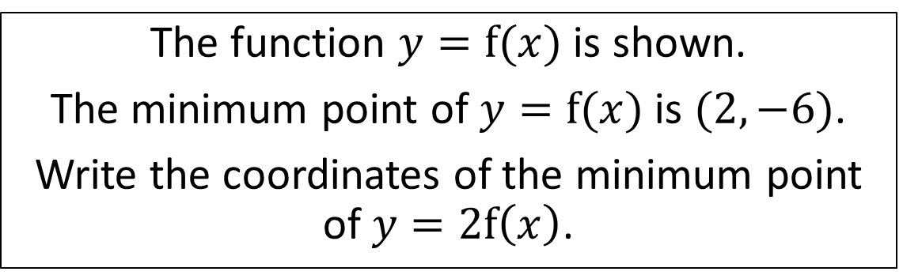


Question 7
The function $y=f(x)$ is shown.
The minimum point of $y=f(x)$ is $(2,−6)$.
Write the coordinates of the minimum point of $y=2f\left(x\right)$.
Ade’s answer:
Belle’s answer:
$$\left(1,−6\right)$$
$$\left(4,−6\right)$$
Chloe’s answer:
Dean’s answer:
$$\left(2,−3\right)$$
$$\left(2,−12\right)$$

Slide 16
Question 7 – Answer
Return to “Choose a question” screen
End the activity
The function $y=f(x)$ is shown.
The minimum point of $y=f(x)$ is $(2,−6)$.
Write the coordinates of the minimum point of $y=2f\left(x\right)$.
Ade’s answer:
Belle’s answer:
$$\left(1,−6\right)$$
$$\left(4,−6\right)$$
Chloe’s answer:
Dean’s answer:
Correct!
$$\left(2,−3\right)$$
$$\left(2,−12\right)$$

Slide 17
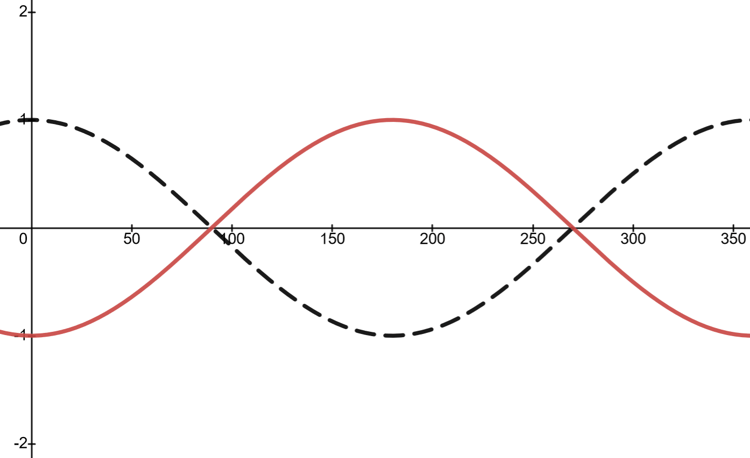


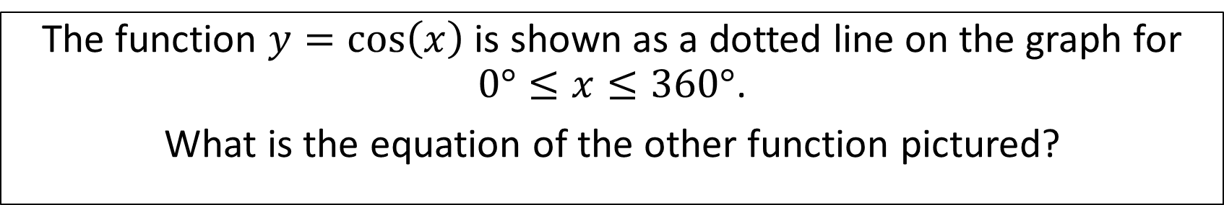


Question 8
The function $y=\cos\left(x\right)$ is shown as a dotted line on the graph for $0°≤x≤360°$.
What is the equation of the other function pictured?
Ade’s answer:
Belle’s answer:
$$y=\sin\left(x\right)$$
$$y=\cos\left(−x\right)$$
Chloe’s answer:
Dean’s answer:
$$y=−\cos\left(x\right)$$
$$y=\cos\left(x\right)$$

Slide 18
Question 8 – Answer
Return to “Choose a question” screen
End the activity
The function $y=\cos\left(x\right)$ is shown as a dotted line on the graph for $0°≤x≤360°$.
What is the equation of the other function pictured?
Ade’s answer:
Belle’s answer:
$$y=\sin\left(x\right)$$
$$y=\cos\left(−x\right)$$
Chloe’s answer:
Dean’s answer:
Correct!
$$y=−\cos\left(x\right)$$
$$y=\cos\left(x\right)$$

Slide 19
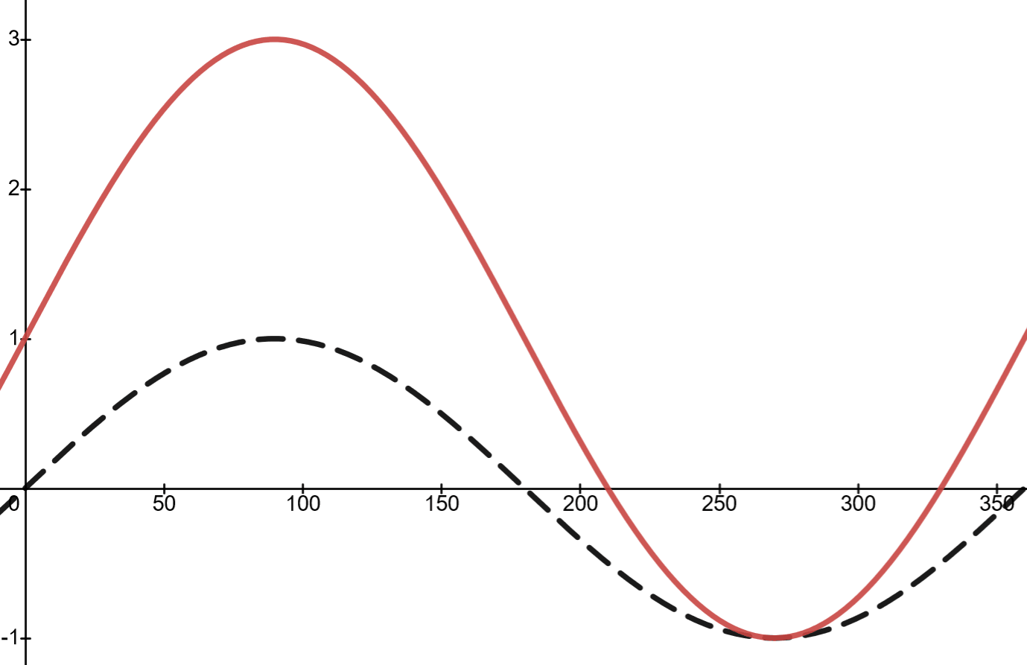


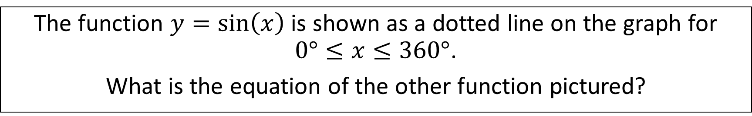


Question 9
The function $y=\sin\left(x\right)$ is shown as a dotted line on the graph for $0°≤x≤360°$.
What is the equation of the other function pictured?
Ade’s answer:
Belle’s answer:
$$y=3+\sin\left(x\right)$$
$$y=3\sin\left(x\right)$$
Chloe’s answer:
Dean’s answer:
$$y=1+2\sin\left(x\right)$$
$$y=1+\sin\left(2x\right)$$

Slide 20
Question 9 – Answer
Return to “Choose a question” screen
End the activity
The function $y=\sin\left(x\right)$ is shown as a dotted line on the graph for $0°≤x≤360°$.
What is the equation of the other function pictured?
Ade’s answer:
Belle’s answer:
$$y=3+\sin\left(x\right)$$
$$y=3\sin\left(x\right)$$
Chloe’s answer:
Dean’s answer:
Correct!
$$y=1+2\sin\left(x\right)$$
$$y=1+\sin\left(2x\right)$$

Slide 21
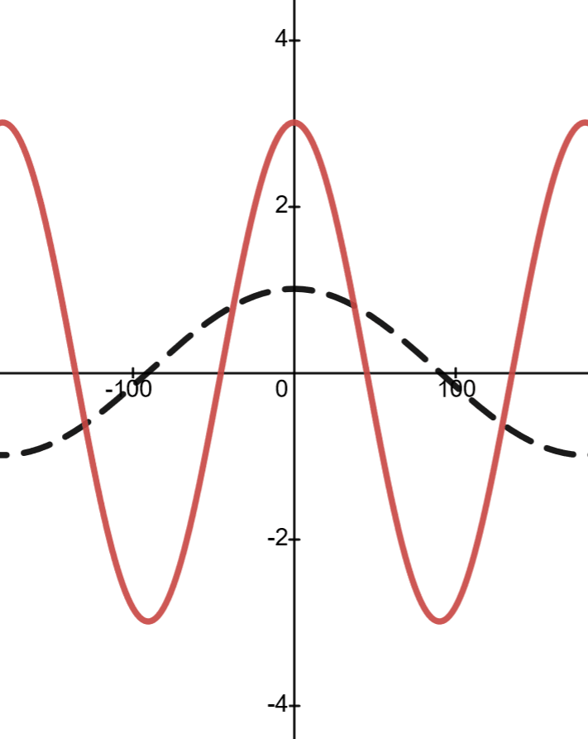

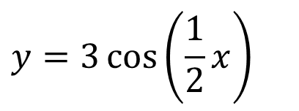
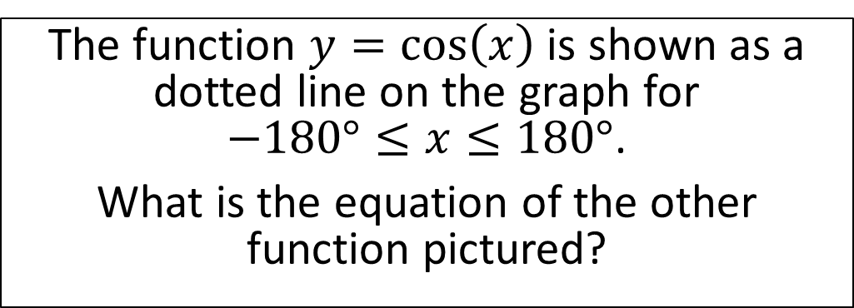

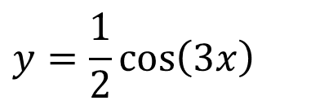
Question 10
The function $y=\cos\left(x\right)$ is shown as a dotted line on the graph for
$−180°≤x≤180°$.
What is the equation of the other
function pictured?
Ade’s answer:
Belle’s answer:
$$y=3\cos\left(2x\right)$$
$$y=2\cos\left(3x\right)$$
Chloe’s answer:
Dean’s answer:
$$y=3\cos\left(\frac{1}{2}x\right)$$
$$y=\frac{1}{2}\cos\left(3x\right)$$

Slide 22
Question 10
Return to “Choose a question” screen
End the activity
The function $y=\cos\left(x\right)$ is shown as a dotted line on the graph for
$−180°≤x≤180°$.
What is the equation of the other
function pictured?
Ade’s answer:
Belle’s answer:
Correct!
$$y=3\cos\left(2x\right)$$
$$y=2\cos\left(3x\right)$$
Chloe’s answer:
Dean’s answer:
$$y=3\cos\left(\frac{1}{2}x\right)$$
$$y=\frac{1}{2}\cos\left(3x\right)$$

Slide 23

The end!

