Slide 1


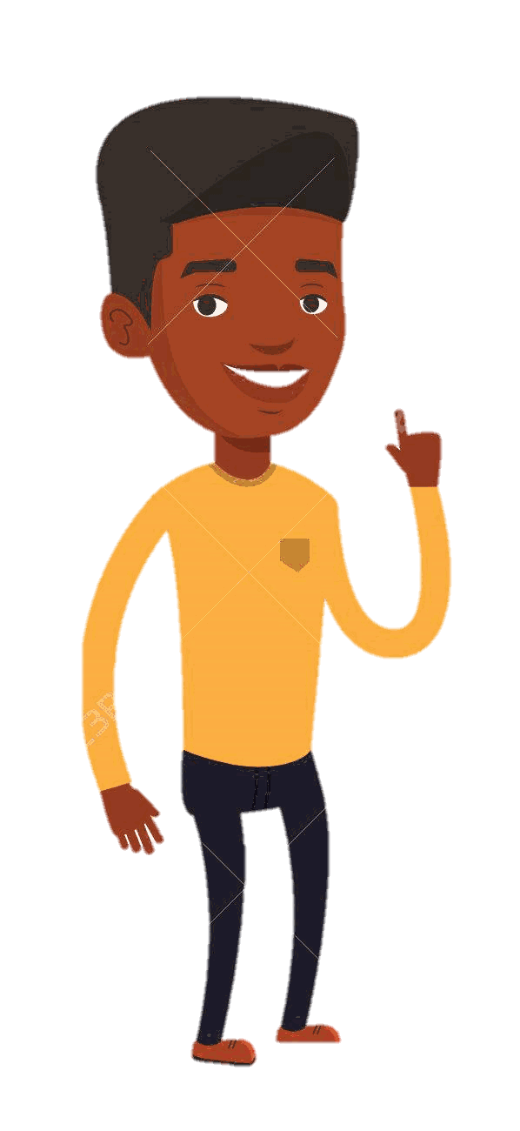

Explain The Errors… Sets and Venn diagrams
Four friends (Ade, Belle, Chloe and Dean) have been doing some maths questions.
In each case, just one of the friends has got the question correct.
Work out who got the correct answer, then work out what those who got the question incorrect have done to get their answer.

Slide 2
Choose a question!
Question 1
Reading a Venn 1
Question 2
Listing elements
Question 3
Reading a Venn 2
Question 4
Using set notation
Question 5
Union or intersection
Question 6
Venn diagram
Question 7
Using set notation
Question 8
Drawing a Venn 1
Question 9
Shading a Venn
Question 10
Drawing a Venn 2

Slide 3
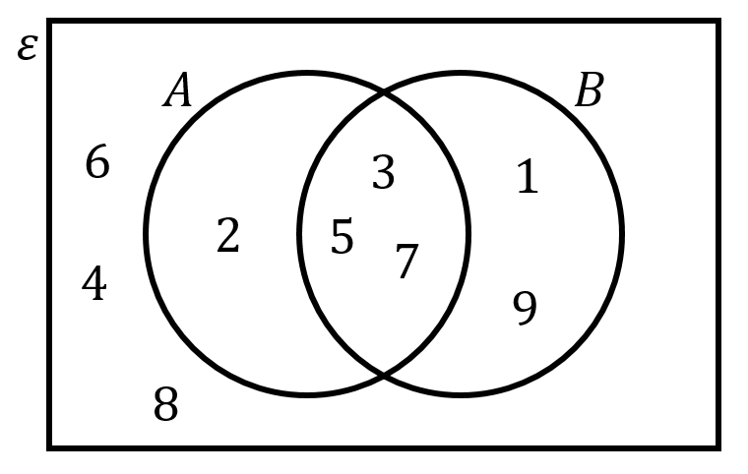
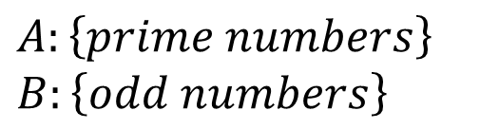
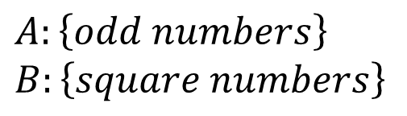
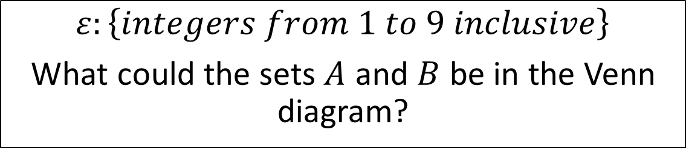
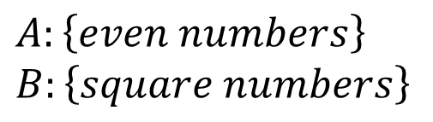
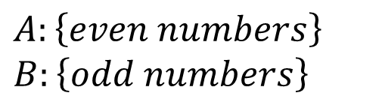
Question 1
$$ε:\left\{integers from 1 to 9 inclusive\right\}$$
What could the sets $A$ and $B$ be in the Venn diagram?
Ade’s answer:
$$A:\left\{even numbers\right\}$$
$$B:\left\{square numbers\right\}$$
Belle’s answer:
$$A:\left\{prime numbers\right\}$$
$$B:\left\{odd numbers\right\}$$
Chloe’s answer:
$$A:\left\{odd numbers\right\}$$
$$B:\left\{square numbers\right\}$$
Dean’s answer:
$$A:\left\{even numbers\right\}$$
$$B:\left\{odd numbers\right\}$$

Slide 4
Question 1 – Answer
Return to “Choose a question” screen
End the activity
$$ε:\left\{integers from 1 to 9 inclusive\right\}$$
What could the sets $A$ and $B$ be in the Venn diagram?
Correct!
Ade’s answer:
$$A:\left\{even numbers\right\}$$
$$B:\left\{square numbers\right\}$$
Belle’s answer:
$$A:\left\{prime numbers\right\}$$
$$B:\left\{odd numbers\right\}$$
Chloe’s answer:
$$A:\left\{odd numbers\right\}$$
$$B:\left\{square numbers\right\}$$
Dean’s answer:
$$A:\left\{even numbers\right\}$$
$$B:\left\{odd numbers\right\}$$

Slide 5





Question 2
$$ε:\left\{integers from 1 to 10 inclusive\right\}$$
$$P:\left\{multiples of 3\right\}$$
$$Q:\left\{factors of 12\right\}$$
List the set $Q′$.
Ade’s answer:
$$5, 7, 8, 9, 10$$
Belle’s answer:
$$1, 2, 3, 4, 6, 12$$
Chloe’s answer:
$$1, 2, 4, 5, 7, 8, 10$$
Dean’s answer:
$$1, 2, 3, 4, 6$$

Slide 6
Question 2 – Answer
Return to “Choose a question” screen
End the activity
$$ε:\left\{integers from 1 to 10 inclusive\right\}$$
$$P:\left\{multiples of 3\right\}$$
$$Q:\left\{factors of 12\right\}$$
List the set $Q′$.
Correct!
Belle’s answer:
$$1, 2, 3, 4, 6, 12$$
Ade’s answer:
$$5, 7, 8, 9, 10$$
Chloe’s answer:
$$1, 2, 4, 5, 7, 8, 10$$
Dean’s answer:
$$1, 2, 3, 4, 6$$

Slide 7
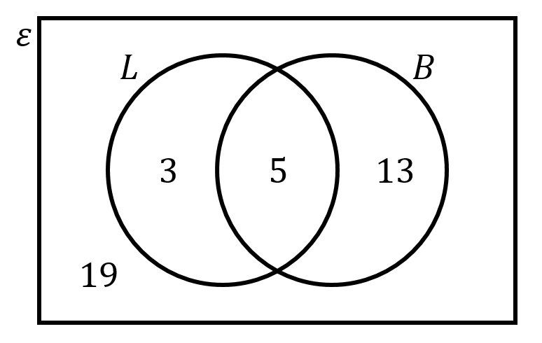


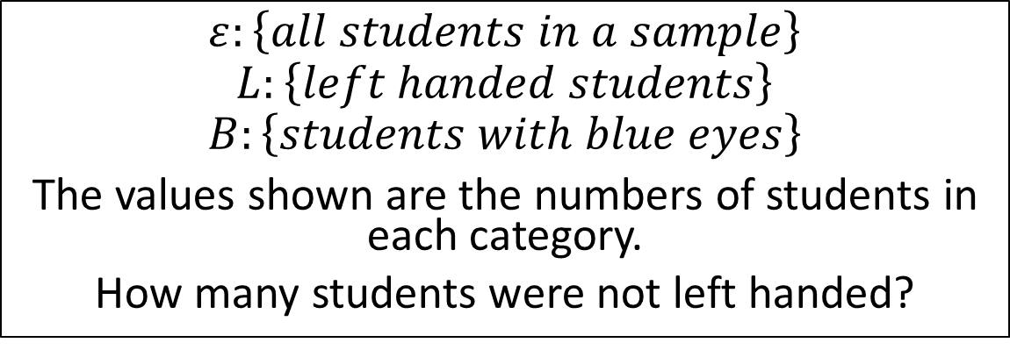


Question 3
$$ε:\left\{all students in a sample\right\}$$
$$L:\left\{left handed students\right\}$$
$$B:\left\{students with blue eyes\right\}$$
The values shown are the numbers of students in each category.
How many students were not left handed?
Ade’s answer:
$$13$$
Belle’s answer:
$$19$$
Chloe’s answer:
$$8$$
Dean’s answer:
$$32$$

Slide 8
Question 3 – Answer
Return to “Choose a question” screen
End the activity
$$ε:\left\{all students in a sample\right\}$$
$$L:\left\{left handed students\right\}$$
$$B:\left\{students with blue eyes\right\}$$
The values shown are the numbers of students in each category.
How many students were not left handed?
Ade’s answer:
$$13$$
Belle’s answer:
$$19$$
Chloe’s answer:
Correct!
$$8$$
Dean’s answer:
$$32$$

Slide 9


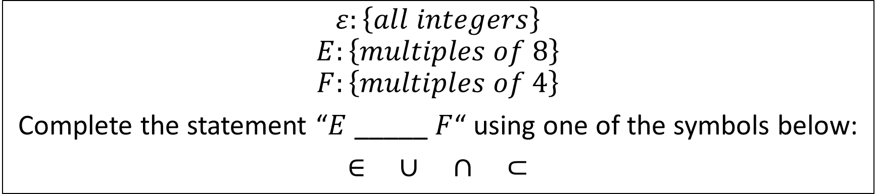


Question 4
$$ε:\left\{all integers\right\}$$
$$E:\left\{multiples of 8\right\}$$
$$F:\left\{multiples of 4\right\}$$
Complete the statement “$E$ _____ $F$“ using one of the symbols below:
$∈$ $∪$ $∩$ $⊂$
Ade’s answer:
$$∈$$
Belle’s answer:
$$∪$$
Chloe’s answer:
$$∩$$
Dean’s answer:
$$⊂$$

Slide 10
Question 4
Return to “Choose a question” screen
End the activity
$$ε:\left\{all integers\right\}$$
$$E:\left\{multiples of 8\right\}$$
$$F:\left\{multiples of 4\right\}$$
Complete the statement “$E$ _____ $F$“ using one of the symbols below:
$∈$ $∪$ $∩$ $⊂$
Ade’s answer:
$$∈$$
Belle’s answer:
$$∪$$
Chloe’s answer:
Correct!
$$∩$$
Dean’s answer:
$$⊂$$

Slide 11
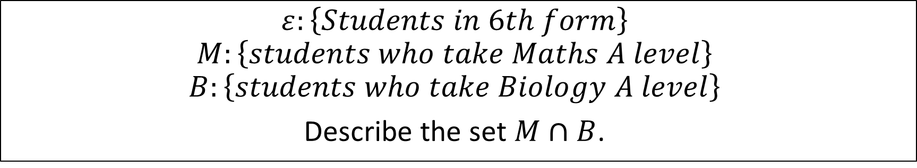
Question 5
$$ε:\left\{Students in 6th form\right\}$$
$$M:\left\{students who take Maths A level\right\}$$
$$B:\left\{students who take Biology A level\right\}$$
Describe the set $M∩B$.
Ade’s answer:
Students who take Maths or Biology A level
Belle’s answer:
Students who take Maths
Chloe’s answer:
Students who take both Maths and Biology
Dean’s answer:
Students who do not take Maths or Biology

Slide 12
Question 5 – Answer
Return to “Choose a question” screen
End the activity
$$ε:\left\{Students in 6th form\right\}$$
$$M:\left\{students who take Maths A level\right\}$$
$$B:\left\{students who take Biology A level\right\}$$
Describe the set $M∩B$.
Ade’s answer:
Students who take Maths or Biology A level
Belle’s answer:
Students who take Maths
Chloe’s answer:
Students who take both Maths and Biology
Dean’s answer:
Students who do not take Maths or Biology
Correct!

Slide 13
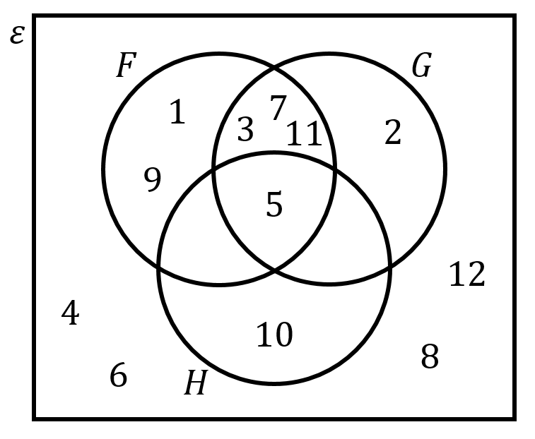


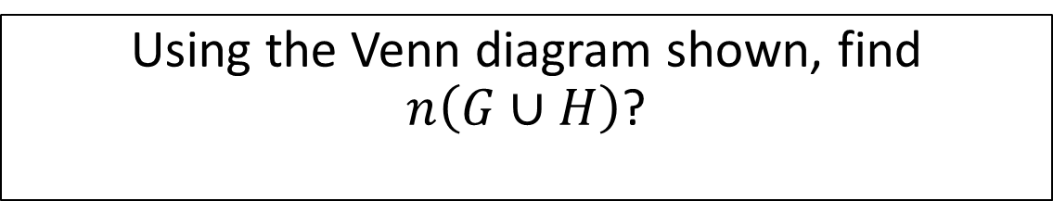


Question 6
Using the Venn diagram shown, find $n\left(G∪H\right)$?
Ade’s answer:
$$6$$
Belle’s answer:
$$5$$
Chloe’s answer:
$$2, 3, 5, 7, 10, 11$$
Dean’s answer:
$$2, 10$$

Slide 14
Question 6 – Answer
Return to “Choose a question” screen
End the activity
Using the Venn diagram shown, find $n\left(G∪H\right)$?
Correct!
Belle’s answer:
$$5$$
Ade’s answer:
$$6$$
Chloe’s answer:
$$2, 3, 5, 7, 10, 11$$
Dean’s answer:
$$2, 10$$

Slide 15

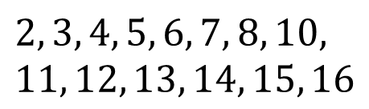



Question 7
$$ε:\left\{integers from 1 to 16 inclusive\right\}$$
$$X:\left\{square numbers\right\}$$
$$Y:\left\{even numbers\right\}$$
List the members of the set $X∩Y′$.
Ade’s answer:
$$4, 16$$
Belle’s answer:
$$1, 9$$
Chloe’s answer:
$$2, 3, 4, 5, 6, 7, 8, 10, \\ 11, 12, 13, 14, 15, 16$$
Dean’s answer:
$$2, 6, 8, 10, 12, 14$$

Slide 16
Question 7
Return to “Choose a question” screen
End the activity
$$ε:\left\{integers from 1 to 16 inclusive\right\}$$
$$X:\left\{square numbers\right\}$$
$$Y:\left\{even numbers\right\}$$
List the members of the set $X∩Y′$.
Ade’s answer:
$$4, 16$$
Belle’s answer:
$$1, 9$$
Correct!
Chloe’s answer:
$$2, 3, 4, 5, 6, 7, 8, 10, \\ 11, 12, 13, 14, 15, 16$$
Dean’s answer:
$$2, 6, 8, 10, 12, 14$$

Slide 17
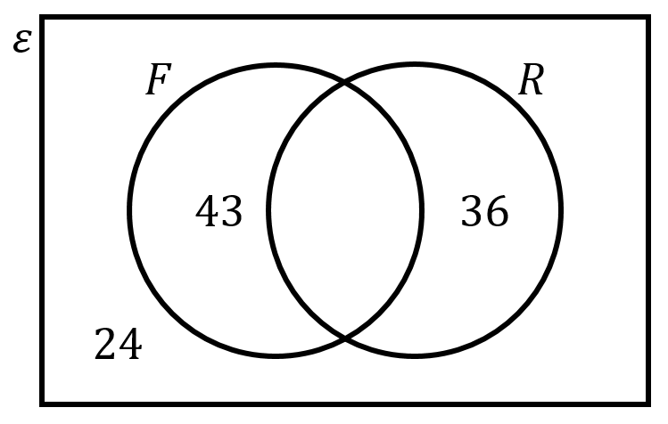
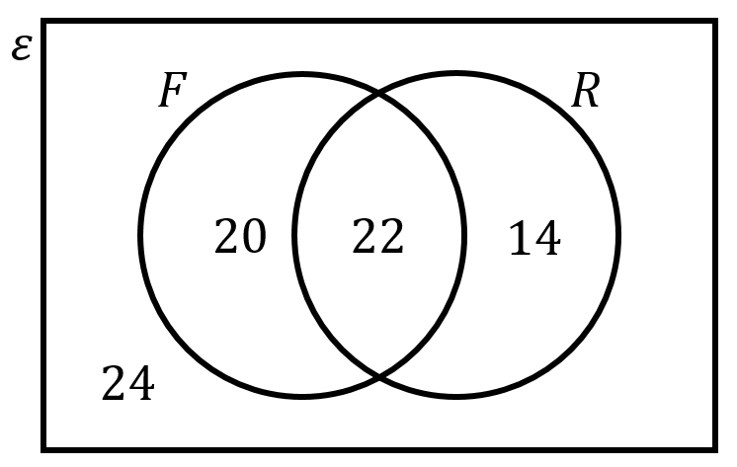
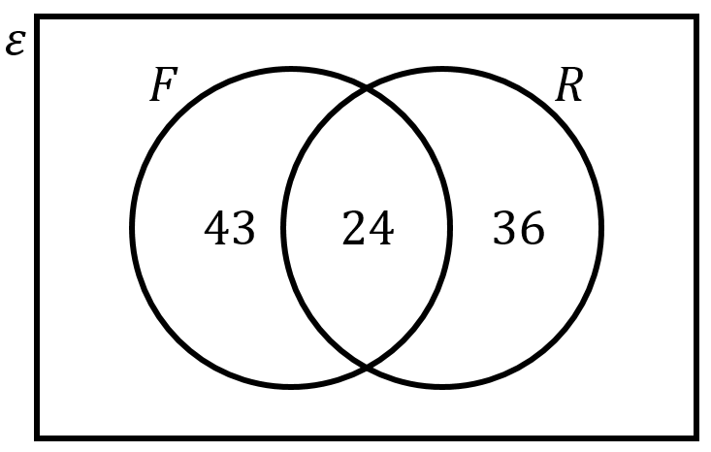
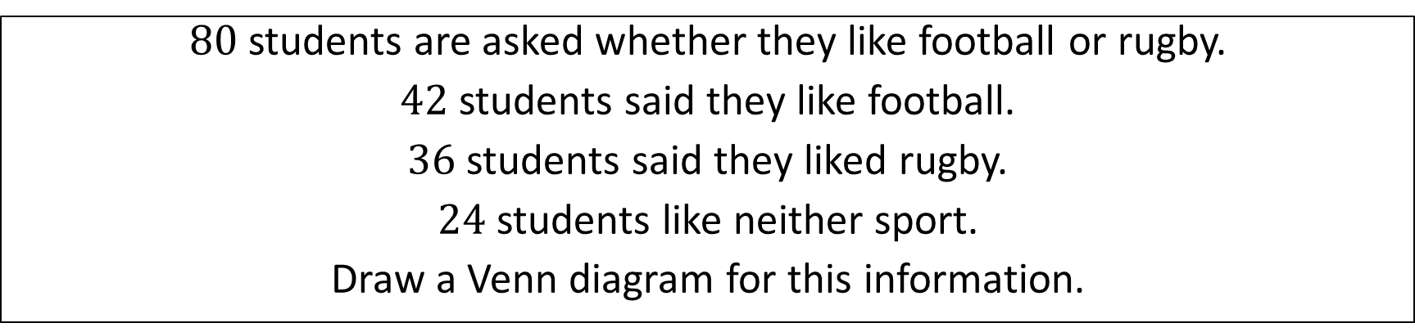
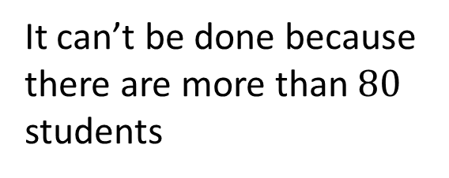
Question 8
$80$ students are asked whether they like football or rugby.
$42$ students said they like football.
$36$ students said they liked rugby.
$24$ students like neither sport.
Draw a Venn diagram for this information.
Ade’s answer:
Belle’s answer:
Chloe’s answer:
It can’t be done because there are more than $80$ students
Dean’s answer:

Slide 18
Question 8 – Answer
Return to “Choose a question” screen
End the activity
$80$ students are asked whether they like football or rugby.
$42$ students said they like football.
$36$ students said they liked rugby.
$24$ students like neither sport.
Draw a Venn diagram for this information.
Ade’s answer:
Belle’s answer:
Correct!
Chloe’s answer:
It can’t be done because there are more than $80$ students
Dean’s answer:

Slide 19
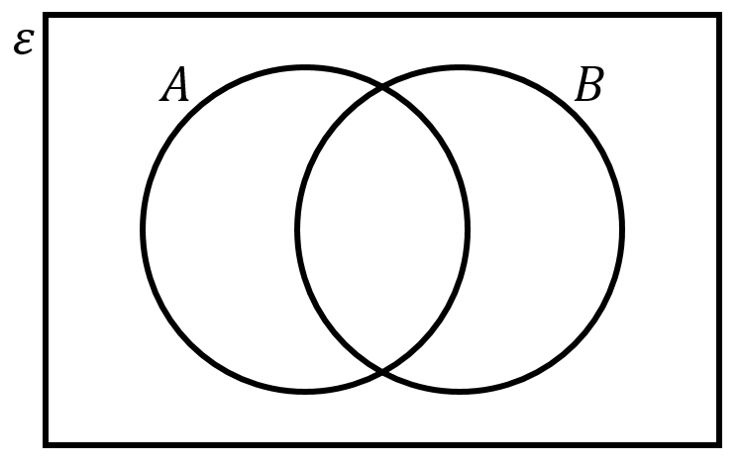
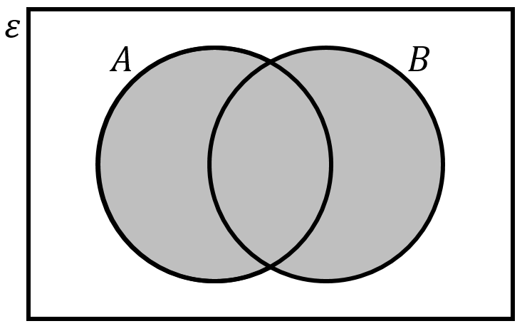
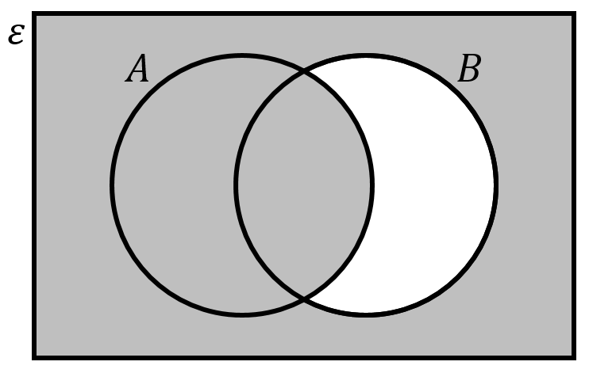
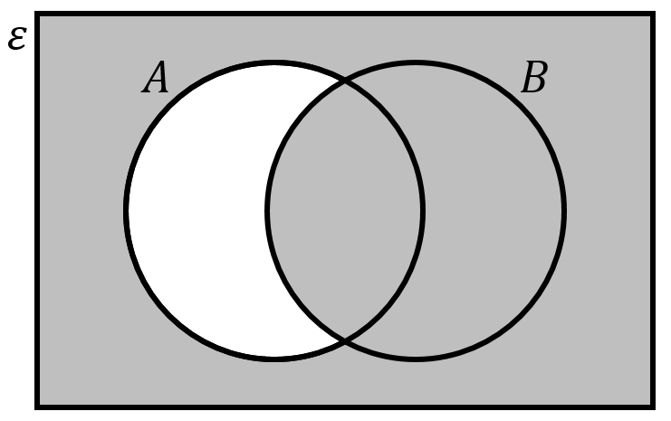
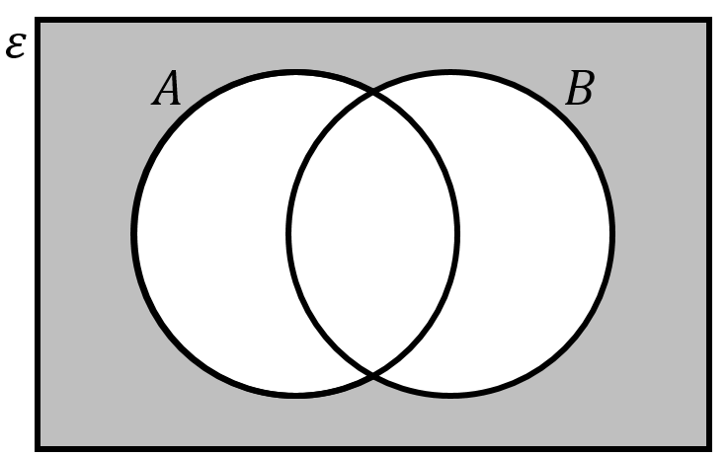
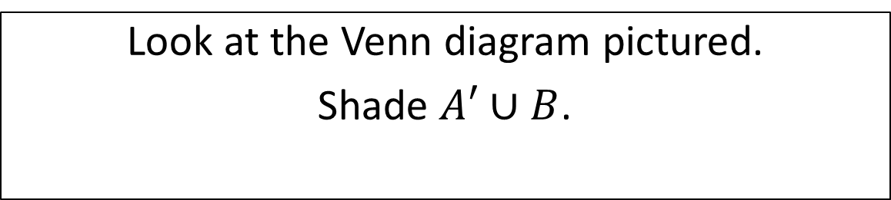
Question 9
Look at the Venn diagram pictured.
Shade $A′∪B$.
Ade’s answer:
Belle’s answer:
Chloe’s answer:
Dean’s answer:

Slide 20
Question 9 – Answer
Return to “Choose a question” screen
End the activity
Look at the Venn diagram pictured.
Shade $A′∪B$.
Ade’s answer:
Belle’s answer:
Correct!
Chloe’s answer:
Dean’s answer:

Slide 21
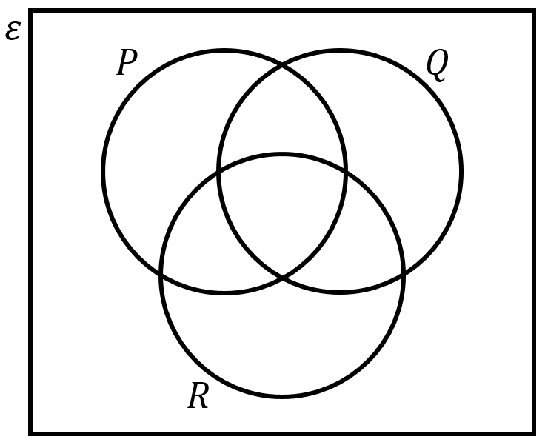
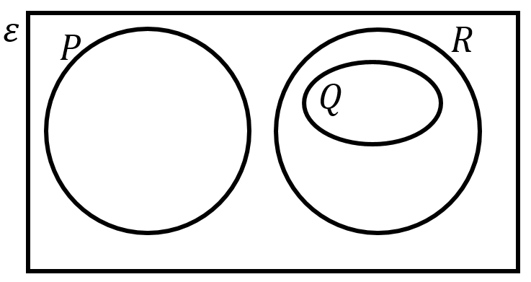
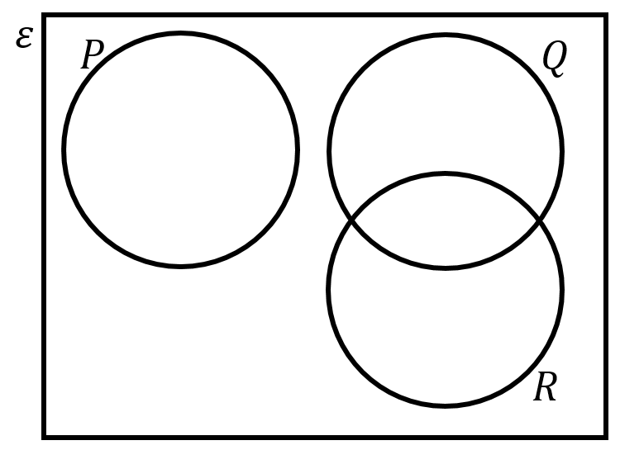
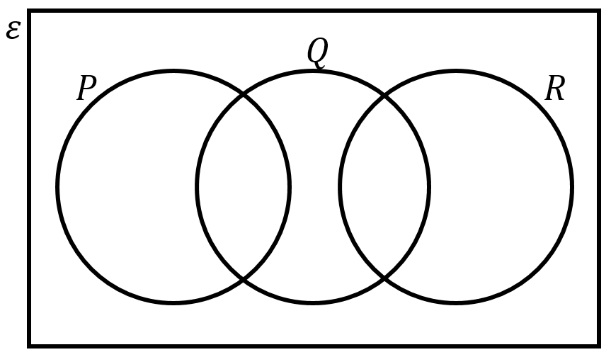
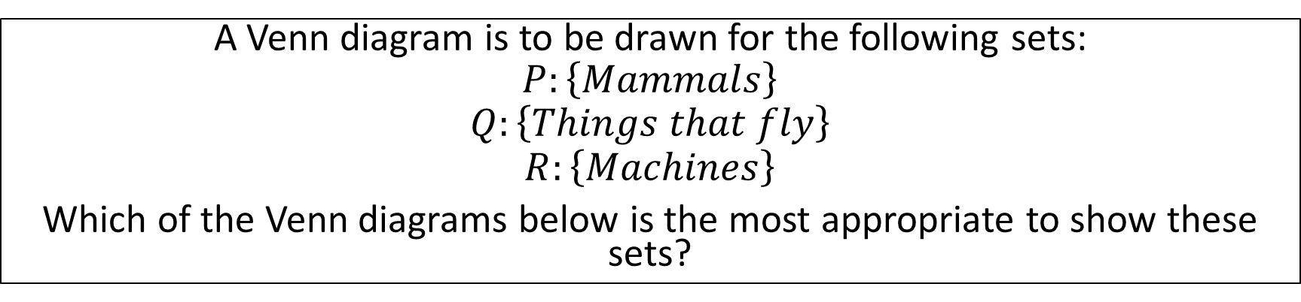
Question 10
A Venn diagram is to be drawn for the following sets:
$$P:\left\{Mammals\right\}$$
$$Q:\left\{Things that fly\right\}$$
$$R:\left\{Machines\right\}$$
Which of the Venn diagrams below is the most appropriate to show these sets?
Ade’s answer:
Belle’s answer:
Chloe’s answer:
Dean’s answer:

Slide 22
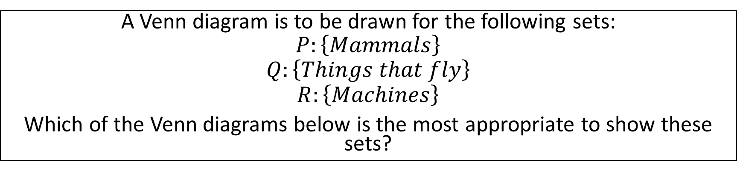
Question 10
Return to “Choose a question” screen
End the activity
A Venn diagram is to be drawn for the following sets:
$$P:\left\{Mammals\right\}$$
$$Q:\left\{Things that fly\right\}$$
$$R:\left\{Machines\right\}$$
Which of the Venn diagrams below is the most appropriate to show these sets?
Ade’s answer:
Belle’s answer:
Chloe’s answer:
Correct!
Dean’s answer:

Slide 23

The end!

