Slide 1
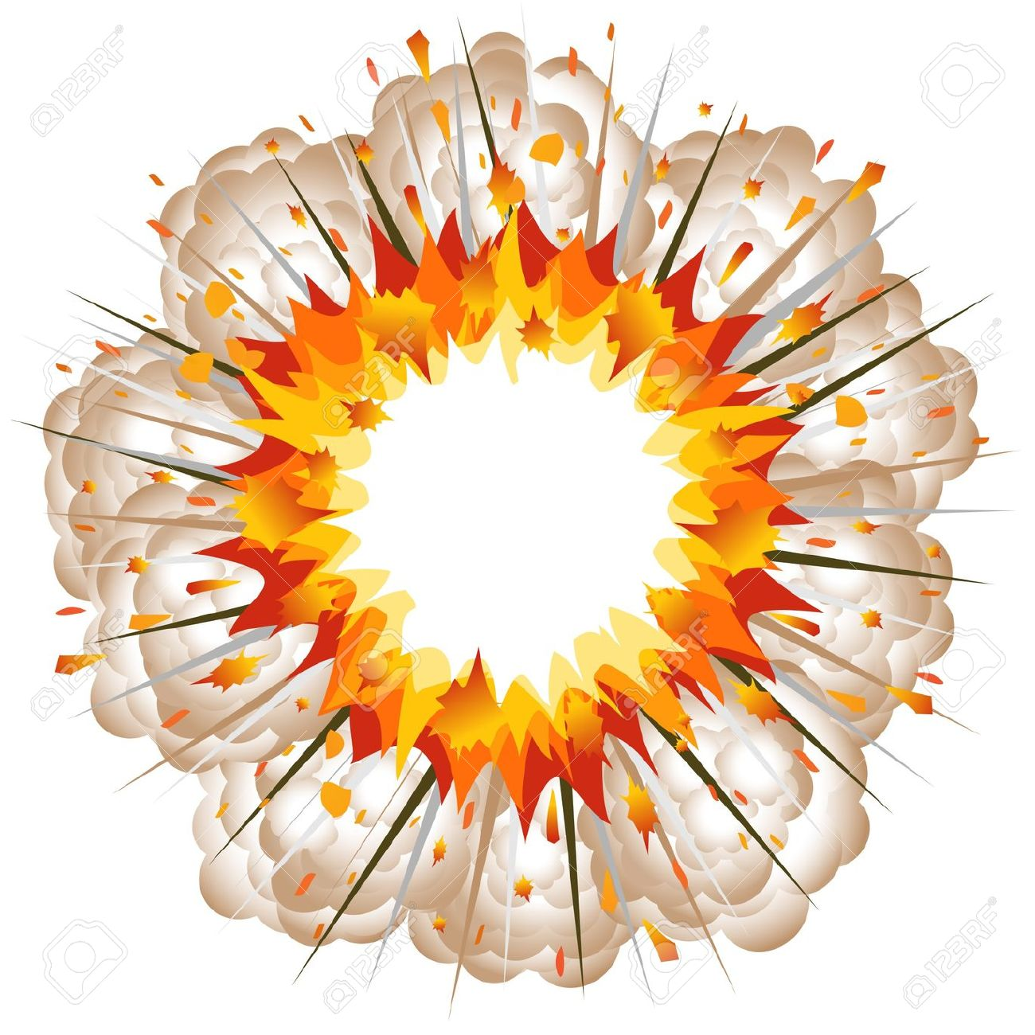
Differentiating Explosions
Can you fill in the blanks?

Slide 2

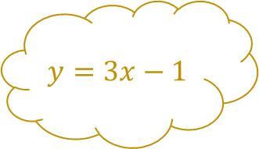
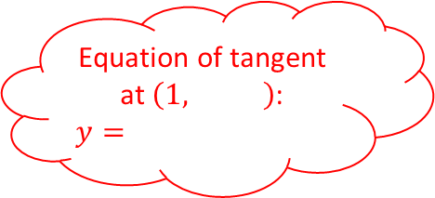
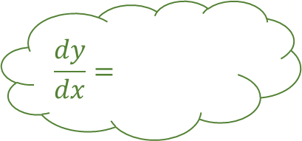
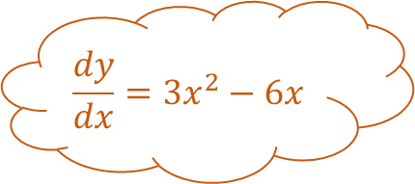
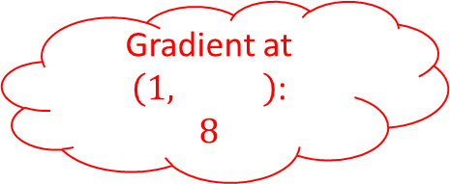
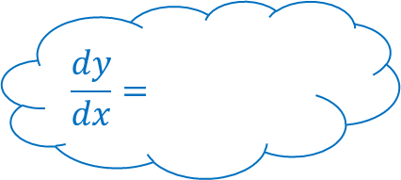
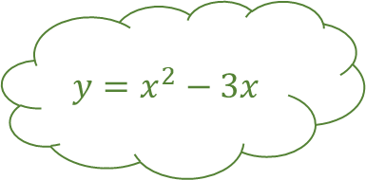
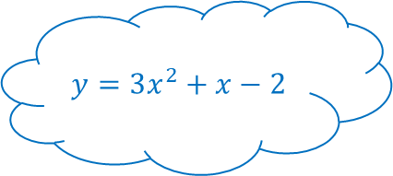
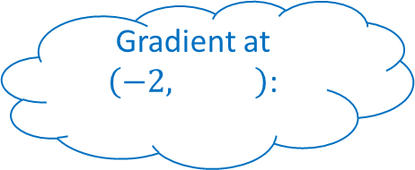
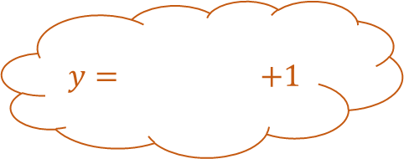
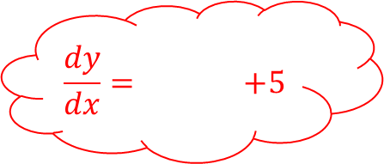
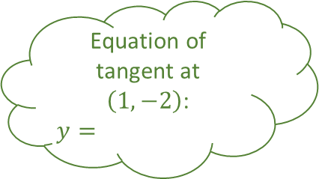
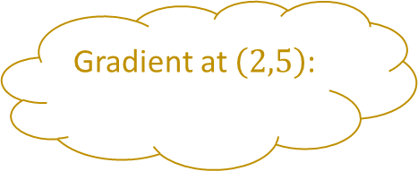
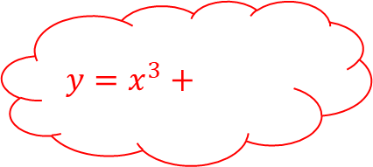
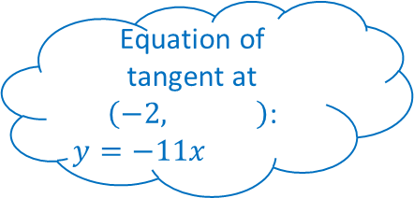
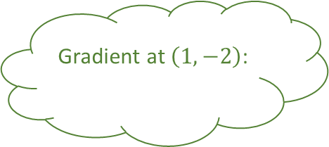
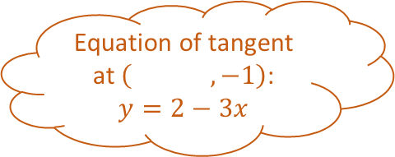
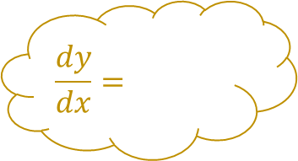
Differentiating Explosions 1
$$y=3x−1$$
$$\frac{dy}{dx}=$$
Gradient at $\left(2,5\right)$:
$$\frac{dy}{dx}=3x^{2}−6x$$
$$y= +1$$
$$y=x^{2}−3x$$
$$\frac{dy}{dx}=$$
Gradient at $\left( ,−1\right)$:
Fill in the blanks
Gradient at $\left(1,−2\right)$:
$$y=3x^{2}+x−2$$
Equation of tangent at $\left(1, \right)$:
$$y=$$
Equation of tangent at $\left(1,−2\right)$:
$$y=$$
Equation of tangent at $\left( ,−1\right)$:
$$y=2−3x$$
$$y=x^{3}+$$
$$\frac{dy}{dx}=$$
Gradient at $\left(1, \right)$:
$$8$$
$$\frac{dy}{dx}= +5$$
Gradient at $\left(−2, \right)$:
Equation of tangent at $\left(−2, \right)$:
$$y=−11x$$

Slide 3

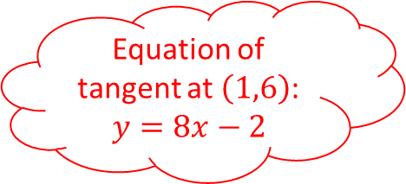
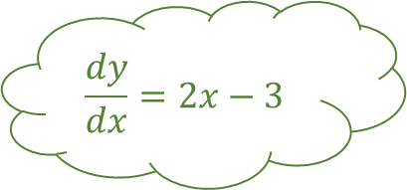
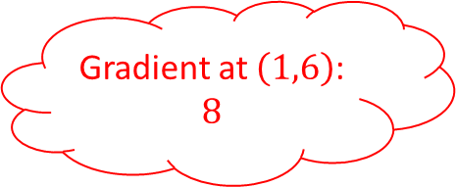
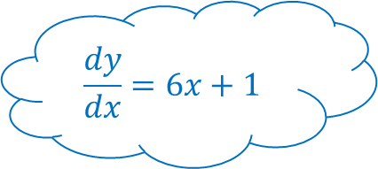

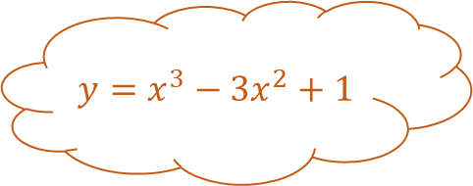
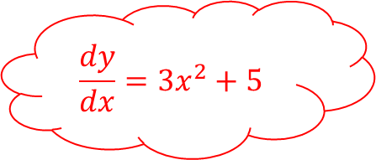
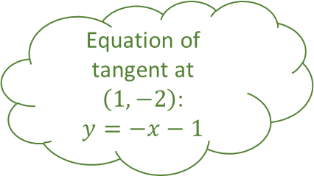
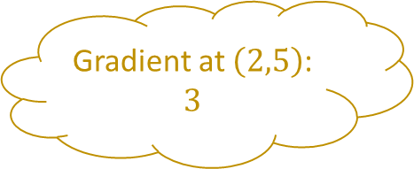
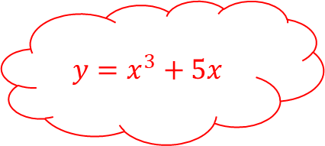
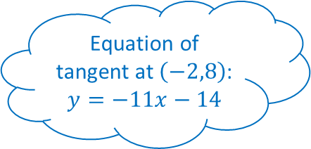
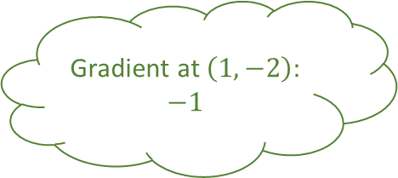
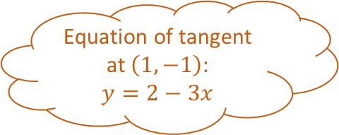
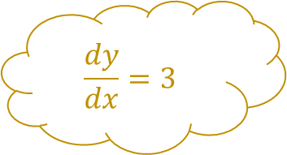
Differentiating Explosions 1
Answers
$$y=3x−1$$
$$\frac{dy}{dx}=3$$
Gradient at $\left(2,5\right)$:
$$3$$
$$\frac{dy}{dx}=3x^{2}−6x$$
$$y=x^{3}−3x^{2}+1$$
$$y=x^{2}−3x$$
$$\frac{dy}{dx}=2x−3$$
Gradient at $\left(1,−1\right)$:
$$−3$$
Fill in the blanks
Gradient at $\left(1,−2\right)$:
$$−1$$
$$y=3x^{2}+x−2$$
Equation of tangent at $\left(1,6\right)$:
$$y=8x−2$$
Equation of tangent at $\left(1,−2\right)$:
$$y=−x−1$$
Equation of tangent at $\left(1,−1\right)$:
$$y=2−3x$$
$$y=x^{3}+5x$$
$$\frac{dy}{dx}=6x+1$$
Gradient at $\left(1,6\right)$:
$$8$$
$$\frac{dy}{dx}=3x^{2}+5$$
Gradient at $\left(−2,8\right)$:
$$−11$$
Equation of tangent at $\left(−2,8\right)$:
$$y=−11x−14$$

Slide 4

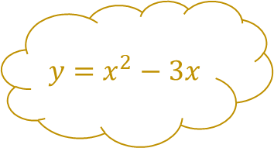
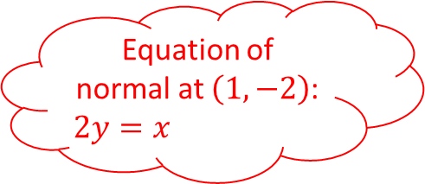

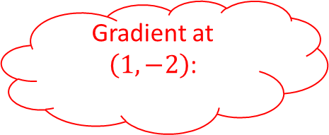
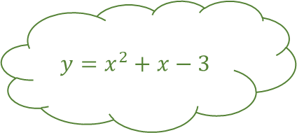
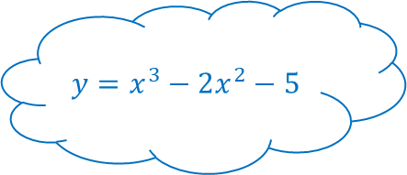

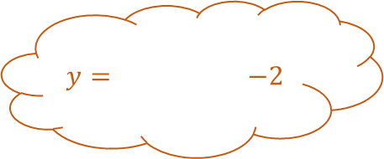
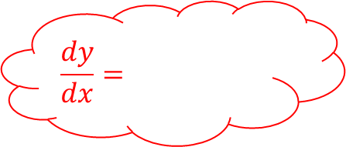
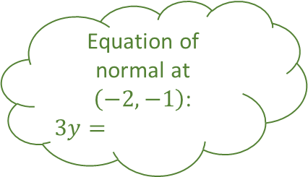


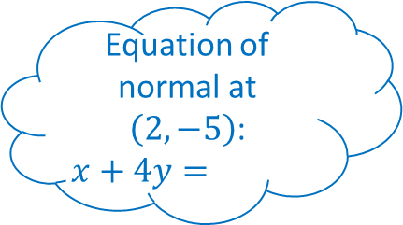

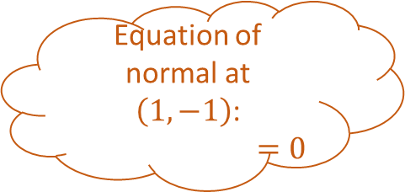
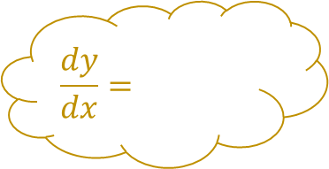
Differentiating Explosions 2
$$y=x^{2}−3x$$
$$\frac{dy}{dx}=$$
Gradient of normal at $\left(2,−2\right)$:
$$\frac{dy}{dx}=8x−3$$
$$y= −2$$
$$y=x^{2}+x−3$$
$$\frac{dy}{dx}=$$
Gradient at $\left(1,−1\right)$:
Fill in the blanks
Gradient at $\left(−2,−1\right)$:
Equation of normal at $\left(1,−2\right)$:
$$2y=x$$
$$y=x^{3}−2x^{2}−5$$
Equation of normal at $\left(−2,−1\right)$:
$$3y=$$
Equation of normal at $\left(1,−1\right)$:
$$=0$$
$$y=x^{4}−3x^{2}$$
$$\frac{dy}{dx}=$$
Equation of normal at $\left(2,−5\right)$:
$$x+4y=$$
Gradient at $\left(1,−2\right)$:
$$\frac{dy}{dx}=$$
Gradient at $\left(2,−5\right)$:

Slide 5

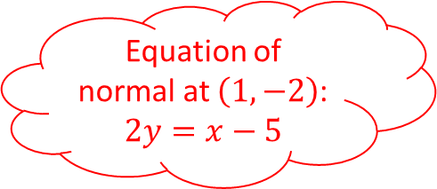

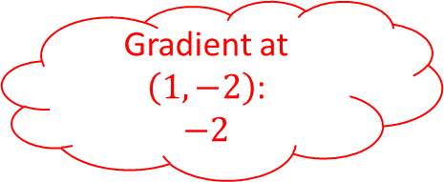
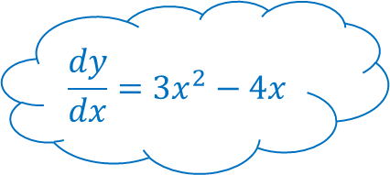

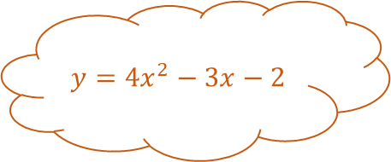
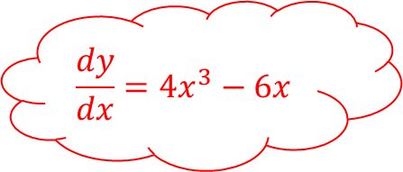
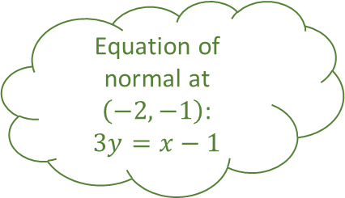

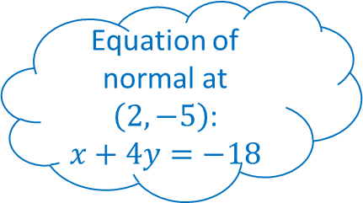



Differentiating Explosions 2
Answers
$$y=x^{2}−3x$$
$$\frac{dy}{dx}=2x−3$$
Gradient of normal at $\left(2,−2\right)$:
$$−1$$
$$\frac{dy}{dx}=8x−3$$
$$y=4x^{2}−3x−2$$
$$y=x^{2}+x−3$$
$$\frac{dy}{dx}=2x+1$$
Gradient at $\left(1,−1\right)$:
$$5$$
Fill in the blanks
Gradient at $\left(−2,−1\right)$:
$$−3$$
Equation of normal at $\left(1,−2\right)$:
$$2y=x−5$$
$$y=x^{3}−2x^{2}−5$$
Equation of normal at $\left(−2,−1\right)$:
$$3y=x−1$$
Equation of normal at $\left(1,−1\right)$:
$$x+5y+4=0$$
$$y=x^{4}−3x^{2}$$
$$\frac{dy}{dx}=3x^{2}−4x$$
Equation of normal at $\left(2,−5\right)$:
$$x+4y=−18$$
Gradient at $\left(1,−2\right)$:
$$−2$$
$$\frac{dy}{dx}=4x^{3}−6x$$
Gradient at $\left(2,−5\right)$:
$$4$$

Slide 6

















Differentiating Explosions 3
$$y=x^{2}−2x+7$$
$$\frac{dy}{dx}=$$
Turning point at $\left( , \right)$
$$\frac{dy}{dx}=$$
$$y=x^{3}−4x^{2}+5x$$
$$y=x^{3}−3x^{2}$$
$$\frac{dy}{dx}=$$
Stationary point at $\left( , \right)$
Fill in the blanks
Turning point at $\left( , \right)$
$$y=2x^{3}−24x$$
Stationary point at $\left( , \right)$
Turning point at $\left( , \right)$
Stationary point at $\left( , \right)$
$$y=4x^{3}−3x$$
$$\frac{dy}{dx}=$$
Stationary point at $\left( , \right)$
$$\frac{dy}{dx}=$$
Turning point at $\left( , \right)$
Turning point at $\left( , \right)$

Slide 7














Differentiating Explosions 3
Answers
$$y=x^{2}−2x+7$$
$$\frac{dy}{dx}=2x−2$$
Turning point at $\left(1,6\right)$
$$\frac{dy}{dx}=3x^{2}−8x+5$$
$$y=x^{3}−4x^{2}+5x$$
$$y=x^{3}−3x^{2}$$
$$\frac{dy}{dx}=3x^{2}−6x$$
Stationary point at $\left(1,2\right)$
Fill in the blanks
Turning point at $\left(0,0\right)$
$$y=2x^{3}−24x$$
Stationary point at $\left(−\frac{1}{2},1\right)$
Turning point at $\left(2,−4\right)$
Stationary point at $\left(\frac{5}{3},\frac{50}{27}\right)$
$$y=4x^{3}−3x$$
$$\frac{dy}{dx}=6x^{2}−24$$
Stationary point at $\left(\frac{1}{2},−1\right)$
$$\frac{dy}{dx}=12x^{2}−3$$
Turning point at $\left(2,−32\right)$
Turning point at $\left(−2,32\right)$

Slide 8



















Differentiating Explosions
Answers
$$y=$$
$$\frac{dy}{dx}=$$
Gradient at $\left(,\right)$:
$$\frac{dy}{dx}=$$
$$y=$$
$$y=$$
$$\frac{dy}{dx}=$$
Gradient at :
Fill in the blanks
Gradient at :
$$y=$$
Equation of tangent at :
Equation of tangent at :
Equation of tangent at :
$$y=$$
$$\frac{dy}{dx}=$$
Gradient at :
$$\frac{dy}{dx}=$$
Gradient at :
Equation of tangent at :

Slide 9
Differentiating Explosions

Slide 10
Differentiating Explosions

