Slide 1
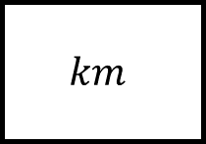
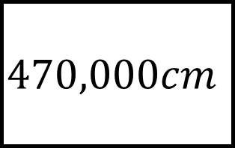
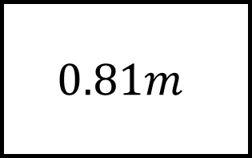
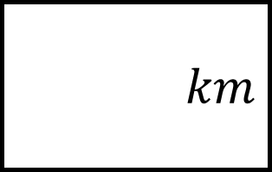
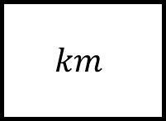
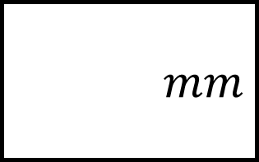
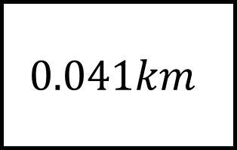
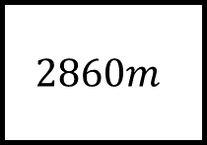
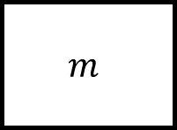
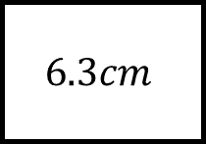
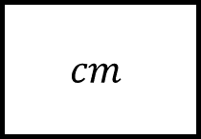
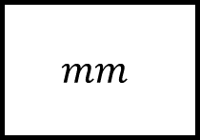

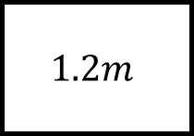
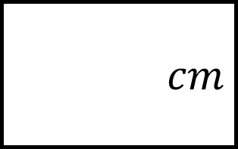
Converting Measures Spider 1
$$470,000cm$$
$$cm$$
$$cm$$
$$cm$$
$$1.2m$$
$$0.81m$$
Convert the length to the units required
$$mm$$
$$m$$
$$6.3cm$$
$$mm$$
$$2860m$$
$$0.041km$$
$$km$$
$$km$$
Fill in the gaps…
where no units are stated you may choose.
$$km$$

Slide 2
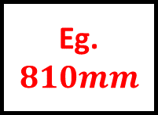
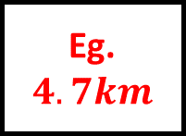
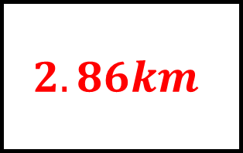
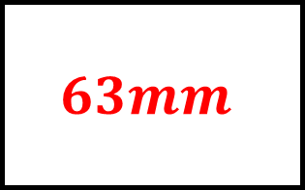
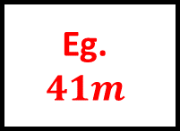
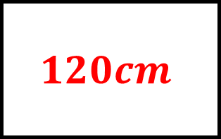
Converting Measures Spider 1 – Answers
$$470,000cm$$
$$120cm$$
$$cm$$
$$cm$$
Eg. $4.7km$
$$1.2m$$
$$0.81m$$
Convert the length to the units required
$$63mm$$
$$m$$
Eg.$810mm$
$$6.3cm$$
$$mm$$
Eg.
$$41m$$
$$2860m$$
$$0.041km$$
$$2.86km$$
$$km$$
Fill in the gaps…
where no units are stated you may choose.
$$km$$

Slide 3
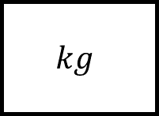
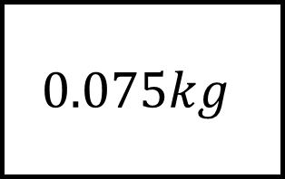
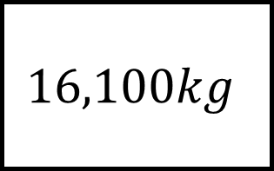
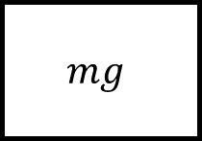
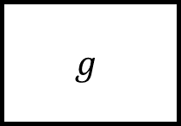
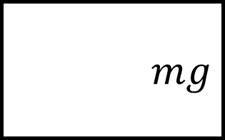
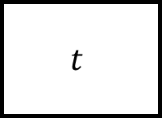
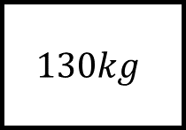
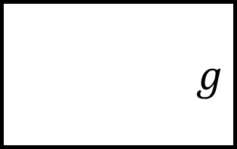
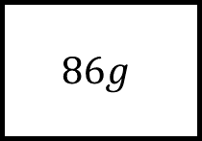
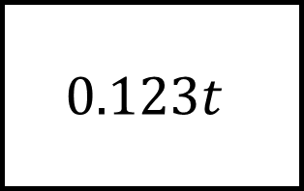
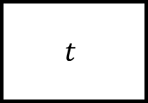

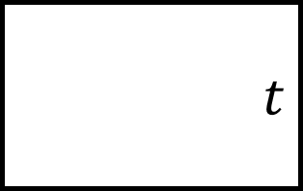

Converting Measures Spider 2
$$0.123t$$
$$g$$
$$t$$
$$g$$
$$3kg$$
$$16,100kg$$
Convert the masses to the units required
$$mg$$
$$kg$$
$$86g$$
$$mg$$
$$130kg$$
$$0.075kg$$
$$t$$
$$kg$$
Fill in the gaps…
where no units are stated you may choose.
$$t$$

Slide 4
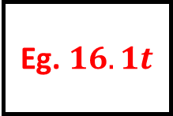
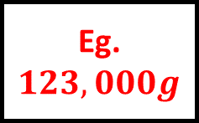
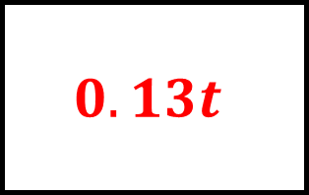
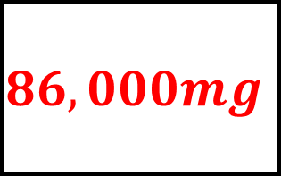
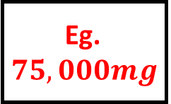
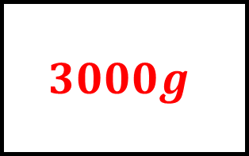
Converting Measures Spider 2 – Answers
$$0.123t$$
$$3000g$$
$$t$$
$$g$$
Eg. $123,000g$
$$3kg$$
$$16,100kg$$
Convert the masses to the units required
$$86,000mg$$
$$kg$$
Eg. $16.1t$
$$86g$$
$$mg$$
Eg. $75,000mg$
$$130kg$$
$$0.075kg$$
$$0.13t$$
$$kg$$
Fill in the gaps…
where no units are stated you may choose.
$$t$$

Slide 5
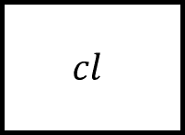
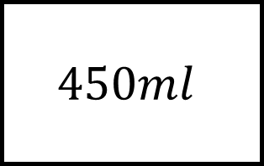
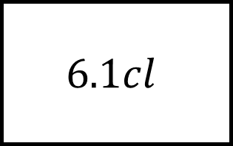
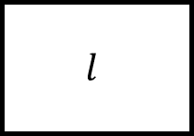
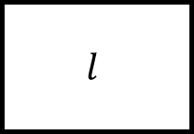
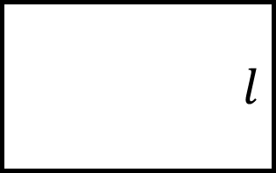
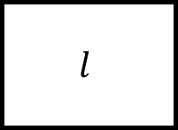
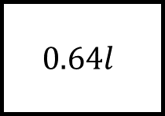
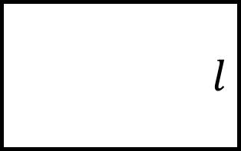
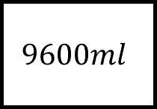
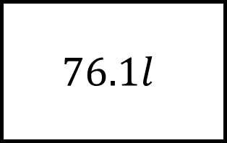




Converting Measures Spider 3
$$76.1l$$
$$l$$
$$l$$
$$l$$
$$400cl$$
$$6.1cl$$
Convert the capacities to the units required
$$l$$
$$cl$$
$$9600ml$$
$$l$$
$$0.64l$$
$$450ml$$
$$cl$$
$$ml$$
Fill in the gaps…
where no units are stated you may choose.
$$cl$$

Slide 6






Converting Measures Spider 3 – Answers
$$76.1l$$
$$4l$$
$$l$$
$$l$$
Eg. $76,100ml$
$$400cl$$
$$6.1cl$$
Convert the capacities to the units required
$$9.6l$$
$$cl$$
Eg.$0.061l$
$$9600ml$$
$$l$$
Eg.
$$45cl$$
$$0.64l$$
$$450ml$$
$$64cl$$
$$ml$$
Fill in the gaps…
where no units are stated you may choose.
$$cl$$

Slide 7












Converting Measures Spider 4
$$4.22km$$
$$820m$$
$$66cm$$
$$120mm$$
The end of each leg is the sum of the other two measures…
$$93cl$$
$$340ml$$
$$0.75l$$
$$400ml$$
$$1.8t$$
$$5.9kg$$
$$610kg$$
Fill in the gaps…
where no units are stated you may choose.
$$4.7kg$$

Slide 8






Converting Measures Spider 4 – Answers
$$4.22km$$
$$78cm$$
$$820m$$
$$66cm$$
$$3.4km$$
$$120mm$$
$$1.09l$$
The end of each leg is the sum of the other two measures…
$$93cl$$
$$340ml$$
$$0.75l$$
$$400ml$$
$$53cl$$
$$1.8t$$
$$1200g$$
$$2.41t$$
$$5.9kg$$
$$610kg$$
Fill in the gaps…
where no units are stated you may choose.
$$4.7kg$$

Slide 9












Converting Measures Spider 5 – Answers
$10$ bottles
cans
$8.2l$
bowl
$1.5l$ jug
bottle
$330ml$ cans
$22$ sweets
How many of the item on each leg will fit in the item given?
pallets
bag
$6570mg$ sweets
$65kg$ pallets
$1.2t$ crane limit
barriers
$30cm$ rulers
$433$ barriers
rulers
$5.2km$ road
Fill in the gaps…
where no units are stated you may choose.
$4.6m$ room

Slide 10






Converting Measures Spider 5 – Answers
$10$ bottles
$4$ cans
$8.2l$
bowl
$1.5l$ jug
Eg. $75cl$ bottle
$330ml$ cans
$22$ sweets
How many of the item on each leg will fit in the item given?
$18$ pallets
Eg. $150g$
bag
$6570mg$ sweets
$65kg$ pallets
$1.2t$ crane limit
Eg. $12m$ barriers
$30cm$ rulers
$433$ barriers
$15$ rulers
$5.2km$ road
Fill in the gaps…
where no units are stated you may choose.
$4.6m$ room

Slide 11


















Converting Measures Spider n – Answers
Convert the n to the units required
Fill in the gaps…
where no units are stated you may choose.

