Slide 1
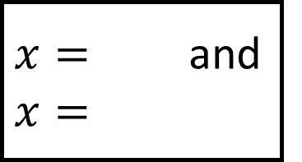
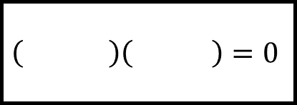
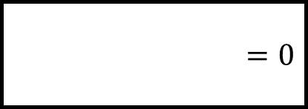
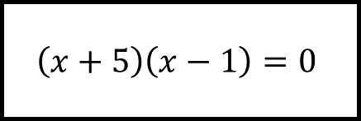
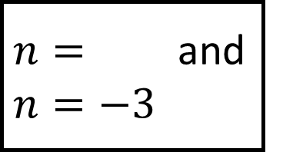
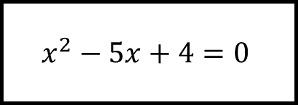
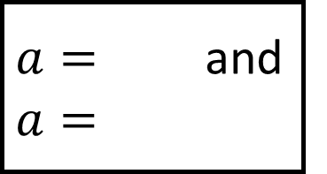
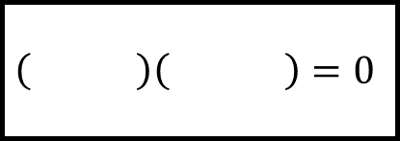

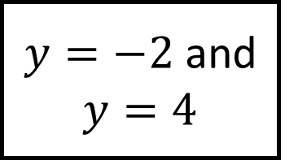
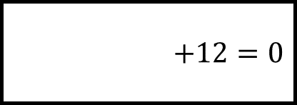
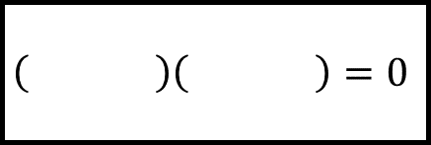
$n=$ and $n=−3$
$x=$ and
$x=$
$$\left( \right)\left( \right)=0$$
$$\left( \right)\left( \right)=0$$
$$+12=0$$
$$x^{2}−5x+4=0$$
Solving Quadratics Spider 1
Fill in the blanks…
$$=0$$
$$=0$$
$y=−2$ and $y=4$
$a=$ and $a=$
$$\left( \right)\left( \right)=0$$
$$\left(x+5\right)\left(x−1\right)=0$$

Slide 2
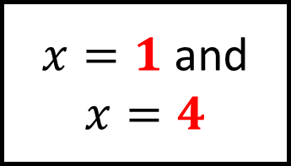
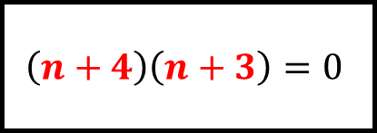
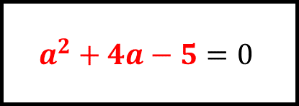
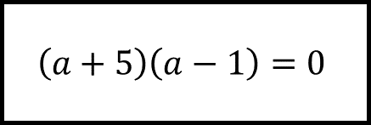
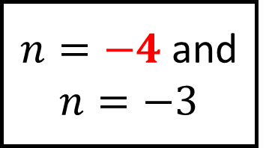
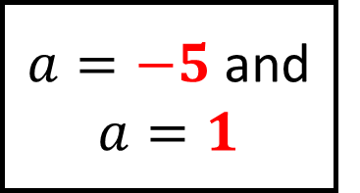
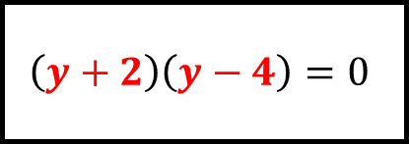
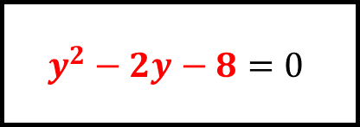
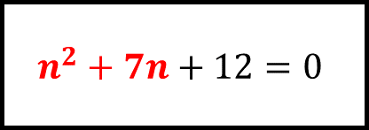
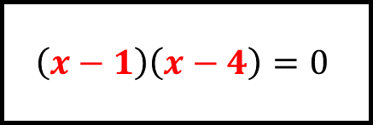
$n=−4$ and $n=−3$
$x=1$ and $x=4$
$$\left(n+4\right)\left(n+3\right)=0$$
$$\left(x−1\right)\left(x−4\right)=0$$
$$n^{2}+7n+12=0$$
$$x^{2}−5x+4=0$$
Solving Quadratics Spider 1 – Answers
Fill in the blanks…
$$y^{2}−2y−8=0$$
$$a^{2}+4a−5=0$$
$y=−2$ and $y=4$
$a=−5$ and $a=1$
$$\left(y+2\right)\left(y−4\right)=0$$
$$\left(a+5\right)\left(a−1\right)=0$$

Slide 3
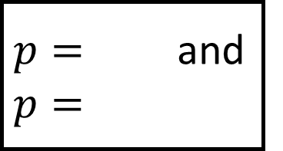
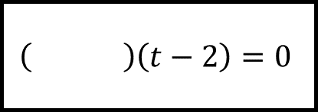
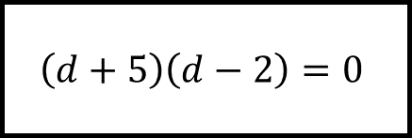
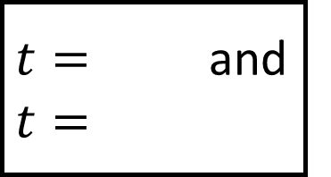
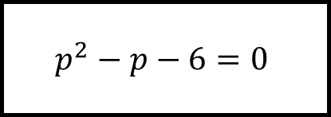
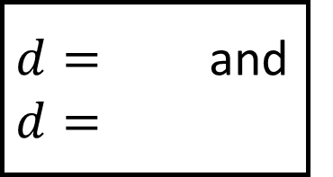
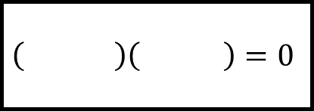
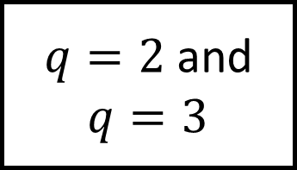
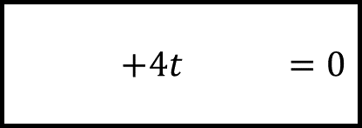
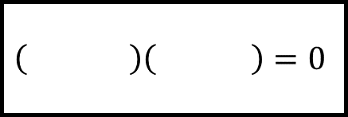
$t=$ and $t=$
$p=$ and $p=$
$$\left( \right)\left(t−2\right)=0$$
$$\left( \right)\left( \right)=0$$
$$+4t =0$$
$$p^{2}−p−6=0$$
Solving Quadratics Spider 2
Fill in the blanks…
$$=0$$
$$=0$$
$q=2$ and $q=3$
$d=$ and $d=$
$$\left( \right)\left( \right)=0$$
$$\left(d+5\right)\left(d−2\right)=0$$

Slide 4
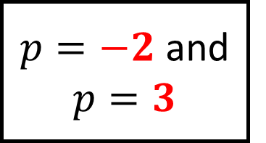
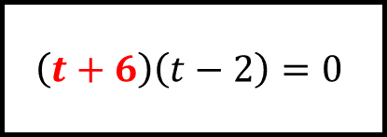
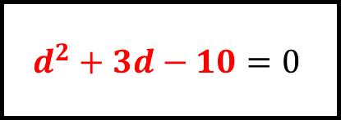
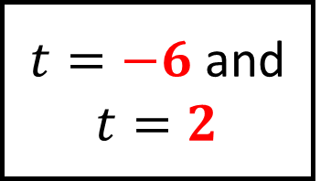
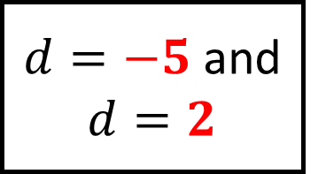
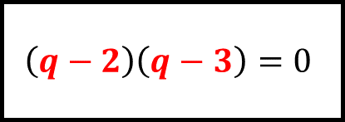
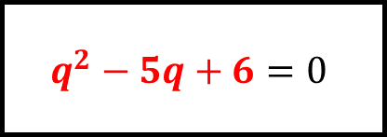
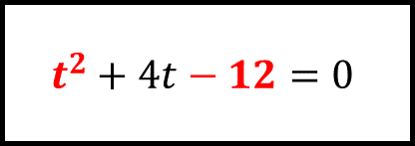
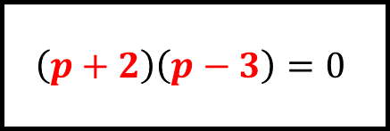
$t=−6$ and $t=2$
$p=−2$ and $p=3$
$$\left(t+6\right)\left(t−2\right)=0$$
$$\left(p+2\right)\left(p−3\right)=0$$
$$t^{2}+4t−12=0$$
$$p^{2}−p−6=0$$
Solving Quadratics Spider 2 – Answers
Fill in the blanks…
$$q^{2}−5q+6=0$$
$$d^{2}+3d−10=0$$
$q=2$ and $q=3$
$d=−5$ and $d=2$
$$\left(q−2\right)\left(q−3\right)=0$$
$$\left(d+5\right)\left(d−2\right)=0$$

Slide 5
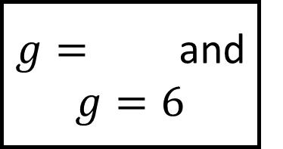
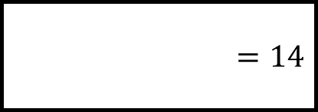
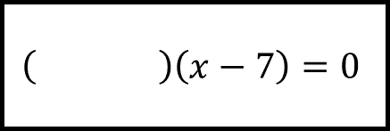
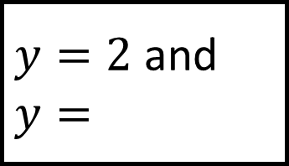
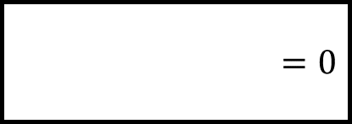
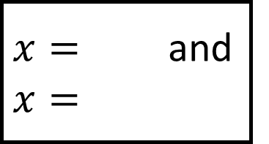
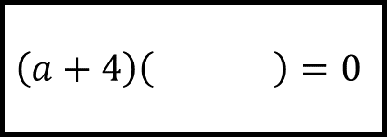
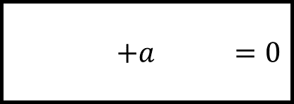
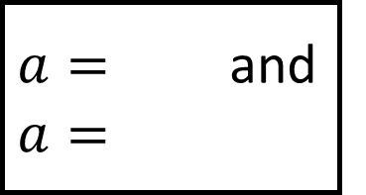
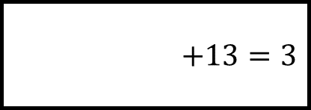

$y=2$ and $y=$
$g=$ and $g=6$
$$\left( \right)\left( \right)=0$$
$$\left(g+3\right)\left( \right)=0$$
$$+13=3$$
$$=0$$
Solving Quadratics Spider 3
Fill in the blanks…
$$+a =0$$
$$=14$$
$a=$ and $a=$
$x=$ and $x=$
$$\left(a+4\right)\left( \right)=0$$
$$\left( \right)\left(x−7\right)=0$$

Slide 6












$y=2$ and $y=5$
$g=−3$ and $g=6$
$$\left(y−2\right)\left(y−5\right)=0$$
$$\left(g+3\right)\left(g−6\right)=0$$
$$y^{2}−7y+13=3$$
$$g^{2}−3g−18=0$$
Solving Quadratics Spider 3 – Answers
Fill in the blanks…
$$a^{2}+a−12=0$$
$$x^{2}−5x=14$$
$a=−4$ and $a=3$
$x=−2$ and $x=7$
$$\left(a+4\right)\left(a−3\right)=0$$
$$\left(x+2\right)\left(x−7\right)=0$$

Slide 7







$n=$ and $n=−\frac{5}{2}$
$x=$ and $x=$
$$\left(n \right)\left(2n \right)=0$$
$$\left( \right)\left( \right)=0$$
$$2n^{2} =10$$
$$2x^{2}+7x+3=0$$
Solving Quadratics Spider 4
Fill in the blanks…
$$=0$$
$$=0$$
$y=−3$ and $y=\frac{1}{5}$
$a=$ and $a=$
$$\left( \right)\left( \right)=0$$
$$\left(3a−2\right)\left(a−4\right)=0$$

Slide 8









$n=2$ and $n=−\frac{5}{2}$
$x=−3$ and $x=−\frac{1}{2}$
$$\left(n−2\right)\left(2n+5\right)=0$$
$$\left(x+3\right)\left(2x+1\right)=0$$
$$2n^{2}+n=10$$
$$2x^{2}+7x+3=0$$
Solving Quadratics Spider 4 – Answers
Fill in the blanks…
$$5y^{2}+14y−3=0$$
$$3a^{2}−14a+8=0$$
$y=−3$ and $y=\frac{1}{5}$
$a=\frac{2}{3}$ and $a=4$
$$\left(y+3\right)\left(5y−1\right)=0$$
$$\left(3a−2\right)\left(a−4\right)=0$$

Slide 9











$$x= ±\sqrt{11}$$
$$y= ±\sqrt{ }$$
$${\left(x \right)}^{2} =0$$
$${\left(y \right)}^{2} =0$$
$$x^{2}+8x =0$$
$$y^{2}−6y−2=0$$
Solving Quadratics Spider 5
Fill in the blanks…
$$=0$$
$$n^{2}+4n−1=0$$
$$p=5±\sqrt{13}$$
$$n= ±\sqrt{ }$$
$${\left(p \right)}^{2} =0$$
$${\left(n \right)}^{2} =0$$

Slide 10









$$x=−4±\sqrt{11}$$
$$y=3±\sqrt{11}$$
$${\left(x+4\right)}^{2}−11=0$$
$${\left(y−3\right)}^{2}−11=0$$
$$x^{2}+8x+5=0$$
$$y^{2}−6y−2=0$$
Solving Quadratics Spider 5 – Answers
Fill in the blanks…
$$p^{2}−10p+12=0$$
$$n^{2}+4n−1=0$$
$$p=5±\sqrt{13}$$
$$n=−2±\sqrt{5}$$
$${\left(p−5\right)}^{2}−13=0$$
$${\left(n+2\right)}^{2}−5=0$$

Slide 11












$$a=$$
and
$$a=$$
$$x=$$
and
$$x=$$
$$a=\frac{ ±\sqrt{ +140}}{10}$$
$$x=\frac{ ±\sqrt{ }}{}$$
$+3a =0$
$$2x^{2}−3x−1=0$$
Solving Quadratics Spider 6
Fill in the blanks…
Round answers to $2$ decimal places
$$=0$$
$$5y^{2}+2y−1=0$$
$$n=$$
and
$$n=$$
$$y=$$
and
$$y=$$
$$n=\frac{5±\sqrt{25−12}}{6}$$
$$y=\frac{ ±\sqrt{ }}{}$$

Slide 12









$$a=0.92$$
and
$$a=−1.52$$
$$x=1.78$$
and
$$x=−0.28$$
$$a=\frac{−3±\sqrt{9+140}}{10}$$
$$x=\frac{3±\sqrt{9+8}}{4}$$
$$5a^{2}+3a−7=0$$
$$2x^{2}−3x−1=0$$
Solving Quadratics Spider 6 – Answers
Fill in the blanks…
Round answers to $2$ decimal places
$$3n^{2}−5n+1=0$$
$$5y^{2}+2y−1=0$$
$$n=1.43$$
and
$$n=0.23$$
$$y=0.29$$
and
$$y=−0.69$$
$$n=\frac{5±\sqrt{25−12}}{6}$$
$$y=\frac{−2±\sqrt{4+20}}{10}$$

