Slide 1



The Best Deal
On each slide determine which deal is the cheapest for what the shopper requires; travel cost is not an issue as all shoppers can walk to each supermarket and they don’t have loyalty cards so earning “points” is also not an issue.
You can buy more than each shopper needs but not less.
You must show how you made your decision (ie. your workings).

Slide 2





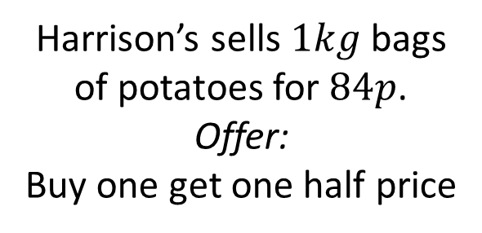
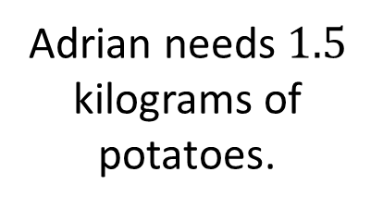
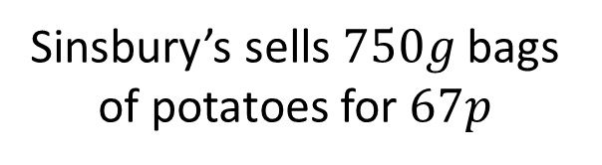
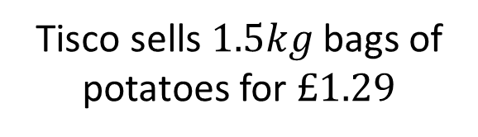
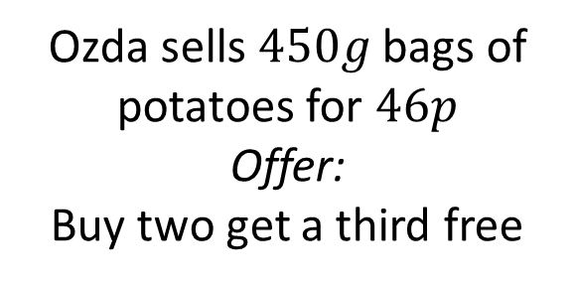
Item A
Harrison’s sells $1kg$ bags of potatoes for $84p$.
Offer:
Buy one get one half price
Tisco sells $1.5kg$ bags of potatoes for $£1.29$
Adrian needs $1.5$ kilograms of potatoes.
Sinsbury’s sells $750g$ bags of potatoes for $67p$
Ozda sells $450g$ bags of potatoes for $46p$
Offer:
Buy two get a third free

Slide 3
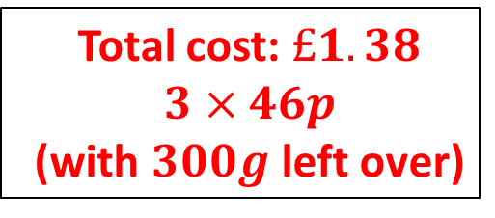
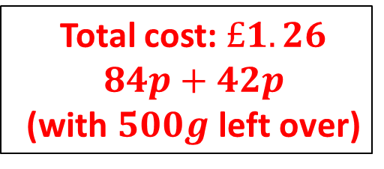
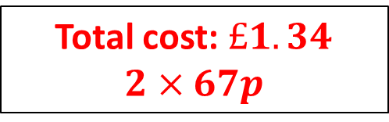

Item A
Total cost: $£1.26$
$$84p+42p$$
(with $500g$ left over)
Total cost: $£1.29$
Harrison’s sells $1kg$ bags of potatoes for $84p$.
Offer:
Buy one get one half price
Tisco sells $1.5kg$ bags of potatoes for $£1.29$
Answer…
Adrian needs $1.5$ kilograms of potatoes.
Total cost: $£1.38$
$$3×46p$$
(with $300g$ left over)
Total cost: $£1.34$
$$2×67p$$
Sinsbury’s sells $750g$ bags of potatoes for $67p$
Ozda sells $450g$ bags of potatoes for $46p$
Offer:
Buy two get a third free
Harrison’s is cheapest

Slide 4

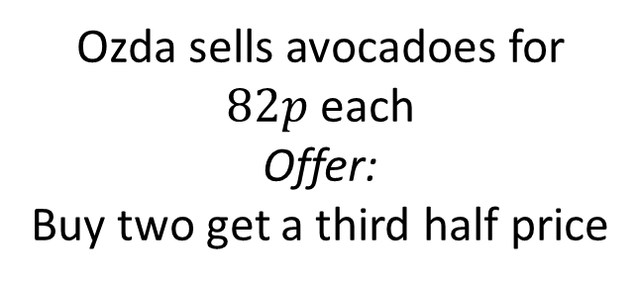
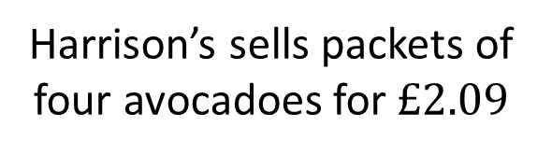
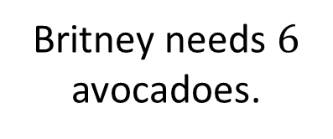
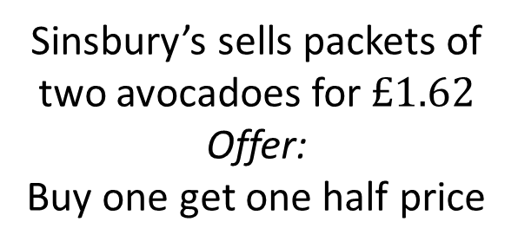

Item B
Tisco sells avocadoes for $69p$ each
Harrison’s sells packets of four avocadoes for $£2.09$
Britney needs $6$ avocadoes.
Sinsbury’s sells packets of two avocadoes for $£1.62$
Offer:
Buy one get one half price
Ozda sells avocadoes for
$82p$ each
Offer:
Buy two get a third half price

Slide 5
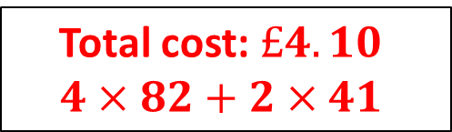
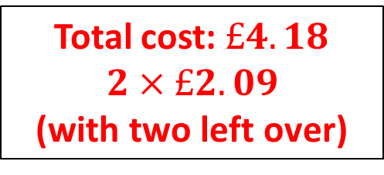
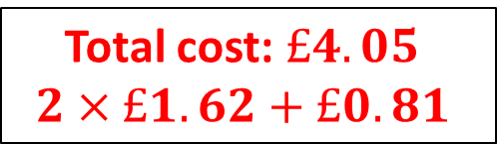
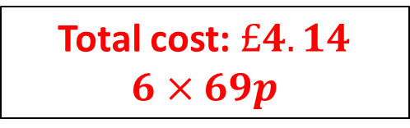
Item B
Total cost: $£4.18$
$2×£2.09$
(with two left over)
Total cost: $£4.14$
$$6×69p$$
Tisco sells avocadoes for $69p$ each
Harrison’s sells packets of four avocadoes for $£2.09$
Answer…
Britney needs $6$ avocadoes.
Total cost: $£4.10$
$$4×82+2×41$$
Total cost: $£4.05$
$$2×£1.62+£0.81$$
Sinsbury’s sells packets of two avocadoes for $£1.62$
Offer:
Buy one get one half price
Sinsbury’s is cheapest
Ozda sells avocadoes for
$82p$ each
Offer:
Buy two get a third half price

Slide 6

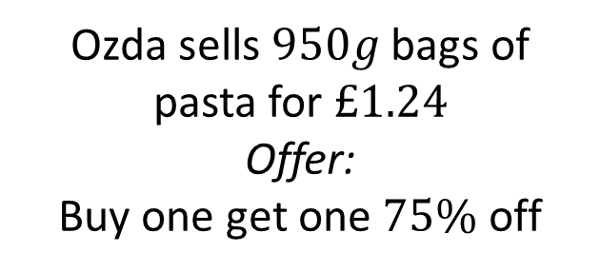
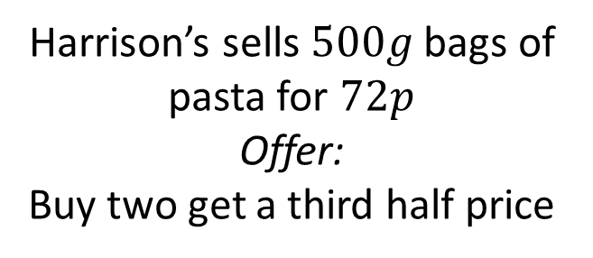
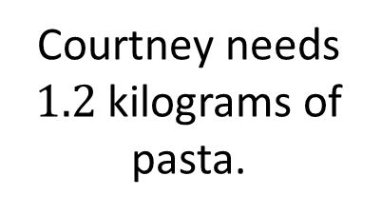
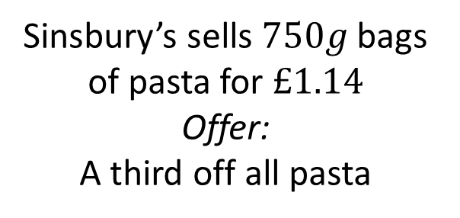

Item C
Harrison’s sells $500g$ bags of pasta for $72p$
Offer:
Buy two get a third half price
Tisco sells $300g$ bags of pasta for $38p$
Courtney needs $1.2$ kilograms of pasta.
Sinsbury’s sells $750g$ bags of pasta for $£1.14$
Offer:
A third off all pasta
Ozda sells $950g$ bags of pasta for $£1.24$
Offer:
Buy one get one $75\%$ off

Slide 7
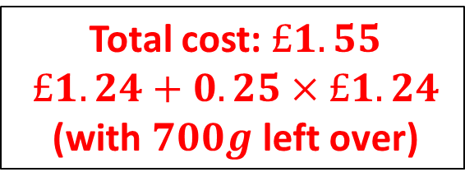
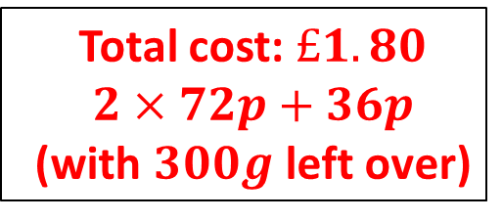
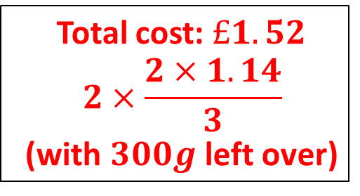
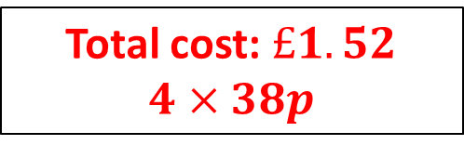
Item C
Total cost: $£1.80$
$$2×72p+36p$$
(with $300g$ left over)
Total cost: $£1.52$
$$4×38p$$
Harrison’s sells $500g$ bags of pasta for $72p$
Offer:
Buy two get a third half price
Tisco sells $300g$ bags of pasta for $38p$
Answer…
Total cost: $£1.52$
$$2×\frac{2×1.14}{3}$$
(with $300g$ left over)
Total cost: $£1.55$
$$£1.24+0.25×£1.24$$
(with $700g$ left over)
Courtney needs $1.2$ kilograms of pasta.
Tisco or Sinsbury’s is cheapest
Sinsbury’s sells $750g$ bags of pasta for $£1.14$
Offer:
A third off all pasta
Ozda sells $950g$ bags of pasta for $£1.24$
Offer:
Buy one get one $75\%$ off

Slide 8
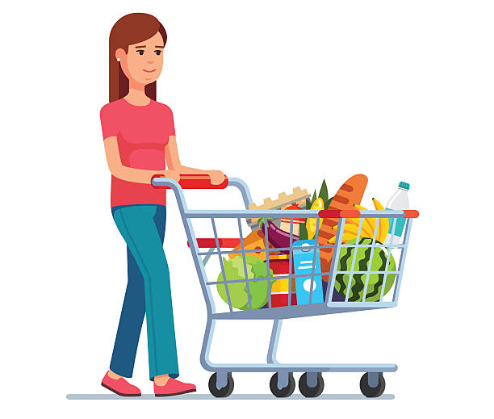
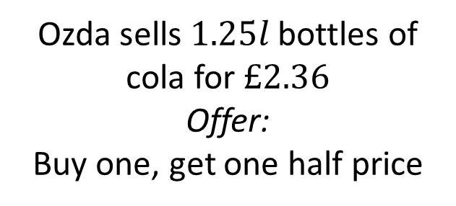
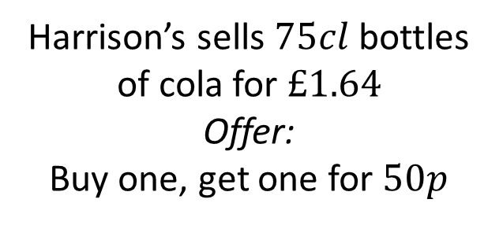
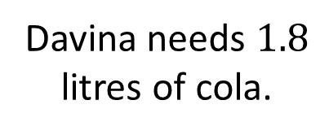
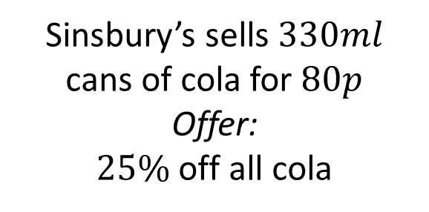
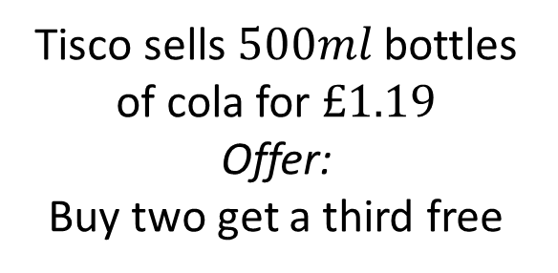
Item D
Harrison’s sells $75cl$ bottles of cola for $£1.64$
Offer:
Buy one, get one for $50p$
Tisco sells $500ml$ bottles of cola for $£1.19$
Offer:
Buy two get a third free
Davina needs $1.8$ litres of cola.
Sinsbury’s sells $330ml$ cans of cola for $80p$
Offer:
$25\%$off all cola
Ozda sells $1.25l$ bottles of cola for $£2.36$
Offer:
Buy one, get one half price

Slide 9
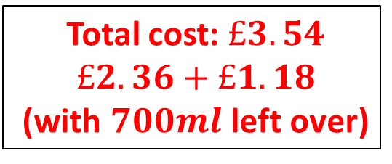
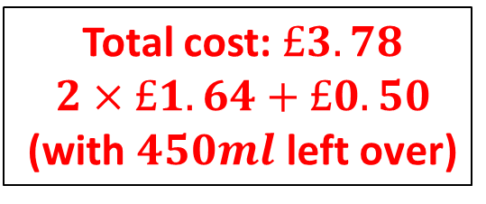
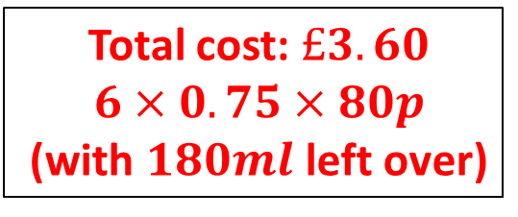
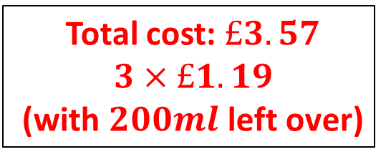
Item D
Total cost: $£3.78$
$$2×£1.64+£0.50$$
(with $450ml$ left over)
Total cost: $£3.57$
$$3×£1.19$$
(with $200ml$ left over)
Harrison’s sells $75cl$ bottles of cola for $£1.64$
Offer:
Buy one, get one for $50p$
Tisco sells $500ml$ bottles of cola for $£1.19$
Offer:
Buy two get a third free
Answer…
Total cost: $£3.54$
$$£2.36+£1.18$$
(with $700ml$ left over)
Total cost: $£3.60$
$$6×0.75×80p$$
(with $180ml$ left over)
Davina needs $1.8$ litres of cola.
Ozda is cheapest
Sinsbury’s sells $330ml$ cans of cola for $80p$
Offer:
$25\%$off all cola
Ozda sells $1.25l$ bottles of cola for $£2.36$
Offer:
Buy one, get one half price

Slide 10

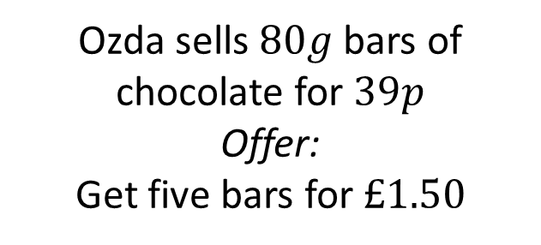
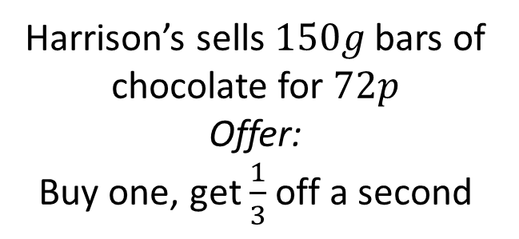
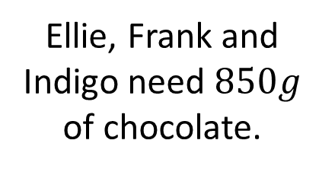
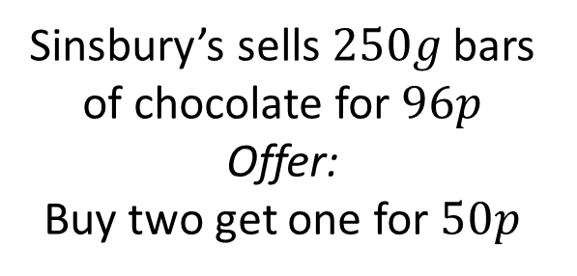
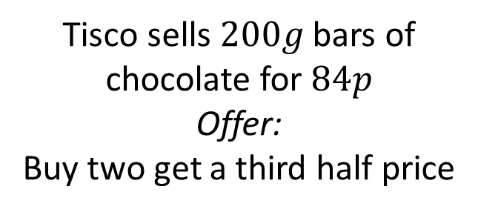
Item E
Harrison’s sells $150g$ bars of chocolate for $72p$
Offer:
Buy one, get $\frac{1}{3}$ off a second
Tisco sells $200g$ bars of chocolate for $84p$
Offer:
Buy two get a third half price
Ellie, Frank and Indigo need $850g$ of chocolate.
Sinsbury’s sells $250g$ bars of chocolate for $96p$
Offer:
Buy two get one for $50p$
Ozda sells $80g$ bars of chocolate for $39p$
Offer:
Get five bars for $£1.50$

Slide 11
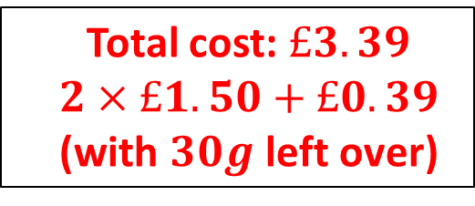
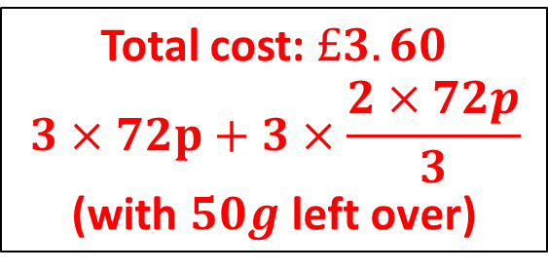
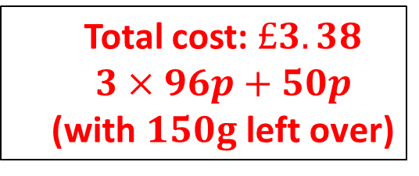
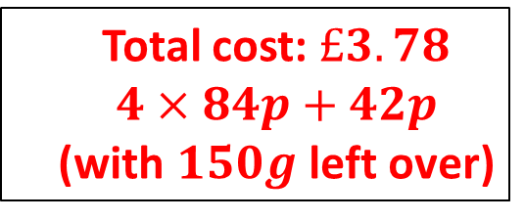
Item E
Total cost: $£3.60$
$$3×72p+3×\frac{2×72p}{3}$$
(with $50g$ left over)
Total cost: $£3.78$
$$4×84p+42p$$
(with $150g$ left over)
Harrison’s sells $150g$ bars of chocolate for $72p$
Offer:
Buy one, get $\frac{1}{3}$ off a second
Tisco sells $200g$ bars of chocolate for $84p$
Offer:
Buy two get a third half price
Answer…
Total cost: $£3.39$
$$2×£1.50+£0.39$$
(with $30g$ left over)
Total cost: $£3.38$
$$3×96p+50p$$
(with $150g$ left over)
Ellie, Frank and Indigo need $850g$ of chocolate.
Sinsbury’s is cheapest
Sinsbury’s sells $250g$ bars of chocolate for $96p$
Offer:
Buy two get one for $50p$
Ozda sells $80g$ bars of chocolate for $39p$
Offer:
Get five bars for $£1.50$

