Slide 1
Recognising Graphs
Match each graph to the correct equation on each slide…

Slide 2
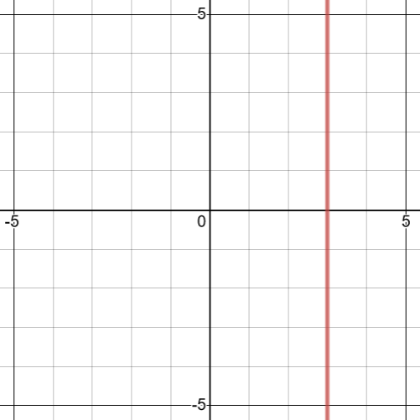
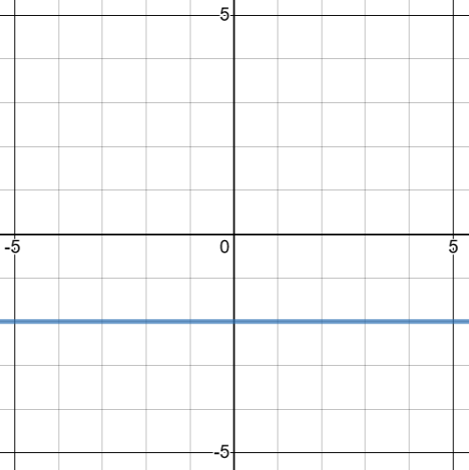
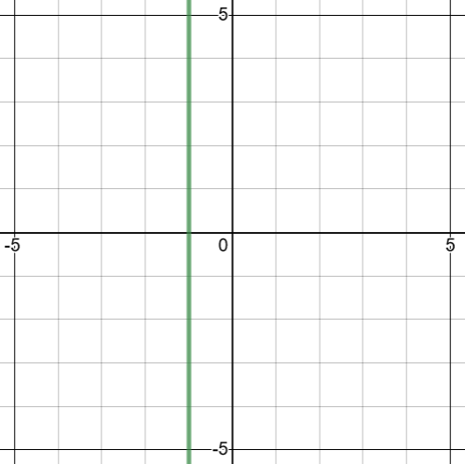









Set of graphs $1$
Sketch the graphs of the equations that do not match to graphs labelling intersections with the axes
$$y=3$$
$$x=−1$$
$$y=−1$$
$$x=−2$$
$$x=3$$
$$y=1$$
$$y=−2$$
$$x=2$$

Slide 3
Set of graphs $1$
Sketch the graphs of the equations that do not match to graphs labelling intersections with the axes
Answers
$$y=3$$
$$x=−1$$
$$y=−1$$
$$x=−2$$
$$x=3$$
$$y=1$$
$$y=−2$$
$$x=2$$

Slide 4
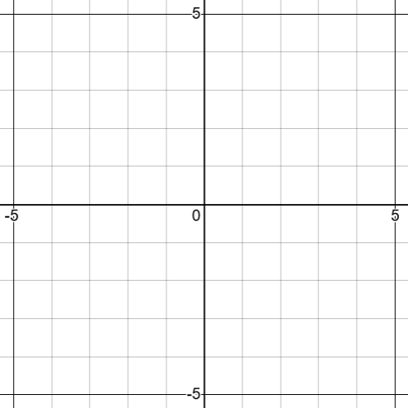


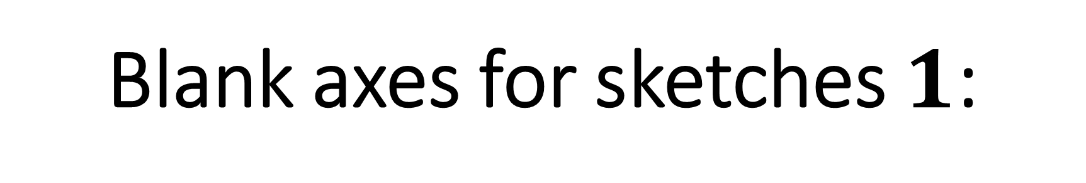



Blank axes for sketches $1$:
$$y=3$$
$$y=−1$$
$$y=1$$
$$x=−2$$
$$x=2$$

Slide 5
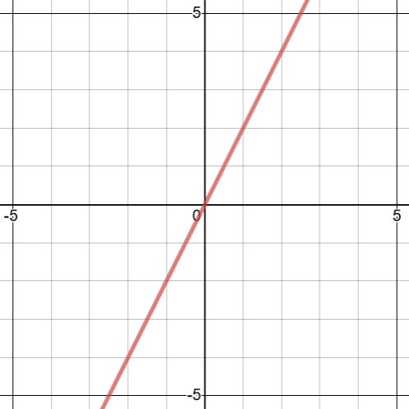
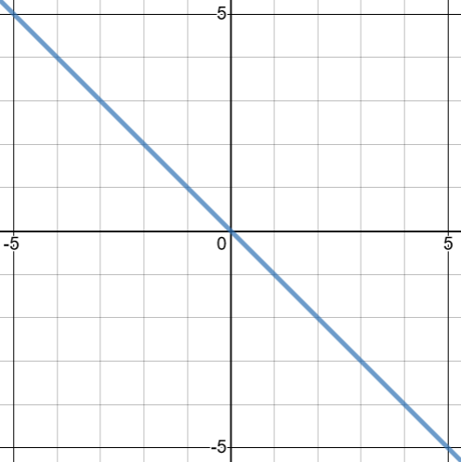
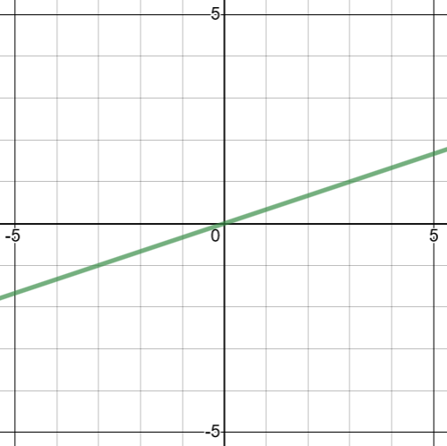







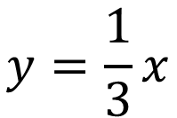
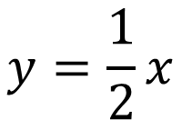
Set of graphs $2$
Sketch the graphs of the equations that do not match to graphs labelling intersections with the axes
$$y=2x$$
$$y=3x$$
$$y=\frac{1}{2}x$$
$$y=−x$$
$$y=\frac{1}{3}x$$
$$y=x$$
$$y=−2x$$
$$x=4y$$

Slide 6
Set of graphs $2$
Sketch the graphs of the equations that do not match to graphs labelling intersections with the axes
Answers
$$y=2x$$
$$y=3x$$
$$y=\frac{1}{2}x$$
$$y=−x$$
$$y=\frac{1}{3}x$$
$$y=x$$
$$y=−2x$$
$$x=4y$$

Slide 7

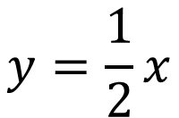
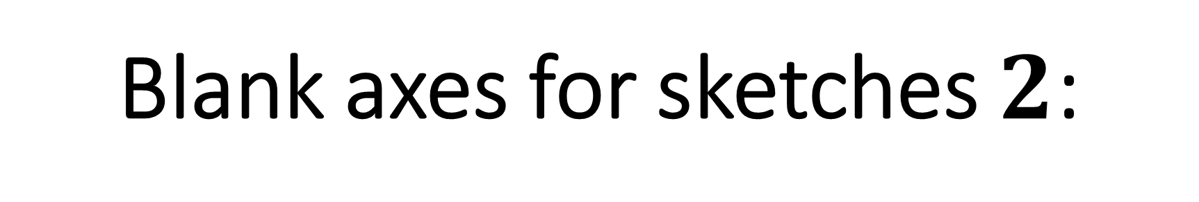



Blank axes for sketches $2$:
$$y=−2x$$
$$y=3x$$
$$y=x$$
$$y=\frac{1}{2}x$$
$$x=4y$$

Slide 8
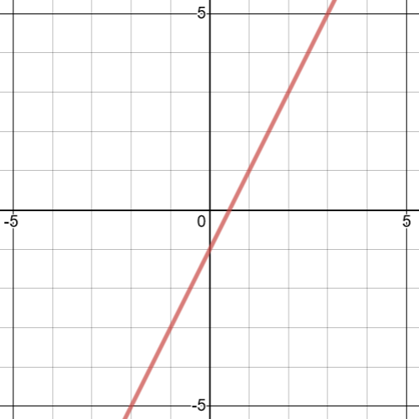
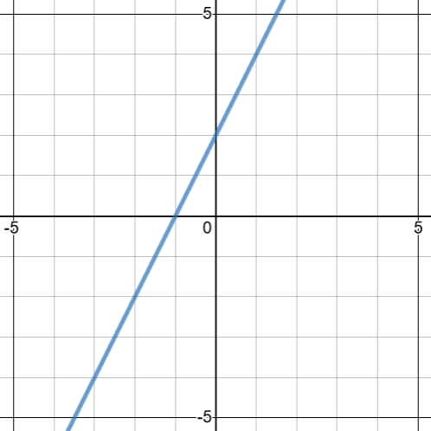
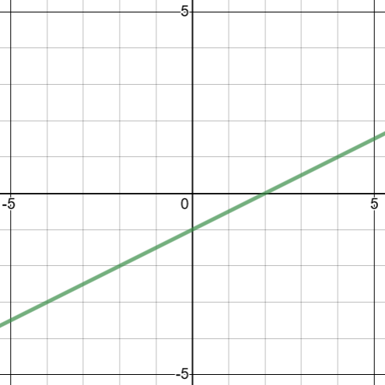

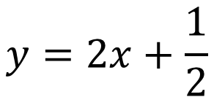
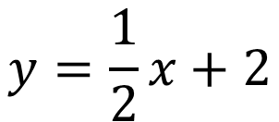



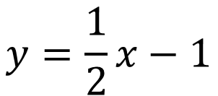
Set of graphs $3$
Sketch the graphs of the equations that do not match to graphs labelling intersections with the axes
$$y=2x+\frac{1}{2}$$
$$y=2x−1$$
$$y=\frac{1}{2}x+2$$
$$y=−2x−1$$
$$y=\frac{1}{2}x−1$$
$$y=2x+2$$

Slide 9
Set of graphs $3$
Sketch the graphs of the equations that do not match to graphs labelling intersections with the axes
Answers
$$y=2x+\frac{1}{2}$$
$$y=2x−1$$
$$y=\frac{1}{2}x+2$$
$$y=−2x−1$$
$$y=\frac{1}{2}x−1$$
$$y=2x+2$$

Slide 10
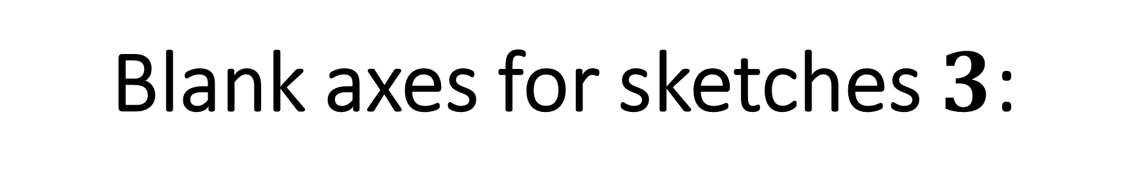
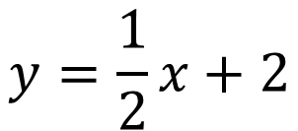

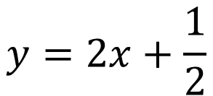
Blank axes for sketches $3$:
$$y=2x+\frac{1}{2}$$
$$y=−2x−1$$
$$y=\frac{1}{2}x+2$$

Slide 11
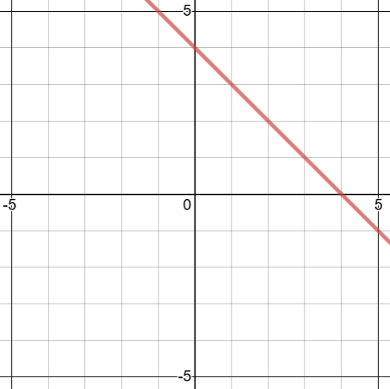
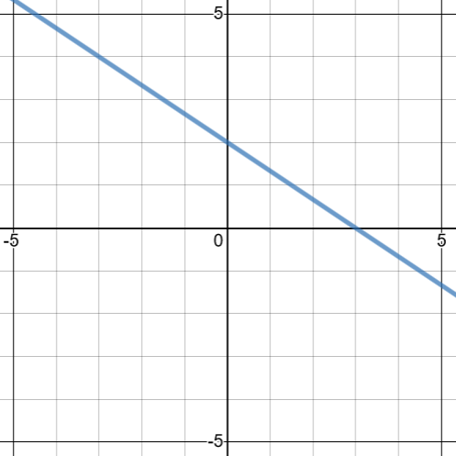
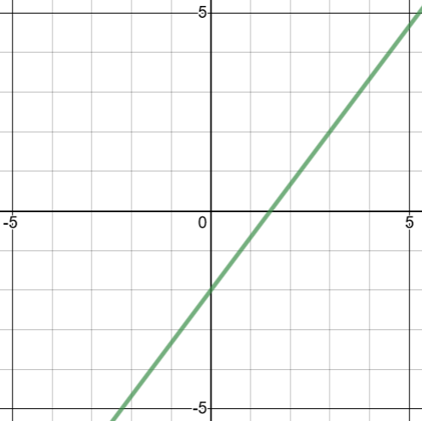







Set of graphs $4$
Sketch the graphs of the equations that do not match to graphs labelling intersections with the axes
$$y+4x=4$$
$$3x+2y=6$$
$$y=2x−2$$
$$x+y=4$$
$$2x+3y=6$$
$$4x−3y=6$$

Slide 12
Set of graphs $4$
Sketch the graphs of the equations that do not match to graphs labelling intersections with the axes
Answers
$$y+4x=4$$
$$3x+2y=6$$
$$y=2x−2$$
$$x+y=4$$
$$2x+3y=6$$
$$4x−3y=6$$

Slide 13
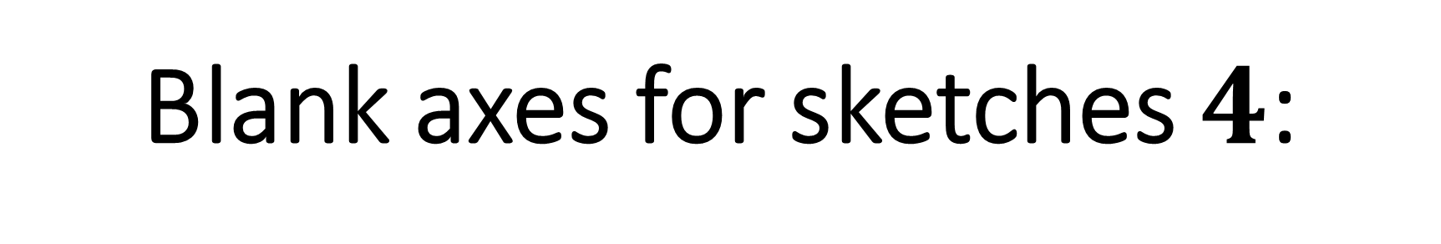



Blank axes for sketches $4$:
$$y+4x=4$$
$$y=2x−2$$
$$3x+2y=6$$

Slide 14
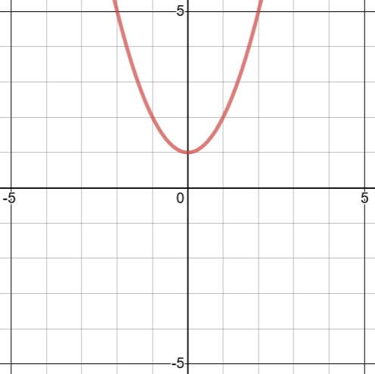
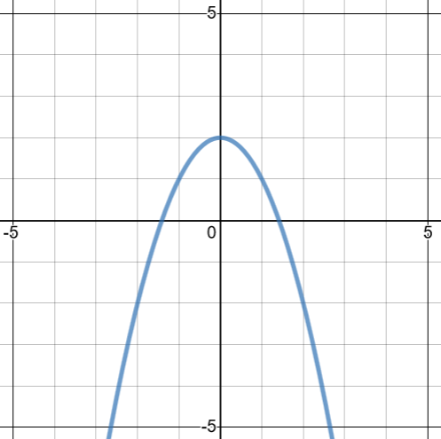
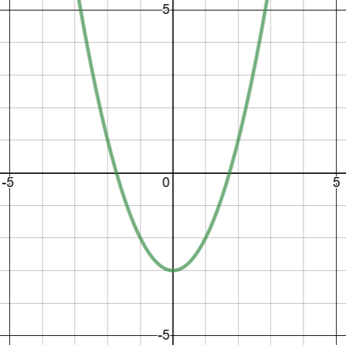







Set of graphs $5$
Sketch the graphs of the equations that do not match to graphs labelling intersections with the axes
$$y=x^{2}+2$$
$$y=3−x^{2}$$
$$y=2−x^{2}$$
$$y=x^{3}+2$$
$$y=x^{2}−3$$
$$y=x^{2}+1$$

Slide 15
Set of graphs $5$
Sketch the graphs of the equations that do not match to graphs labelling intersections with the axes
Answers
$$y=x^{2}+2$$
$$y=3−x^{2}$$
$$y=2−x^{2}$$
$$y=x^{3}+2$$
$$y=x^{2}−3$$
$$y=x^{2}+1$$

Slide 16
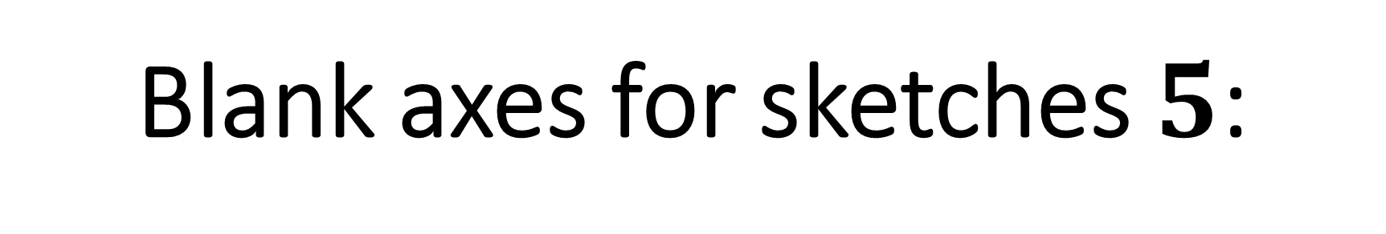



Blank axes for sketches $5$:
$$y=x^{2}+2$$
$$y=3−x^{2}$$
$$y=x^{3}+2$$

Slide 17
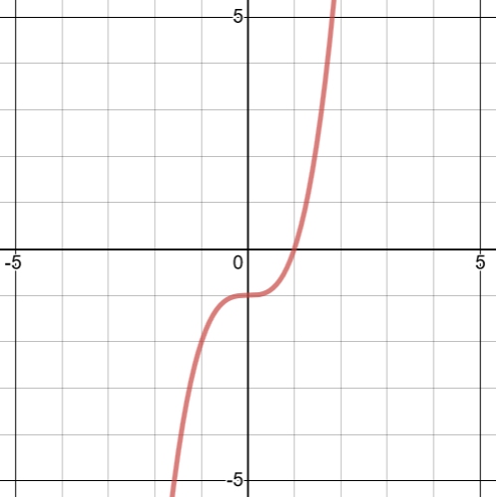
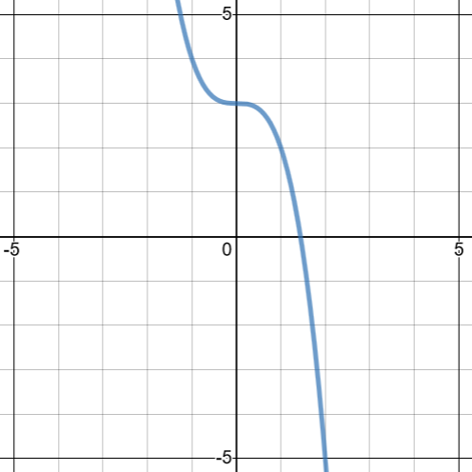
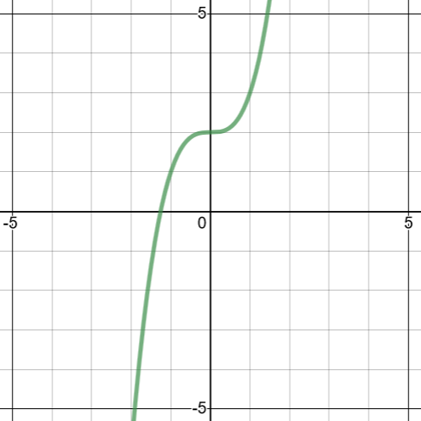






Set of graphs $6$
Sketch the graphs of the equations that do not match to graphs labelling intersections with the axes
$$y=x^{3}−1$$
$$y=3−x^{3}$$
$$y=1−x^{3}$$
$$y=x^{3}+2$$
$$y=x^{3}+3$$
$$y=2−x^{3}$$

Slide 18
Set of graphs $6$
Sketch the graphs of the equations that do not match to graphs labelling intersections with the axes
Answers
$$y=x^{3}−1$$
$$y=3−x^{3}$$
$$y=1−x^{3}$$
$$y=x^{3}+2$$
$$y=x^{3}+3$$
$$y=2−x^{3}$$

Slide 19
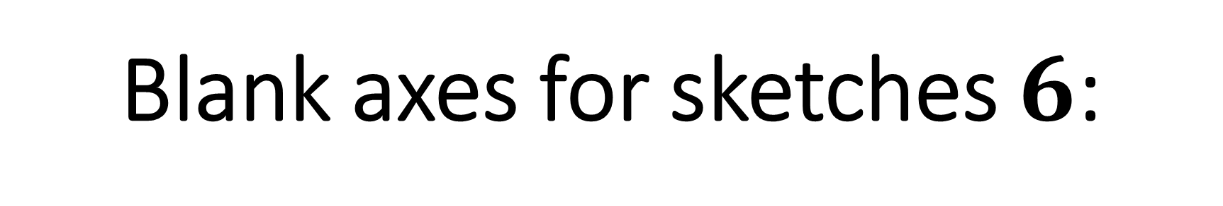



Blank axes for sketches $6$:
$$y=1−x^{3}$$
$$y=x^{3}+3$$
$$y=2−x^{3}$$

Slide 20
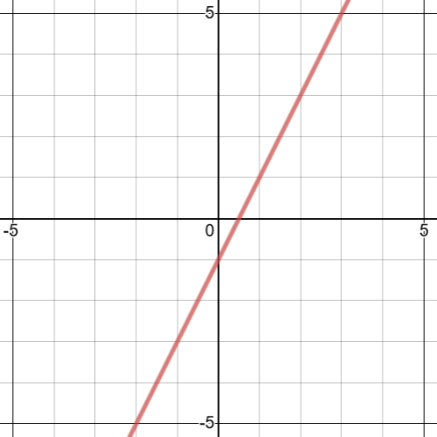
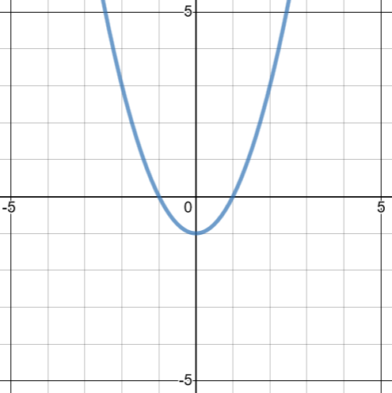
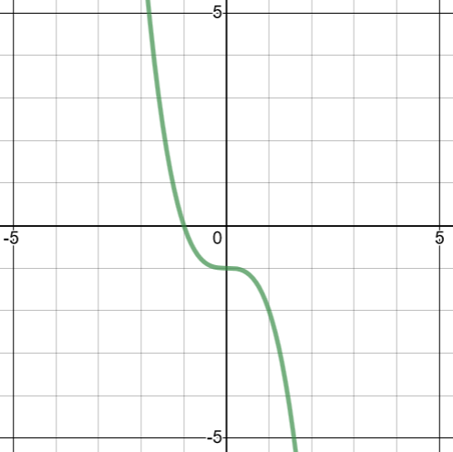







Set of graphs $7$
Sketch the graphs of the equations that do not match to graphs labelling intersections with the axes
$$y=2x−1$$
$$y=−x^{3}−1$$
$$y=2−x$$
$$y=x^{2}−1$$
$$y=x^{2}+1$$
$$y=x^{3}−1$$

Slide 21
Set of graphs $7$
Sketch the graphs of the equations that do not match to graphs labelling intersections with the axes
Answers
$$y=2x−1$$
$$y=−x^{3}−1$$
$$y=2−x$$
$$y=x^{2}−1$$
$$y=x^{2}+1$$
$$y=x^{3}−1$$

Slide 22
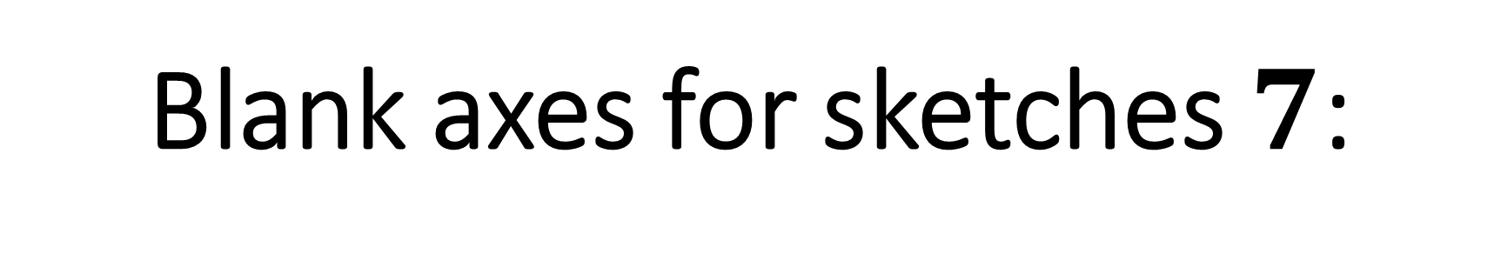



Blank axes for sketches $7$:
$$y=2−x$$
$$y=x^{2}+1$$
$$y=x^{3}−1$$

Slide 23
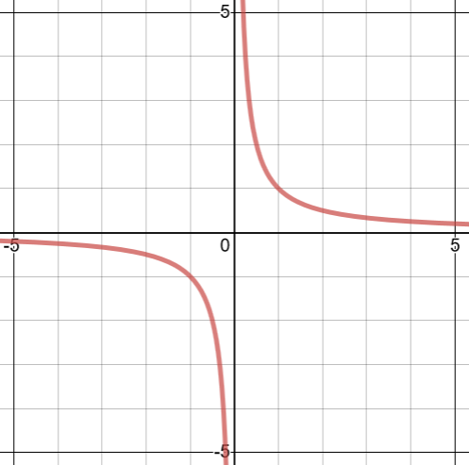
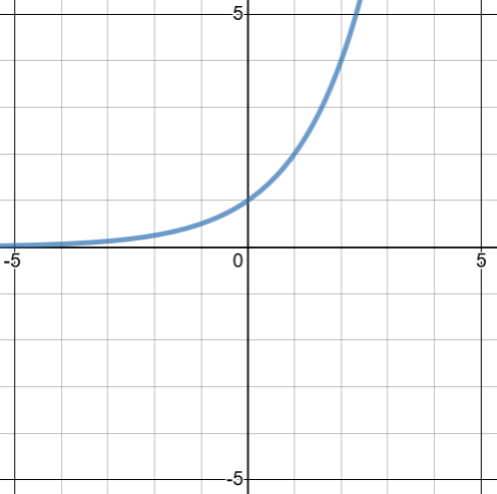
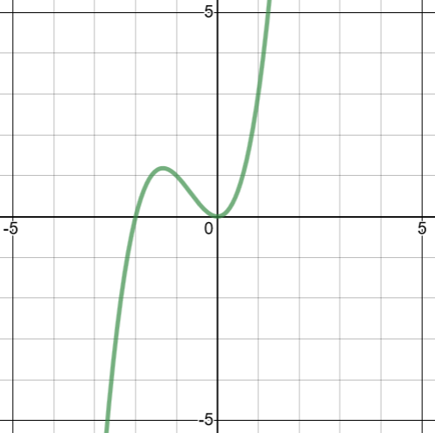



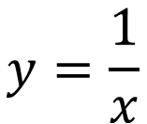

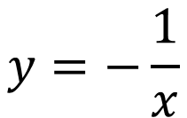

Set of graphs $8$
Sketch the graphs of the equations that do not match to graphs labelling intersections with the axes
$$y=x^{3}+2x^{2}$$
$$y=\frac{1}{x}$$
$$y=2−x^{3}$$
$$y=−\frac{1}{x}$$
$$y=2^{x}$$
$$y=\sqrt{x}$$

Slide 24
Set of graphs $8$
Sketch the graphs of the equations that do not match to graphs labelling intersections with the axes
Answers
$$y=x^{3}+2x^{2}$$
$$y=\frac{1}{x}$$
$$y=2−x^{3}$$
$$y=−\frac{1}{x}$$
$$y=2^{x}$$
$$y=\sqrt{x}$$

Slide 25
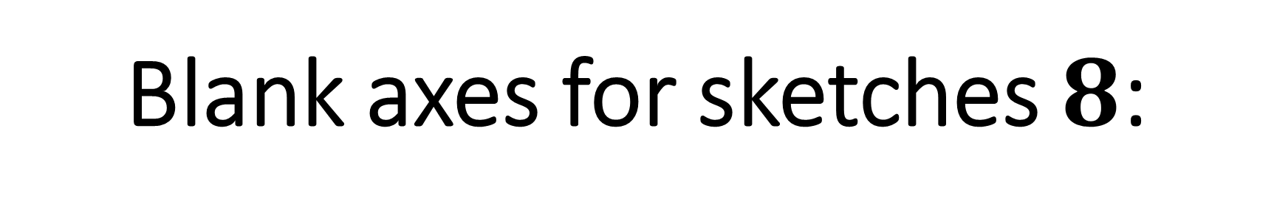
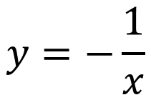


Blank axes for sketches $8$:
$$y=2−x^{3}$$
$$y=−\frac{1}{x}$$
$$y=\sqrt{x}$$

