Slide 1
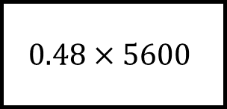
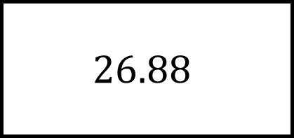
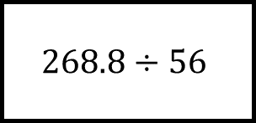
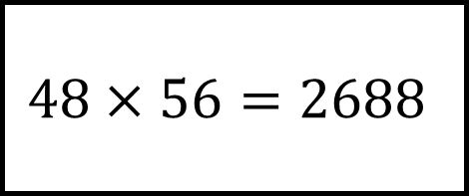
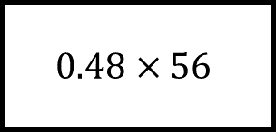
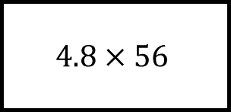
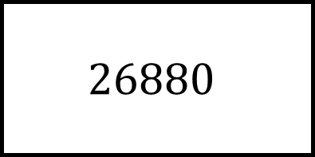
Related Calculations Spider 1
$$268.8÷56$$
$$4.8×56$$
$$26880$$
$$48×56=2688$$
$$26.88$$
$$0.48×5600$$
$$0.48×56$$
Use the calculation at the centre to fill in the blanks… there should be no repeated calculations

Slide 2
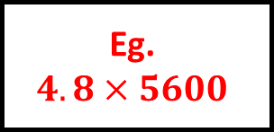
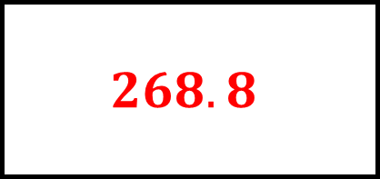
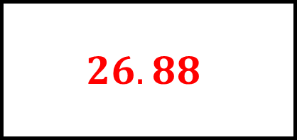
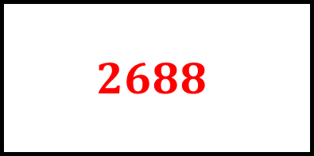
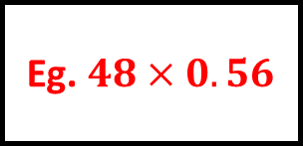
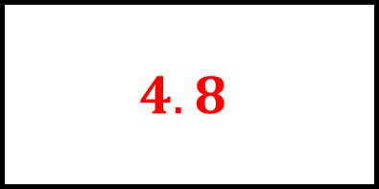
Related Calculations Spider 1 - Answers
$$4.8$$
$$268.8$$
$$268.8÷56$$
$$4.8×56$$
$$26880$$
$$48×56=2688$$
$$26.88$$
Eg.
$$4.8×5600$$
Eg. $48×0.56$
$$0.48×5600$$
$$0.48×56$$
$$2688$$
$$26.88$$
Use the calculation at the centre to fill in the blanks… there should be no repeated calculations

Slide 3
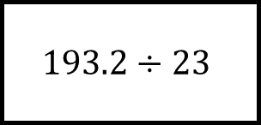
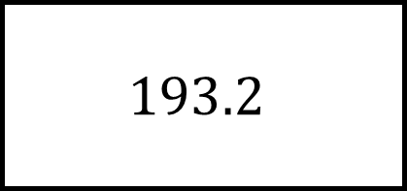
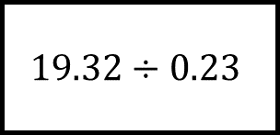
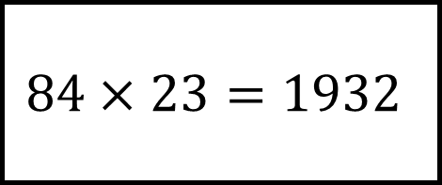
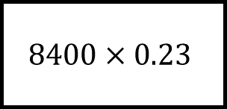
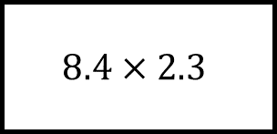
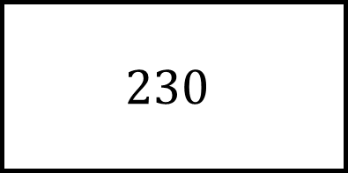
Related Calculations Spider 2
$$19.32÷0.23$$
$$8.4×2.3$$
$$230$$
$$84×23=1932$$
$$193.2$$
$$193.2÷23$$
$$8400×0.23$$
Use the calculation at the centre to fill in the blanks… there should be no repeated calculations

Slide 4
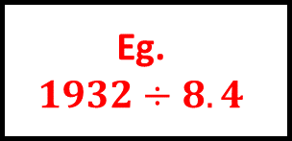
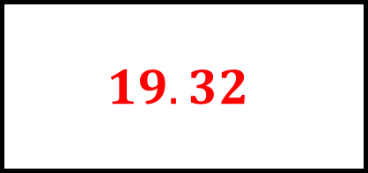
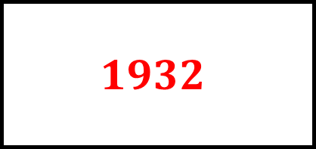
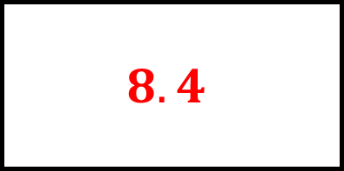
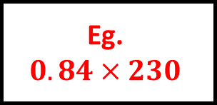
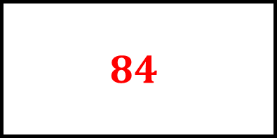
Related Calculations Spider 2 - Answers
$$84$$
$$19.32$$
$$19.32÷0.23$$
$$8.4×2.3$$
$$230$$
$$84×23=1932$$
$$193.2$$
Eg.
$$1932÷8.4$$
Eg.
$$0.84×230$$
$$193.2÷23$$
$$8400×0.23$$
$$8.4$$
$$1932$$
Use the calculation at the centre to fill in the blanks… there should be no repeated calculations

Slide 5
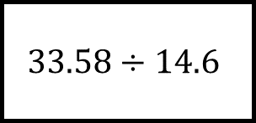
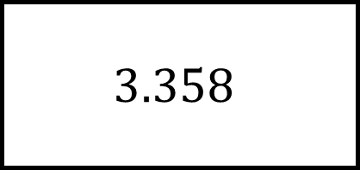
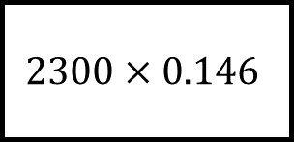
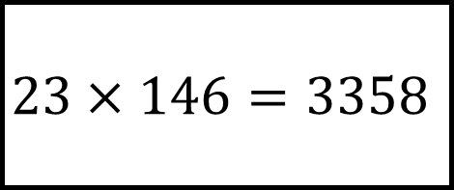
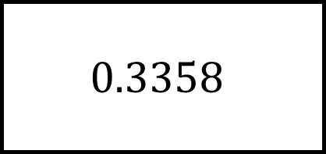
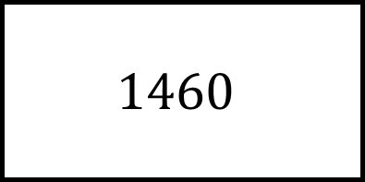
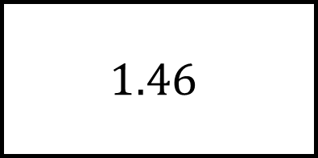
Related Calculations Spider 3
$$1.46$$
$$3.358$$
$$23×146=3358$$
$$33.58÷14.6$$
$$2300×0.146$$
$$1460$$
$$0.3358$$
Use the calculation at the centre to fill in the blanks… there should be no repeated calculations

Slide 6
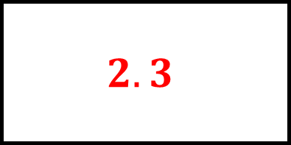
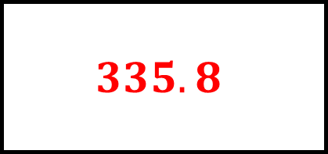
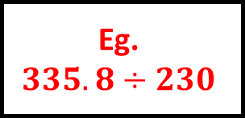
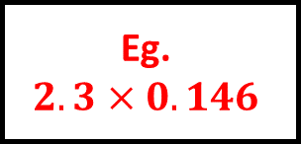
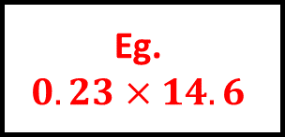
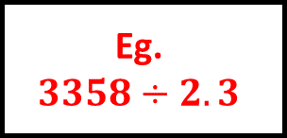
Related Calculations Spider 3 - Answers
$$1.46$$
$$3.358$$
Eg.
$$335.8÷230$$
Eg.
$$0.23×14.6$$
$$2.3$$
$$23×146=3358$$
$$335.8$$
$$33.58÷14.6$$
$$2300×0.146$$
Eg.
$$3358÷2.3$$
Eg.
$$2.3×0.146$$
$$1460$$
$$0.3358$$
Use the calculation at the centre to fill in the blanks… there should be no repeated calculations

Slide 7
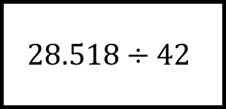
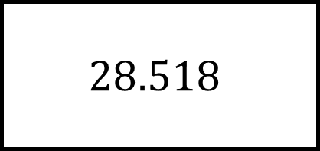
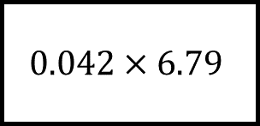
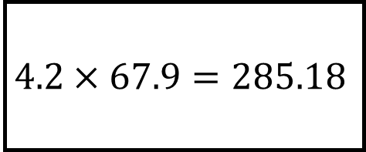
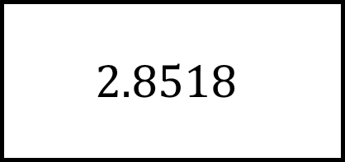
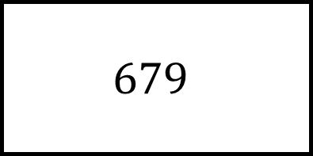
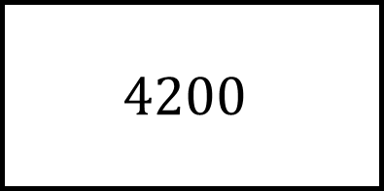
Related Calculations Spider 4
$$4200$$
$$28.518$$
$$4.2×67.9=285.18$$
$$28.518÷42$$
$$0.042×6.79$$
$$679$$
$$2.8518$$
Use the calculation at the centre to fill in the blanks… there should be no repeated calculations

Slide 8
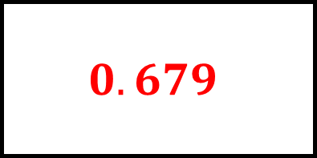
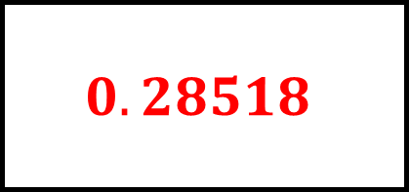
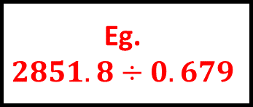
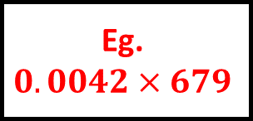


Related Calculations Spider 4 - Answers
$$4200$$
$$28.518$$
Eg.
$$2851.8÷0.679$$
Eg.
$$42×0.679$$
$$0.679$$
$$4.2×67.9=285.18$$
$$0.28518$$
$$28.518÷42$$
$$0.042×6.79$$
Eg.
$$28518÷42$$
Eg.
$$0.0042×679$$
$$679$$
$$2.8518$$
Use the calculation at the centre to fill in the blanks… there should be no repeated calculations

Slide 9













Related Calculations Spider n - Answers
Use the calculation at the centre to fill in the blanks… there should be no repeated calculations

