Slide 1
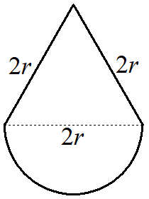
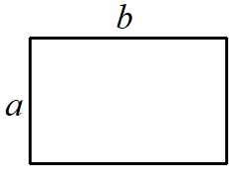
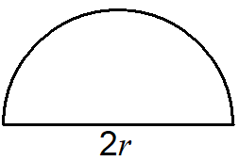
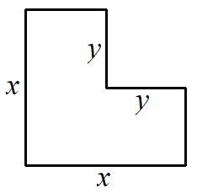
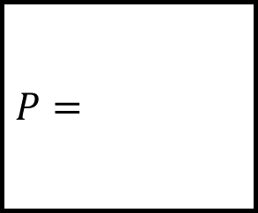
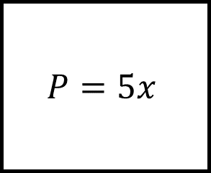



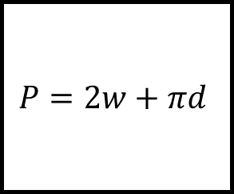
Deriving Perimeter Formulae Spider
$$P=$$
$$P=$$
$$P=2w+πd$$
$$P=5x$$
Fill in the blanks…
$$P=$$
The formula on each leg is to calculate the perimeter for the shape at the end of that leg.
$$P=$$

Slide 2
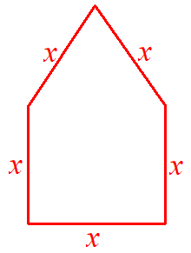
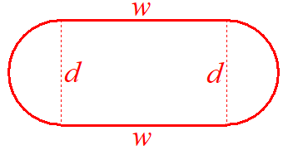
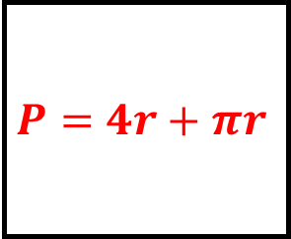
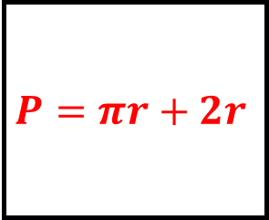
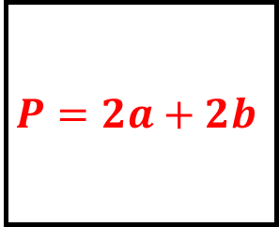
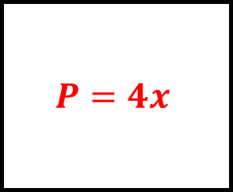
Deriving Perimeter Formulae Spider - Answers
$$P=4r+πr$$
$$P=2a+2b$$
$$P=2w+πd$$
$$P=5x$$
Fill in the blanks…
$$P=πr+2r$$
The formula on each leg is to calculate the perimeter for the shape at the end of that leg.
$$P=4x$$

Slide 3
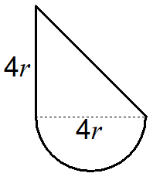
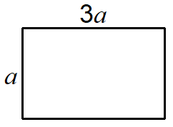
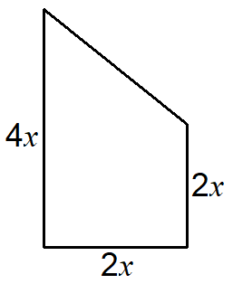
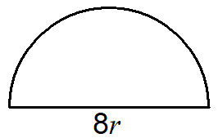
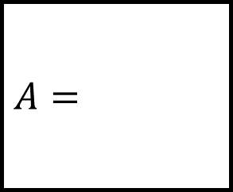
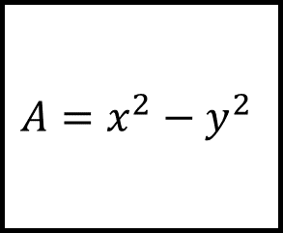
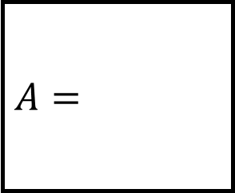


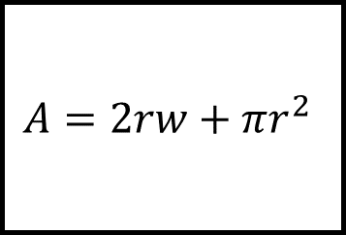
Deriving Area Formulae Spider 1 - Answers
$$A=$$
$$A=$$
$$A=2rw+πr^{2}$$
$$A=x^{2}−y^{2}$$
Fill in the blanks…
$$A=$$
The formula on each leg is to calculate the area for the shape at the end of that leg.
$$A=$$

Slide 4
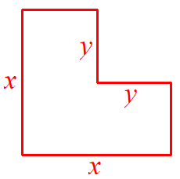
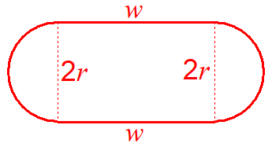
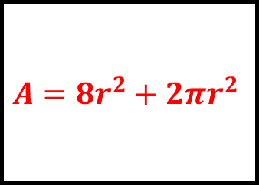
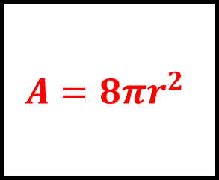
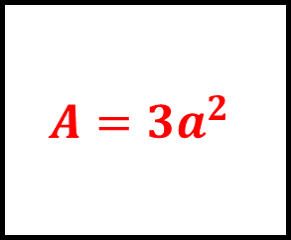
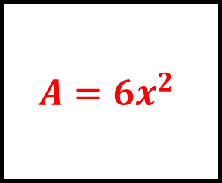

Deriving Area Formulae Spider 1 - Answers
$$A=8r^{2}+2πr^{2}$$
$$A=3a^{2}$$
$$A=2rw+πr^{2}$$
$$A=x^{2}−y^{2}$$
Fill in the blanks…
$$A=8πr^{2}$$
The formula on each leg is to calculate the area for the shape at the end of that leg.
$$A=6x^{2}$$

Slide 5
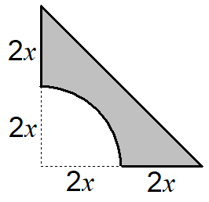
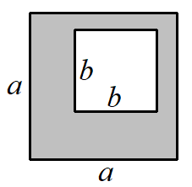
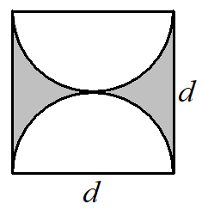
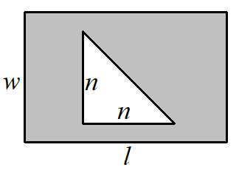

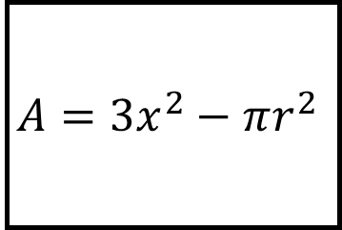
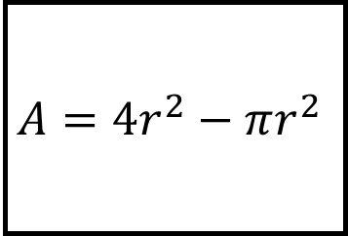
Deriving Area Formulae Spider 2
$$A=$$
$$A=$$
$$A=4r^{2}−πr^{2}$$
$$A=3x^{2}−πr^{2}$$
Fill in the blanks…
$$A=$$
The formula on each leg is to calculate the shaded area at the end of that leg.
$$A=$$

Slide 6
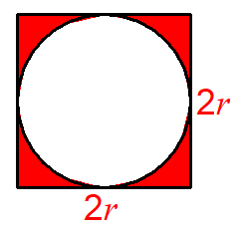
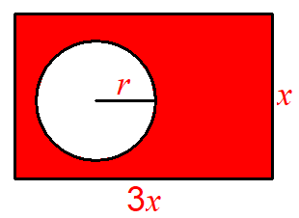
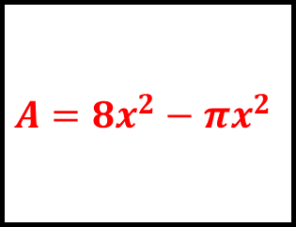
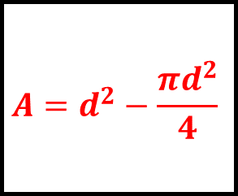
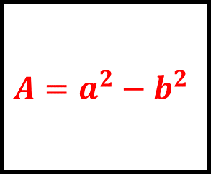
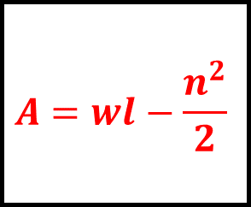
Deriving Area Formulae Spider 2 - Answers
$$A=8x^{2}−πx^{2}$$
$$A=a^{2}−b^{2}$$
$$A=4r^{2}−πr^{2}$$
$$A=3x^{2}−πr^{2}$$
Fill in the blanks…
$$A=d^{2}−\frac{πd^{2}}{4}$$
The formula on each leg is to calculate the shaded area at the end of that leg.
$$A=wl−\frac{n^{2}}{2}$$

Slide 7
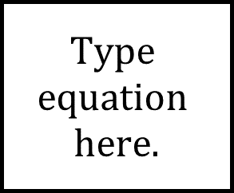


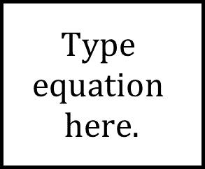


Deriving Formulae Spider - Answers
Fill in the blanks…

