Slide 1
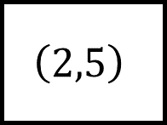
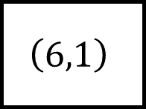
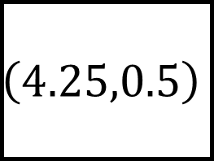


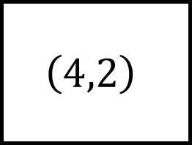
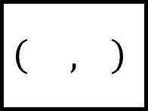
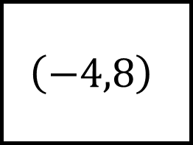
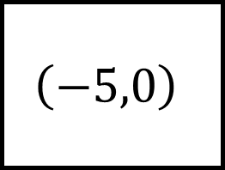
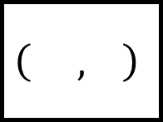
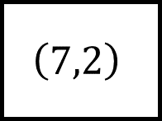
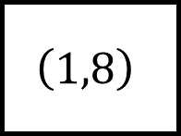
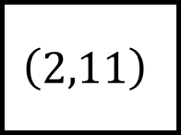
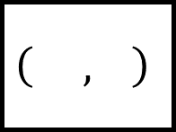
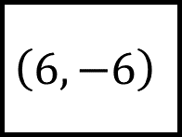

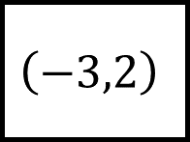

The coordinate at the end of each leg is the midpoint of the other two points
$$\left(4.25,0.5\right)$$
$$\left( , \right)$$
$$\left(6,−6\right)$$
$$\left(2,11\right)$$
$$\left( , \right)$$
$$\left(2,5\right)$$
Midpoints Spider 1
$$\left( , \right)$$
Fill in the missing points…
$$\left(−4,8\right)$$
$$\left(7,2\right)$$
$$\left(2,5\right)$$
$$\left(1,8\right)$$
$$\left( , \right)$$
$$\left(−3,2\right)$$
$$\left( , \right)$$
$$\left(−5,0\right)$$
$$\left(4,2\right)$$
$$\left( , \right)$$
$$\left(6,1\right)$$

Slide 2
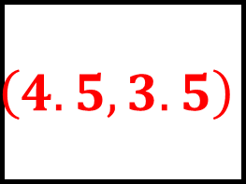
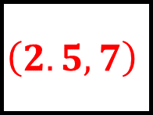
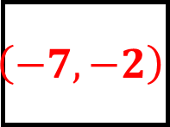
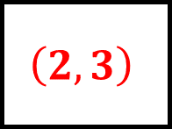
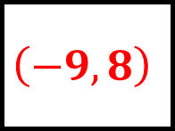
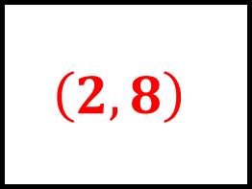
The coordinate at the end of each leg is the midpoint of the other two points
$$\left(4.25,0.5\right)$$
$$\left(2,8\right)$$
$$\left(6,−6\right)$$
$$\left(2,11\right)$$
$$\left(2.5,7\right)$$
$$\left(2,5\right)$$
Midpoints Spider 1 – Answers
$$\left(4.5,3.5\right)$$
Fill in the missing points…
$$\left(−4,8\right)$$
$$\left(7,2\right)$$
$$\left(2,5\right)$$
$$\left(1,8\right)$$
$$\left(−9,8\right)$$
$$\left(−3,2\right)$$
$$\left(2,3\right)$$
$$\left(−5,0\right)$$
$$\left(4,2\right)$$
$$\left(−7,−2\right)$$
$$\left(6,1\right)$$

Slide 3
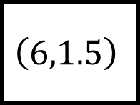
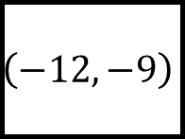
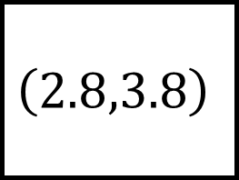
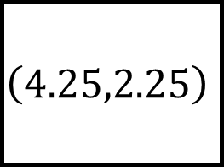
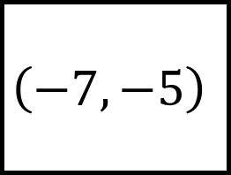
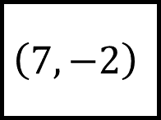
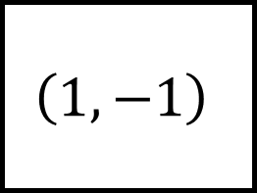


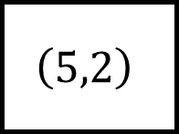
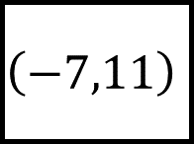
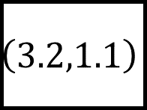
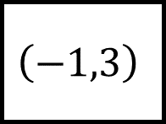

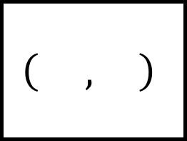
The coordinate at the end of each leg is the midpoint of the other two points
$$\left(2.8,3.8\right)$$
$$\left( , \right)$$
$$\left(3.2,1.1\right)$$
$$\left(−7,11\right)$$
$$\left( , \right)$$
$$\left(−1,3\right)$$
Midpoints Spider 2
$$\left(4.25,2.25\right)$$
Fill in the missing points…
$$\left(1,−1\right)$$
$$\left( , \right)$$
$$\left(6,1.5\right)$$
$$\left(5,2\right)$$
$$\left( , \right)$$
$$\left(2,5\right)$$
$$\left( , \right)$$
$$\left( , \right)$$
$$\left(−7,−5\right)$$
$$\left(7,−2\right)$$
$$\left(−12,−9\right)$$

Slide 4
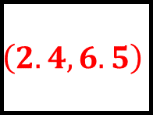
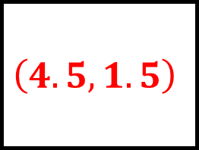
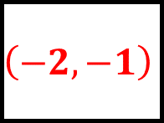
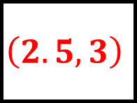
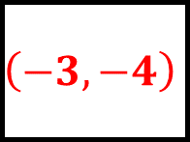
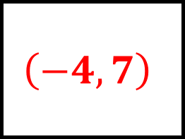
The coordinate at the end of each leg is the midpoint of the other two points
$$\left(2.8,3.8\right)$$
$$\left(−4,7\right)$$
$$\left(3.2,1.1\right)$$
$$\left(−7,11\right)$$
$$\left(2.4,6.5\right)$$
$$\left(−1,3\right)$$
Midpoints Spider 2 – Answers
$$\left(4.25,2.25\right)$$
Fill in the missing points…
$$\left(1,−1\right)$$
$$\left(2.5,3\right)$$
$$\left(6,1.5\right)$$
$$\left(5,2\right)$$
$$\left(−3,−4\right)$$
$$\left(2,5\right)$$
$$\left(−2,−1\right)$$
$$\left(4.5,1.5\right)$$
$$\left(−7,−5\right)$$
$$\left(7,−2\right)$$
$$\left(−12,−9\right)$$

Slide 5
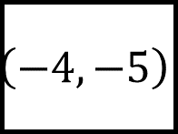
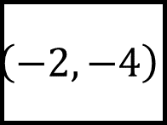

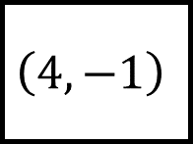
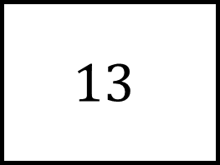
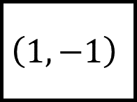
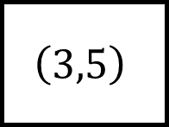
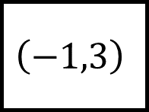
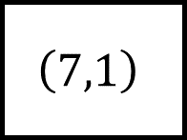
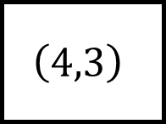
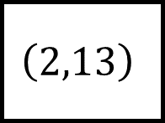

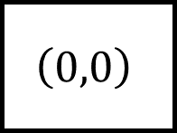
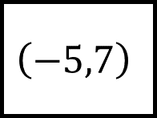
The length at the end of each leg is the distance between the two given points
$$13$$
$$\left( , \right)$$
$$\left(4,3\right)$$
$$\left(4,−1\right)$$
$$\left(0,0\right)$$
Distance Between Two Points Spider 1
Fill in the blanks…
$$\left(−1,3\right)$$
$$\left(−4,−5\right)$$
$$\left(7,1\right)$$
$$\left(2,13\right)$$
$$\left(−5,7\right)$$
$$\left(3,5\right)$$
$$\left(1,−1\right)$$
$$\left(−2,−4\right)$$
Round to $1$ decimal place where appropriate

Slide 6






The length at the end of each leg is the distance between the two given points
$$13$$
$$5$$
Eg.$\left(−9,−1\right)$
$$\left(4,3\right)$$
$$\left(4,−1\right)$$
$$\left(0,0\right)$$
Distance Between Two Points Spider 1 – Answers
$$8.5$$
Fill in the blanks…
$$13$$
$$\left(−1,3\right)$$
$$\left(−4,−5\right)$$
$$\left(7,1\right)$$
$$\left(2,13\right)$$
$$\left(−5,7\right)$$
$$\left(3,5\right)$$
$$10$$
$$10.3$$
$$\left(1,−1\right)$$
$$\left(−2,−4\right)$$
Round to $1$ decimal place where appropriate

Slide 7














The length at the end of each leg is the distance between the two given points
$$26$$
$$5$$
$$\left( , \right)$$
$$\left(5,6\right)$$
$$\left(−4,3\right)$$
$$\left( , \right)$$
Distance Between Two Points Spider 2
$$17$$
Fill in the blanks…
$$12$$
$$\left(−2,−13\right)$$
$$\left( , \right)$$
$$\left(2,8\right)$$
$$\left( , \right)$$
$$\left(5,7\right)$$
$$\left( , \right)$$
$$15$$
$$10$$
$$\left( , \right)$$
All lines are diagonal
$$\left(−9,−3\right)$$

Slide 8






The length at the end of each leg is the distance between the two given points
$$26$$
$$5$$
Eg. $\left(20,−7\right)$
$$\left(5,6\right)$$
$$\left(−4,3\right)$$
Eg. $\left(1,3\right)$
Distance Between Two Points Spider 2 – Answers
$$17$$
Fill in the blanks…
$$12$$
$$\left(−2,−13\right)$$
Eg. $\left(6,2\right)$
$$\left(2,8\right)$$
Eg. $\left(14,13\right)$
$$\left(5,7\right)$$
Eg. $\left(−1,3\right)$
$$15$$
$$10$$
Eg. $\left(−4,−5\right)$
All lines are diagonal
$$\left(−9,−3\right)$$

Slide 9



















Blank Spider – Answers

