Slide 1
Averages Manipulation
Follow the instructions to meet each of the requirements listed below.
There may more multiple answers for each.

Slide 2
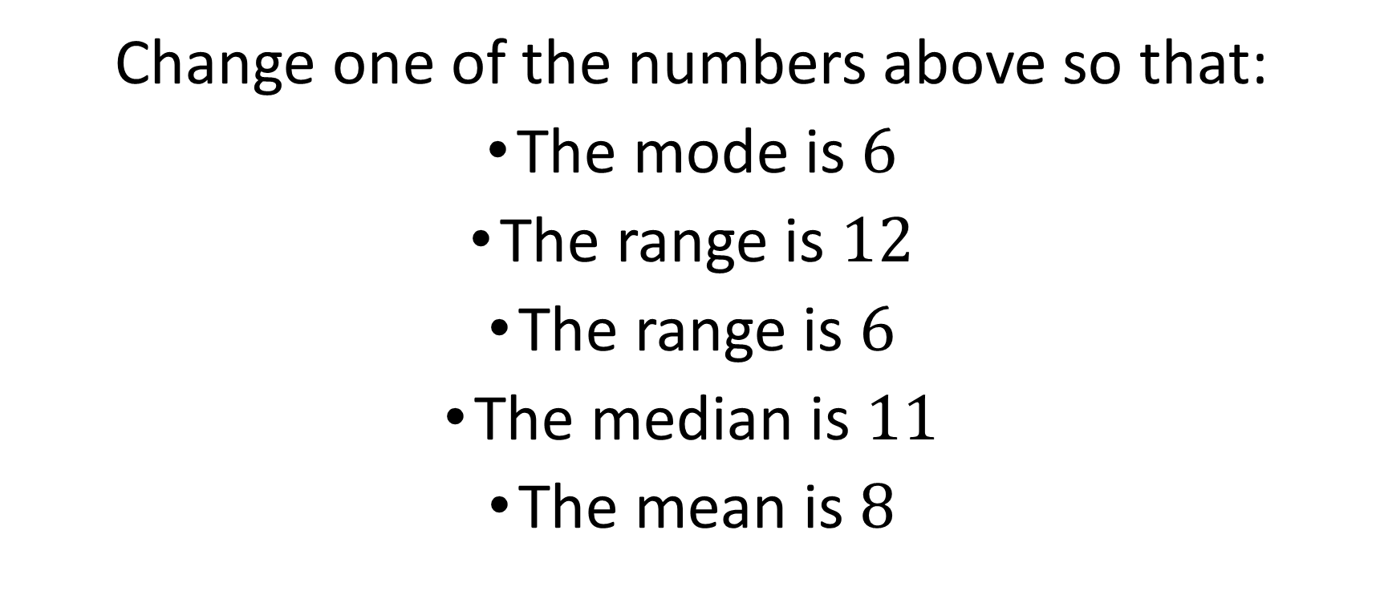

List $1$: $5,6,8,11,15$
Change one of the numbers above so that:
The mode is $6$
The range is $12$
The range is $6$
The median is $11$
The mean is $8$

Slide 3
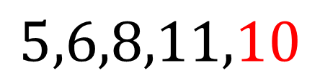
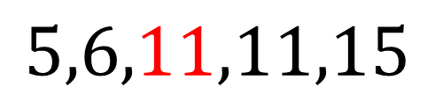
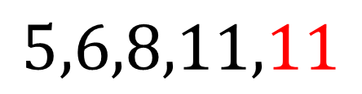
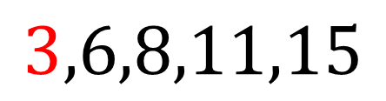
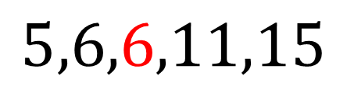
List $1$: $5,6,8,11,15$
Possible answers
Change one of the numbers above so that:
The mode is $6$
The range is $12$
The range is $6$
The median is $11$
The mean is $8$
$$5,6,6,11,15$$
$$3,6,8,11,15$$
$$5,6,8,11,11$$
$$5,6,11,11,15$$
$$5,6,8,11,10$$

Slide 4
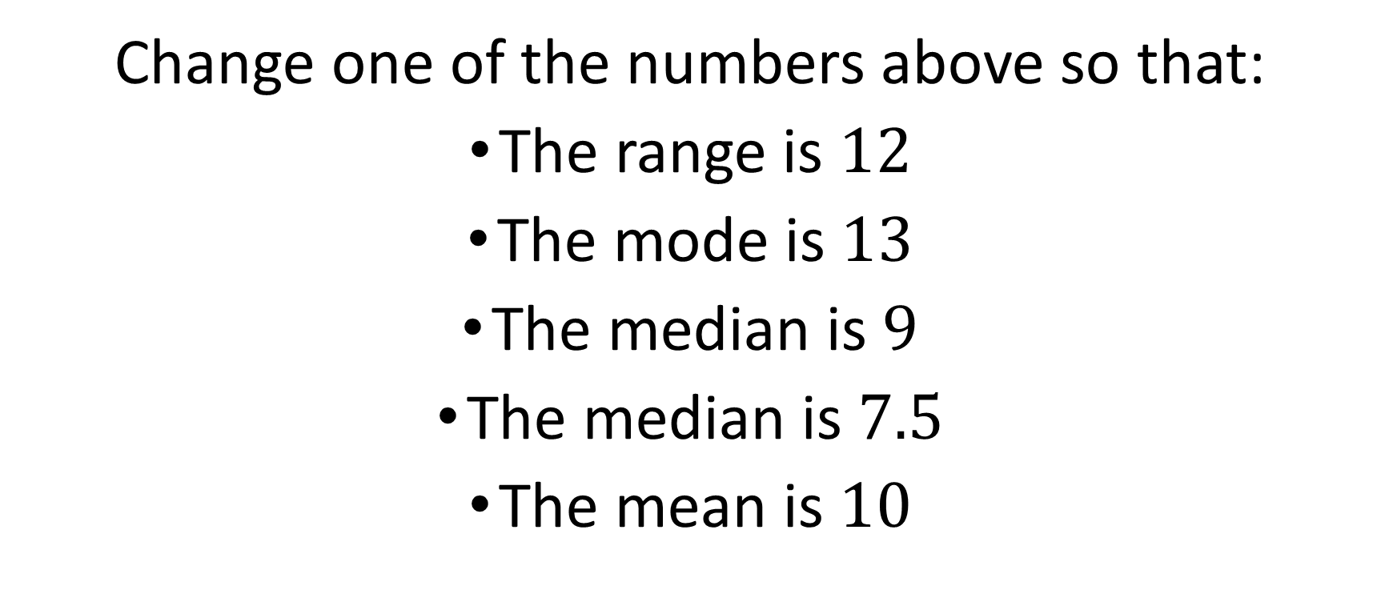

List $2$: $4,5,7,10,13,15$
Change one of the numbers above so that:
The range is $12$
The mode is $13$
The median is $9$
The median is $7.5$
The mean is $10$

Slide 5
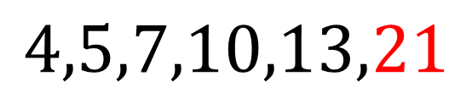
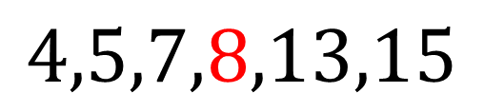
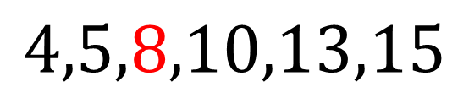
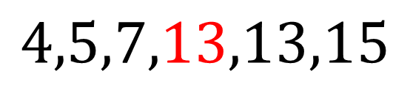
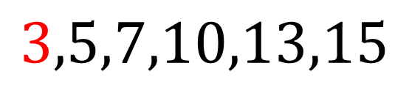
List $2$: $4,5,7,10,13,15$
Possible answers
Change one of the numbers above so that:
The range is $12$
The mode is $13$
The median is $9$
The median is $7.5$
The mean is $10$
$$3,5,7,10,13,15$$
$$4,5,7,13,13,15$$
$$4,5,8,10,13,15$$
$$4,5,7,8,13,15$$
$$4,5,7,10,13,21$$

Slide 6
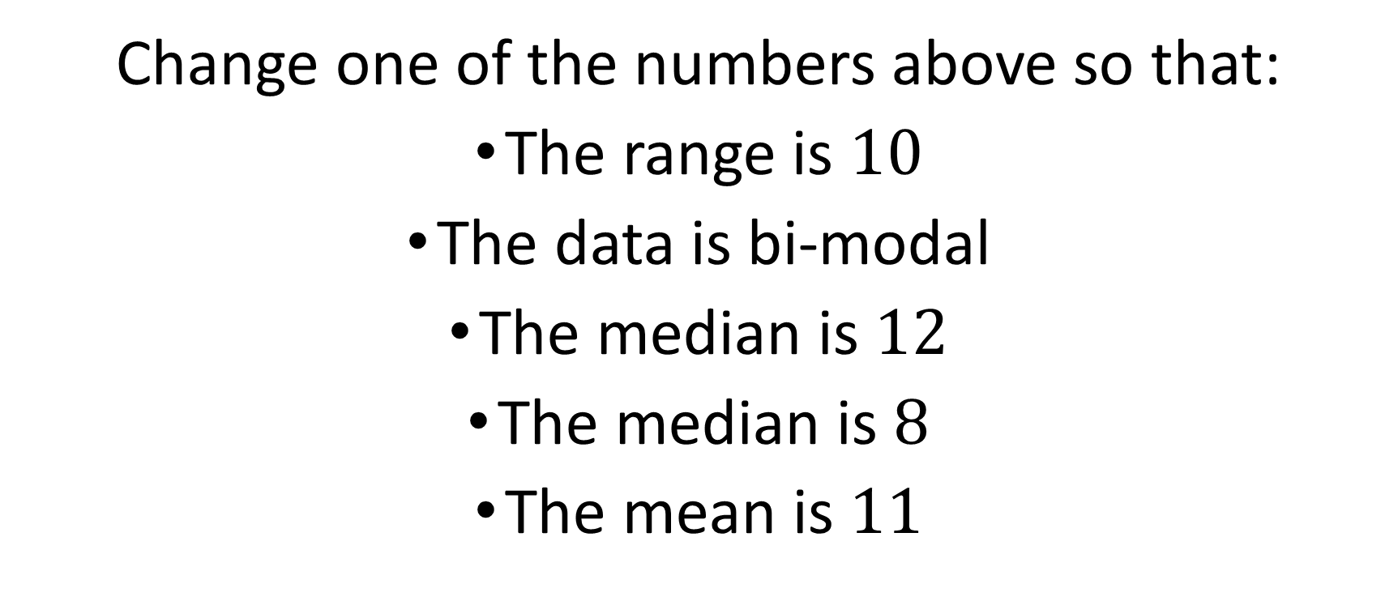

List $3$: $12,8,8,10,15$
Change one of the numbers above so that:
The range is $10$
The data is bi-modal
The median is $12$
The median is $8$
The mean is $11$

Slide 7
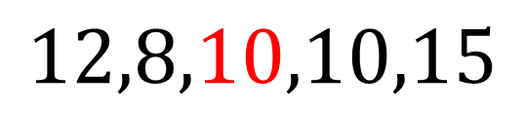
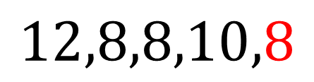
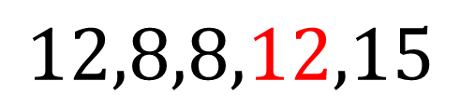
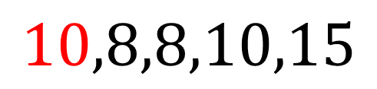
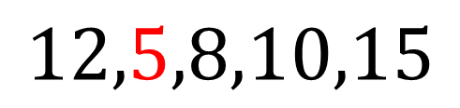
List $3$: $12,8,8,10,15$
Possible answers
Change one of the numbers above so that:
The range is $10$
The data is bi-modal
The median is $12$
The median is $8$
The mean is $11$
$$12,5,8,10,15$$
$$10,8,8,10,15$$
$$12,8,8,12,15$$
$$12,8,8,10,8$$
$$12,8,10,10,15$$

Slide 8
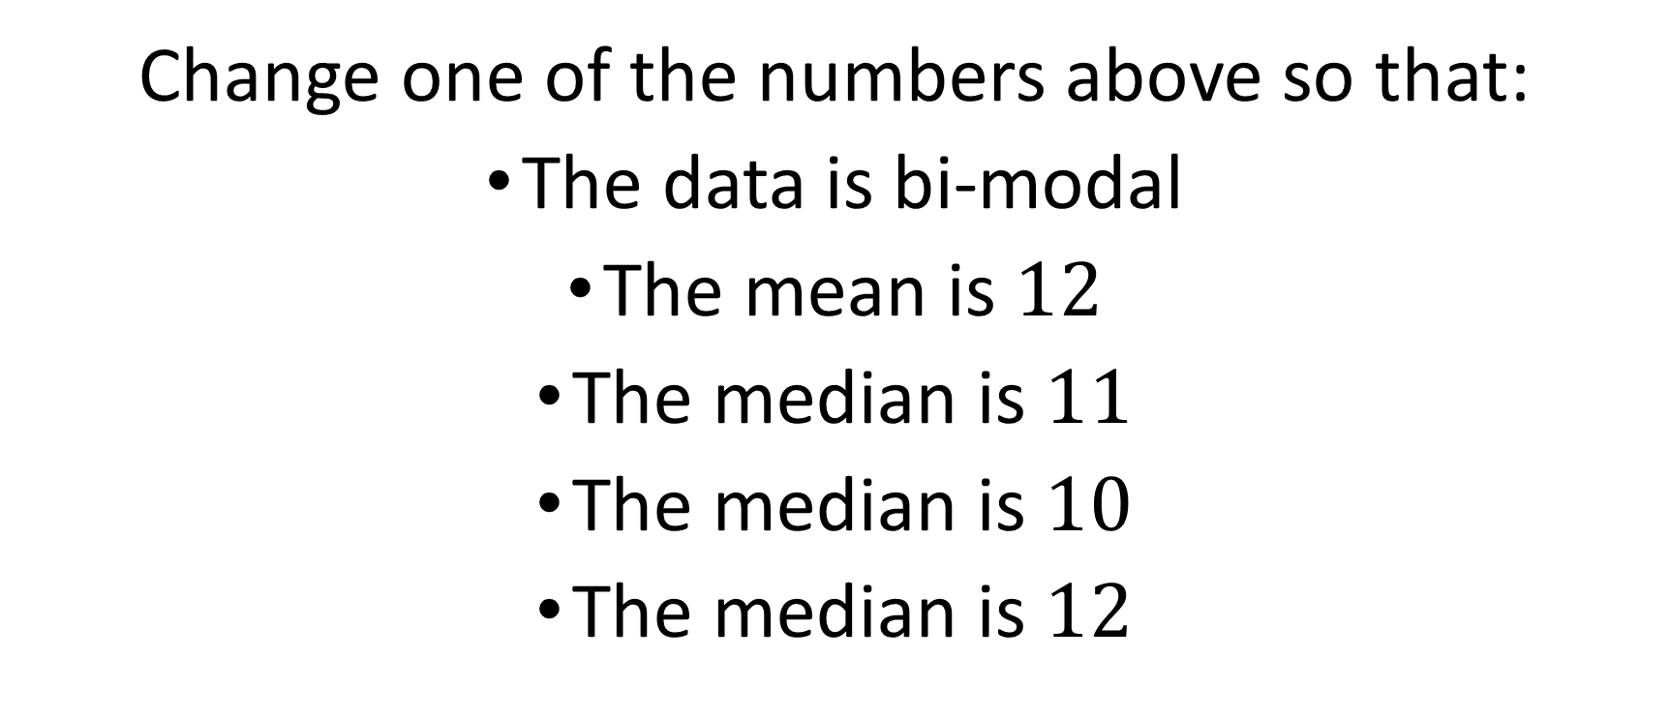

List $4$: $16,7,10,11,14,10$
Change one of the numbers above so that:
The data is bi-modal
The mean is $12$
The median is $11$
The median is $10$
The median is $12$

Slide 9
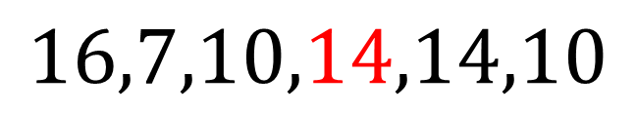
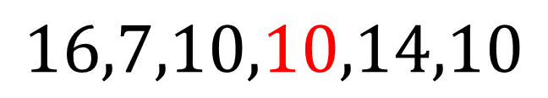
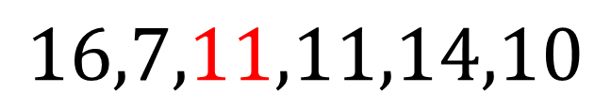
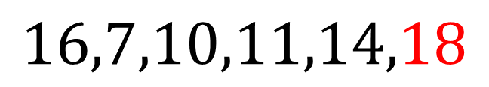
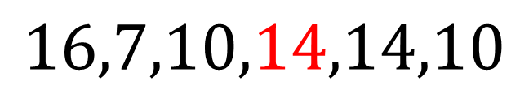
List $4$: $16,7,10,11,14,10$
Possible answers
Change one of the numbers above so that:
The data is bi-modal
The mean is $12$
The median is $11$
The median is $10$
The median is $12$
$$16,7,10,14,14,10$$
$$16,7,10,11,14,18$$
$$16,7,11,11,14,10$$
$$16,7,10,10,14,10$$
$$16,7,10,14,14,10$$

Slide 10
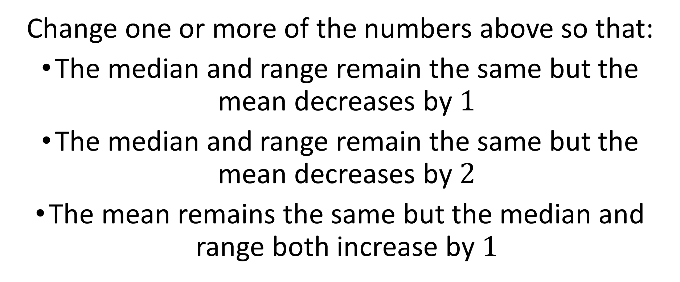

List $5$: $5,10,13,14,18$
Change one or more of the numbers above so that:
The median and range remain the same but the mean decreases by $1$
The median and range remain the same but the mean decreases by $2$
The mean remains the same but the median and range both increase by $1$

Slide 11
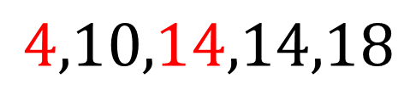
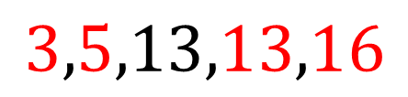
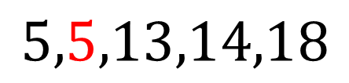
List $5$: $5,10,13,14,18$
Possible answers
Change one or more of the numbers above so that:
The median and range remain the same but the mean decreases by $1$
The median and range remain the same but the mean decreases by $2$
The mean remains the same but the median and range both increase by $1$
$$5,5,13,14,18$$
$$3,5,13,13,16$$
$$4,10,14,14,18$$

Slide 12
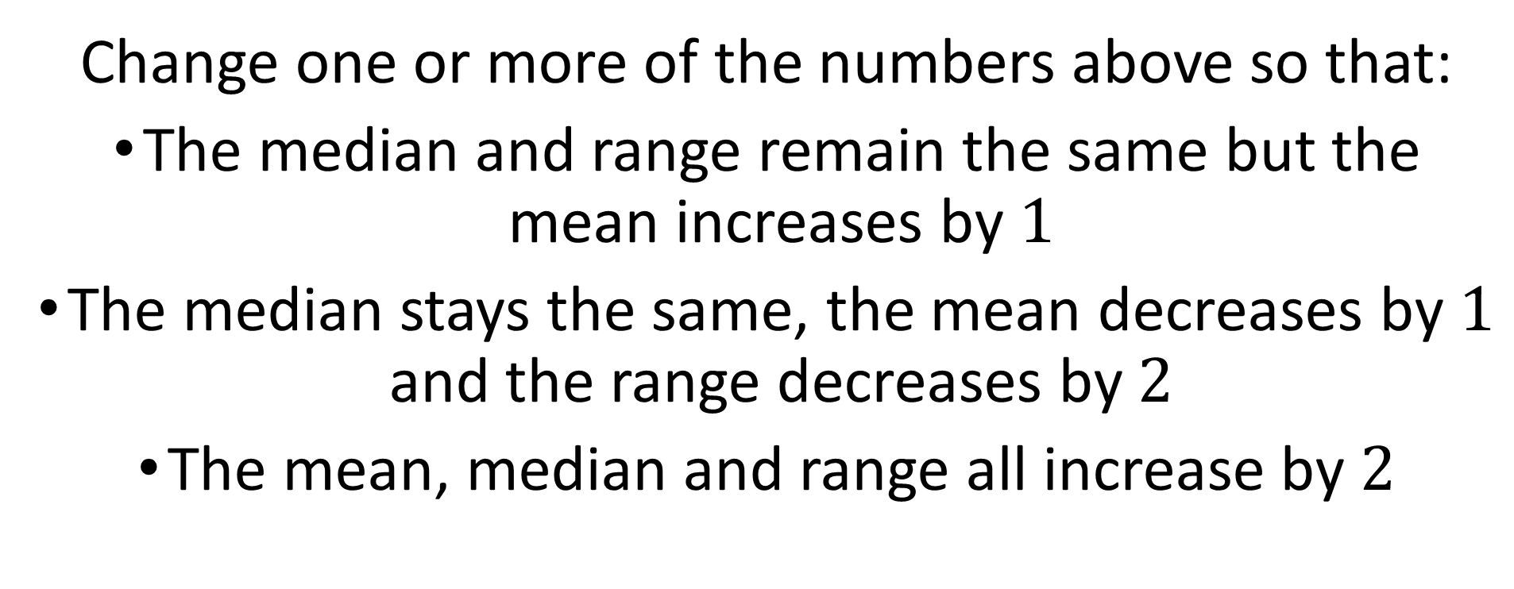

List $6$: $16,9,21,23,17,10$
Change one or more of the numbers above so that:
The median and range remain the same but the mean increases by $1$
The median stays the same, the mean decreases by $1$ and the range decreases by $2$
The mean, median and range all increase by $2$

Slide 13



List $6$: $16,9,21,23,17,10$
Possible answers
Change one or more of the numbers above so that:
The median and range remain the same but the mean increases by $1$
The median stays the same, the mean decreases by $1$ and the range decreases by $2$
The mean, median and range all increase by $2$
$$16,9,21,23,17,16$$
$$16,8,20,20,17,9$$
$$18,10,23,26,19,12$$

Slide 14

List $n$:
Change one of the numbers above so that:

